Slide 1
Humanitarian Assistance and Disaster Relief
Dr. Sireen Alkhaldi
Department of Family and Com. Med.
Global Health Course
Summer Semester 2014/ 2015
Textbook: Understanding Global health,
Markle W, Fisher M, and Smego R. (2nd ed. 2014)

Slide 2
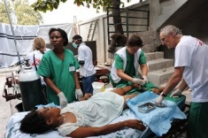
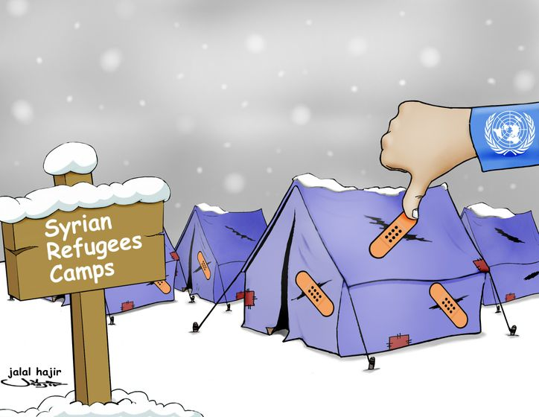
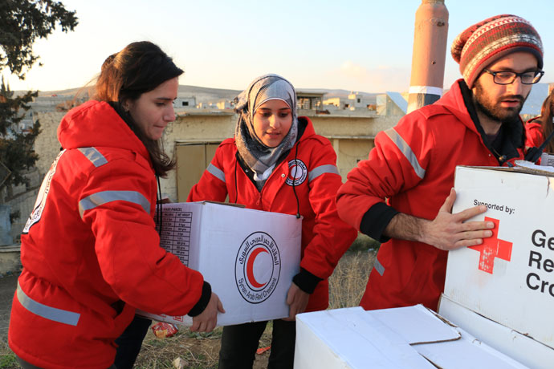
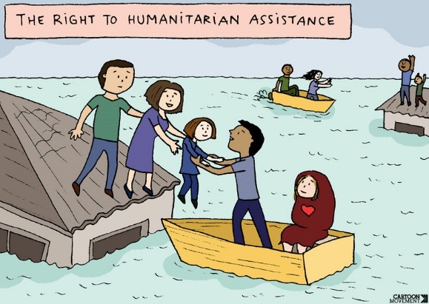

Slide 3
A history of Humanitarian Work
What is a Humanitarian?
Many groups with different philosophies participate in relief work.
Most believe that humanitarian assistance is about relieving suffering and saving lives in times of conflict and natural disasters where the entities responsible for the basic services are not doing so.
The Red Cross Movement was founded by a Swiss businessman who encountered thousands of soldiers of multiple nationalities lying wounded near Solferino, Italy, during the war of Italian Unification in 1859. He assisted the wounded and wrote a book about his experience, highlighting the need for volunteers ready to assist in emergencies and calling for the establishment of an international relief agency.

Slide 4
The Red Cross (ICRC)
The International Committee of the Red Cross (ICRC)’s activities include visiting prisoners, transporting messages between family members divided by conflict, and medical and surgical assistance. The ICRC is based in Geneva.
This later became the International Federation of the Red Cross and Red Crescent Societies. Nearly 200 countries maintain a Red Cross or Red Crescent society.
Red Cross delegates document violations of the laws of war. For example, the Red Cross questioned the interrogation techniques and torture in Guantanamo bay and in Afghanistan.
In 2010, the ICRC condemned the Israel’s blockade of Ghaza as a violation of the country’s commitments under International laws.
Often, aid workers are the only independent outsiders to witness war crimes against civilians. The nongovernmental organization (NGO) Doctors without Borders also witness human rights violations.

Slide 5
Who Else Provides Aid?
Most assistance provided in conflicts and disaster situations, particularly in the critical early days, is performed by local and national –rather than international- agencies and authorities.
These include local health providers and health facilities, Red Cross and red Crescent, civil society organizations, militaries, police, and regular citizens. Too often……their work is overlooked or sidelined by international actors coming to “save the day”.
United Nations (UN) agencies also play a major role in humanitarian assistance. The UN High Commissioner for Refugees (UNHCR) protects refugees, and in recent years it assisted larger populations of internally displaced persons (IDPs), displaced within country of origin.
UN and other agencies providing humanitarian work are listed in Table 15-2.

Slide 6
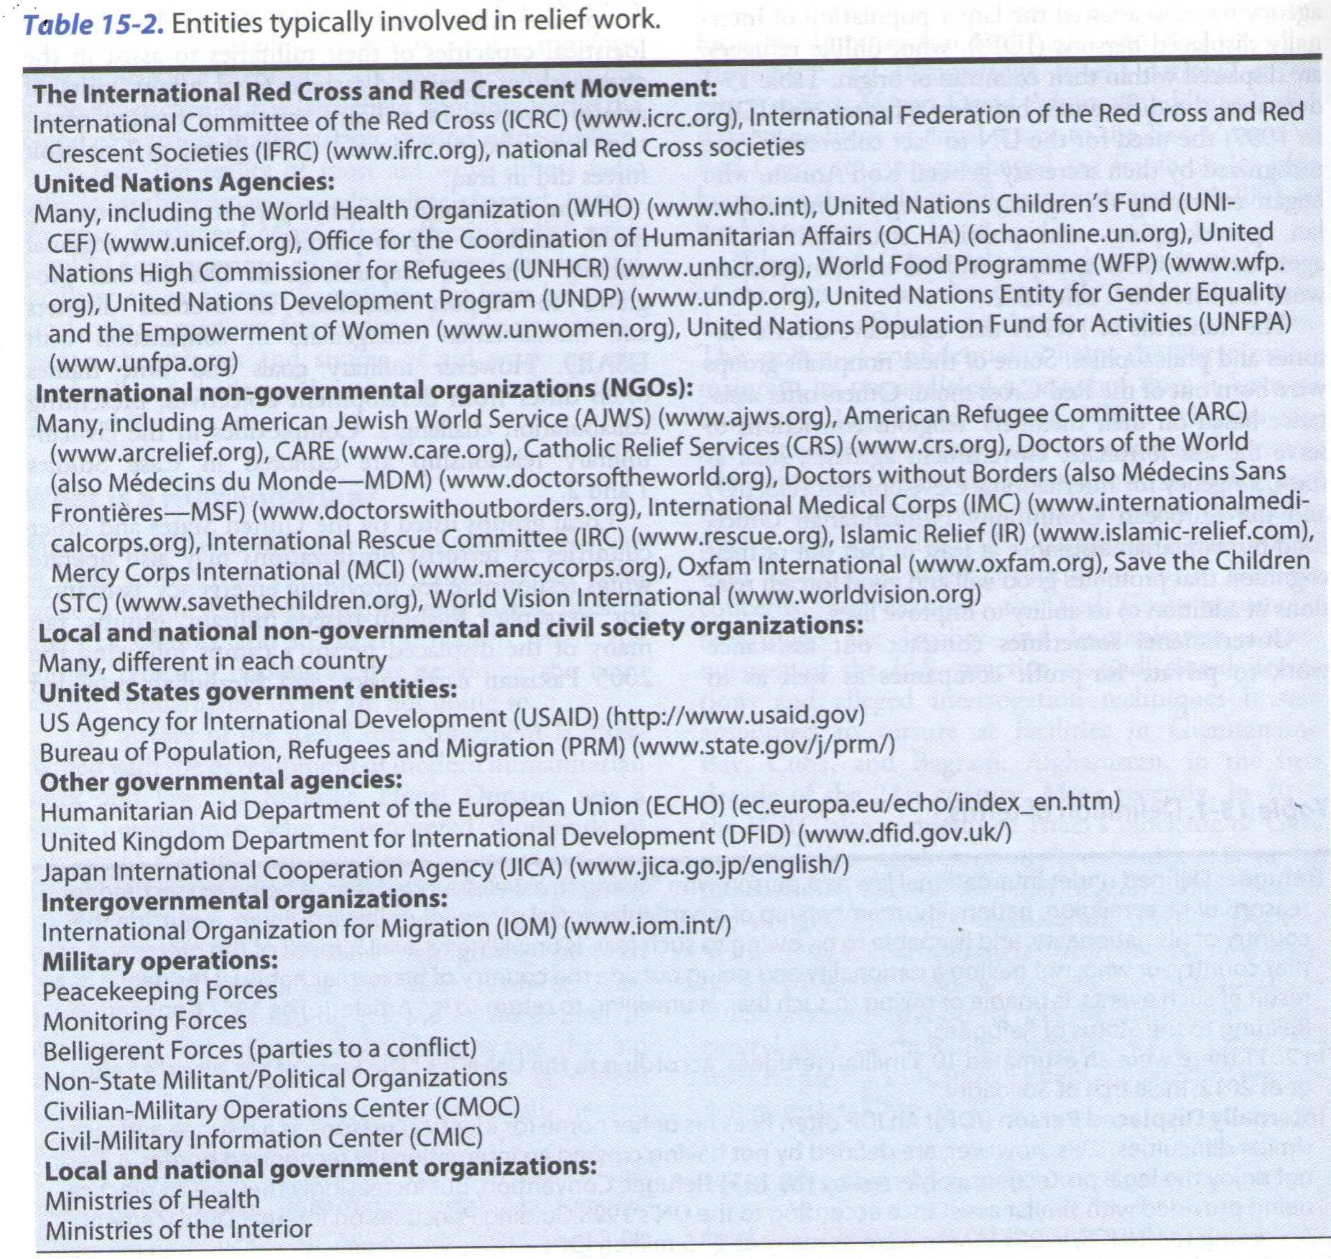

Slide 7
Coordinating Diverse Agencies
In complex emergencies, humanitarian needs exceed the capacity of a single agency. The number of these agencies have increased recently.
However, the greatest criticism of the international relief response has been its poor coordination.
In 2005, as part of reform efforts, the UN set out nine thematic “clusters” covering key areas of humanitarian assistance in crisis: agriculture, camp coordination and management, early recovery, education, health, nutrition, protection, emergency shelter and water, and sanitation and hygiene. In the field, each cluster is led by a UN agency. The goal is to deliver humanitarian assistance in a cohesive and effective manner.
Although NGO’s operate independently, most have agreed to adhere to a common code of conduct.
Through the current coordination system, UN and non-UN actors engage in joint planning and prioritization of humanitarian response strategy.

Slide 8
Coordinating Diverse Agencies
Case Study/ Dilemma:
USNS Comfort After the Haiti Earthquake

Slide 9
Humanitarians in the Age of Terrorism
Terrorism is a major concern for international aid workers because aid workers are increasingly targets of terrorists.
This may be due to the mixed humanitarian, peacekeeping, and political roles of the UN agencies. In Baghdad, Iraq, in 2003, both the UN and the Red Cross headquarters, were targeted by suicide bombers.
For their protection in conflict zones, humanitarian aid workers have relied on an invisible shield of “laws of war” which state that relief workers are never military targets.
Humanitarians still prefer to avoid security measures that involve armed protection. Subsequently, many aid agencies have withdrawn from countries where violence has surged in recent years such as Afghanistan, Pakistan, and Somalia.

Slide 10
Legal Conventions Governing Humanitarian Practice
International Humanitarian law (IHL): Includes the Geneva Convention of 1949. In 2006, it achieved universal acceptance. The IHL requires that belligerents respect the four principles of discrimination, proportionality, precaution, and protection of non-combatants.
Refugee Law: gives nations the duty to grant asylum, thus protecting refugees when their home countries have failed to do so.
Human Rights Law: It prohibits torture, slavery, and degrading or inhuman treatment or punishment in wartime as well as peacetime. Medical aid workers must uphold medical ethics, and treat patients according to need, without discriminating based on nationality, religion, ethnicity, political views, or even membership of a certain military force.
Healthcare clinics or hospitals used by military to store weapons or conduct attacks can lose their protected status.

Slide 11
Medical and Public Health Priorities
The failure of humanitarian agencies to avert widespread death and suffering among refugee populations in the 1990s (particularly in Rawanda) led to calls for minimum standards for aid.
The 1997 Sphere Project has produced a handbook of minimum standards in relief. In its 3rd edition released in 2011, it covers water supply, sanitation and hygiene promotion, food security and nutrition, shelter, settlement and nonfood items, and health action. Later “Protection Principles” were added.
Sphere is based on the idea that aid workers provide assistance because disaster-affected populations have a right to human dignity and therefore to receive quality assistance.

Slide 12
Chief Causes of Morbidity and Mortality in Conflicts and Disasters
In recent years, epidemiologic surveillance have emphasized the specific causes of morbidity and mortality in war and disaster-affected populations, which are:
Infectious diseases: diarrheal infection (particularly cholera), measles, respiratory infections and malaria.
Traumatic injuries
Emotional distress
Malnutrition/ micronutrient deficiencies
Exacerbation of chronic illnesses (due to treatment interruption)
Infectious disease outbreaks are less common among populations displaces by natural disasters than by war. Populations with poorer pre-disaster health status often have higher proportion of health problems due to infectious diseases, and more vulnerability if also malnourished.

Slide 13
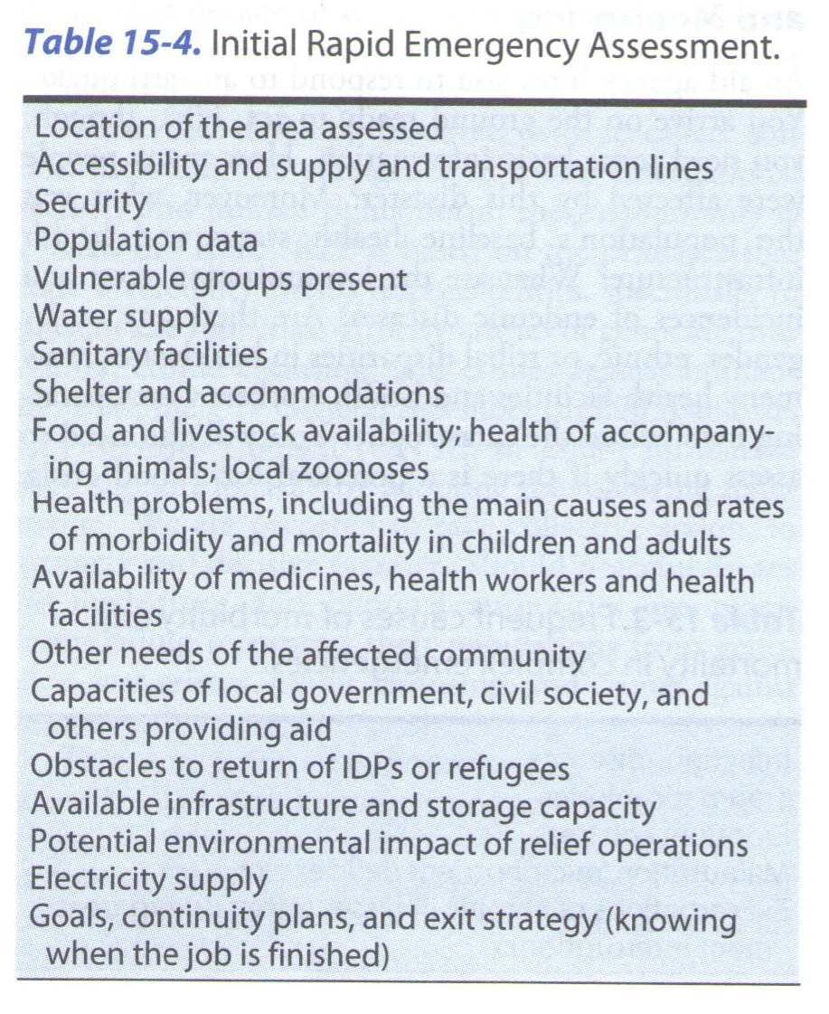
Gathering Data: Initial Assessment
An aid agency hires you to respond to an earthquake. You arrive on the ground ready to act. First, though, you need some basic information (initial assessment):
How many people have been affected ?
What was the population’s baseline health status and infrastructure?
What was the immunization rate?
Are there any disparities in healthcare?
Is there potential for food crisis?
Will be a need for shelter? ….See Table 15-4

Slide 14
Key Public Health Interventions
Often aid workers think of the disaster response in phases, beginning with the immediate aftermath (hours to days), followed by an emergency phase (days to weeks), then the late/ recovery phase (weeks to months), and finally the rehabilitation and rebuilding phase (months to years).

Slide 15
Key Public Health Interventions
Immediate Aftermath:
Priorities include rescue, first aid, trauma care, and protection of the population from further exposure to harm. The local community usually provides the bulk of these services.
Triage Triage is a French word that refers to sorting of coffee beans. Today triage is used when the number of injured exceeds available resources. Typically, medical workers divide care to achieve the greatest good for the greatest number of people. There are 9 well-recognized triage systems. Most call for people with relatively minor injuries to wait while patients with the most acute needs are evacuated or treated.

Slide 16
Emergency Phase
As the emergency phase continues, and help arrives from outside, top priorities include the provision of safe water in adequate quantities, safe shelter, food, and proper sanitation.
Now, local and regional medical structures often need support.
International medical assistance typically emphasize on primary healthcare, emergency healthcare, and preventive health services focusing on major causes of morbidity and mortality in displaced populations, particularly communicable diseases.
The lack of water in adequate quantity and quality and ineffective sanitation and poor hygiene can result in epidemic of diarrheal illnesses, including cholera.

Slide 17
Emergency Phase
Hand washing with soap and water should be promoted.
Appropriate latrines should be established (one per 20-50 persons).
Rehydration therapy for diarrhea.
Supplementary or therapeutic feeding program. Food provided should be appropriate and acceptable to culture and religious beliefs.
Mass measles vaccination campaign for children 6m to 15 years should be implemented if local vaccination coverage falls below 90% or is unknown.
Gender-based violence and rape often plague displaced and conflict-affected populations, due to overcrowding and inadequate shelter.
Psychosocial trauma is a major cause of suffering in emergencies.

Slide 18
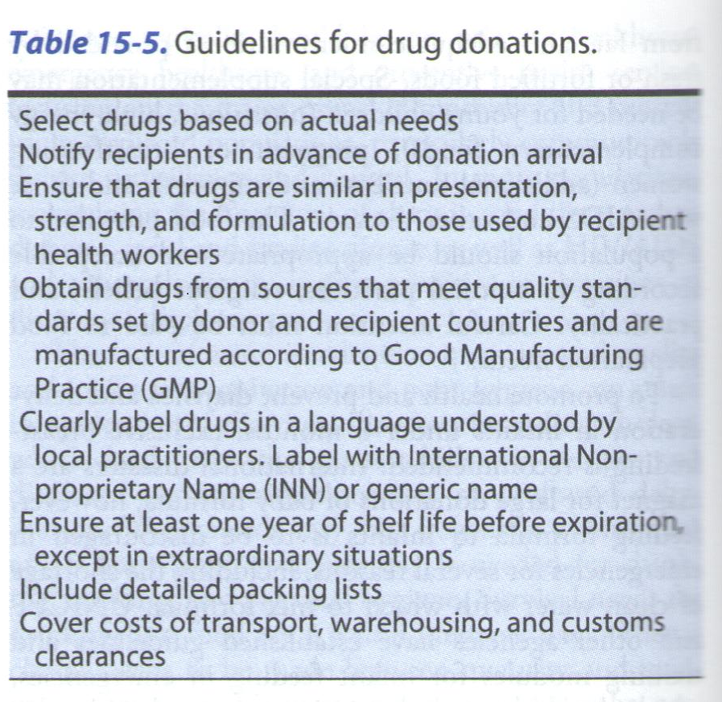
Emergency Phase
Aid workers often provide medical supplies and medicines.
Some governments set guidelines for medical donations.
Unfortunately, disasters often attract inappropriate, useless, and expired medical donations that end up as toxic medical waste problem (motivated by tax breaks for the donor hospital or drug company).

Slide 19
Later Phases of the Emergency
Reproductive health services
Chronic Conditions: tuberculosis, AIDS, chronic diseases, Psychological conditions, rehabilitation, physical therapy, prosthetic and orthotic services (for amputees).
Child health: expanded immunization program, childhood illnesses, nutritional interventions, and parasitic infections.
Health Infrastructure: The presence of foreign aid workers is only a temporary situation, but it is an opportunity to train and educate local health workers.

Slide 20
Special considerations in certain crises
Dealing with Human Remains
Survivors have a strong need to know what happened to their loved ones, both for emotional well-being and for legal reasons. Therefore, it is important to manage all the dead equally with dignity and respect, and in a way that facilitates their identification and allows family members to be kept involved and informed.
So, rapid burial should not take precedence over identification.
The basic requirements for handling human remains should be followed (in natural disasters or epidemic disease).
Identification errors frequently happen in mass disasters. Photography, forensic examination (finger prints and dental records), and later, DNA-matching (all were used in Thailand in 2004 Tsunami).
Bodies decompose rapidly in hot climate, and facial recognition will be difficult then. Bodies should be kept in body bags, buried temporarily, or refrigerated with waterproof labels and unique IDs.

Slide 21
Chemical, Biologic, Radiologic, and Nuclear Threats
Threats from Chemical, Biologic, Radiologic, and Nuclear (CBRN) sources are an ever-present danger from industrial accidents, war, and terrorism.
The risk of exposure to CBRN agents and weapons during humanitarian action is currently considered low, but the March 2011 nuclear power accident, following the massive Japanese earthquake and tsunami highlighted the possibility.
Chemical Threats can cause health effects in minutes to hours, affect a large number of people, and persist in the environment. Key principles are to get away from the threat, and then decontaminate. In the Tokyo subway attack using Sarine nerve gas, first respondents were also affected.
Other potential chemical threats include mustard gas, choking agents, blood agents, tearing agents, and incapacitating agents.

Slide 22
Chemical, Biologic, Radiologic, and Nuclear Threats
Biologic Threats : Biological threats tend to come from naturally occurring infectious particles harnessed to produce widespread illness.
Some of the most potentially threatening include smallpox, anthrax, plague, botulism, tularemia, and Ebola and other hemorrhagic infections.
It is important that when these are a threat, international aid workers are trained to recognize and treat these illnesses. Many can be prevented and treated by antibiotics.
Surveillance and use of good infection control measures are important.

Slide 23
Chemical, Biologic, Radiologic, and Nuclear Threats
Radiologic and Nuclear Threats :
As the Great East Japan Earthquake and tsunami showed, radiologic emergencies at nuclear power plants and waste storage or processing facilities can result from natural disasters and accidents, not only from military attacks and or terrorism.
Dangers also come from nuclear bombs, including some suitcase-sized small nuclear devices that were stolen from the former Soviet Union. There is also the so-called dirty bomb.
Removal from the source, and shielding are key actions. Care for blast and burn injuries is typically the first priority, followed by decontamination (disposing of clothing and washing with water and mild soap).
The greatest long-term threat of radiologic exposure comes from inhalation of gamma particles from contaminated fallout (one millionth of a gram of some radiologic compounds can cause lung cancer).

Slide 24
Particular Needs of Specific populations
1. Patients requiring medical services unavailable in the immediate area:
fully-equipped and staffed field hospitals that are donated in some emergencies can certainly be of use. Sometimes foreign hospitals and doctors offer to treat patients if they can be evacuated.
Medical evacuation although potentially lifesaving, are almost always complicated with difficult logistical and ethical concerns. Desperation for evacuation may lead to corruption and payoffs within the medical system.
Clear medical guidelines for evacuation need to be set and communicated to the community.
See Case Study/ Dilemma 4: The Arab Spring

Slide 25
2. Ethnic, political, and religious minorities and socially marginalized groups:
Many recent wars and conflicts have targeted specific groups for displacement and even killing.
One issue here is the danger that aid organizations will be steered away from these groups and not notice their needs. These groups have to be identified early to ensure equal access to care.
However, another danger is that will receive what appears to those around them as preferential treatment, increasing the risk of further abuse.
This is why good communication and transparency are critical for aid organizations to explain that aid is being given based on need.
One other danger is equity, that the disaster-affected subset of the population may receive more food or higher quality shelter than those around them who are living at much poorer circumstances.

Slide 26
3. Children:
UNICEF recently estimated that more than 1 billion children under the age of 18 were living in conflict-affected areas, many of them were separated from their families and unaccompanied.
Exploiting of children including child trafficking into labor or prostitution rings, sexual abuse, and abduction, may take place in camps and situations of displacement.
Unaccompanied children, children separated from their customary caregivers are particularly vulnerable. In case of evacuation, children should be evacuated with their intact families.
Any disaster can lead to children being separated from families, it is better to place them with relatives, neighbors, or friends within their communities, instead of adoption or putting in orphanage.
Resuming education is important, UNICEF offers “School-in-a-Box” for short-term temporary classrooms created in camp settings.

Slide 27
Particular Needs of Specific populations
4. Women: Women are frequently victims of physical and sexual assault is unstable situations. It is helpful in involve local women in the provision of healthcare (contraception and prenatal care) and health and hygiene education. This is important because many women cannot leave their living area to seek healthcare.
5.Men: they are frequently at risk of being killed by hostile forces, or pressured into fighting. They are less willing to seek help.
6. Older and chronically ill people: typically they are among the most vulnerable and poor, and often neglected during humanitarian crises. They usually rely on others to provide food and shelter. In disasters they are commonly separated from their families, with chronic diseases that require medicines and care.

Slide 28
Particular Needs of Specific populations
7. Aid Workers: providing humanitarian assistance is a risky business. Hundreds of aid workers have been killed on the job in recent years.
The risk of infectious diseases, kidnapping, and traffic accidents.
Humanitarian work is often stressful.
They may suffer from long-term psychological impact.
Transition to life back home can be difficult. It may be helpful to seek professional counseling

Slide 29
Working with Reporters and Communicating with the Public
Media coverage can shape crisis response by the public, politicians, and the donor community. It can expose violations of human rights and the laws of war that impact civilians and aid workers. This promotes accountability in aid provision, helping uncover unethical or harmful practices and catalize improvements.
Reporters must seek the truth, translating what is happening into stories for the public. Public Relations specialists represent the humanitarian agencies that employ them and help disseminate information about their work through meetings, radio, internet, and social media.
Make time to understand the political and historicalcontext of the place where you work
If your group lacks a public relations representative, choose someone as a media go-to person to receive and transmit data and updates. Recognize the politics, line of authority, hidden agendas, and sensetivities that may cause unintended offense to some Be predictable available to the media (at beginning or end of the day).
audiences.
Remember, journalists are never off duty, and casual conversations can still be picked up and reported.

