Slide 1
بسم الله الرحمن الرحيم
الحمد لله رب العالمين والصلاة والسلام على نبينا محمد خاتم الأنبياء وسيد المرسلين وعلى آله وصحبه أجمعين وبعد

Slide 2
Mental Health and Illness
Overview of Approaches, Definitions, Perspectives

Slide 3
Continuous or discrete?
Continuous model:
  Mental Health Mental Illness
  +++++++++++++++++++++++++++++
  Healthy>>>>Adjustment reaction>>>>Neurosis>>>>Psychosis
  We all have differing degrees of mental health at different times in our lives. Most people aren’t at the extremes but fall somewhere in the middle.
  Anyone can become mentally ill, given the right circumstances.

Slide 4
Discrete model
Some people are mentally healthy; others have specific mental disorders.
“Decision trees” can distinguish who has a specific mental disease and who doesn’t.
Mentally Healthy
Mentally Ill

Slide 5
What is mental health?
In our society, a mentally healthy person:
Has self-esteem, self-acceptance
Is realizing potential
Is able to maintain fulfilling relationships
Has a sense of psychological well-being
Has sense of autonomy
(Independent , can take decisions by his own.)
Has sense of competence, mastery, purpose
However, other cultures may have different ideas about what mental health is.

Slide 6
Who has mental health?
We all fall short to some extent.
Therefore, advocates of mental health believe that a broad range of mental health services should be available to general population, not just seriously mentally ill.
They believe that prevention and education, as well as treatment, are important.

Slide 7
What is mental illness?
Is it a disease, like diabetes or smallpox?
Is it a form of deviant behavior—like being rebellious, choosing to dress differently, being extremely religious, being extremely creative?

Slide 8
The Medical Model and Concepts of Disease
“When distress or inappropriate behavior is thought to be a consequence of a bodily dysfunction, it is called a ‘disease.’” Mechanic, p. 14.
To diagnose diseases in physical medicine, doctors perform laboratory tests, do body imaging, take medical history, do physical examinations.
Once disease is diagnosed, doctor generally knows:
  Its cause
  How disease is likely to run its course
  What most appropriate treatment is

Slide 9
Are mental illnesses like other diseases?
Mental illnesses cannot be confirmed by objective laboratory tests or body imaging.
Diagnosis in mental illness does not lead to an understanding of cause, of the course of the illness, or of the most appropriate treatment.
Some (e.g., Thomas Szasz) have argued that mental illnesses are not diseases because of the above problems.

Slide 10
Sociological perspective
Mental disorders are type of deviant behavior, not a disease process.
Those who are seen as mentally ill are those who violate social rules, don’t behave appropriately.
Individuals who become labeled as mentally ill are those not powerful enough to resist such labels.

Slide 11
How can mental illness be measured?
Some researchers (sociologists, public health specialists, social workers) prefer to study how mental illness develops in communities, rather than its manifestations in those who are being treated for mental illness.

Slide 12
What causes mental illness?
No one really knows. Research so far is inconclusive.
Research is being carried out from diverse perspectives:
  Psychological
  Biological
  Sociological

Slide 13
Biological, developmental, or social?
Causes are complex, involving some combination of biological vulnerability, environmental conditions, social stressors, social network and supports, psychological orientations, and learned behavior.

Slide 14
Possible biological causation:
Factors examined by researchers:
Genetics
Neurochemisty
Viral causation

Slide 15
Possible environmental/social causation:
Factors examined by researchers:
Chronic strains in the environment
  Poverty
  Poor living conditions
  Dangerous neighborhoods
  Overwhelming role responsibilities
Negative life events—stress and coping
  Natural disasters
  Unemployment
  Adjusting to new environments and roles

Slide 16
Disease or problem in living?
Some problematic behaviors are given the status of disease in DSM:
  Alcohol abuse and dependence
  Drug abuse
  Conduct disorders in children
They may not really fit into the disease model
It may be more valid to consider them as problems in living

Slide 17
Public definitions of mental illness
Most people who seek treatment for mental disorders do so because they feel distressed.
Some people, however, feel they do not need help but are identified by others (e.g., family, friends, police, schools, employers). Evaluators have to make difficult judgments in such cases.

Slide 18
Mental health consists in mood and behaviour appropriate to the situation based upon
INSIGHT
UNDERSTANDING
INTELLIGENCE
PREVIOUS EXPERIENCE

Slide 19
The behaviour will be culturally determined and appropriate to the norms of the society.Thus the response to the death of a severely handicapped child by a mother in Europe may be quite different to that of a refugee mother in Afghanistan with such a child to care for.
The behaviour, the response may be different but in each case quite appropriate

Slide 20
It is then helpful to try to define mental illness and measure the size and shape of the problem, to identify the determinants, to provide rational therapy and effective prevention.

Slide 21
Mental illness is becoming a greater problem in health care
perhaps because of
The particular pattern of modern urban life-work pressures, social demands, the fear of failure, unemployment, loneliness…..

Slide 22
In Summary
The burden of poverty-2 billion people in the world live on less than 2$ per day
The increasing proportion of elderly people in the population with problems around depression, anxiety and dementia

Slide 23
Mental illness is a major contributor to the Global Burden of Disease
Mental illness accounts for 12% of the disease burden of the world

Slide 24
Mental illness is an increasing problem in prevalence and severity
The % of Disability Lost Years from Mental illness is increasing
In 1990-10% of all DALY’s
In 2000-12% of all DALY’s
In 2020-15% of all DALY’s
Mental illness can be treated effectively

Slide 25
Mental illness is common 6 in 10 women and 4 in 10 men
in Western Europe and North America will have a
significant mental illness during their lifetime
Mental illness can affect any one of us
Mental illness occurs in all societies and cultures
Notes:
At any one time 300-400 million people in the world have a significant mental illness i.e. 5%

Slide 26
At any one time 300-400 million people in the world have a significant mental illness i.e. 5%

Slide 27
A Holistic Approach
BODY
Arrow of Time
CULTURE
MIND
SPIRIT
Notes:
Human beings are a mix of Body-Mind-Spirit,and health is maintaining a balance between the three. A disturbance in one may provoke imbalance and disturbance in other parts of the triad.
Even the most physical of diseases will have implications for Mental health-a man who breaks his leg and is laid up for several weeks will be concerned and anxious about his job and his family. Will he be able to return to work and be as fit and able as before? The frightened, anxious person may have anginal attacks, sleep poorly, smoke heavily and abuse alcohol in attempt to anaesthetize some of that pain and distress.
Mental Health is at the heart of the brain/mind interface. Man among all the animals has a consciousness of himself, a curiosity about his world and a spark of the divine in that there is a constant and restless searching for good, truth, god…..He is aware of good and evil and believes in his capacity to make free choice.
The body is there to support the mind and spirit.The human body is a superb machine;it culminates in the brain and arguably it exists for this purpose above all else.Yet there is interaction between mind and body-we are influenced by the biological imperatives-maternal instinct, self preservation, food, sex;our bodies require to be groomed, fed and clothed. A physical illness, a disturbance to our “internal environment”-a change in body temperature, blood sugar, pH may provoke delusion, hallucination or epileptiform convulsions.

Slide 28
Human beings are a mix of Body-Mind-Spirit and health is maintaining a balance between the three. A disturbance in one may provoke imbalance and disturbance in other parts of the triad.

Slide 29
A Classification
Affective Disorders
Anxiety,depression,mania,obsessional disorders
Schizophrenia
Simple,Hebephrenic,Catatonic,paranoid
Organic states
Delirium,dementia
Personality Disorder
Abnormal personality,Psychopathy
Substance abuse problems
Drugs, alcohol
Learning disorders
Subnormality
Notes:
The Classification is arbitrary and essentially clinical. Diagnosis can be difficult and it may take time to be certain of distinguishing between Schizophrenia and Drug intoxication.
A major distinction , based upon the gravity of symptoms and the patient’s grasp upon reality is between the Neuroses and the Psychoses.
The Neurotic patient is aware of himself and his surroundings and is orientated in time and place. He has some insight into his condition.
The Psychotic patient is prey to delusions and hallucinations. He hears voices inside his head, he sees visions, he is deeply disturbed by the threatening world he sees and hears all about him where the most innocent action is construed as a personal attack.
A severely depressed person may become Psychotic although the affective disorders are more often neuroses

Slide 30
Aetiology
Inheritance-Genetics/Intra-uterine environment Schizophrenia,Huntington’s
Drug Abuse
Alcohol,Heroin etc
Upbringing
Mothering,education,parenting
Neurological diseases
MS,Brain tumour
Trauma/head injury
Biochemistry/metabolic
Porphyria,Diabetes
Infections-HIV,Syphilis,CJD
Vascular-CVA
Nutrition/PCM
Notes:
There are several well known factors which determine mental illness
Infections -Syphilis, HIV
Trauma-post head injury
Neoplasms-Brain tumours may present with personality change and mental distress
Genetics-Huntington’s chorea and dementia
Vascular-post stroke or intermittent arterial embolism
Drug abuse-Korsakoff’s psychosis in chronic alcoholics
but often there is no obvious cause

Slide 31
Treatment and Care
Hospital Care
Community Care
Notes:
It is increasingly recognised that mental illness is a chronic and relapsing condition and that treatment may,in consequence be for months, years or even for life.
Previously many patients spent weary years in long-stay care-the mental asylums. They became institutionalised. There was no effective therapy and they were simply looked after in a simple routine, the worst of their symptoms often “burned out’ but by that time they had lost all contact with family, friends ,work etc.
Now many more patients can be cared for in the community after discharge from hospital. They may never need hospital admission or attend day hospital as part of therapy. Community care is expensive in the professional time and effort to look after patients in a social setting rather than an institution. There are more demands upon friends, family and social services but the results are much better. Long term medication, supervised therapy and intense rehabilitation all play their part.
Medication:Anti-depressants, anti-psychotics, anxiolytics, mood stabilisers
Electro-convulsive therapy (ECT)
Psychotherapy-individuala nd group,Psychoanalysis
Psychosurgery-Prefrontal leucotomy, temporal lobe surgery

Slide 32
Preventive Networks
Church,Family, Home, Friends, Work
Notes:
Mental illness is preventable, mental illness can be effectively treated
The social networks are important in
Primary prevention;
Having a home, being married, having work, friends,beliefs
-a positive self image
Secondary prevention;
early diagnosis,effective treatment, community support
Tertiary prevention;
long term management and care in the community

Slide 33
Mental Handicap/learning disability
The mind of a young child in the body of an adult
Notes:
Mental handicap or learning disability is about those people in the lowest 3% of the IQ curve.
The incidence of severe Mental Handicap is 3 per 1,000 (IQ < 50) and may be the consequence of genetic abnormality, chromosome disorders or severe brain damage.
Moderate handicap (IQ 50-70) is more common among poor deprived populations; with effective parenting, education and care such people can learn to live and live well; without this they will decline into a quasi animal state with associated behavioural problems and frank mental illness
People with learning disability often have other congenital problems-cardiac, orthopaedic, neurological, ophthalmic.
The cause of much mental handicap is unknown The setting up of registers of mentally handicapped people enables the effective provision of health, social and educational services determined by and tailored to their needs.

Slide 34
Mental handicap or learning disability is about those people in the lowest 3% of the IQ curve.
The incidence of severe Mental Handicap is 3 per 1,000 (IQ < 50) and may be the consequence of genetic abnormality, chromosome disorders or severe brain damage.

Slide 35
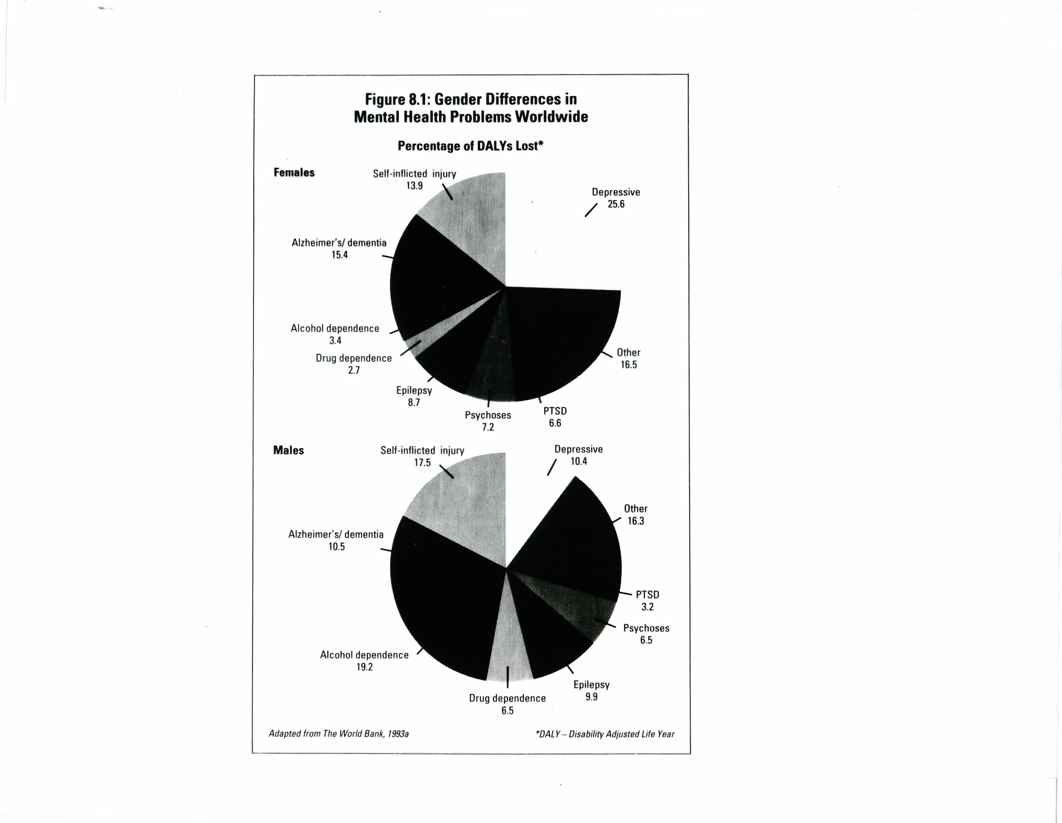
Gender Differences in
Mental Health Problems Worldwide
Percentage of DALYs* Lost

Slide 36
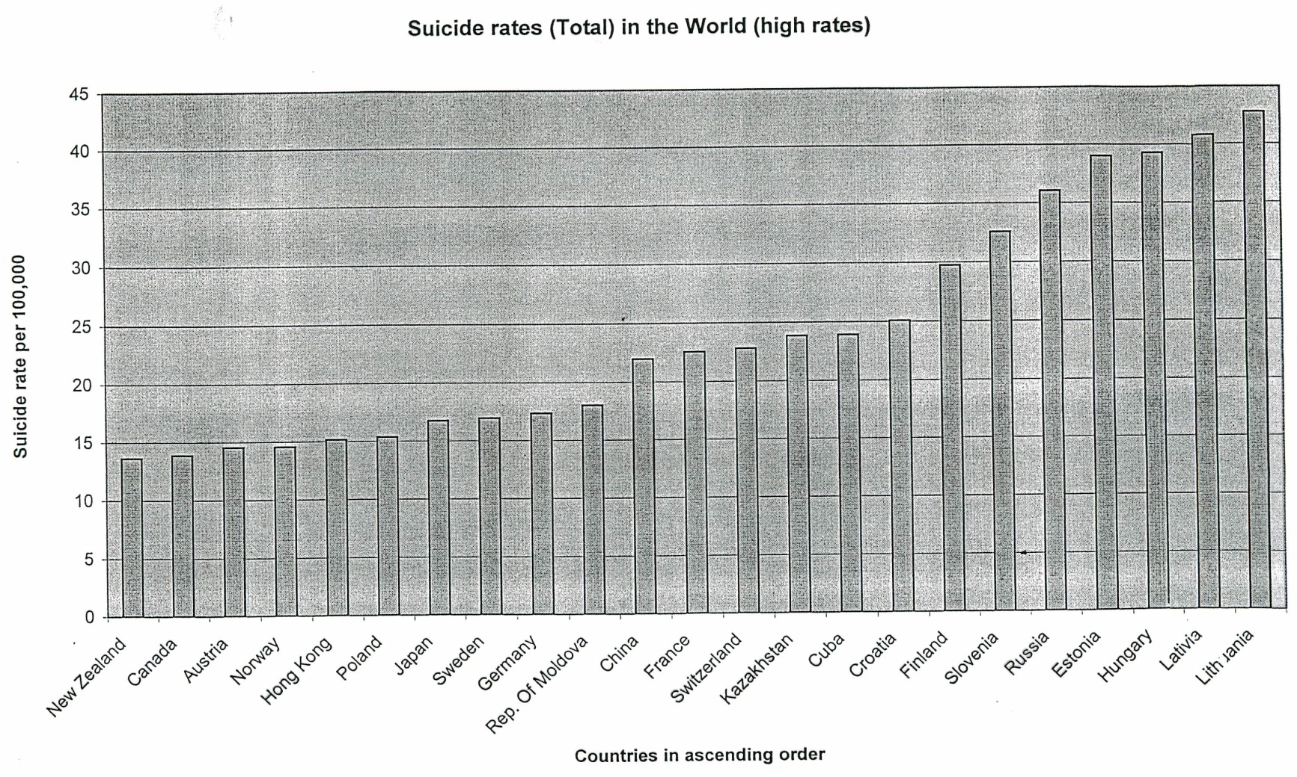
Suicide Rates in the World

Slide 37
Relationship of Suicide and Mental Illness
According to US psychiatrists, 90% of those who commit suicide have a diagnosed mental illness, most often major depressive disorder. This is disputed.

Slide 38
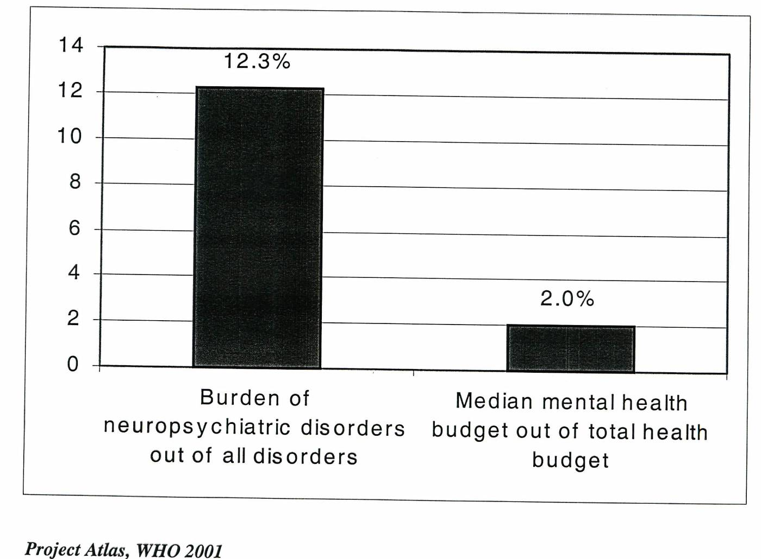
Burden vs. Budget

Slide 39
Mental Disorders
Disability
Non-Communicable
Disorders
Poverty

Slide 40
YLLs: Years of life lost
YLDs = Years Lived with Disability
DALY : disability-adjusted life years
the effect of age-weighting on years of life lost due to death at each age as well as the different effect on short- and medium-term disability were taken into consideration.

Slide 41
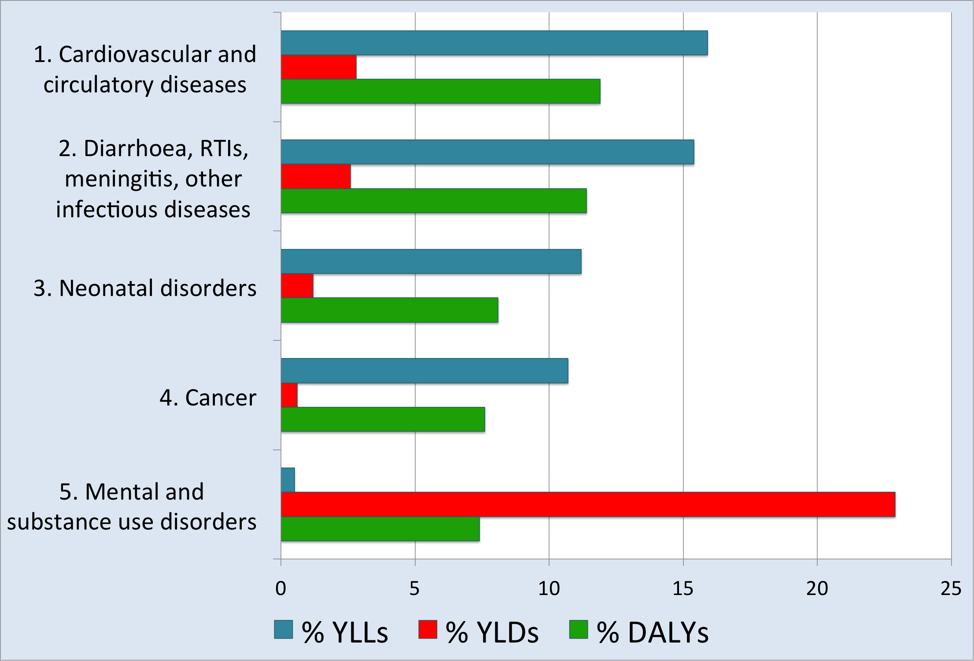

Slide 42
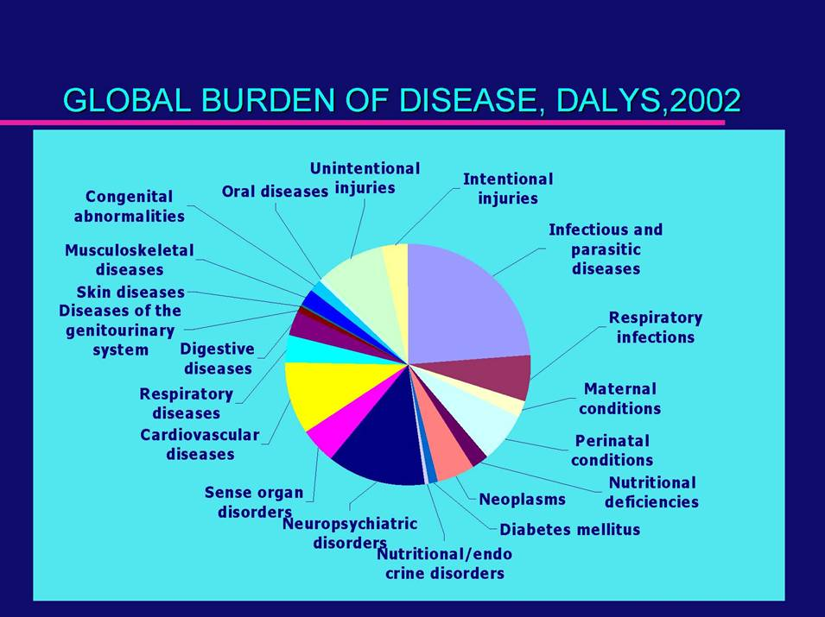
THE WORLDWIDE BURDEN

Slide 43
Leading Causes of Disability Around The World (Cost in Billions of US Dollars)
World Health Organization, 1996

Slide 44
Mental Disorders are Rarely the Only Health Problem
Cancer
10-20%
Chronic Physical Pain
25-50%
Neurologic
Disorders
10-20%
Mental Health / Substance Abuse
Smoking, Obesity, Physical Inactivity
40-70%
Heart Disease
10-30%
Diabetes
10-30%
Notes:
Interestingly—
-Prevalence of Depression is substantially higher in persons with chronic diseases than otherwise healthy individuals - prevalence of depression ~ 5-10 %

Slide 45
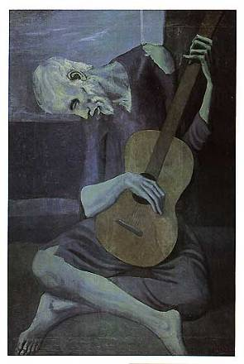
Improving Care for Depression
Common
10% in primary care, more common in
patients with chronic medical illnesses
Disabling
  #2 cause of disability (WHO)
Expensive
  50-100% higher health care costs
  (ED, inpatient, outpatient, pharmacy)
Deadly
  Over 30,000 suicides / year
Notes:
IMPACT is a national program to improve care for older adults with depression.
Let me say a little bit about depression.

Slide 46
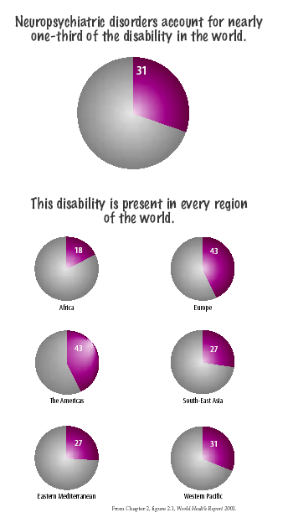

Slide 47
Increasing Burden of Noncommunicable Diseases and Injuries
Change in rank order of DALYs for the 15 leading causes
1999 Disease or Injury
2020 Disease or Injury
1. Acute lower respiratory infections
2. HIV/AIDS
3. Perinatal conditions
4. Diarrhoeal diseases
5. Unipolar major depression
6. Ischaemic heart disease
7. Cerebrovascular disease
8. Malaria
9. Road traffic injuries
10. Chronic obstructive pulmonary disease
11. Congenital anomalies
12. Tuberculosis
13. Falls
14. Measles
15. Anaemias
1. Ischaemic heart disease
2. Unipolar major depression
3. Road traffic injuries
4. Cerebrovascular disease
5. Chronic obstructive pulmonary disease
6. Lower respiratory infections
7. Tuberculosis
8. War
9. Diarrhoeal diseases
10. HIV
11. Perinatal conditions
12. Violence
13. Congenital anomalies
14. Self-inflicted injuries
15. Trachea, bronchus and lung cancers
DALY = Disability-adjusted life year
Source: WHO, Evidence, Information and Policy, 2000

Slide 48

“An estimated 400 million people alive today suffer from mental or neurological disorders or from psychosocial problems related to alcohol and drug abuse.
Many of them suffer silently and alone. Beyond the suffering and beyond the absence of care lie the frontiers of stigma, shame, exclusion and, more often than we care to know, death.
Our advocacy effort will concentrate on reducing stigma associated with mental ill health and neurological disorders and on raising awareness about the many effective, affordable treatments that are available but underused, both in developing and industrialized countries.”
Dr Gro Harlem Brundtland, Director General WHO Geneva, 12 February 2001

Slide 49
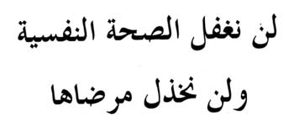
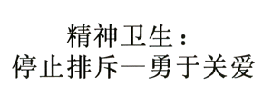
Santé mentale:
Non à l’exclusion, oui aux soins
Mental Health:
Stop exclusion – Dare to care
Охрана психического здоровья:
откажитесь от изоляции - окажите помощь
Salud mental:
Sí a la atención, no a la exclusión

Slide 50


Slide 51
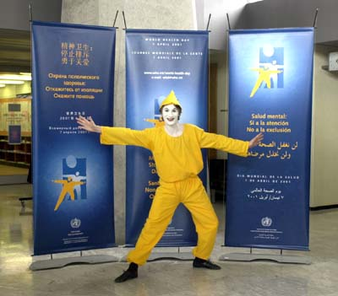

Slide 52


World Health Report 2001
Messages (1-3)
Mental health is relevant to all of health.
Mental disorders are real, diagnosable, common and universal. If left untreated, they can produce suffering and severe disability in individuals, and major social and economic losses.
Mental disorders are treatable. Prevention and treatment are possible and feasible, but currently most sufferers are unreached.

Slide 53

World Health Report 2001
Recommendations
Provide treatment in primary care
Make psychotropic medications available
Give care in the community
Educate the public
Involve communities, families, and consumers
Establish national policies, programs, and legislation
Develop Human resources
Link with other sectors
Monitor community mental health
Support more research.

Slide 54
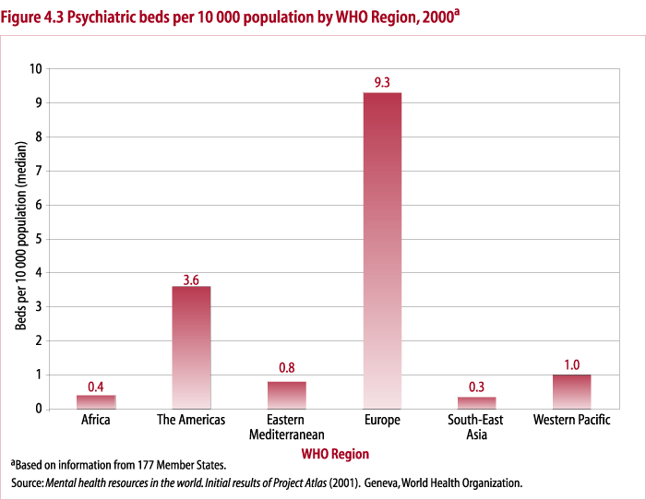

Slide 55
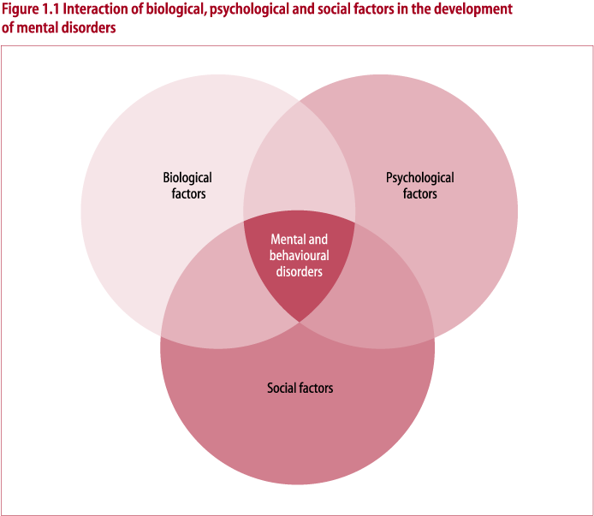

Slide 56
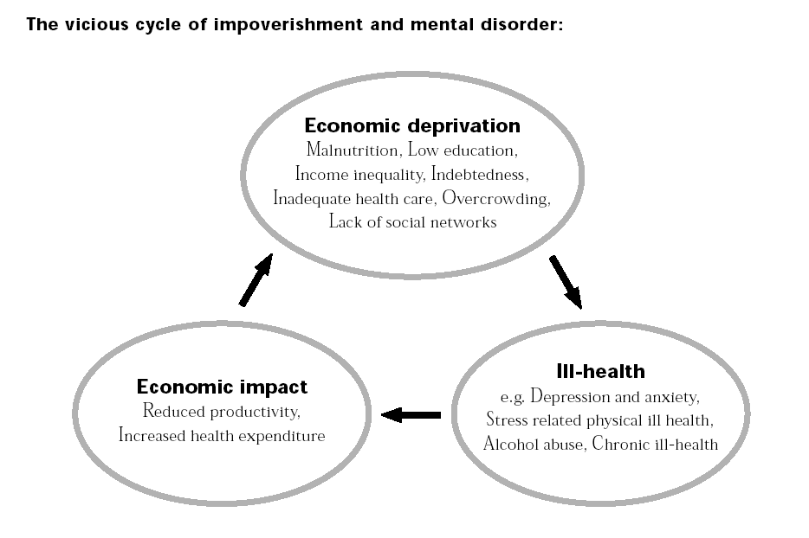

Slide 57

تم بحمد الله
Notes:
57

