Slide 1
1-The Mediastinum
extends
Posteriorly:
to the vertebral column
Superiorly:
to the thoracic outlet and the root of the neck
Inferiorly: to the diaphragm
Anteriorly: to the sternum

Slide 2
An imaginary plane passing
from
the sternal angle anteriorly
to
the lower border of the body of
the fourth thoracic vertebra posteriorly
divides the mediastinum
into:
SUPERIOR AND INFERIOR MEDIASTINA
Which one is larger?

Slide 3
THE INFERIOR MEDIASTINUM is further subdivided into:
1-THE MIDDLE MEDIASTINUM
consists of
the pericardium and heart
2-THE ANTERIOR MEDIASTINUM
is a space between the pericardium and the sternum
3-THE POSTERIOR MEDIASTINUM
lies between
THE PERICARDIUM
And
THE VERTEBRAL COLUMN

Slide 5
is bounded in front by
the manubrium sterni
and behind by
the first four thoracic vertebrae
THE SUPERIOR MEDIASTINUM
contains
From anterior to posterior
posterior
THYMUS
LARGE VEINS?
LARGE ARTERIES?
TRACHEA
ESOPHAGUS
THORACIC DUCT
SYMPATHETIC TRUNKS
anterior

Slide 6
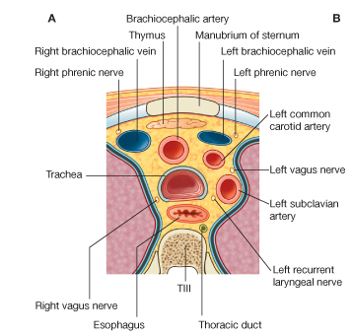
Main contents!
THE SUPERIOR MEDIASTINUM
THYMUS
LARGE VEINS, right and left brachiocephalic veins and the upper half of superior vena cava.
LARGE ARTERIES, arch of the aorta with its three large branches.
TRACHEA
ESOPHAGUS
THORACIC DUCT
(g) phrenic nerves, vagus nerves
and SYMPATHETIC TRUNKS
Anterior
Posterior
Cross-section through the superior mediastinum at the level of vertebra TIII.

Slide 7
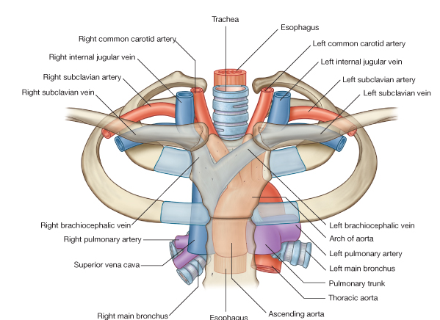
Structures in the superior mediastinum

Slide 8
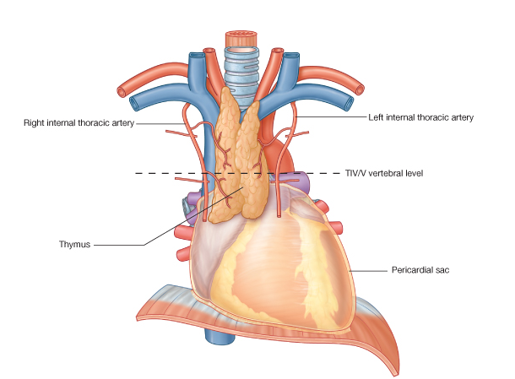
THYMUS
Involved in the early development of the immune system,
the thymus is a large structure in the child,
begins to atrophy after puberty
In the elderly adult, it is barely identifiable as an organ, consisting mostly of fatty tissue

Slide 9
the right internal
jugular veins
Large Veins of the
Thorax
the right subclavian
1-Brachiocephalic Veins
A-The right brachiocephalic vein:
formed by the union of
the right subclavian and
the right internal
jugular veins
(note: it is shorter and vertical)

Slide 10
Is formed by the union of the LEFT subclavian and the LEFT internal jugular veins
( note: It passes obliquely and it is longer)
It joins the right brachiocephalic vein to form the superior vena cava
B-The left brachiocephalic vein:

Slide 11
Superior Vena Cava
The superior vena cava contains all the venous blood from the head and neck and both upper limbs
is formed by the union of the two brachiocephalic veins
It passes downward to end in the right atrium of the heart
The vena azygos joins the superior vena cava just before it enters the pericardium

Slide 12
Azygos Veins
The azygos veins consist of:
c-THE SUPERIOR HEMIAZYGOS VEIN
a-THE MAIN AZYGOS VEIN
b-THE INFERIOR HEMIAZYGOS VEIN

Slide 13
Inferior Vena Cava
The inferior vena cava pierces the central tendon of the diaphragm
opposite the eighth thoracic vertebra
and almost immediately enters the lowest part of the right atrium

Slide 14
Large Arteries of the Thorax
Aorta
The aorta is the main arterial trunk that delivers oxygenated blood from the left ventricle of the heart to the tissues of the body.
It is divided for purposes of description into the following parts:
A-ASCENDING AORTA
B-ARCH OF THE AORTA
C-DESCENDING:
THORACIC AORTA (above diaphragm)
ABDOMINAL AORTA
(below diaphragm)

Slide 15
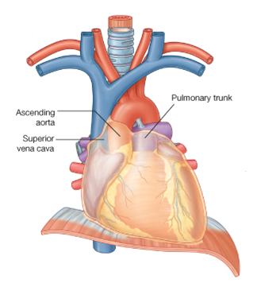
A-Ascending Aorta
The ascending aorta lies within the fibrous pericardium
(what does this mean?)
Begins at the base of the left ventricle
Ends at the level of the sternal angle, where it becomes continuous with the arch of the aorta
At its root it possesses three bulges, the sinuses of the aorta
Branches
The right coronary artery
The left coronary artery

Slide 16
B-Arch of the Aorta
is a continuation of the ascending aorta
(what does this mean?)
Ends at the level of the sternal angle where it becomes continuous with the descending aorta.
Branches
a-THE BRACHIOCEPHALIC ARTERY
arises from the convex surface of the aortic arch
It divides into:
1-THE RIGHT SUBCLAVIAN ARTERY
2-RIGHT COMMON CAROTID ARTERY

Slide 17
b-The left common carotid artery
Arises from the convex surface of the aortic arch
enters the neck behind the left sternoclavicular joint.
c-The left subclavian artery
Why we call it subclavian?
arises from the aortic arch
Runs in a groove in the first rib

Slide 18
C- Descending Thoracic Aorta
lies in the posterior mediastinum
begins as a continuation of the arch of the aorta
(opposite the sternal angle).
At the level of
the 12th thoracic vertebra,
it passes behind the diaphragm (through the aortic opening) in the midline and becomes continuous with the abdominal aorta.
Branches
1-Posterior intercostal arteries are given off to the lower nine intercostal spaces
2-Pericardial, esophageal, and bronchial arteries are small branches that are distributed to these organs.
READ ONLY

Slide 19
What do you think about the aorta and
mediastina?

Slide 20
Thoracic Duct
The thoracic duct begins below in the abdomen as a dilated sac,
THE CISTERNA CHYLI
It ascends through the aortic opening in the diaphragm
enters the beginning of
the left brachiocephalic vein.
Passes through superior and posterior mediastinum
Read only
The thoracic duct thus conveys to the blood all lymph from the lower limbs, pelvic cavity, abdominal cavity, left side of the thorax, and left side of the head, neck, and left arm

Slide 21
Nerves of the Thorax
Vagus Nerves
Cranial nerve 10
The right vagus nerve
The left vagus nerve
Located in
the neck
Thorax: passes through both
superior and posterior mediastinum

Slide 22
Phrenic Nerves
The phrenic nerves arise from the anterior rami of the third, fourth, and fifth cervical nerves
It passes in front of the root of the lungs
Its terminal branches pass through the caval opening in the diaphragm to supply the central part of the peritoneum on its underaspect.
Read only

Slide 23
Thoracic Part of the Sympathetic Trunk
The thoracic part of the sympathetic trunk is continuous above with the cervical and below with the lumbar parts of the sympathetic trunk.
: passes through both
superior and posterior mediastinum
Read only
The first ganglion is often fused with the inferior cervical ganglion to form
the stellate ganglion

Slide 24
The esophagus has three anatomic and physiologic constrictions
Esophagus
is a tubular structure about 10 in. (25 cm) long
is continuous above with the laryngeal part of the pharynx opposite
the sixth cervical vertebra.
It passes through the diaphragm at the level of the
10th thoracic vertebra
to join the stomach
where the pharynx joins the upper end
1
2
These constrictions are
where the aortic arch and the left bronchus cross its anterior surface
Read only
3
where the esophagus passes through the diaphragm into the stomach
passes through both
superior and posterior mediastinum

