Slide 1
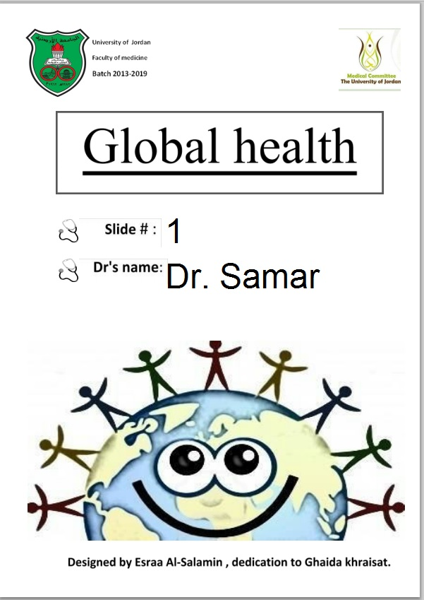

Slide 2
بسم الله الرحمن الرحيم
الحمد لله رب العالمين والصلاة والسلام علي سيدنا محمد الصادق الوعد الأمين ، اللهم أخرجنا من ظلمات الجهل والوهم ، إلى نور المعرفة والعلم..

Slide 3
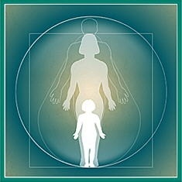
Maternal and children health.
HEALTH
MOTHER
CHILD
SOCIETY
Healthy children need healthy mothers

Slide 4
WHO. Health definition.
WHO 2001: Health is a complete physical, mental and social well-being state and not only absence of disease or ailment.
This medullar ideas conform the totality in health, although there are differences between ages, countries, cultures, classes and gender that prevent a homogenous consensus.

Slide 5
Health.
Physical and mental health, and well-being/social health, cannot exist independent. It belongs to interdependent dimensions.
Health and disease exist simultaneously and are mutually exclusive only if the health is defined restrictively

Slide 6
Human health.
Health and disease are determined by many factors that interact in social, psychological and biological form.
Those that world-wide are associate with indicators of poverty and low levels of education.

Slide 7
Individual health.
Individual health is affected by individual factors, social interaction, cultural structures and values society resources.
Economic levels and health services eficacy and effectiveness have direct implications in the individual, familiar and communities health;from the local to the global setting.

Slide 8
Public health.
Like a science and art, Public health is to promote health, to prevent diseases and to prolong the life through organized efforts of the society.
The gains in health have been obtained as a result of improvements in the economic income, education, water provision, nutrition, hygiene, house, health services and the result of new knowledge on the causes, prevention and treatment of diseases.

Slide 9
PHEF and maternal/child health
PHEF 1:Population health
monitoring and analyses
PHEF 2. Monitoring,
investigation
and control
of risks and damages
PHEF 3. Health promotion.
PHEF 4. Social
participation &
empowerment
PHEF 5. Development of
policies
and capacity of management.
PHEF 9. Quality of health
services
PHEF 7: Evaluation and promotion of the equitable access to the services
PHEF 11.
Impact reduction
of emergencies
and disasters
FESP 10.
Researching &
development

Slide 10
Demographic changes
Chronic diseases
Epidemiologic changes
Modern life condition
SANITARY CHALLENGES
PUBLIC
HEALTH
Environment
Accidents
MORBIDITY MORTALITY
POPULATION HEALTH STATUS
SDH
Reproductive health
Maternal & Child health
Risk factor
Emergent Reemergent Diseases
Inequities
Maternal
Child
Morbidity
&
Mortality
Local & Global health problem.
Undernutrition Lack of access

Slide 11
Public health challenges.
Actual sanitary challenges requires to implement new strategies of public health that prevent the diseases appearance and promote total development of health.
These challenges exist due to the priority of diseases treatment services by on promotion programs and primary prevention of diseases.

Slide 12
Reproductive health.
Addresses the reproductive processes, functions and system at all stages of life.
Implies that people are able to have a responsible, satisfying and safe sex life and that they have the capability to reproduce and the freedom to decide if, when and how often to do so.

Slide 13
Reproductive health.
Implicit the right to be informed of and to have access to safe, effective, affordable and acceptable methods of fertility regulation of their choice.
Women right of access to appropriate health care services to go safely through pregnancy and childbirth and provide couples with the best chance of having a healthy infant.

Slide 14
Reproductive health universe.
Genetics factor
Social
determinants
of health
Health services
Promotion
&
Prevention
Reproductive
health
Maternal
&
Child health
Morbidity
&
Mortality

Slide 15
Maternal health.
Health of women during pregnancy, childbirth and the postpartum period.
Motherhood, for too many women it is associated with suffering, ill-health and death.
Haemorrhage, infection, HBP, unsafe abortion and obstructed labour still are major direct causes of maternal morbidity and mortality.

Slide 16
Maternal health care.
Is a concept that encompasses family planning, preconception, prenatal, and posnatal care.
Goals of preconception care can include providing education, health promotion, screening and interventions for women of reproductive age to reduce risk factors that might affect future pregnancies.

Slide 17
Maternal prenatal care.
Prenatal care is the comprehensive care that women receive and provide for themselves throughout their pregnancy.
Women who begin prenatal care early in their pregnancies have better birth outcomes than women who receive little or no care during their pregnancies.

Slide 18
Maternal postnatal care.
Postnatal care issues include recovery from childbirth, concerns about newborn care, nutrition, breastfeeding and family planning.
Time just after delivery is especially critical for newborns and mothers, especially during the first 24 hours. Two-thirds of all maternal deaths occur in this postnatal period;.

Slide 19
Maternal health and developing countries.
Most women do not have a good access to the health care and sexual health education services.
A woman in sub-Saharan Africa has a 1 in 16 chance of dying in pregnancy or childbirth, compared to a 1 in 4,000 risk in a developing country – the largest difference between poor and rich countries of any health indicator.

Slide 20
Maternal health and developing countries.
At the level of preconception and prenatal care, pregnancy complications and childbirth are the leading causes of death among women of reproductive age.
Less than one percent of these deaths occur in developed countries, showing that they could be avoided if resources and services were available.

Slide 21
Maternal & child health.
There are birth-related disabilities that affect many more women and go untreated like injuries to pelvic muscles, organs or the spinal cord.
At least 20% of the burden of disease in children below the age of 5 is related to poor maternal health and nutrition, as well as quality of care at delivery and during the newborn period.

Slide 22
Maternal & child health.
Yearly 8 million babies die before or during delivery or in the first week of life.
Further, many children are tragically left motherless each year.
These children are 10 times more likely to die within two years of their mothers' death.

Slide 23
Maternal and child health and disease
Maternal and child health and disease has multi-factor origin and can exist of sequential and continuous form.
Bad maternal conditions account for the fourth leading cause of death for women after HIV/AIDS, malaria, and tuberculosis

Slide 24
Maternal death.
Death of a woman while pregnant or within 42 days of termination of pregnancy, irrespective of the duration and site of the pregnancy, from any cause related to or aggravated by the pregnancy or its management but not from accidental or incidental causes.
Burden of maternal mortality is an important input to health decision-making.

Slide 25
Burden of morbidity and mortality in maternal period.
Global burden of disease in pregnancy woman (GBDPW) analysis provides a comprehensive and comparable assessment of mortality and loss of health due to pregnancy and its risk factors in all regions.
Is assessed using the disability-adjusted life year (DALY), that combines years of life lost due to premature mortality.

Slide 26
Maternal death.
To facilitate the identification of maternal deaths in circumstances in which cause of death attribution is inadequate, a new category has been introduced:
Pregnancy-related death is defined as the death of a woman while pregnant or within 42 days of termination of pregnancy, irrespective of the cause of death.

Slide 27
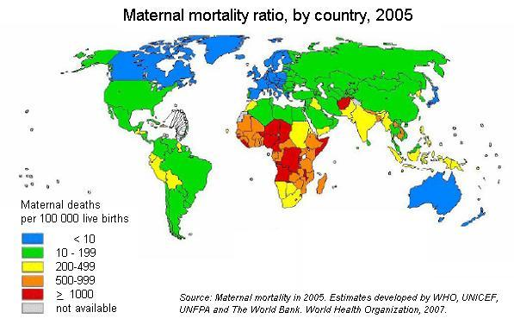

Slide 28
Maternal mortality.
Critical indicator of population health reflecting the overall state of maternal health as well as quality and accessibility of PHC available to pregnant women and infants. Maternal mortality ratio is measured per 100 000 live births.
Measuring maternal mortality accurately is difficult except where comprehensive registration of deaths and of causes of death exists.

Slide 29
Maternal mortality.
Maternal deaths are clustered around the intrapartum (labour, delivery and the immediate postpartum); the most common direct cause globally is obstetric haemorrhage.
Other major causes are: obstetric haemorrhage; anaemia; sepsis/infection obstructed labour; hypertensive disorders and unsafe abortions.

Slide 30
Maternal death risks.
Risk of maternal death is affected by many factors like:
Frequency and spacing of births.
Nutrition level (maternal undernutrition)
Stature and maternal age.

Slide 31
Maternal death risk.
Appropriate medical and midwife support.
Access to emergency and intensive treatment if were necessary.
Lack of management capacity in the health system.
No political will and lack of management capacity in the health system.

Slide 32
Maternal death risk.
Another risk to expectant women is malaria. It can lead to anaemia, which increases the risk for maternal and infant mortality and developmental problems for babies.
A majority of these deaths and disabilities are preventable, being mainly due to insufficient care during pregnancy and delivery.

Slide 33
Maternal death risk.
HIV infection is an increasing threat. Mother-to-child transmission of HIV continues to be a major problem, with up to 45 per cent of HIV-infected mothers transmitting infection to their children.
Further, HIV is becoming a major cause of maternal mortality in highly affected countries in Southern Africa, especially with the TB re-emergency.

Slide 34
بسم الله الرحمن الرحيم
الحمد لله رب العالمين والصلاة والسلام علي سيدنا محمد الصادق الوعد الأمين ، اللهم أخرجنا من ظلمات الجهل والوهم ، إلى نور المعرفة والعلم..

Slide 35
Children health.
Child's health includes physical, mental and social well-being too.
Each year more than 10 million children under the age of five die.
At least 6.6 million child deaths can be prevented each year if affordable health interventions are made available to the mothers and children who need them.

Slide 36
Underlying causes of Child illness and death.
Poverty: More than 200 million children under five live in absolute poverty, on less than $1 per day.
Under-nutrition and malnutrition: At least 200 million children under five are malnourished.
High fertility and short birth intervals.

Slide 37
Infant mortality
Critical indicator of population health reflecting the overall state of maternal health as well as quality and accessibility of PHC available to pregnant women and infants.
Infant Mortality Rate (IMR): number of infant deaths per 1,000 live births in a population.

Slide 38
Other indicators.
Neonatal Death: Death of an infant less than 28 days after birth (<28 days).
Postneonatal Death: Death of an infant between 28 days and one year after birth (28-364 days).
Low Birthweight (LBW): Birth weight less than 2,500 grams and VLBW 1500.

Slide 39
Infant and neonatal mortality.
Infant mortality rate is made up of two components: neonatal mortality (death in the first 28 days of life) & postneonatal mortality (death from the infants’ 29th day but within the first year).
The leading causes of neonatal death include birth defects, disorders related to short gestation (prematurity) and LBW, and pregnancy complications.

Slide 40
Neonatal mortality.
The most to be preventable are those related to preterm birth and LBW, which represent approximately 20 percent of neonatal deaths.
Postneonatal death reflects events experienced in infancy, including SIDS (Sudden Infant Death Syndrome), birth defects, injuries, and homicide. SIDS is the leading cause of postneonatal death.

Slide 41
Neonatal mortality.
Most neonatal deaths usually occur in the first 24 hours of life, and three-quarters of neonatal deaths occur in the first week after birth.
Most newborn deaths are preventable through affordable interventions. To address the high burden of newborn deaths care must be available during pregnancy, labour and postpartum.

Slide 42
Perinatal and fetal mortality.
Health of infants depends in large part on their health in utero. A fetus with severe defects or growth problems may not be delivered alive.
Because only live births are counted in infant mortality rates, perinatal and fetal mortality rates provide a more complete picture of perinatal health than does the infant mortality rate alone.

Slide 43
Perinatal mortality.
The perinatal mortality rate includes both deaths of live-born infants through the first 7 days of life and fetal deaths after 28 weeks of gestation.
This rate is a useful overall measure of perinatal health and the quality of health care provided to pregnant women and newborns.

Slide 44
Fetal death.
Fetal death often is associated with maternal complications of pregnancy, such as problems with amniotic fluid levels and blood disorders.
Also when birth defects, such as anencephalus, renal agenesis, and hydrocephalus, are present.

Slide 45
Fetal death.
Rates of fetal mortality are 35 percent greater than average in women who use tobacco during pregnancy and 77 percent higher in women who use alcohol.
Targeting prenatal risk screening and intervention to high-risk groups is critical to reducing this gap.

Slide 46
Stillbirth (around in the dark)
Information about 4 million neonatal deaths worldwide is limited, even less information is available for stillbirths (babies born dead in the last 12 weeks of pregnancy) and there are no systematic global estimates.
The numbers of stillbirths are high and regions in which most stillbirths occur, with under-reporting being a major challenge.

Slide 47
Under-five mortality rate (U5MR) .
Indicates the probability of dying between birth and exactly five years of age, expressed per 1,000 live births, if subject to current mortality rates.
It has several advantages as a barometer of child well-being in general and child health in particular. It measures an ‘outcome’ of the development process.

Slide 48
Under-five mortality rate (U5MR)
Is known to be the result of a wide variety of inputs:
nutritional status and the health knowledge of mothers;
level of immunization and oral rehydration therapy;
availability of maternal and child health services (including prenatal care);

Slide 49
Under-five mortality rate (U5MR)
Income and food availability in the family;
Availability of safe drinking water and basic sanitation;
Safety of the child’s environment, among other factors
U5MR is less susceptible to the fallacy due that is a picture of the health status of the majority of children (and of society as a whole).

Slide 50
Children < 5 years mortality (2008).
Globally, 80 percent of all child deaths to children under five are due to only a handful of causes:
pneumonia (19 %),
diarrhea (18 %),
malaria (8 %),
neonatal pneumonia or sepsis (10 %),
pre-term delivery (10 %),
asphyxia at birth (8 %),
measles (4 %),
HIV/AIDS (3 %).

Slide 51
Deaths among infants under 7 days are decreasing more slowly than among older infants
100
Developing Regions
80
Post-neonatal mortality
Late neonatal mortality
60
Early neonatal mortality
40
20
Developed Regions
0
1983
2000
1983
2000
Source: RHR/WHO, 2003

Slide 52
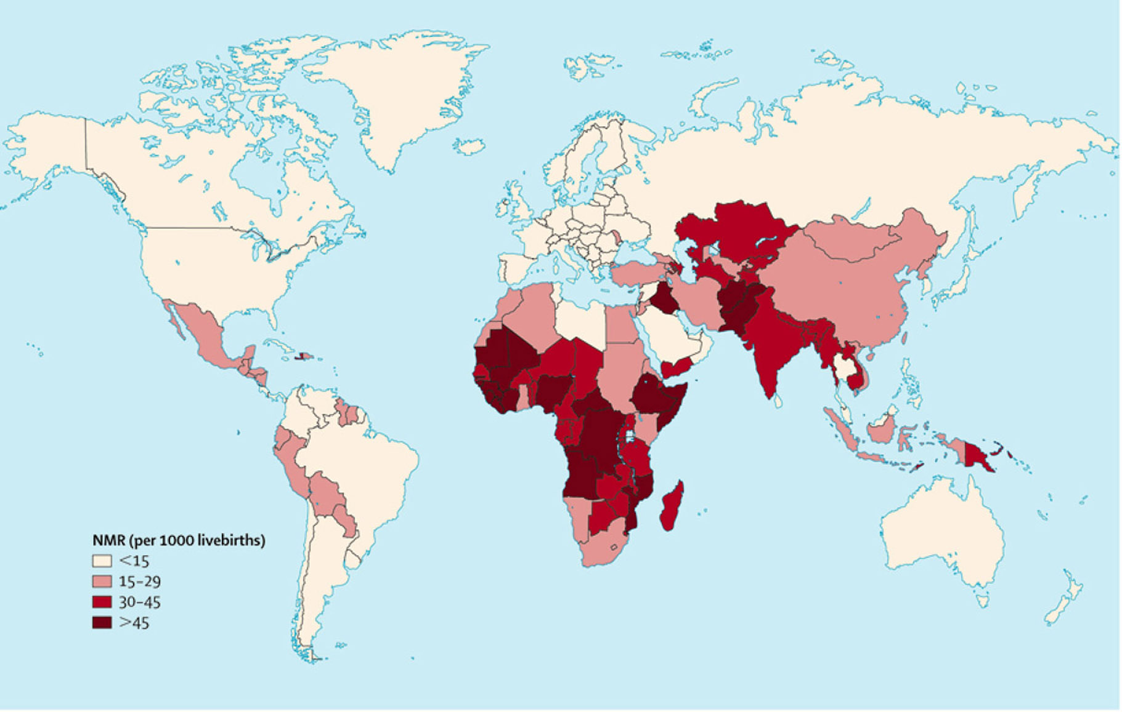
Where do 4 million newborns die?
1.5 million (38% of all newborn deaths) occur in 4 countries of South Asia

Slide 53
When do they die?
Up to 50%
of neonatal
deaths are in
the first 24 hours
75% of neonatal
deaths are in
the first week –
3 million deaths
Notes:
Data from DHS surveys in 47 countries, 10,048 neonatal deaths. A very high proportion of deaths occur in the first hours and days after birth. Prevention of these early neonatal deaths will require improvements in care at the time of birth and improvements in care in the early neonatal period.

Slide 54
Spectrum of Asphyxia outcomes
Neonatal encephalopathy (mild/ mod / severe)
Neonatal death as a consequence of NE
(neonatal encephalopathy)
Neurological disability as a complication of neonatal encephalopathy

Slide 55
Newborn Deaths from Asphyxia: the tip of an iceberg
0.9 million asphyxia deaths
1-2 million suffer medium to long–term impairment
Stillbirths from
intrapartum hypoxia
(~ 1 million deaths)

Slide 56
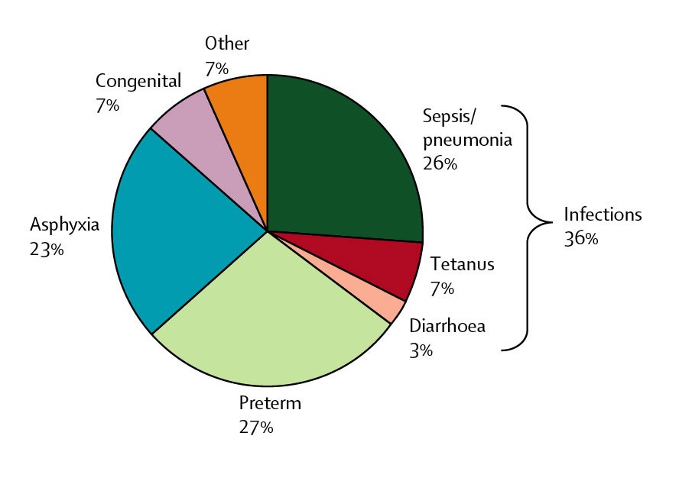
4 million newborn deaths – Why? almost all are due to preventable conditions
Two thirds of all neonatal deaths are in LBW infants

Slide 57
MDGs and maternal/child health
Millennium Development Goal 4 aims to reduce child deaths by two-thirds(66%) between 1990 and 2015.
Millennium Development Goal 5 has the target of reducing maternal deaths by three-quarters (75%) over the same period.

Slide 58
MDGs and maternal/child health
Unfortunately, on present trends, most countries are unlikely to achieve either of these goals.
A recent review of MDG progress, show that the world have only 32% of the way to achieving the child health goal and less than 10% of the way to achieving the goal for maternal health.

Slide 59
Some emerging and reemerging problems to M & Ch Health.
HIV/AIDS and TB plus Multirresistant TB.
Dengue.
Others viral haemorragic fever.
Old neglected diseases with new burden.
Cholera outbreaks in Africa and Asia.
Avian and swyne flu.
Conflicts, war and infraestructure destruction.
Bad governance and uneffective polices.

Slide 60
Core interventions to prevent child deaths.
Preventive interventions:
Vaccination
Folic acid supplementation
Tetanus toxoid
Syphilis screening and treatment
Pre-eclampsia and eclampsia prevention (calcium supplementation)
Intermittent presumptive treatment for malaria in pregnancy

Slide 61
Core interventions to prevent child deaths.
Preventive interventions:
Antibiotics for premature rupture of membranes
Detection and management of breech (caesarian section)
Labor surveillance
Clean delivery practices
Breastfeeding

Slide 62
Core interventions to prevent child deaths.
Preventive interventions:
Prevention and management of hypothermia
Kangaroo mother care (skin-to-skin contact) for low birth-weight newborns
Newborn temperature management
Insecticide-treated materials
Complementary feeding

Slide 63
Core interventions to prevent child deaths.
Preventive interventions:
Zinc
Hib vaccine
Water, sanitation, hygiene
Antenatal steroids
Vitamin A
Nevirapine and replacement feeding to prevent HIV transmission
Measles vaccine

Slide 64
Core interventions to prevent child deaths.
Treatment interventions:
Detection and treatment of asymptomatic bacteriuria.
Corticosteroids for preterm labor.
Newborn resuscitation
Community-based pneumonia case management, including antibiotics
Oral rehydration therapy

Slide 65
Core interventions to prevent child deaths.
Antibiotics for dysentery, sepsis, emerging and reemeging diseases.
Antimalarials
Zinc for diarrhea
Vitamin A in respiratory diseases.

Slide 66
Maternal & child health. Hollistic approach.
MORTALITY
DEATH Survival
SHC actions
DISEASES
Pluripathologic condition
SEPSIS
SHOCK
MOF
OBJETO
MORBIDITY
Integral Care
HEALTH
ACESS
PHC ACTIONS
Susceptibility
Vulnerability
PREVENTION
RISK FACTORS
SOCIAL DETERMINANTS
AGENT
CAUSE

Slide 67
Key facts (as of May 2012)
1-Every day approximately 800 women die from preventable causes related to pregnancy and childbirth.
2- 99% of all maternal deaths occur in developing countries.
3- Young adolescents face a higher risk of complications and death as a result of pregnancy.

Slide 68
Skilled care before during and after childbirth can save the lives of women and newborn babies.
Between 1990 and 2010 maternal mortality worldwide dropped by almost 50%
Everyday 8000 newborn babies die from preventable causes.
Nearly 99% of all neonatal deaths occur in low and middle income countries

Slide 69
70% of global deaths among newborn babies happen in just two WHO regions: Africa and South East Asia
Essential maternal and newborn care and access to care for complications can save the lives of mothers and newborn babies.

Slide 70
Some conclusions.
Maternal, neonatal and child mortality has been very persistent in a global context.
Now 38 percent of all child deaths (4 million) occur in the first month of life.
More than 10 million children under 5yr die each year. Most result from preventable and treatable causes. That’s 30,000 children a day.
Most of these children live in developing countries

Slide 72
Conclusions
Improving newborn health and care is critical to attaining the MDG targets for child survival
To do so would require concerted efforts to improve maternal care, outreach and provide innovative models of community support and education
Emerging data from demonstration projects in health system settings indicate that this is doable and can be scaled up using affordable models of care
Community engagement and ownership is a critical element in successful intervention models for maternal and newborn care

