Slide 1
Testicular Neoplasms
- In the 15- to 34-year-old age group, they are the most common tumors of men.
- include:
I. Germ cell tumors : 95%; all are malignant.
II. Sex cord-stromal tumors: from Sertoli or Leydig cells; usually benign.
-The cause of testicular neoplasms remains unknown

Slide 2
Risk factors:
1. whites > blacks.
2. Cryptorchidism
3- to-5 folds risk of cancer in the undescended testis, and an increased risk of cancer in the contralateral descended testis.
3. Intersex syndromes
-Androgen insensitivity syndrome; Gonadal dysgenesis
4. Family history Brothers of males with germ cell tumors have an 8-10-fold increased risk over that of the population

Slide 3
5. The development of cancer in one testis markedly increased risk of neoplasia in the contralateral testis.
6. An isochromosome of the short arm of chromosome 12, i(12p), is found in virtually all germ cell tumors, regardless of their histologic type.
7. Most testicular tumors in postpubertal males arise from the in situ lesion intratubular germ cell neoplasia; present in conditions associated with a high risk of developing germ cell tumors (e.g., cryptorchidism, dysgenetic gonads

Slide 4
Testicular germ cell tumors are subclassified into:
I. Seminomas
II. Non-seminomatous germ cell tumors(NSGCT)
- The histologic appearances may be:
1. Pure (i.e., composed of a single histologic type 60% of cases)
2. Mixed (seen in 40% of cases).

Slide 5
I. Seminomas,
- Make up 30-40% of all testicular tumors
- 90% of the cases
- fourth decade of life
- rare in prepubertal children
- progressive painless enlargement of the testis
- histologically identical to ovarian dysgerminomas and to germinomas occurring in the CNS and other extragonadal sites.

Slide 6
MORPHOLOGY
Gross
- soft, well-demarcated tumors
usually without hemorrhage.

Slide 7
2. Embryonal carcinomas :
Are ill-defined, invasive masses containing foci of hemorrhage and necrosis
Microscopically
The tumor cells are large and primitive-looking. The cytoplasm is basophilic.

Slide 8
3. Yolk sac tumors
- the most common primary testicular neoplasm in children younger than 3 yr.
In adults, yolk sac tumors have a worse prognosis
In nonseminomatous germ cell tumors, the incidence of yolk sac elements is 80% (mixed).

Slide 9
Histologic examination
The tumor is composed of low cuboidal to columnar epithelial cells forming Microcysts, Lacelike (reticular) patterns.
A distinctive feature is the presence of structures resembling primitive glomeruli, called Schiller-Duvall bodies.
- AFP can also be detected in the serum.

Slide 10
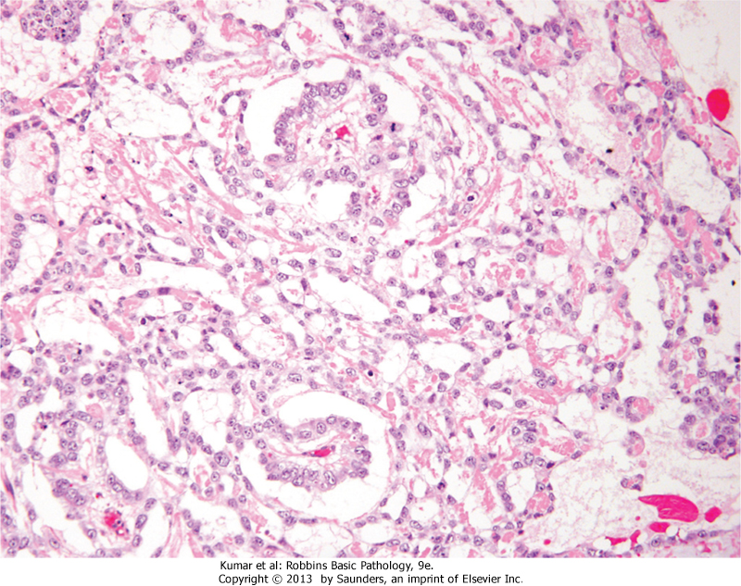
Yolk sac tumor black arrows: Schiller-Duvall bodies.

Slide 11
4. Choriocarcinomas
- the germ cells differentiate along trophoblastic lines.
- about 5% of all testicular tumors
Grossly
- may be small lesions, even those with extensive systemic metastases
May show total necrosis and tumor regression
Microscopic examination
composed of sheets of small cuboidal cells (cytotrophoblasts) irregularly intermingled with large, eosinophilic syncytial cells containing multiple dark, pleomorphic nuclei( syncytiotrophoblasts).
HCG is elevated in the serum

Slide 12
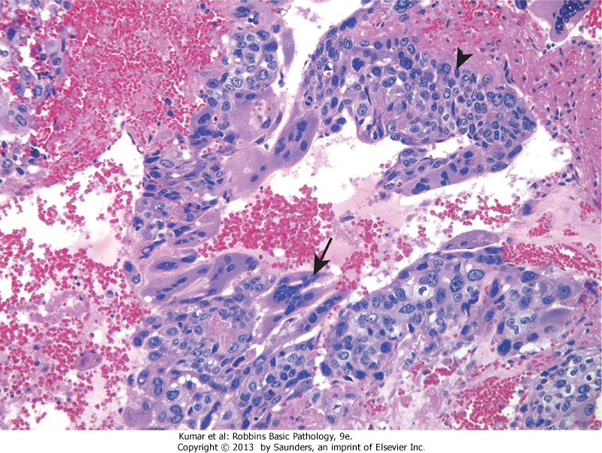
Choriocarcinoma: arrows represents syncytiotrophoblasts

Slide 13
5. Teratomas
- the neoplastic germ cells differentiate along somatic cell lines.
Pure forms of teratoma are common in infants
and children , being second in frequency only to yolk sac tumors
- In adults, pure teratomas are rare

Slide 14
Microscopically
1. Mature teratomas
a heterogeneous, collection of differentiated cells or organoid structures, such as neural tissue, muscle bundles, islands of cartilage, clusters of squamous epithelium, etc
2. Immature teratoma
- Share histologic features with fetal or embryonal tissues

Slide 15
Prognosis:
In prepubertal males, teratomas are typically benign, whereas teratomas in postpubertal males are malignant, being capable of metastasis
regardless of whether they are composed of mature or immature elements

Slide 16
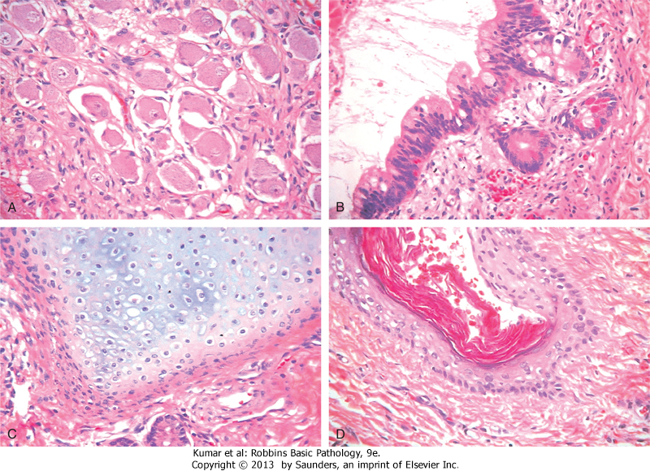
teratoma

Slide 17
Clinical Features of testicular germ cell neoplasms
1- present most frequently with a painless testicular mass.
2- Biopsy of a testicular neoplasm is associated with a risk of tumor spillage (contraindicated), so best to do excision of the scrotal skin in addition to orchiectomy.

Slide 18
3 - Seminomas and nonseminomatous tumors differ in their behavior and clinical course:
I. Seminomas
-Often remain confined to the testis for long intervals.
-Metastases mostly to iliac and paraaortic lymph nodes
II. Nonseminomatous germ cell neoplasms
- metastasize earlier, by lymphatic as well as hematogenous routes (most common in the liver and lungs).

Slide 19
Assay of tumor markers secreted by germ cell
a. These markers are helpful diagnostically and in follow up response of tumors to therapy
I. Human chorionic gonadotropin (hCG)
- Is always elevated in choriocarcinoma.
2. Increased alpha fetoprotein (AFP) in the setting of a testicular neoplasm indicates a yolk sac tumor component.
3. lactate dehydrogenase (LDH) correlate with the tumor burden.

Slide 20
The treatment of testicular germ cell neoplasms
I. Seminoma:
radiosensitive , has the best prognosis (95% of patients with early-stage disease can be cured)
II. nonseminomatous germ cell tumors, are treated as a group.
90% of the patients achieve complete remission with aggressive chemotherapy, and most are cured.
-Pure choriocarcinoma carries a dismal prognosis.
- With all testicular tumors, recurrences, typically in the form of distant metastases, usually occur within the first 2 years after treatment

Slide 21
Benign Prostatic Hyperplasia (Nodular Hyperplasia)
- Is an extremely common abnormality of men by the age of 40, and its frequency rises progressively with age.
Is characterized by androgen-dependent proliferation of both stromal and epithelial elements, with resultant enlargement of the gland and, in some cases, urinary obstruction.
BPH does not occur in males castrated before the onset of puberty

Slide 22
Clinical Features
- Occur in only about 10% of men BPH.
the most common manifestations are related to lower urinary tract obstruction, often in the form of hesitancy; urgency, frequency, and nocturia.
- increases the risk of urinary tract infections.

Slide 23
Carcinoma of the Prostate
- Adenocarcinoma of the prostate occurs mainly in men older than 50 years of age.
- It is the most common form of cancer in men,
- Over the past several decades, there has been a significant drop in prostate cancer mortality, due to increased detection of the disease through screening

Slide 24
PATHOGENESIS
1. Androgens are of central importance.
- Cancer of the prostate does not develop in males castrated before puberty.
- Cancers regress in response to surgical or chemical castration

Slide 25
2. Heredity –
- There is an increased risk among first-degree relatives of patients with prostate cancer.
- Incidence highest among blacks and is also high in Scandinavian countries.

Slide 26
3. Environment
- plays a role, as evidenced by the fact that in Japanese immigrants to the United States the incidence of the disease rises (although not to the level seen in native-born Americans).
-Also, as the diet in Asia becomes more Westernized, the incidence of clinical prostate cancer in this region of the world appears to be increasing. However, the relationship between specific dietary components and prostate cancer risk is unclear.

Slide 27
4. Acquired somatic mutations,
androgen-regulated promoter of the TMPRSS2 gene and the coding sequence of ETS family transcription factors (the most common being ERG).
- TMPRSS2-ETS fusion genes occur in approximately 40% to 50% of prostate cancers

Slide 28
Clinical Features
70% to 80% arise in peripheral glands →palpable on digital rectal examination.
asymptomatic lesions are discovered on needle biopsy to investigate elevated serum prostate-specific antigen (PSA) level
Bone metastases (axial skeleton,) typically cause osteoblastic (bone-producing) lesions that can be detected on radionuclide bone scans

