Slide 1

Malabsorption
& Celiac Disease
Eyad Swaity, MD
American Board, MRCP GI
Senior Gastroenterology & Hepatology Specialist
Division of Gastroenterology - Jordan University Hospital

Slide 2
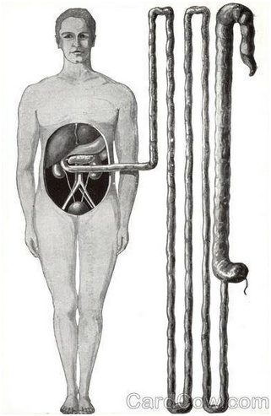
Absorptive Capability
Measured Small Intestine Length = 6 Meters

Slide 3
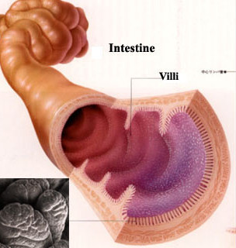
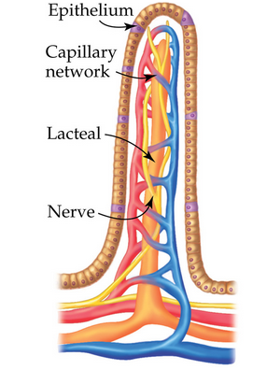
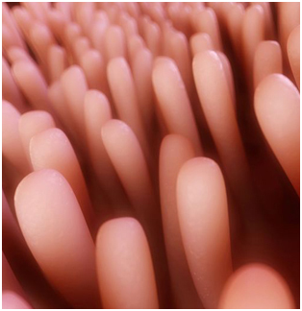
Absorptive Capability
Villi / Mico-Villi

Slide 4
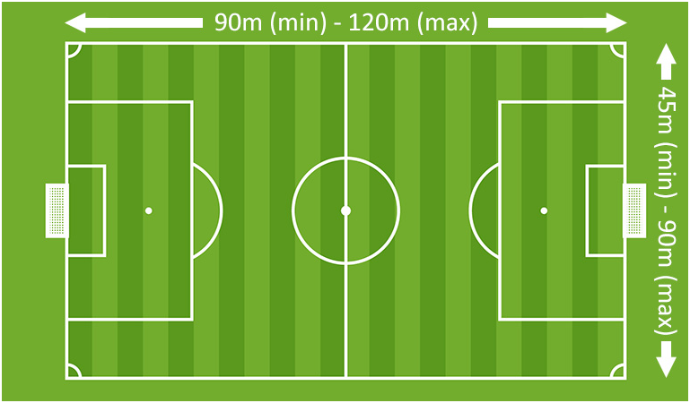
Absorptive Capability
Standard Football Field

Slide 5
Maldigestion Vs Malabsorption
Maldigestion:
Impaired breakdown of nutrients (absorbable split-procarbohydrates, protein, fat) to ducts (mono-, di-, or oligosaccharides; amino acids; oligopeptides; fatty acids; monoglycerides)
Malabsorption:
Defective mucosal uptake and transport of adequately digested nutrients including vitamins and trace elements.

Slide 6
Malabsorption Syndrome
A clinical term that encompasses defects occurring during the digestion and absorption of food nutrients by the gastrointestinal tract.

Slide 7
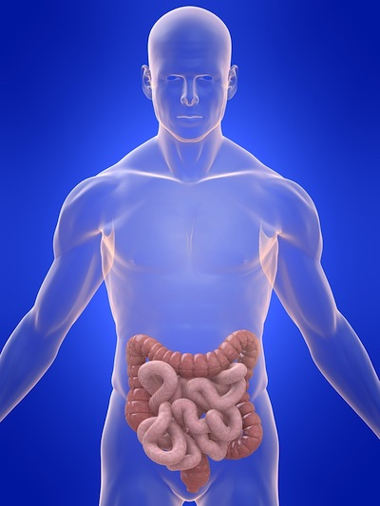
The digestion or absorption of a single nutrient component may be impaired, as in lactose intolerance due to lactase deficiency.
However, when a diffuse disorder, such as Celiac disease or Crohn's disease, affects the intestine, the absorption of almost all nutrients is impaired.

Slide 8
Maldigestion Vs Malabsorption
Maldigestion
Malabsorption
Inadequate mixing of food with enzymes (e.g. post-gastrectomy)
Pancreatic exocrine insufficiency
1ry diseases of the pancreas
(e.g. cystic fibrosis, pancreatitis, cancer)
Bile salt deficiency:
- Terminal ileal disease
(impaired recycling),
- Bacterial overgrowth
(deconjugation of bile salts),
- Liver disease (cholestatic)
Specific enzyme deficiencies
(e.g. lactase)
    Inadequate absorptive surface
 - infections/infestations
(e.g. Whipple’s disease, Giardia)
 - immunologic or allergic injury
(e.g. celiac disease)
 - infiltration (e.g. lymphoma, amyloidosis)
- fibrosis (e.g. systemic sclerosis, radiation enteritis)
- bowel resection
- extensive Crohn’s disease
    Drug-induced:
    cholestyramine, ETOH, neomycine
    Endocrine:
- DM (complex pathogenesis)

Slide 9
Pathophysiology
Malabsorption results from disturbance in at least one of the 3 phases of nutrients digestion & absorption:
Luminal phase (Defective digestion)
Mucosal phase (Defective absorption)
Post Absorptive phase (Deranged lymphatics)

Slide 10
Where to start from?!!
The best way to classify the numerous causes of
malabsorption is to consider the 3 phases of
digestion and absorption.

Slide 11
Maldigestion
Impaired Luminal phase
❑
Defect in the hydrolysis of nutrients

Slide 12
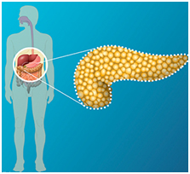
Luminal Phase
“digestion”
  Pancreatic insufficiency
  “The most common cause”
  •Ch Pancreatitis •CF •Post Sx (Gastric/Pancreatic)
  ❑
  lipase & proteases
  ❑
  lipid & protein malabsorption
  Inactivation of pancreatic enzymes by gastric hypersecretion (ZE) →↓pH

Slide 13
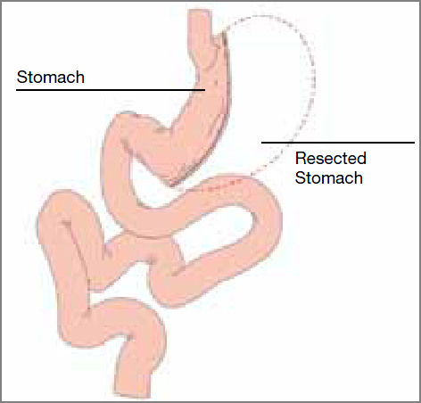
Luminal Phase
“digestion”
    Post-Gastrectomy Inadequate mixing of nutrients, bile, and pancreatic enzymes, also causes impaired hydrolysis.

Slide 14
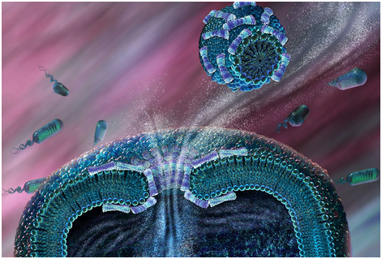
Luminal Phase
“digestion”
Impaired Micelle formation
Impaired micelle formation causes
a problem in fat solubilization and subsequent fat malabsorption.
•Decreased bile salt synthesis/secretion:
Liver diseases, Biliary obstruction, Drugs (cholestyramine)
•Impaired enterohepatic bile circulation
Ileal resection/disease
•Bile salt deconjugation
(SIBO)

Slide 15
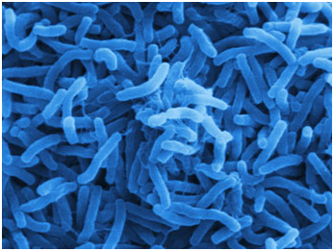
Luminal Phase
“digestion”
Bile Salts Deconjugation:
Stasis of intestinal content caused by a motor abnormality (eg, scleroderma, diabetic neuropathy, intestinal obstruction),
Anatomic abnormality (eg, small bowel stricture, ischemia, blind loops),
Small bowel contamination from enterocolonic fistulas can cause bacterial overgrowth

Slide 16
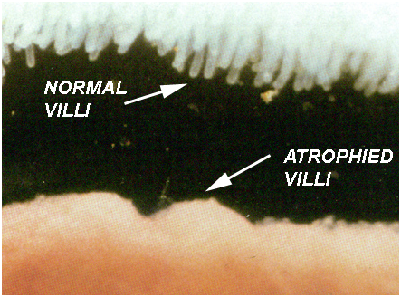
Mucosal phase
    Mucosal damage: (Villous Atrophy)

Slide 17
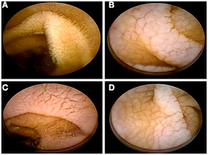
Mucosal phase
    Mucosal damage: (Villous Atrophy)

Slide 18
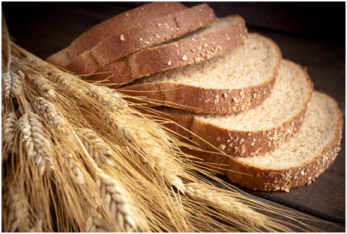
  Celiac

Slide 19
  Celiac

Slide 20
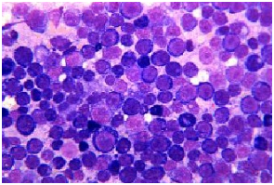

Slide 21
  Intestinal
  Lymphoma

Slide 22
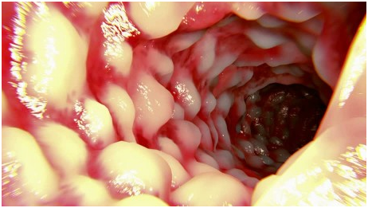

Slide 23
  Crohn’s

Slide 24
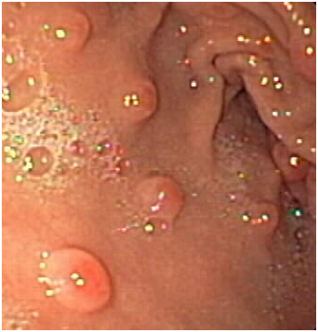

Slide 25
  Eosinophilic enteritis

Slide 27
  Common Variable ImmunoDeficiency

Slide 28
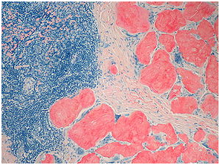

Slide 29
  Amyloidosis

Slide 30
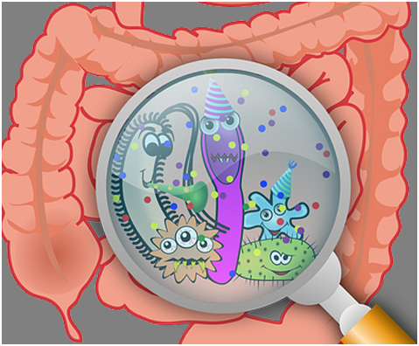

Slide 31
  SIBO

Slide 32
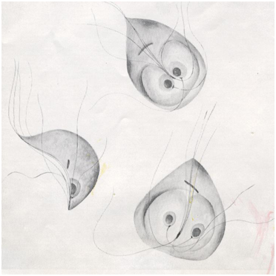

Slide 33
  Giardiasis

Slide 34
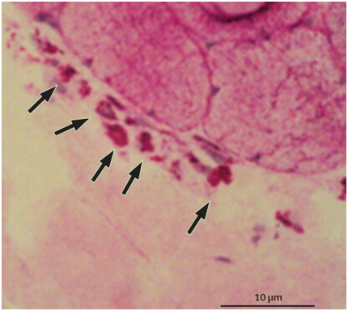

Slide 35
  Whipple’s

Slide 36


Slide 37
  Tropical Sprue

Slide 38
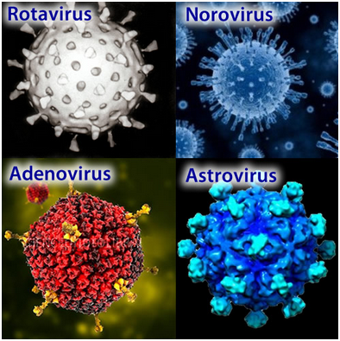

Slide 39
  Viral GE

Slide 40
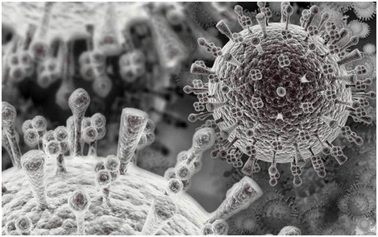

Slide 41
  AIDS Enteropathy

Slide 42
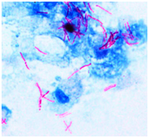

Slide 43
  Intestinal TB

Slide 44
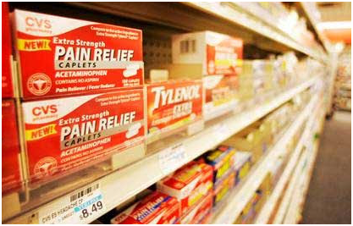
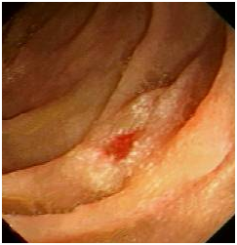

Slide 45
  NSAIDs

Slide 46

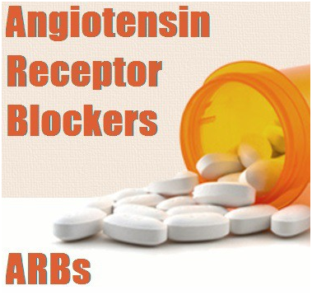

Slide 47
  Olmesartan

Slide 48
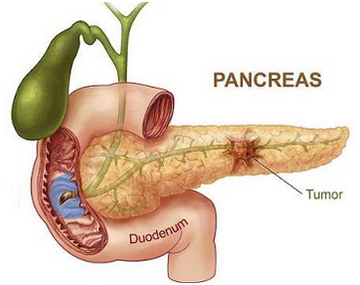
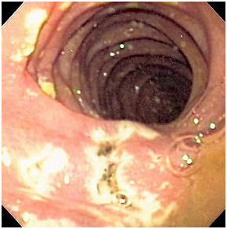

Slide 49
  Zollinger Ellison syndrome

Slide 50
Mucosal phase
    Mucosal damage: (Villous Atrophy)
    Celiac disease, Intestinal Lymphoma
    Crohn’s disease (CD), Eosinophilic enteritis, Auto-Immune Enteropathy (AIE), Common variable immunodeficiency, Amyloidosis
    SIBO, Giardiasis, Whipple’s disease, Tropical sprue, Viral GE, AIDS enteropathy, Intestinal TB
    NSAIDs, Olmesartan
    ZE synd (Gastrinoma)
    ❑
↓surface area, ↓absorption/secretion

Slide 51
Mucosal phase
    ↓Brush border Enzymes:
    •Disaccharidase deficiency (Lactase,Trehalase, Sucrose) can lead to disaccharide malabsorption.
    Lactase deficiency, either Congenital or Acquired, is the most common form of disaccharidase deficiency.
    Acquired lactase deficiency can be due to acute gastroenteritis (rotavirus or giardia infection), chronic alcoholism, celiac sprue, radiation enteritis, regional enteritis, or AIDS enteropathy.

Slide 52
Mucosal phase
    Immunoglobulin A (IgA) deficiency (most common immunodeficiency) is due to decreased or absent serum and intestinal IgA, which clinically appears similar to celiac disease and is unresponsive to a gluten-free diet.
    Acrodermatitis enteropathica is an autosomal recessive disease with selective inability to absorb zinc, leading to villous atrophy and acral dermatitis.

Slide 53
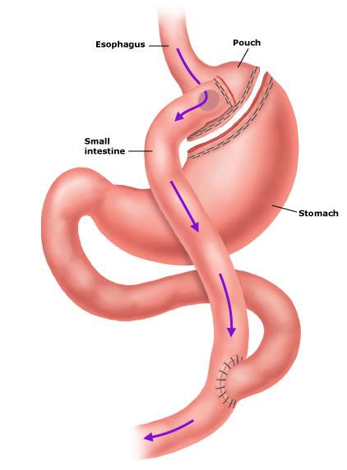
    Acquired disorders are far more common and are caused by the following:
    (1) Decreased absorptive surface area,
    (2) Damaged absorbing surface,;
    (3) Infiltrating disease of the intestinal wall,
    (4) Infections,

Slide 54
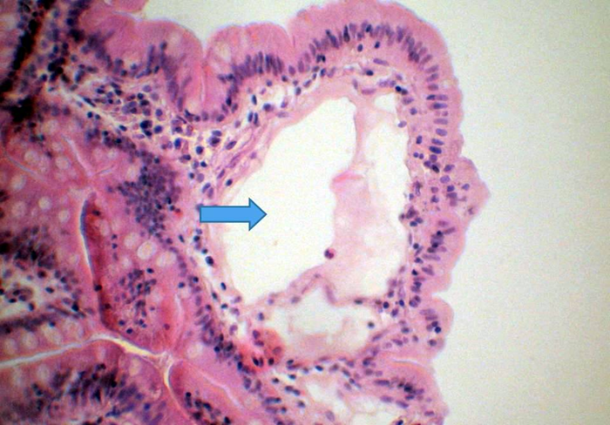
Post Absorptive Phase
“Lymphatics”
Obstruction of the lymphatic system:
-Congenital
(Intestinal Lymphangiectasia)
-Acquired
Whipple disease, neoplasm (lymphoma), TB, CHF, Constrictive Pericarditis, Rad Tx, Retroperitoneal Fibrosis
❑
impairs the absorption of chylomicrons & lipoproteins

Slide 55
Pathophysiology of Clinical Manifestations of Malabsorption
Symptom or Sign | Mechanism
Weight loss/malnutrition | Anorexia, malabsorption of nutrients
Diarrhea | Impaired absorption or secretion of water and electrolytes; colonic fluid secretion secondary to unabsorbed dihydroxy bile acids and fatty acids
Flatus | Bacterial fermentation of unabsorbed carbohydrate
Glossitis, cheilosis, stomatitis | Deficiency of iron, vitamin B12, folate, and vitamin A
Abdominal pain | Bowel distention or inflammation, pancreatitis
Bone pain | Calcium, vitamin D malabsorption, protein deficiency, osteoporosis
Tetany, paresthesia | Calcium and magnesium malabsorption
Weakness | Anemia, electrolyte depletion (particularly K⁺)
Azotemia, hypotension | Fluid and electrolyte depletion
Amenorrhea, decreased libido | Protein depletion, decreased calories, secondary hypopituitarism
Anemia | Impaired absorption of iron, folate, vitamin B12
Bleeding | Vitamin K malabsorption, hypoprothrombinemia
Night blindness/xerophthalmia | Vitamin A malabsorption
Peripheral neuropathy | Vitamin B12 and thiamine deficiency
Dermatitis | Deficiency of vitamin A, zinc, and essential fatty acid

Slide 56

Diarrhea
Diarrhea is the most common symptomatic complaint
Diarrhea is defined as an increase in stool mass, frequency, or fluidity, typically greater than 200 g per day.

Slide 57
Diarrhea can be classified according to 4 categories:
• Secretory diarrhea
is characterized by isotonic stool and persists during fasting.
• Osmotic diarrhea
due to the excessive osmotic forces exerted by unabsorbed luminal solutes. The diarrhea is over 100 mOsm more concentrated than plasma and abates with fasting.
• Malabsorptive diarrhea
follows generalized failures of nutrient absorption and is associated with steatorrhea and is relieved by fasting.
• Exudative diarrhea
2ry inflammatory disease & characterized by purulent, bloody stools that continue during fasting.

Slide 58

Steatorrhea
  Steatorrhea is the result of fat malabsorption.
  The hallmark of steatorrhea is the passage of pale, bulky, and malodorous stools.
  Such stools often float on top of the toilet water and are difficult to flush. Also, patients find floating oil droplets in the toilet following defecation.

Slide 59

Weight loss & fatigue
  Weight loss is common and may be pronounced; however, patients may compensate by increasing their caloric consumption, masking weight loss from malabsorption.
  The chance of weight loss increases in diffuse diseases involving the intestine, such as celiac disease and Whipple disease.

Slide 60

Flatulence & abdominal distention
  Bacterial fermentation of unabsorbed food substances
  releases gaseous products, such as hydrogen and methane, causing flatulence.
  Flatulence often causes uncomfortable abdominal distention and cramps.

Slide 61

Edema
  Hypoalbuminemia from chronic protein malabsorption or from loss of protein into the intestinal lumen causes peripheral edema.
  Extensive obstruction of the lymphatic system, as seen in intestinal lymphangiectasia, can cause protein loss.
  With severe protein depletion, ascites may develop.

Slide 62
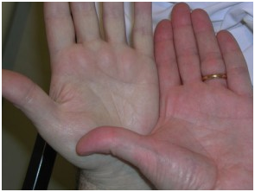
Anemia
  Depending on the cause, anemia resulting from malabsorption can be either microcytic (iron deficiency) or macrocytic (vitamin B-12 deficiency).
  Iron deficiency anemia often is a manifestation of celiac disease.
  Ileal involvement in Crohn disease or ileal resection can cause megaloblastic anemia due to vitamin B-12 deficiency.

Slide 63
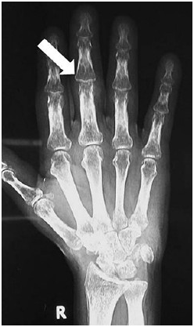
Metabolic defects of bones
  Vitamin D deficiency can cause bone disorders, such as osteopenia or osteomalacia.
  Bone pain and pathologic fractures may be observed.
  Malabsorption of calcium can lead to secondary hyperparathyroidism.

Slide 64
Carbohydrates Malabsorption
Osmotic diarrhea
+ Flatus (Odorless) / Bloating
(≈No Wt changes)
P-P: ↑lumen Osm + bacterial fermentation

Slide 65
Carbohydrate Malapsorbtion
Etiology
• Lactase deficiency:
(Most common Æ of carbohydrate malabsorption)
• S/P intestinal resection
• Mucosal disease
• Post-infectious GE syndrome (Viral/Bacterial)
• Changing diet from Eastern → Western Diet

Slide 66
Carbohydrates Malabsorption
Workup
•Stool Osmotic gap
>100 (Osmotic Diarrhea)

Slide 67
Carbohydrates Malabsorption
Workup
•Stool Osmolality:
Normally shall equal that of plasma Osmolality
Shall be measured; if not → will considered ≈290
Stool gap: is normally a minimal difference 2ry to some ⊖ charged particles ≈ 50 – 100
So …
Stool gap =
(Measured) (or ≈290) - (Calculated) [stool (Na⁺ + K⁺) x2]

Slide 68
Carbohydrates Malabsorption
Workup
•Stool Osmotic gap
>100 (Osmotic Diarrhea)
•Stool pH
<6 (Fermentation)
•Lactase DNA Assay
•Breath testing w/H₂
(↑fermentation of unabsorbed carbohydrate by bacteria) = Malabsorption

Slide 69
Fat Malabsorption
Greasy foul smell Diarrhea
↓Wt
fat-soluble Vit def (ADEK)

Slide 70
Fat Malabsorption
Workup
Pancreatic
Vs
Small Bowel
↓level
(≤20mg/dL)
(Small Bowel Disease)
(D-Xylose test)
25g D-xylose po →
serum level @1hr &/or urine collection level x5hrs
(3) Alternatively:
empiric trial of pancreatic enzymes w/Quantify of fecal fat before & after
↑level
(≈45mg/dL)
(Pancreatic Insufficiency)
•SBBx
•SB Cx
•SB Imaging
(1) Imaging:
•X-Ray (Calcifications) •CT •MRCP •EUS
(2) pancreatic function:
•Secretin (measure HCO₃)
•CCK (measure lipase/trypsin)

Slide 71
Protein Malabsorption
Diarrhea
Dependent edema
Ascites

Slide 72
Protein Malabsorption
Workup
• Serum:
↓ Protein
↓ Albumin
↓ IgG (except IgE (short half-life/rapid Re-Synth))
↓ WBC/Lymph (w/Lymphangiectasia)
• Stool:
↑ α 1-Antitrypsin “A1A” (↑ α 1-Antitrypsin Clearance)
 A1A: not digested, absorbed or secreted by intestine

Slide 73
Treatment
Treating the cause

Slide 74
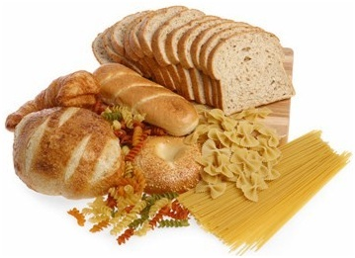
Celiac Disease

Slide 75
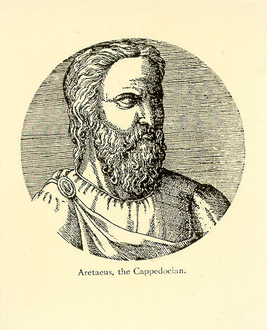
Aretaeus from Cappadochia (now Turkey) in the 2nd century AD described a chronic malabsorptive condition
He named this disorder "koiliakos” which is Greek for "suffering in the bowels.”

Slide 76
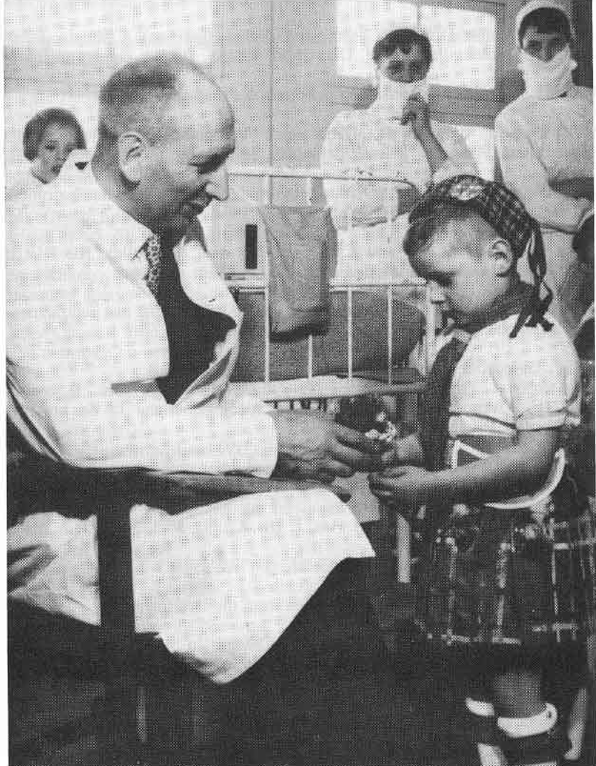
During World War II, celiac children improved during the food shortages when bread was unavailable.
After the war, symptoms reoccurred when bread and cereals were reintroduced.
Dutch pediatrician Willem K Dicke recognized and confirmed this association between cereal grains and malabsorption.

Slide 77
Origin of the Term Celiac
Pain in the belly
Greek
Koiliakos
=
Issues of the Hollow part (Abdomen)
❑
Latin
Coeliacus “with K”
❑
Modern Latin
Coeliacus “with C”
❑
English UK
Coeliac
❑
English USA
Celiac
Celiac Disease

Slide 78
Also known as
Celiac sprue
Non - tropical sprue
Gluten intolerance
Gluten-sensitive enteropathy

Slide 79
Pathophysiology
Celiac disease
is …
an immune disorder,
that is …
triggered by an environmental agent
(gliadin component of gluten),
in …
genetically predisposed individuals.

Slide 80
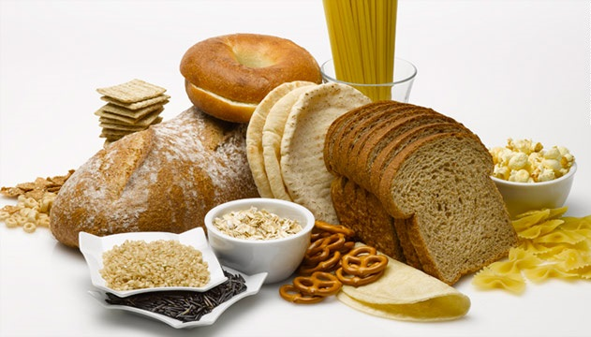
Grain protein exists in four forms:
Prolamins
Glutenins
Globulins
Minor albumins
Glutens

Slide 81
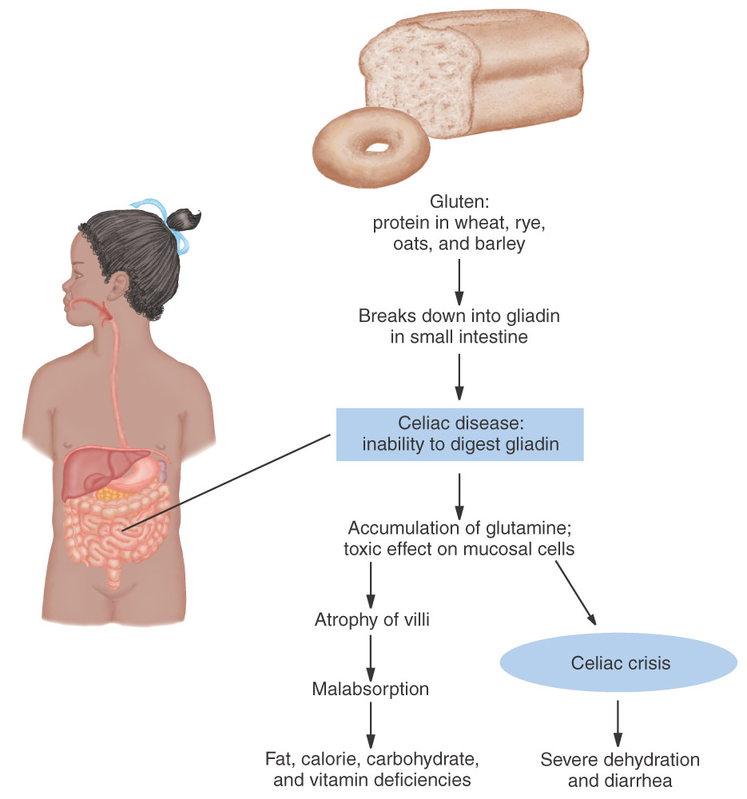

Slide 82

Pathophysiology
Similarities between gliadin proteins and certain enteral pathogens may result in the immunologic response to antigens in gluten.
Gliadin-sensitive T cells in genetically predisposed individuals recognize gluten-derived peptide epitopes and develop an inflammatory response which produces mucosal damage

Slide 83
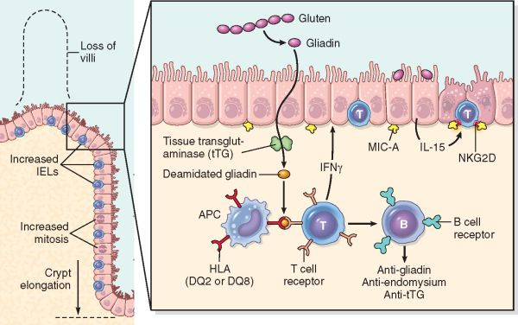
Pathogenesis of Celiac Disease

Slide 84
Genetic factors play an important role- there is significantly increased risk of celiac among family members
A close association with the HLA-DQ2 and/or DQ8 gene locus has been recognized
HLA-DQ2 is found in 98 percent of celiac patients from Northern Europe.
However, ~25% of “normal” individuals in this population will also demonstrate HLA-DQ2

Slide 85

Risk Factors for Celiac Disease
People suffering from other immune diseases and certain genetic
disorders are more likely to have celiac disease. Some disorders
associated with celiac include:
Rheumatoid arthritis
Type 1 diabetes
Thyroid disease
Autoimmune liver disease
Addison’s disease
Sjogren’s disease
Lupus
Down syndrome
Turner syndrome
Lactose intolerance
Intestinal lymphoma

Slide 86

Malignant diseases are more frequent in patients with long-term untreated classical CD.
Small-bowel adenocarcinoma, esophageal and oropharyngeal squamous-cell carcinoma, and non-Hodgkin’s lymphoma occur more often in CD patients than in healthy control individuals.

Slide 87

Diagnosis of Celiac: Serologic Testing
  Some of the serologic tests used to diagnose celiac:
  IgA and IgG antigliadin antibodies
  IgA endomysial antibodies
  IgA and IgG tissue transglutaminase antibodies
  Anti reticulin antibodies (no longer used)

Slide 88
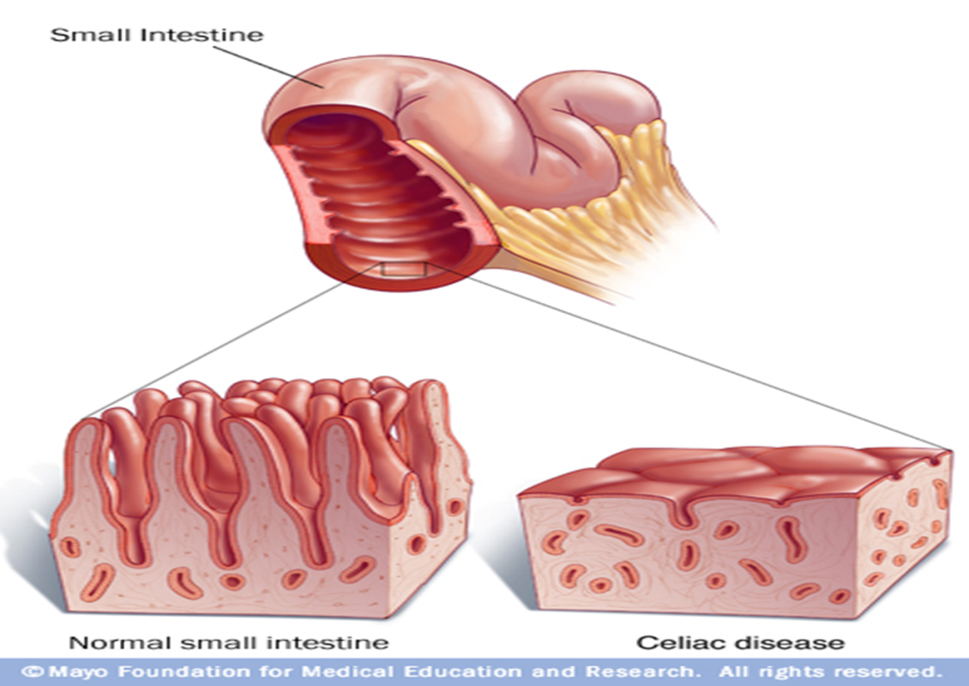
Histopathology:
The only definitive test is small intestinal biopsy taken endoscopically (the proximal duodenum is maximally affected).
It shows subtotal or total villous atrophy with Intraepithelial Lymphocytic infiltration.
Genetic Testing:
HLA‐DQ2 and HLA‐DQ8 markers in >90% CD patients

Slide 89
Normal
Pathology

Slide 90
Symptoms & Signs
Intestinal (Classic)
Ch Diarrhea (can be steatorrhea/osmotic/ or watery), edema, Flatulence, distention, ↓wt, ↓appetite, Abd pain, N&V, Constipation, Aphthous stomatitis, Angular cheilosis
Extra Intestinal
-Abnormal LFTs
-Dermatitis Herpetiformis
-Hypo-Splenism (Splenic)
-Osteopenia/OP/Enamel defects, Arthropathy (Non-erosive, polyarticular, symmetrical, large joint) (Non-Migratory)
-Peripheral neuropathy (Symmetrical & distal), Ataxia (Cerebellar), Epilepsy (Bilat parieto-occipital calcifications), Depression/anxiety
-Infertility (M & F)

Slide 91
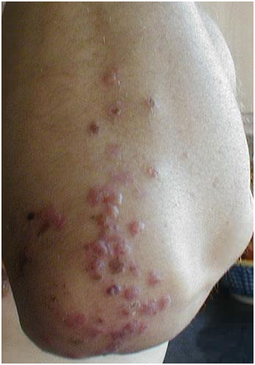

Slide 92

Diagnosis: Gluten Rechallenge
Gluten Rechallenge- improvement in symptoms and histology with gluten avoidance with a documented return of these features upon gluten reintroduction.
May be performed by consuming 10 g of gluten per day (an amount contained in four slices of regular bread) for four to six weeks.
One hazard of rechallenge is development of fulminant diarrhea, with dehydration, acidosis, and other metabolic disturbances ("gliadin shock").

Slide 93
Diagnosis of Celiac Disease
Probability < 2 to 5 percent
Obtain IgA endomysial or tTG Ab
and serum IgA level
Positive
Negative
Small bowel biopsy
Diagnosis excluded

Slide 94
{
Family history
Unexplained iron deficiency anemia
Steatorrhea or other GI symptoms
Failure to thrive
Type 1 diabetes mellitus or other associated disorders
Other symptoms
Probability > 2 to 5 percent
IgA endomysial or tTG Ab + IgA
AND Small bowel biopsy
Histology -
Serology +
Both positive
Histology +
Serology -
Both negative
Rule out other causes of villous atrophy
+
-
+
Review and/or repeat biopsy
TREAT
Diagnosis excluded
-

