Slide 1
Major components of cells
Nucleic acids
Carbohydrates
Proteins
Lipids (50% of mass of plasma membranes, 30% of mitochondrial membranes)
Membrane proteins

Slide 2
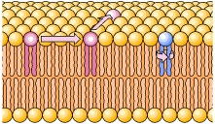
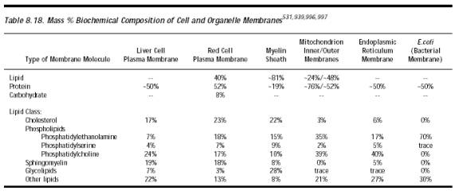
Composition and properties of membranes
Cholesterol is an essential component of animal plasma membrane.
It is not resent in bacteria and plant cells, but latter cells contain sterols.

Slide 3
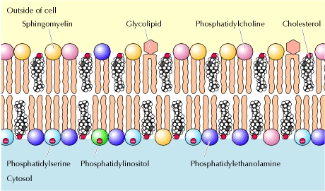
Composition and properties of plasma membranes
The phospholipids are asymmetrically distributed between the two halves of the membrane bilayer.
  The outer leaflet: ➔choline, sphingomyelin
  The inner leaflet:➔ethanolamine, ➔serine, ➔inositol (minor)
  ➔inositol has a role in cell signaling.
  The head groups of both ➔serine and ➔inositol are negatively charged making the cytosolic face of the plasma membrane having a net negative charge.

Slide 4
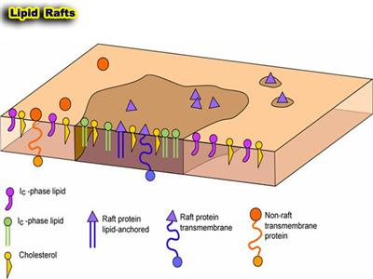
Lipid rafts
These are clusters of cholesterol and the sphingolipids (sphingomyelin and glycolipids).
Sphingolipids provide an ordered lipid environment.
Rafts are enriched in glycosylphosphatidylinositol (GPI)-anchored proteins, as well as proteins involved in signal transduction and intracellular trafficking.

Slide 5
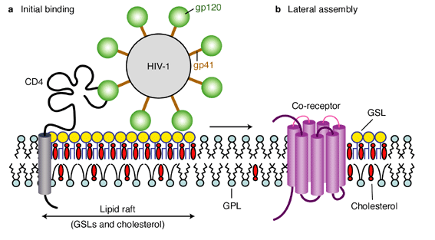
Lipid rafts and diseases
HIV virus
  Budding may occur from lipid rafts
Influenza virus
  Raft-associated glycoproteins in envelope
Prion disorder
  Normal prion protein (PrPc) is converted to abnormal proteins (PrPsc) in lipid rafts .

Slide 6
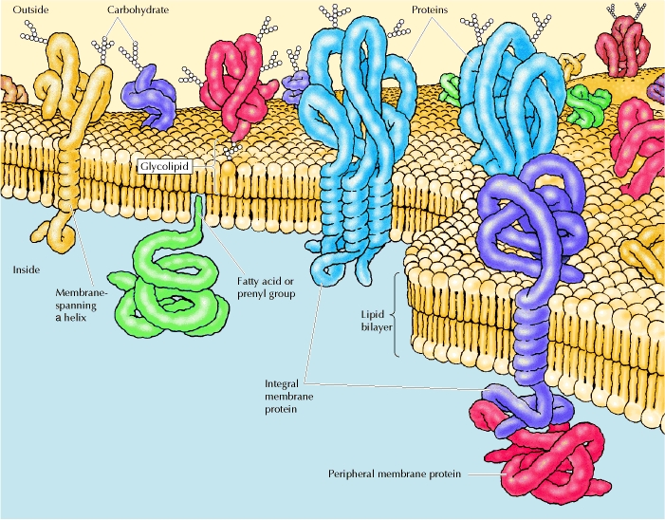
Membrane proteins

Slide 7
Peripheral membrane proteins
They are proteins that dissociate from the membrane following treatments with polar reagents (solutions of extreme pH or high salt concentration) that do not disrupt the phospholipid bilayer.
Once dissociated, they are soluble in aqueous buffers.
They are indirectly associated with membranes through protein-protein interactions, mainly ionic bonds.

Slide 8
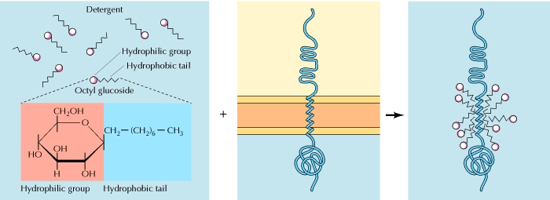
Integral membrane proteins
Portions of these integral membrane proteins are inserted into the lipid bilayer.
They are dissociated by reagents of small amphipathic molecules.
  The hydrophobic portions of detergents disrupt hydrophobic interactions.
  The hydrophilic part makes the detergent-protein complexes soluble in aqueous solutions.

Slide 9
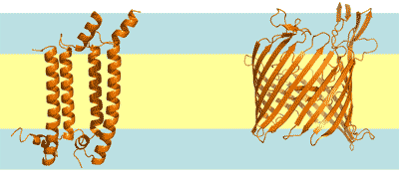
α-helices vs. β-sheets
The membrane-spanning portions of transmembrane proteins are usually α-helices of 20-25 hydrophobic amino acids.
They are usually glycosylated with the oligosaccharides exposed on the surface of the cell.
Beta-barrel (example: porins)
(bacteria, chloroplast, mitochondria)

Slide 10
Lipid-anchored membrane proteins
Four types have been found:
  Myristoylation
    Myristate attached to glycine at inner face of membrane
  Palmitoylation
    Palmitate is added to sulfur atoms of the side chains of internal cysteine residues.
  Prenylation
    It refers to linking of "isoprene"-based groups
    Attached to cysteine near C-terminus of proteins
  Glycolipid (glycosyl phosphatidylinositol) anchors
    The carbohydrate bridges the protein with the fatty acid chains of the phospholipid (usually ethanolamine)

Slide 11
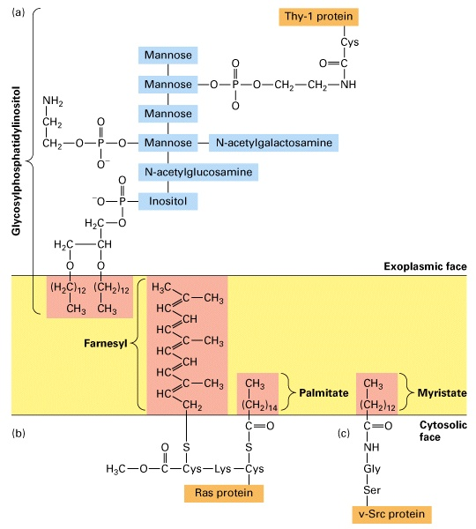
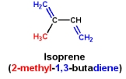

Slide 12
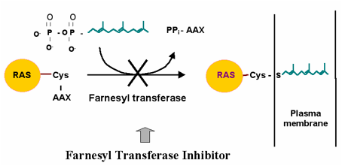
Example: farnesylation of Ras
Ras is an oncogene that farnesylation is important for its function and oncogenic activity.
Farnesyltransferase inhibitors (FITs) had impressive anti-tumor activity in preclinical cell culture and mouse models, but they failed in human clinical trials because:
  FTIs did not block prenylation of other Ras isoforms (N-Ras and K-Ras) and their tumorigenic activity.
  There are other farnesylated proteins with important roles in the cell including growth regulation.
FTIs are considered for the treatment of other diseases such as Hutchinson-Gilford Progeria Syndrome (AKA progeria), which is caused by mutated gene encoding lamin A, a farnesylated protein.

Slide 13
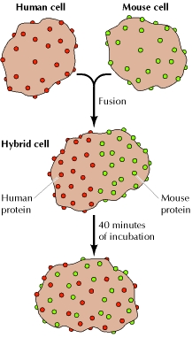
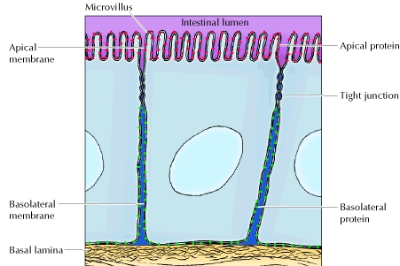
Protein mobility
Both proteins and lipids are able to diffuse laterally through the membrane.
The mobility of membrane proteins is restricted by
  Their association with the cytoskeleton
  Specific membrane domains such as tight junctions, which maintain the specific distribution of apical and basolateral proteins,
  Lipid composition restrict protein mobility (e.g. lipid rafts).

Slide 14
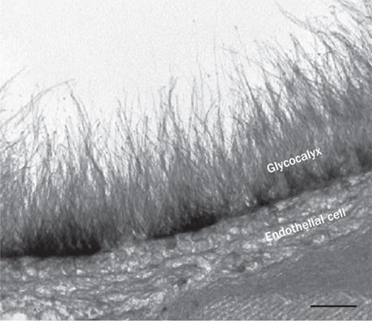
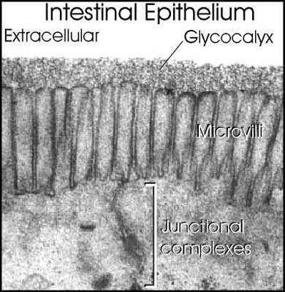
Glycocalyx
The surface of the cell is covered by a carbohydrate coat, known as the glycocalyx, formed by the oligosaccharides of glycolipids and transmembrane glycoproteins.
Functions:
  Cell-cell interactions (e.g, leukocytes)
  Protection of cell surface from ionic and mechanical stress
  Formation of a barrier for microorganisms

Slide 15
Techniques

Slide 16
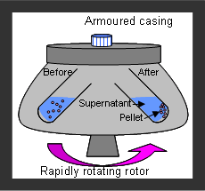
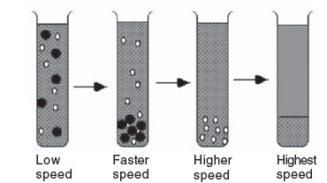
Centrifugation (ultra-)

Slide 17
Sedimentation
A particle sediments by centrifugation
Sedimentation depends on its mass and shape
The sedimentation of a particle is constant and can be defined as a sedimentation coefficient
  Sedimentation coefficient = 10⁻¹³ S Svedberg
The sedimentation of a particle depends on its
  Mass (direct correlation)
  Density (direct correlation)
  Shape (inverse correlation)
  The density of the solution (inverse correlation)

Slide 18
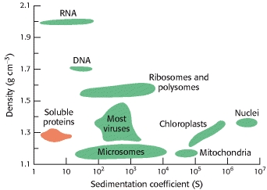

Slide 19
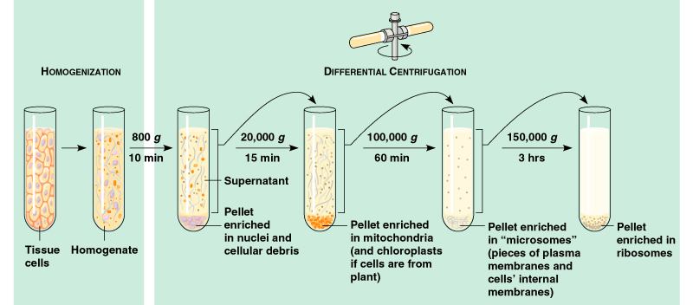
Example: cell fractionation

Slide 20
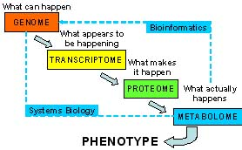
The science of -omics

Slide 21
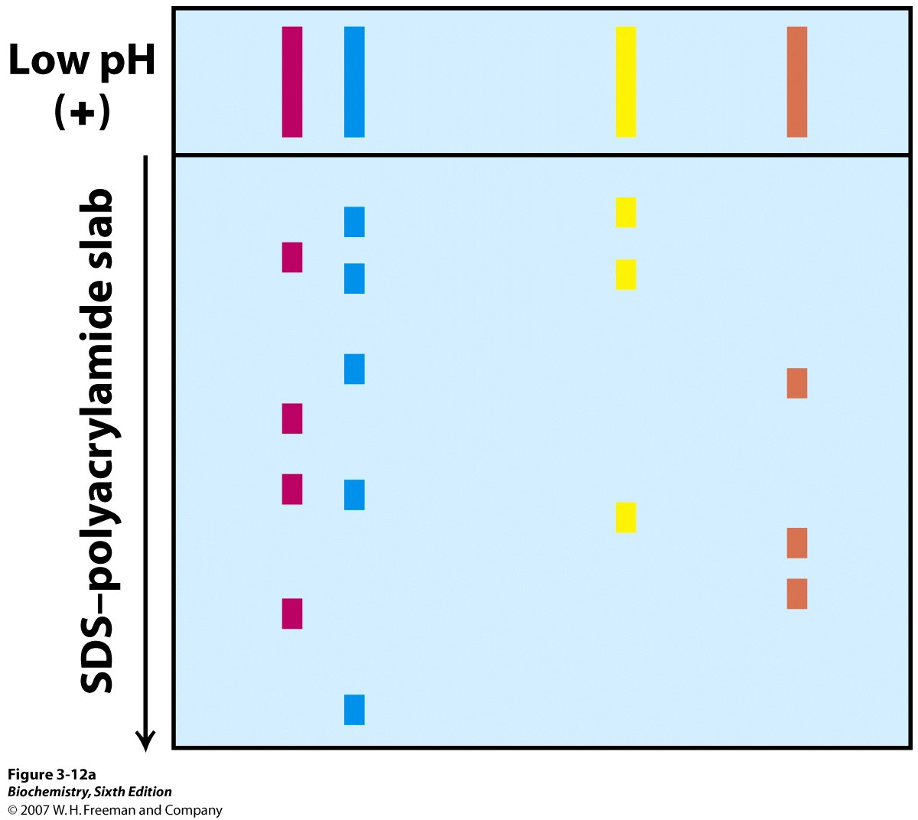
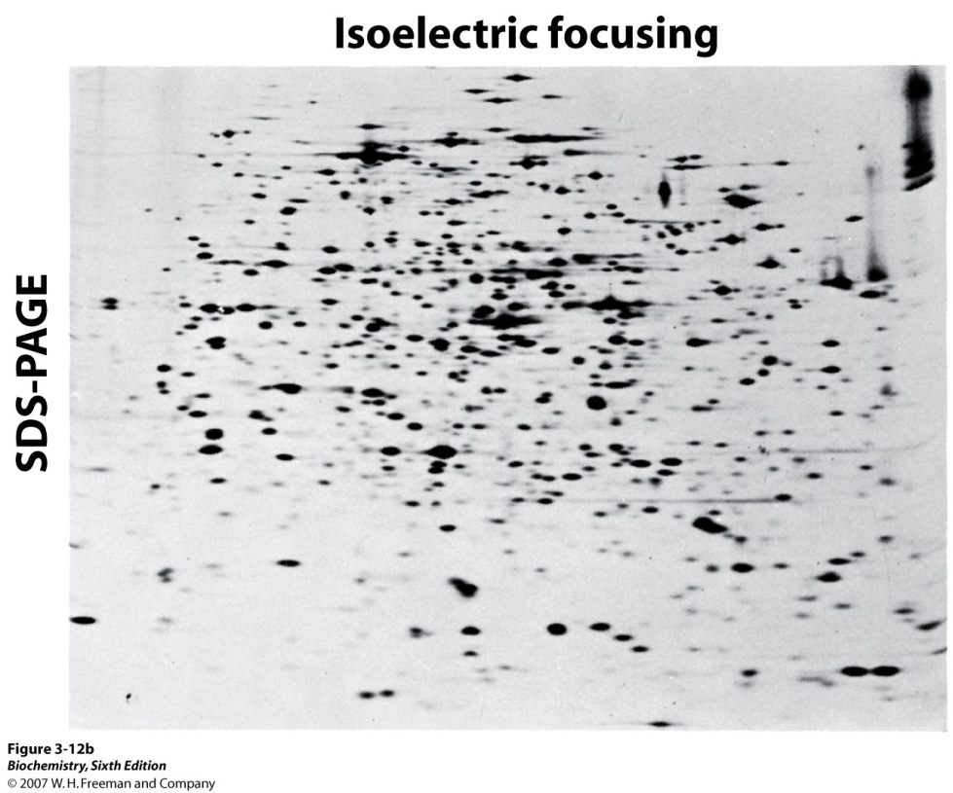
Two-dimensional gele electrophoresis (2D-PAGE)
In 2D-PAGE, proteins are separated by first, isoelectric focusing, then through an SDS-PAGE
Thus, it allows protein separation based on both charge and size

Slide 22
pH
3
10
+
-
High
MW
Low
MW

Slide 23
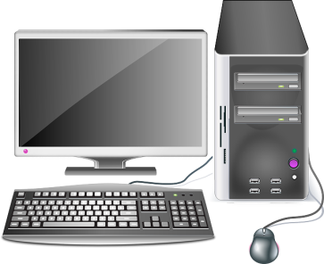
Basics of tandem mass spectrometry
Ion
source
Mass
analyzer
Mass
analyzer
CID
HPLC
Detector
Detector
Protein
identification

Slide 24
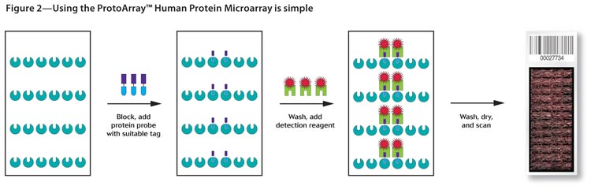
Types of protein microarrays
Expression microarrays
Y
Y
Y
Y
Y
Y
Y
Y
Direct labeling
Forward-phase microarray
Indirect labeling
Forward-phase microarray
Reverse-phase microarray
Functional microarrays
ADP
ATP
E
-P
-P
Interaction microarray
Enzymatic microarray

Slide 25
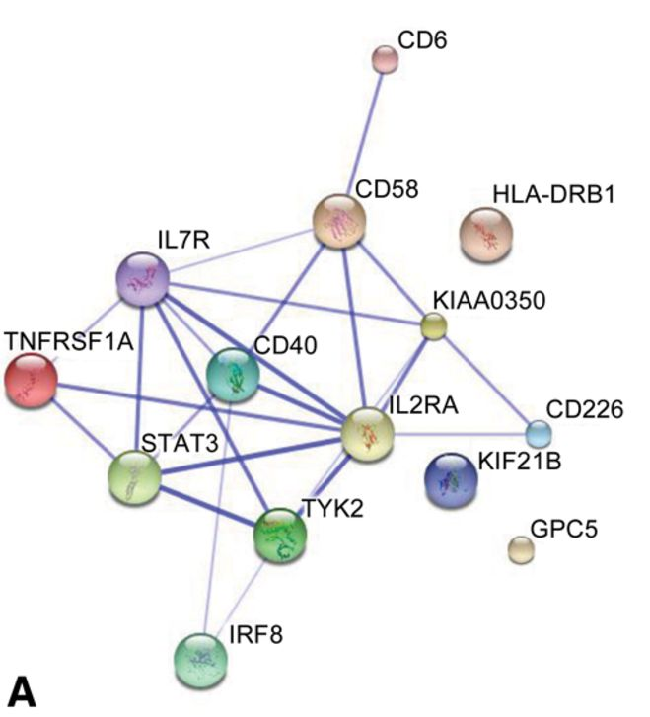
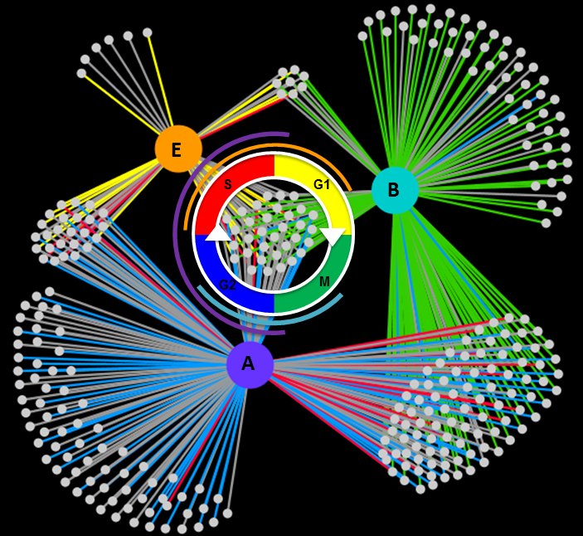
Interactome

