Slide 1
Calcium Metabolism
Primary Hyperparathyroidism

Slide 2
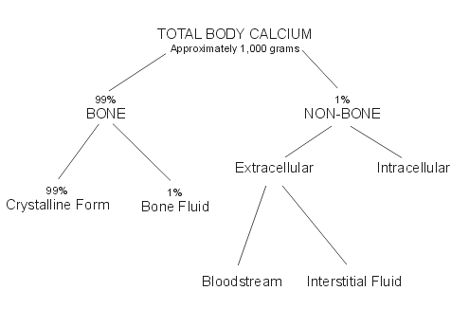

Slide 3
Calcium metabolism
99% of total body calcium in the bone
1% in ICF ,ECF , cell membranes *
Calcium content
400mg/kg in infant
950mg/kg in adult
* 50% ionized
40% bound to albumin.
10% citrate, phosphate

Slide 4
NORMAL PTH SECRETION/ACTIONS
PTH 1-84
secreted within seconds after hypocalcemia
Intact PTH half life of 2-4 min (renal and hepatic clearence)

Slide 5
Calcitriol: inhibits PTH synthesis
Mg: binds to Calcium Sensing Receptor
low Mg causes:
- PTH resistance
- reduced PTH secretion
Low Ca, high PO4 stimulate PTH secretion

Slide 6
ACTIONS OF PTH
A. Skeletal actions of PTH :
• release of calcium by activation of bone resorption

Slide 7
B. Renal actions of PTH :
1. Ca Reabsorption:
on distal tubule to stimulate ca reabsorption .

Slide 8
2. inhibit tubular reabsorption of phosphate
3. Synthesis of calcitriol :
1-alpha hydroxylase in proximal tubules

Slide 9
Primary hyperparathyroidism
Mostly asymptomatic
Mild hypercalcemia
Mostly > 45 years .
F:M (2:1)

Slide 10
Pathogenesis and etiology
The routine measurement led to a marked rise in the incidence

Slide 11
ETIOLOGY
1. Radiation exposure: to the head and neck, 20 - 40 yrs earlier

Slide 12
Etiology
2. Genetic or chromosomal defects :
a. Cyclin D1/PRAD1 gene: parathyroid adenoma 1, proto-oncogene
20-40 % of sporadic parathyroid adenomas

Slide 13
b. MEN1 (tumor suppressor gene): sporadic nonfamilial parathyroid adenomas
16 % with sporadic tumors.

Slide 14
C. HRPT2 gene : inactivating mutations in parathyroid ca
D. RET gene : rarley found in sporadic primary hyperparathyroidism

Slide 15
PATHOLOGY IN PRIMARY HYPERPARATHYROIDISM
1. Adenoma:
Single adenoma: 89 %
double adenomas: 5 %
rarely in the thymus.

Slide 16
2. Glandular hyperplasia: 6 % of cases
3. Carcinoma: 1-2% of cases
at least one:
- local invasion of contiguous structures
- lymph node
- distant metastases

Slide 17
Clinical manifestations – PrimaryHyperparathyroidism
asymptomatic hypercalcemia
Biochemical screening detects 80 % of pts

Slide 18
ASYMPTOMATIC PRIMARY HYPERPARATHYROIDISM
mild and sometimes only intermittent hypercalcemia .
The mean s ca is < 1.0 mg/dL above nl
nonspecific symptoms: fatigue, weakness, anorexia, mild depression

Slide 19
CLASSICAL MANIFESTATIONS
Anorexia, nausea, constipation,
Polydipsia, and polyuria.
Osteitis fibrosa cystica: is rare (<5 % of pts)
Nephrolithiasis: most common complication, 15-20 % of newly diagnosed pts .

Slide 20
Osteitis fibrosa cystica
bone pain
X-ray

Slide 21
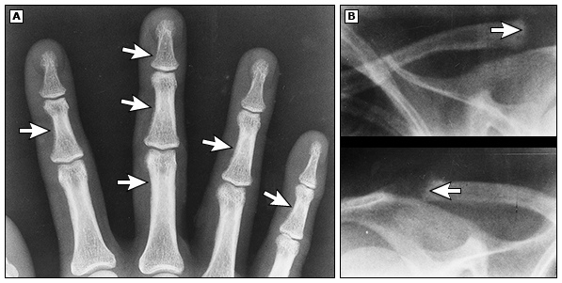
Subperiosteal bone resorption Tapering of distal clavicles

Slide 22
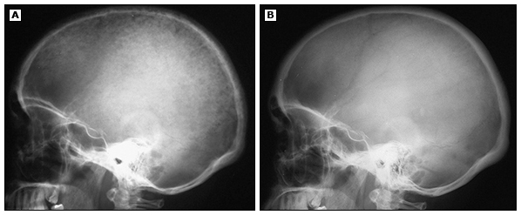
Before after surgery

Slide 23
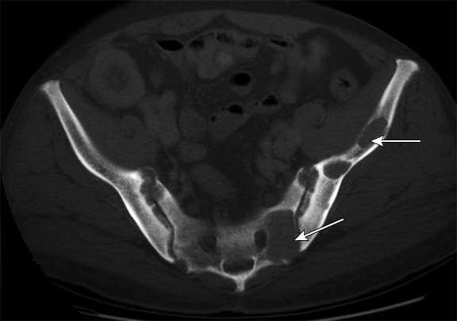
Brown tumors of pelvis ( ? PTH ca)

Slide 24
Neuromuscular/Psych symptoms
Neuromuscular: weakness and fatigue. Myopath is rare
Neuropsychiatric: depressed mood, psychosis,

Slide 25
Bone mineral density
Decreased BMD : cortical sites (forearm and hip) > cancellous sites (spine)

Slide 26
Cardiovascular
• HTN is common
• Mean carotid intima-media thickness was significantly higher compared with controls

Slide 27
Mortality
increased mortality: primarily due to CVS disease

Slide 28
DIAGNOSIS
Serum calcium : confirmed
PTH

Slide 29
Measurement of PTH
-80-90 %: high PTH
-10-20 %: minimally elevated or high normal

Slide 30
DIFFERENTIAL DIAGNOSIS
1. Malignancy: often evident clinically
Intact PTH: very low in hypercalcemia of malignancy
mediated by PTHrP

Slide 31
2. FHH: an inactivating mutation in the Ca-SR in the parathyroid glands and the kidneys
- A f/h of hypercalcemia (young children)
- absence of symptoms and signs of hypercalcemia

Slide 32
15- 20 % of pts with FHH: mildly elevated PTH
FHH vs primary hyperparathyroidism:
low urine ca excretion and Ca/Cr clearance ratio

Slide 33
3. Drugs :thiazide diuretics and lithium.
reduce u ca excretion and can cause mild hypercalcemia (up to 11.5 mg/dL )
thiazide should be stopped and calcium and PTH assessed 2-3 months later

Slide 34
Lithium
in bipolar disorder
s/e: nephrogenic DI, hypothyroidism and hyperparathyroidism.
PTH less inhibited by calcium
It decreases renal Ca excretion (independent of PTH)

Slide 35
4. Secondary hyperparathyroidism:
High PTH and nl or low ca

Slide 36
causes:
- renal failure and impaired calcitriol production
- inadequate calcium intake or absorption:
- vitamin D deficiency
- malabsorption .

Slide 37
TESTS TO CONFIRM PRIMARY HYPERPARATHYROIDISM
1. Urinary Ca excretion : distinguishes PHPT from FHH
If low ( < 200 mg/day): FHH vs hyperparathyroidism with vit D deficiency

Slide 38
2. 25 Vitamin D:
replete low levels ( ≤ 50 nmol/L) before management decisions
3. Serum phosphorus: decreased or low nl

Slide 39
Renal imaging: renal U/S should be performed if kidney stones are suspected .

Slide 40
Localization studies:
U/S,
technetium-99m sestamibi
CT, or MRI
intraoperative PTH monitoring

Slide 41
Management of primary hyperparathyroidism
- Parathyroidectomy: first line therapy
- indicated in asymptomatic patients if :
• S Ca >= 1.0 mg/dL above the upper nl
• Cr clearance <60 mL/min
• BMD at hip, lumbar spine, or distal radius (T score <-2.5) and/or previous fragility fracture
• Age < 50 years

Slide 42
ALTERNATIVES TO SURGERY
• Avoid: thiazide
lithium
volume depletion
prolonged bed rest / inactivity
high calcium diet (>1000 mg/day)
• Encourage physical activity
• Adequate hydration to minimize the risk of nephrolithiasis.

Slide 43
• Moderate calcium intake (800-1000 mg/day).
A low calcium diet may lead to further increases in PTH secretion and bone disease
• Maintain moderate vitamin D intake (400-600 IU/ d)

Slide 44
Monitoring: S Ca and Cr annually and bone density (hip, spine, and forearm) every 1-2 years is sufficient.

Slide 45
Drug therapy
Bisphosphonates:
Drug of choice for pts who do not meet surgical criteria or who prefer to avoid surgery

Slide 46
Calcimimetics: activate the calcium-sensing receptor in the parathyroid gland, thereby inhibiting PTH secretion
- cinacalcet:
- Rx of 2 hyperparathyroidism associated with renal failure
- hypercalcemia in parathyroid cancer

Slide 47
HYPERCALCEMIA
TREATMENT OF HYPERCALCEMIA regardless of etiology

Slide 48
INDICATIONS FOR TREATMENT
1. Asymptomatic or mildly symptomatic hypercalcemia (Ca <12 mg/dL) do not require immediate treatment.
2. S Ca of 12-14 mg/dL may be well-tolerated chronically, but acutely requires more aggressive measures
3. S Ca >14 mg/dL requires treatment, regardless of symptoms.

Slide 49
SALINE HYDRATION
isotonic saline at 200-300 mL/h initially
if edema: loop diuretic may be used

Slide 50
CALCITONIN
Salmon calcitonin (4 IU/kg) IM or sc q 12 hrs. Nasal calcitonin is not effective
lowers ca by 1-2 mg/dL within 4-6 hours
Efficacy limited to the first 48 hrs, even with repeated doses (tachyphylaxis)

Slide 51
BISPHOSPHONATES
Pamidronate:
malignancy
acute primary hyperparathyroidism
immobilization
hypervitaminosis D
sarcoidosis
(60 mg over 2-4 hrs): NL ca for >2 wks
Serum ca decreases in 1-2 days

Slide 52
Zoledronic acid:
drug of choice for malignancy-associated hypercalcemia
4 mg/15 min
a single dose normalized calcium in 88 % of pts the median duration control 32 -43 days

Slide 53
GLUCOCORTICOIDS
high Ca with overproduction of calcitriol (sarcoidosis and lymphoma)
prednisone 20 to 40 mg/day
reduces serum calcium within 2-5 days

Slide 54
HYPOCALCEMIA

Slide 55
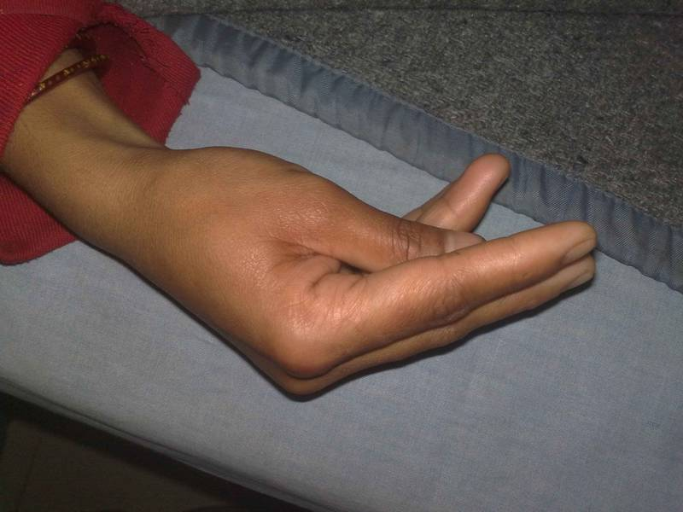
Tetany

Slide 57
Etiology
A. HYPOCALCEMIA WITH LOW PTH (HYPOPARATHYROIDISM):
1. Destruction of the parathyroid glands
- Surgical : most common cause
Transient:20 %
permanent: 0.8-3 % after total thyroidectomy

Slide 58
2. Autoimmune :
polyglandular autoimmune syndrome type I
presents in childhood
- candidiasis
- hypoparathyroidism
- adrenal insufficiency during adolescence.

Slide 59
3. Abnormal parathyroid gland development:
Genetic defects:
- X-linked, autosomal recessive
- DiGeorge syndrome

Slide 60
B. HYPOCALCEMIA WITH HIGH PTH
1. PTH resistance: (Pseudohypoparathyroidism):
- childhood
- low Ca, high phosphate, and elevated PTH
2. Vitamin D deficiency or resistance
3. Extravascular deposition: deposition in tissues or binding within the vascular space

Slide 61
4. Hyperphosphatemia : CKD / ARF/ rhabdomyolysis/ tumor lysis
5. Osteoblastic metastases: breast or prostate cancer
6. Acute pancreatitis :precipitation of calcium soaps in the abdominal cavity
7. Sepsis or severe illness: hypocalcemia in critically ill or postsurgical pts 80-90 %.

Slide 62
C. DISORDERS OF MAGNESIUM METABOLISM:
1. magnesium depletion: PTH resistance (Mg < 1 mg/dL) or by decreasing PTH secretion
- Malabsorption
- Chronic alcoholism
- Cisplatin therapy
- diuretic therapy
- aminoglycosides
2. Severe hypermagnesemia: suppressing the secretion of PTH ( mg > 6 mg/dL)

Slide 63
Treatment of hypocalcemia
IV calcium :
- acute symptomatic pts
- asymptomatic hypocalcemia with acute decreases to ≤7.5 mg/dL
1 - 2 g of calcium gluconate ( 90 - 180 mg elemental calcium) in 50 mL of 5 % D over 10 - 20 minutes
iv solution: 100 mL (10 amp) of 10 % calcium gluconate in 1000 mL of 5 % dextrose in water, at 50 mL/h

Slide 64
Iv calcium continued until the patient is recieving oral calcium and Calcitriol
Oral calcium: mild acute hypocalcemia (7.5 - 8.0 mg/dL) or for chronic hypocalcemia.
1500 - 2000 mg of elemental calcium
Vitamin D supplement is also needed.

Slide 65
Thank you

Slide 68
Clinical manifestations and diagnosis of MEN 1

Slide 69
INTRODUCTION
MEN1 :
autosomal dominant:
- parathyroid glands
- anterior pituitary
- pancreatic islet cells
Also:
- duodenum: gastrinomas, and carcinoid tumors
- adrenal adenomas, and lipomas

Slide 70
DEFINITION OF MEN1
presence of two of the three main MEN1 tumor types (parathyroid, entero-pancreatic endocrine adenomas, and pituitary adenomas)
Familial MEN1 : index MEN1 case with at least 1 relative with 1 of 3 main MEN1 tumors

Slide 71
PRIMARY HYPERPARATHYROIDISM in MEN 1
most common : almost 100 % by age 40-50 yrs
1-2 % of primary hyperparathyroidism are due to MEN1
different features from the sporadic form :
• The M: F ratio is even in MEN1 in contrast to the female predominance in sporadic form
• in MEN1 presents in the 2nd - 4th decade of life (2 decades earlier than in sporadic form)

Slide 72
• Multiple gland involvement in MEN1.
80-85 % of pts with sporadic disease have single parathyroid adenomas.

Slide 73
• A high rate of recurrent hyperparathyroidism after subtotal parathyroidectomy.
recurrence rate > 50 % at 12 yrs .

Slide 74
Diagnosis
hypercalcemia with inappropriately high PTH

Slide 75
PITUITARY ADENOMAS
Clinically apparent in 15 - 20 % by CT or MRI ;
Pathological prevalence > 60 % .
The most common type is a prolactinoma,
GH-producing, ACTH-producing, gonadotroph and clinically non-functioning tumors can also occur .
Multiple tumors are rare

Slide 76
macroadenomas
- 85 % had macroadenomas versus 42 % in non-MEN1 patients
- MEN1 patients had tumors that were larger and more aggressive than those in non-MEN patients

Slide 77
The approach to diagnosis and therapy of pituitary adenomas in patients with MEN1 is similar to that in patients with sporadic adenomas.

Slide 78
PANCREATIC ISLET CELL/GASTROINTESTINAL ADENOMAS
1/3 of pts with MEN1
The most common cause of symptomatic disease is the Zollinger-Ellison (gastrinoma) syndrome, leading to multiple peptic ulcers.
60 % of pts with MEN1 have ZES or asymptomatic elevation in serum gastrin

Slide 79
MEN1 is present in 20- 60 % of pts with ZES
Symptomatic insulinomas also occur
VIPomas and glucagonomas are rare

Slide 80
The prevalence of nonfunctioning tumors is 30- 80 %.
clinically nonfunctioning Pancreatic Endocrine Tumors may be malignant causing liver metastases

Slide 81
Zollinger-Ellison syndrome
the gastrinomas in MEN1 are multifocal, often very small
the duodenum is a common site of gastrinomas in MEN1 and sporadic form
Tumors in the pancreas do not usually secrete gastrin

Slide 82
The risk of death from malignant MEN1 gastrinoma is < sporadic

Slide 83
• ZES : initial manifestation of MEN1 in 40 %
• The onset of ZES symptoms preceded the dx of hyperparathyroidism in 45 % of pts
• Pituitary disease occurred in 60 % of patients.

Slide 84
Diagnosis
Suspected clinically by the presence of multiple peptic ulcers or symptoms like diarrhea
similar to sporadic form

Slide 85
nonfamilial gastrinoma: the usual cause is ectopic ACTH release from the islet-cell tumor.
Patients with MEN1 and ZES who develop Cushing's syndrome usually have a corticotroph adenoma of the pituitary

Slide 86
Insulinoma
In MEN1 are often small, may be multiple,

Slide 87
Nonfunctioning pancreatic Endocrine tumors
Detected as early as ages 12 -14 in asymptomatic children
• The risks of metastasis and death are low for tumors ≤ 20 mm

Slide 88
Carcinoid tumors
Thymic carcinoid tumors occur in MEN1 (2.6 -5 %),
- mostly in men
- heavy smoking ? a risk factor
Thymic carcinoids : are typically nonfunctional (in contrast to the substantial incidence of ectopic Cushing's syndrome in pts with sporadic thymic carcinoid), and tend to be aggressive

Slide 89
Thymic carcinoids in MEN1
• CT and MRI were sensitive for detecting the tumors
• All patients underwent surgical resection with high rate of recurrence

Slide 90
Cutaneous tumors
• Angiofibromas and collagenomas were more common in MEN1 patients
• lipomas were present in 17 %

Slide 91
others
- adrenal tumors, especially nonfunctional adrenocortical adenomas,
- gastric carcinoids,
- pheochromocytoma (very rarely)
- angiomyolipomas
- spinal cord ependymomas .

Slide 92
SCREENING OF FAMILY MEMBERS IN MEN1 KINDREDS
little evidence that early, presymptomatic detection actually reduces overall morbidity or mortality in MEN1
one low-cost option for screening is measurement of serum calcium

Slide 93
DNA TESTING IN DIAGNOSIS OR SCREENING FOR MEN1
Direct DNA testing for MEN1 mutations is available
DNA testing in specific individuals can be helpful when the diagnosis of MEN1 is unable to be clearly established on clinical grounds and would alter management

Slide 94
current evidence does not support routine use of intensive laboratory evaluation and/or imaging studies in the absence of relevant signs or symptoms

Slide 95
PTH receptors
1. PTH / PTHrP receptor (type 1R) :
- bone and kidney
- recognizes PTH and PTH-related protein

Slide 96
2. PTH2 receptor (type 2R):
- binds PTH but not PTHrP

