Slide 1
Graded (Electrotonic) Potential
(lec-3)

Slide 3
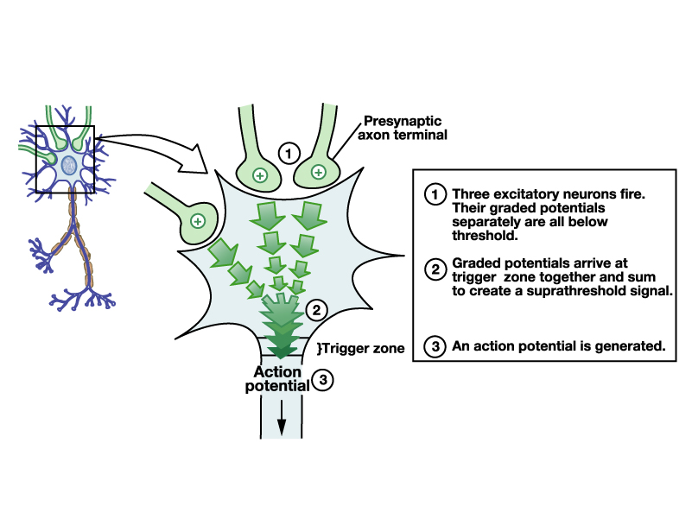
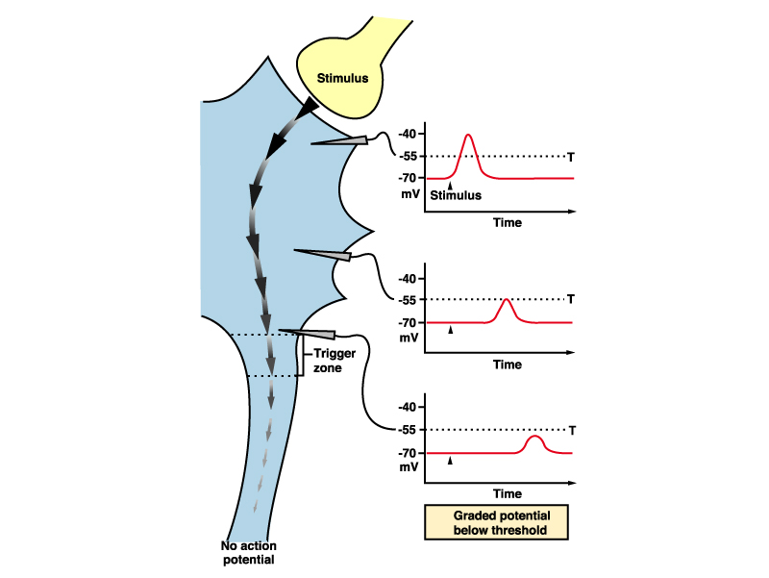
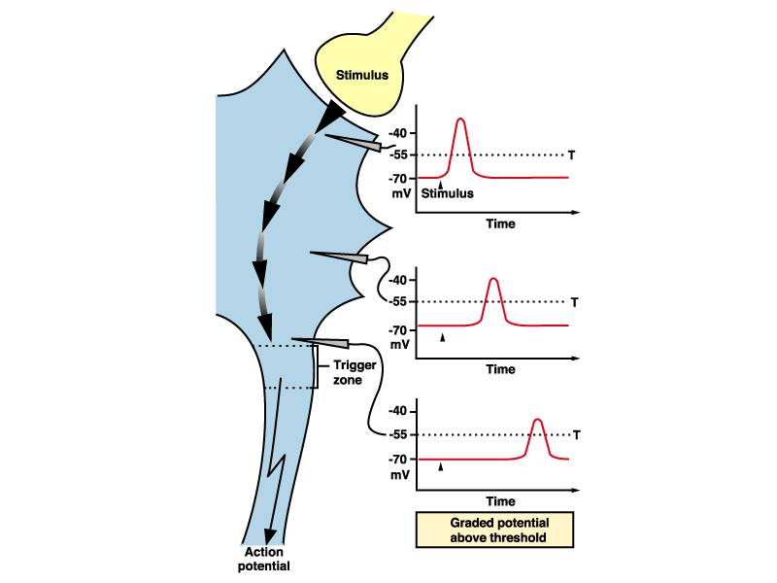

Slide 6
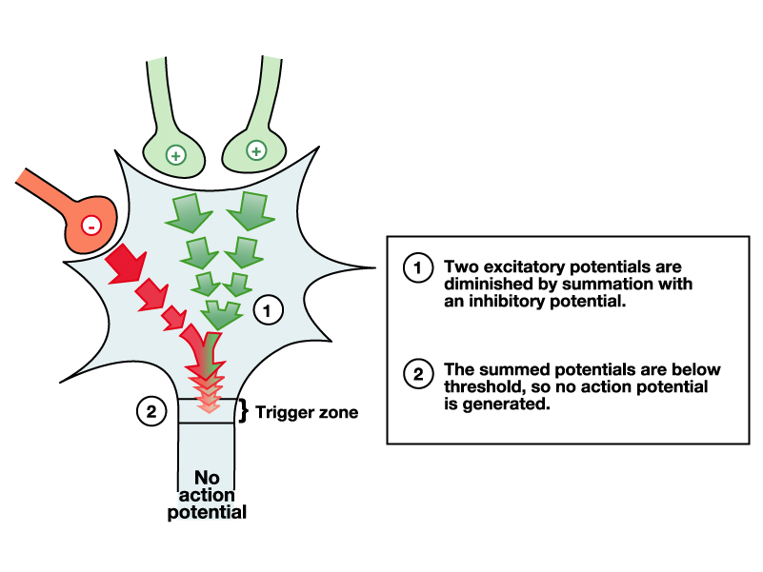

Slide 8
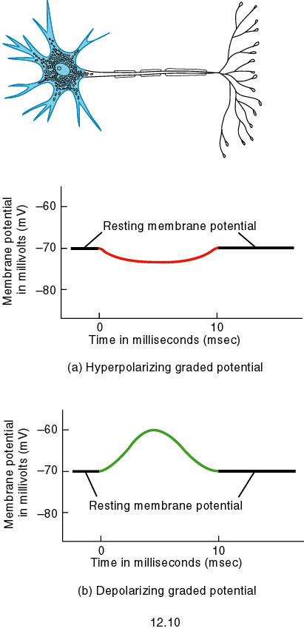
Fig. 12.10

Slide 10
Graded(Electrotonic) potential
Arises mainly in dendrites and soma.
Ligand-gated or Mechanically gated channels
Decremental (non-propagating) conduction
Amplitude depends on stimulus strength (1-50 mv)
Duration longer than Action Potential
Hyperpolarizing or depolarizing
No refractory period
Temporal / Spatial Summation.
Function:
1. Higher cortical functions; thinking, solving problems, retrieval…etc
2. Seeing all the mixed colors.

Slide 11
Peripheral nerve, What electrical activity can we record from?

Slide 12
Common injuries to the brachial plexus

