Slide 1
Electrical Signals within the Nervous System (lec 2)

Slide 2
Electrical Signals within the NS
1-Action potential
2-Electrotonic(graded) potential

Slide 3
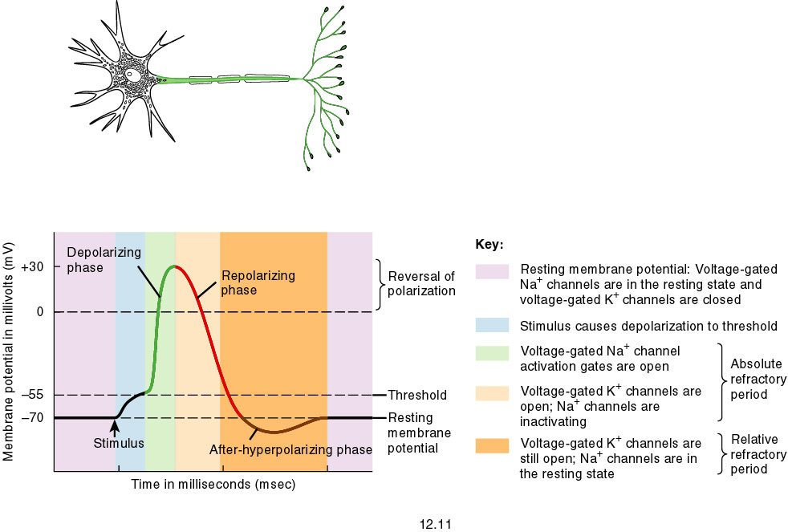

Slide 4
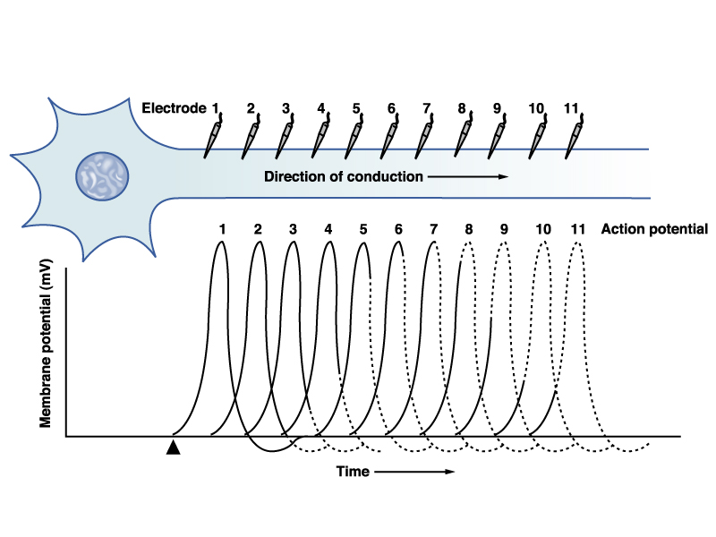

Slide 5
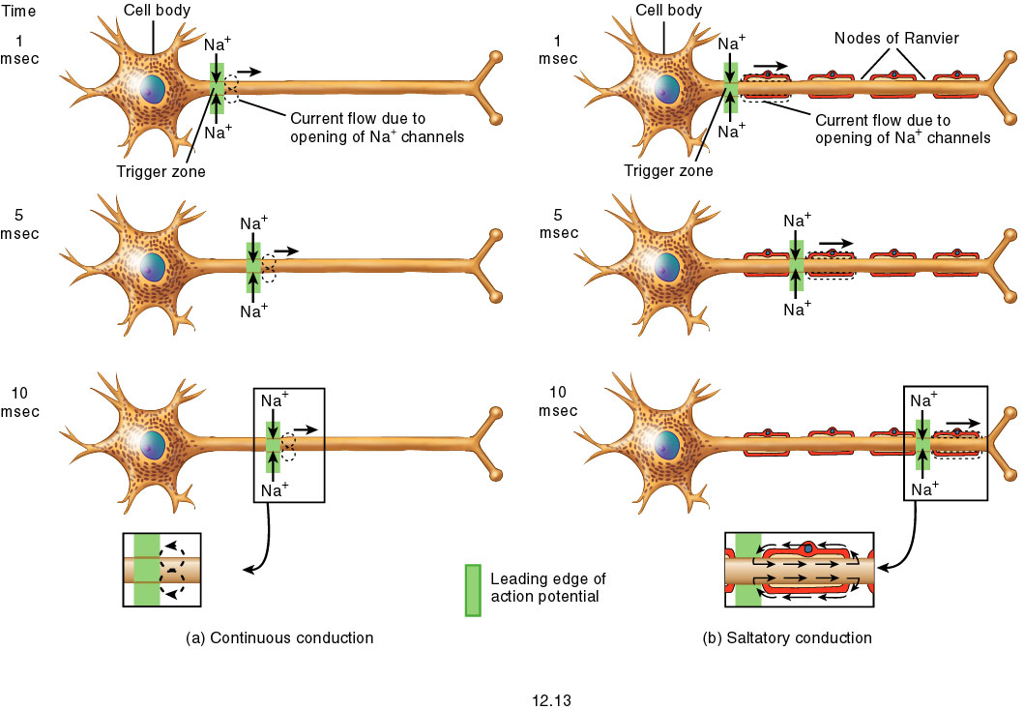
Fig. 12.13

Slide 6
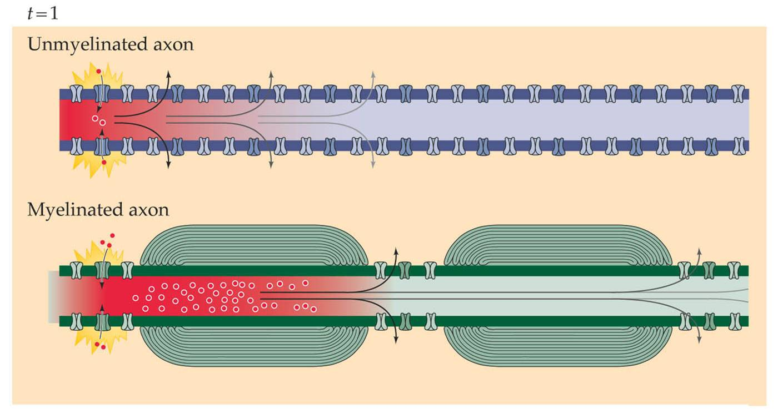
Myelination increase membrane resistance & decrease membrane capacitance.

Slide 8
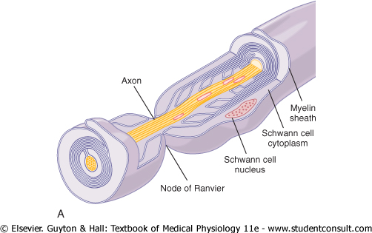

Slide 9
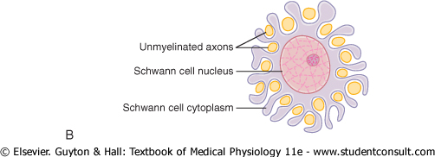

Slide 10
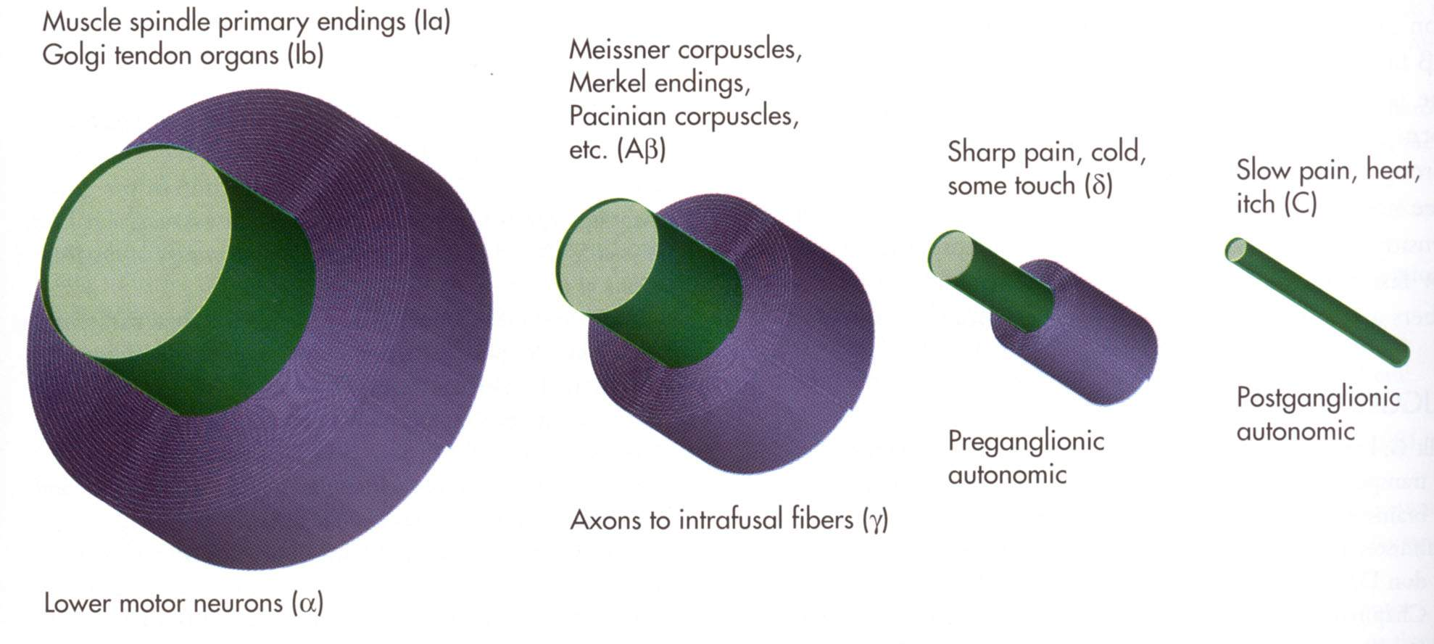
Classification for Peripheral Fibers
Fiber size: I, II, III, IV
Conduction velocity: A, B, C
Major afferent
Major efferent
Nolte 9-21

Slide 11
Susceptibility of Different Types of Fibers to Conduction Block by Various Agents
 | Most susceptible | Effect | Least susceptible
Block by hypoxia | B | A | C
Block by pressure | A | B | C
Block by local anesthetics | C | B | A

Slide 12
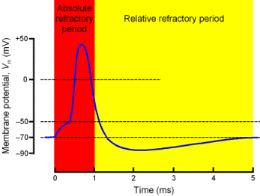
Absolute & Relative Refractory Period

Slide 13
Refractory period

Slide 14
Action potential
Regenerative,
Threshold
Move along axon
Voltage gated channels
Propagates
All or None
Amplitude above 100 mv
Short duration
Depolarizing then repolarizing
Refractory period
No summation.
Function: carries information faithfully unchanged from one end of neuron to other, without decrement.

Slide 15
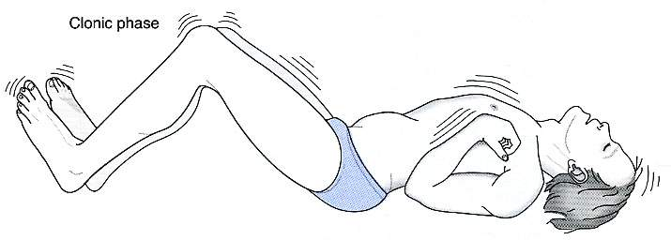
Convulsion/Fit/Seizure

Slide 16
Effect of ionic composition on nerve fiber excitability:
Hypercalcaemia
& Hypokalemia
Decrease n.f. excitability.
Hypocalcaemia
increase n.f. excitability

