Slide 1
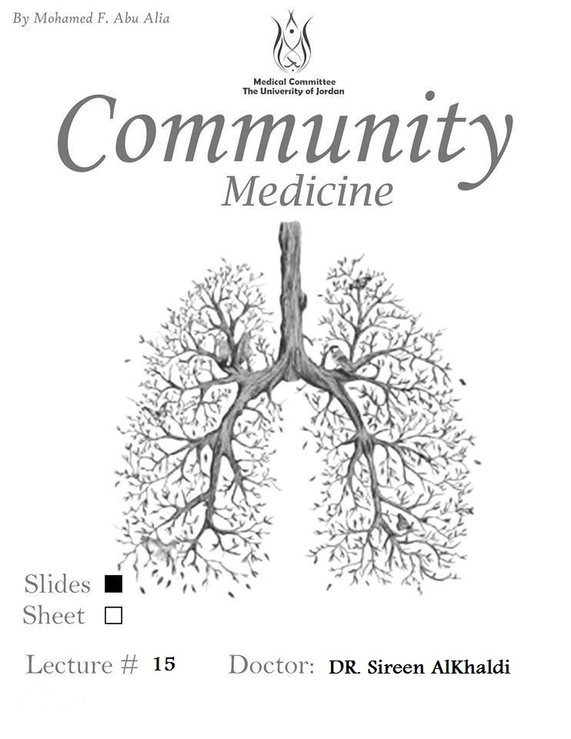

Slide 2
Health Care Management
Dr. Sireen Alkhaldi, BDS, MPH, DrPH
Community Health / First Semester 2014/2015
Department of Family and Community Medicine
Faculty of Medicine/ The University of Jordan

Slide 3
Health Care Management
In the next four lectures you are going to get introduced to:
1. A Health Care System and its components (Macro level)
2. Levels of Health care, and the main approaches to health care provision, in addition to Resources, and Financing.
3. Introduction to Management in health care organizations (Micro level ).
4. The Four Functions of Management: Planning, Organizing, Leading and Controlling.

Slide 4
What is a Health Care System?
What is Health?
The World Health Organization (WHO) defined health in 1946 as:
“Health is a state of complete physical, mental and social well-being and not merely the absence of disease or infirmity.”

Slide 5
What is a Health Care System?
What is a System?
System: “a set or arrangement of things connected or related to form a unity or organic whole”.
System: “a collection of components organized to accomplish a specific function or a set of functions”.
The parts of a system can be referred to as its elements or components
The environment of the system is defined as all of the factors that affect the system and are affected by it.

Slide 6
What is a Health Care System?
A Health Care System: “the complete network of agencies, facilities, and all providers of health care in a specified geographic area.”
(Mosby's Medical Dictionary, 8th edition. © 2009, Elsevier.)

Slide 7
What is a Health Care System?
health care system: “an organized plan of health services.”
The term is usually used to refer to the system or program by which health care is made available to the population and financed by government, private enterprise, or both.

Slide 8
Health Care System
Every country has a health care system, however fragmented it may be among different organizations or however unsystematically it may seem to operate.
Integration and oversight do not determine the system, but they may greatly influence how well it performs.

Slide 9
Health Care Systems
Health care systems are designed to meet the health care needs of target populations.
In some countries, the health care system has evolved and has not been planned, whereas in others efforts have been made by governments, trade unions, charities, religious, or other coordinated bodies to deliver planned health care services targeted to the populations they serve.

Slide 10
Goals of a Health Care System
The goals for health systems, according to the World Health Report (WHO, 2000), are:
Good health for the population
Responsiveness to the needs and expectations of the population
Fair financial contribution to the health care system
Efficient to achieve the best outcomes possible given available resources and circumstances

Slide 11
What is a Health Care Delivery System?
Three major components that make up the Health Care Delivery System are:
Facilities
Practitioners
Entities

Slide 12
Facilities
Hospitals: acute and sub-acute care, primary care, and tertiary care (medical education and complex cases)
Health Centers or Ambulatory Surgery (out-patient)
Physician offices (GP,s and specialists)
Skilled Nursing Facilities
Home Health Agencies: nursing care at home
Freestanding Substance Abuse Facilities: inpatient
Hospice: care for terminally ill patients
End-stage Renal Disease Centers

Slide 13
Practitioners
Physicians
Medical Doctors (MD’s)
Nurses
Nurse Practitioners
Registered Nurse (RN)
Physician Assistants (Pas)
Therapists
Physiotherapist (PT)
Occupational therapist (OT)
Speech therapist (ST)

Slide 14
Entities
Provide the financial and regulatory functions for the facilities and practitioners, e.g. government.
Governmental Health Care Functions:
Direct Services (hospitals, health care centers)
Financing
Information
Policy Setting

Slide 15
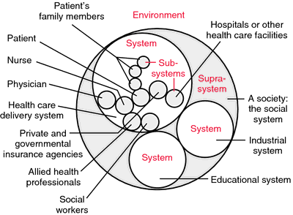
Health Care Delivery System

Slide 16
Elements of a health care system
One way to look at the HCS is by identifying elements of a health care system that embrace the following:
Personal health care services for individuals and families, available at hospitals, clinics, neighborhood centers, and in physicians' offices, etc…… .
Public health services needed to maintain a healthy environment, such as control of water and food supplies, regulation of drugs, and safety regulations.
Teaching and research activities related to the prevention, detection, and treatment of disease.
Third party (health insurance, pharmaceutical companies) of system services.

Slide 17
Key components of a well functioning health system
Health System Building Blocks
The building blocks alone do not constitute a system, any more than a pile of bricks constitutes a functioning building.
It is the multiple relationships and interactions (integration) among the blocks – how one affects and influences the others, and is in turn affected by them – that convert these blocks into a system.

Slide 18
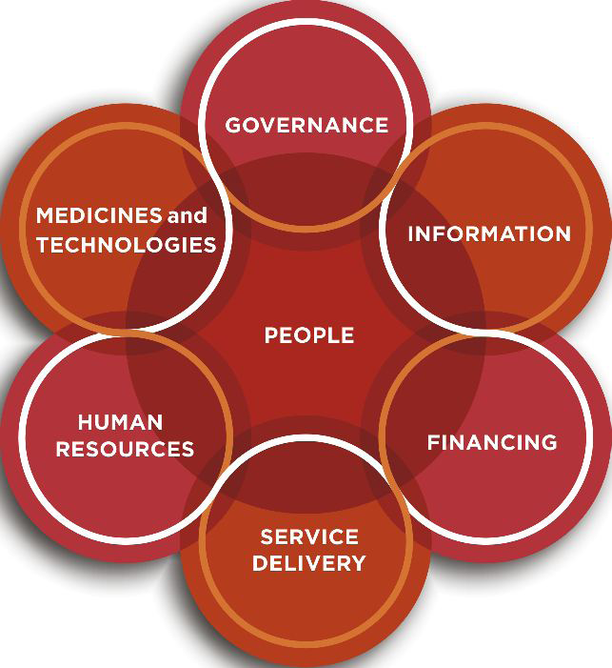
Figure 1.2 The dynamic architecture and interconnectedness of the health system building blocks

Slide 19
