Slide 1
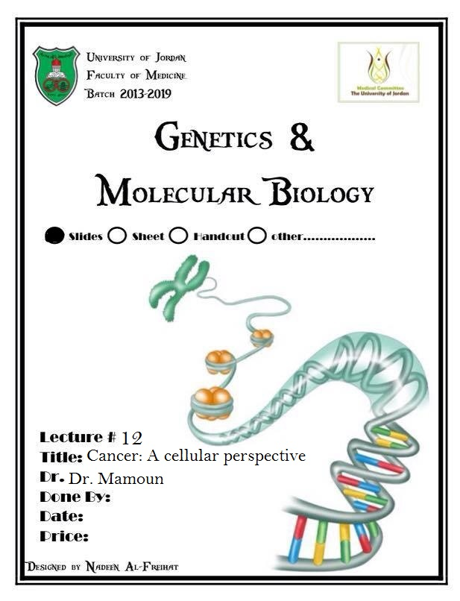

Slide 2
Lecture 12:
Cancer: a cellular perspective
Dr. Mamoun Ahram
Faculty of Medicine
Second year, Second semester, 2014-2014
Principles of Genetics and Molecular Biology

Slide 3
What is cancer?
A tumor is any abnormal proliferation of cells.
  A benign tumor is confined to its original location.
  A malignant tumor (cancer) is capable of both invading surrounding normal tissue and spreading throughout the body via the circulatory or lymphatic systems (metastasis).
It develops from a multistep process involving mutation with progressively increasing capacity for proliferation, survival, invasion, and metastasis.

Slide 4
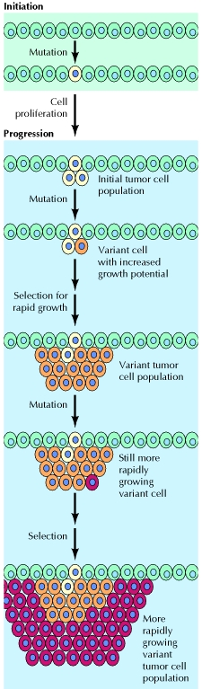
Processes of tumorigenesis
Tumor initiation: a genetic alteration leading to abnormal proliferation of cells into a tumor
Tumor progression: accumulation of mutations within cells of the tumor population.
  Some of these mutations confer a selective advantage to the cell, such as more rapid growth.

Slide 5
Tumor heterogeneity

Slide 6
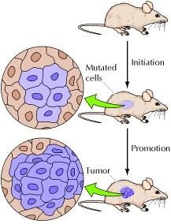
Environmental cause of cancer
Carcinogens (substances that cause cancer) are of two types:
Initiators: induce genetic mutations
  Radiation, viral, and chemical carcinogens (chemicals in tobacco smoke and aflatoxin)
Promoters: stimulate cell proliferation
  The phorbol esters stimulate cell proliferation by activating protein kinase C.
  Hormones (estrogens) increase risk of female cancers.
  Pathogens

Slide 7

Features of cancer (1)
Clonality
Accumulation of genetic mutations
Uncontrolled proliferation
Autocrine growth stimulation
Reduced cell-cell contact and cell-matrix adhesion

Slide 8
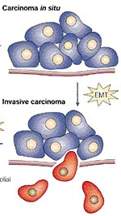
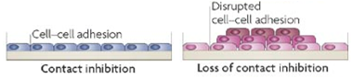
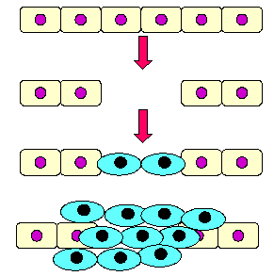

Features of cancer (2)
Density-dependent inhibition
Contact inhibition
Invasiveness and extracellular proteolysis

Slide 9
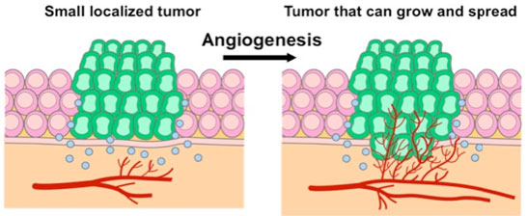
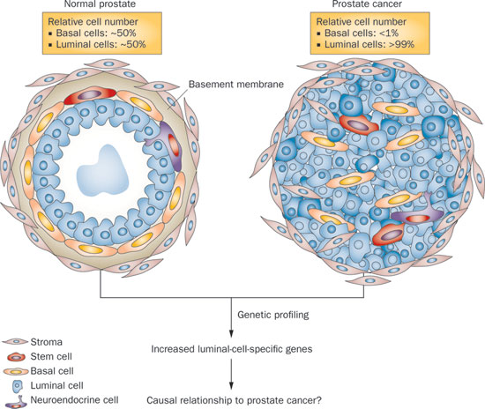
Features of cancer (3)
Angiogenesis
Lack of differentiation
Loss of apoptotic capability
Cessation of senescence

Slide 10
Oncogenes and tumor suppressor genes
Oncogene
Tumor suppressor gene
A gene capable of inducing one or more characteristics of cancer cells when activated.
A proto-oncogene: a normal cell gene that can be converted into an oncogene.
A gene whose inactivation leads to tumor development.

Slide 11
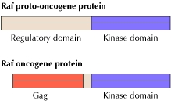
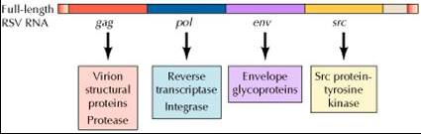
Viral oncogenes
Oncogene | Virus
abl | Abelson leukemia
akt | AKT8 virus
erbA | Avian erythroblastosis-ES4
erbB | Avian erythroblastosis-ES4
raf | 3611 murine sarcoma
rasH | Harvey sarcoma
rasK | Kirsten sarcoma
src | Rous sarcoma
Rous sarcoma virus

Slide 12
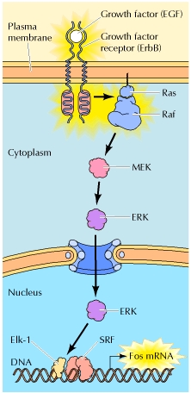
Oncogenes and signal transduction
Oncogene proteins act as:
  Growth factors (e.g., EGF)
  growth factor receptors (e.g., ErbB)
  Intracellular signaling molecules (Ras and Raf)
  transcription factors (e.g., fos)

Slide 13
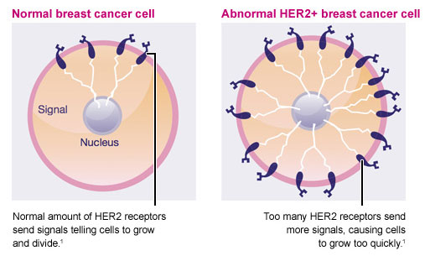
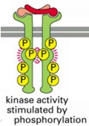
Oncogenes and receptors

Slide 14
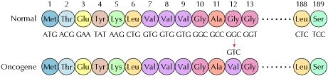
Oncogenes and transducers
A single nucleotide change, which alters codon 12 from GGC (Gly) to GTC (Val), is responsible for the tumorigenic activity of the rasH oncogene.
The mutation maintains the Ras proteins constitutively in the active GTP-bound conformation.

Slide 15
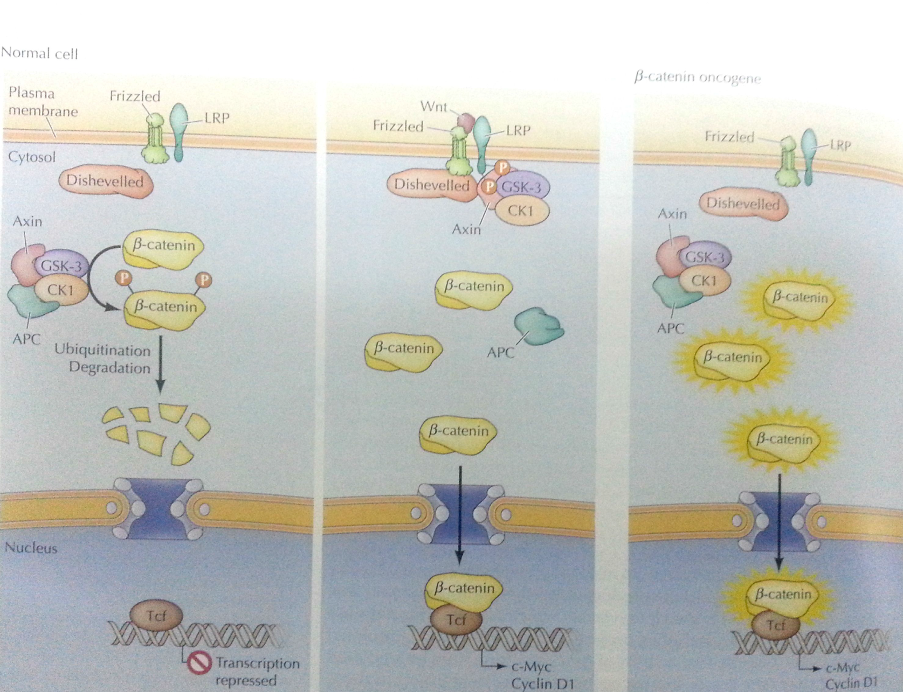
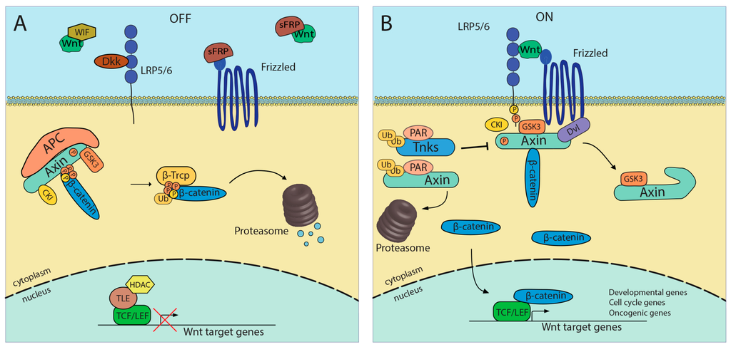
Oncogenes and transcription factors
Normal cell
Tumor cell

Slide 16
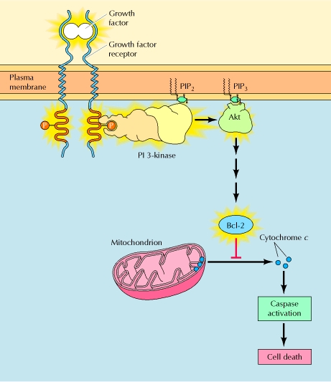
Oncogenes and cell survival
The Akt pathway involving proto-oncogenes (ligands, receptors, PI-3 kinase, and AKT) promotes cell survival by inhibiting pro-apoptotic proteins and inducing anti-apoptotic proteins.

Slide 17
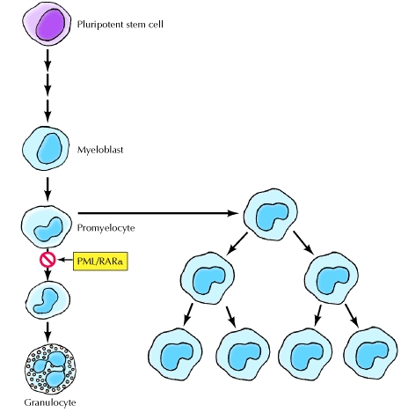
Oncogenes and cell differentiation
Mutated forms of both the thyroid hormone receptor (ErbA) and the retinoic acid receptor (PML/RARα) act as oncogene proteins in human acute promyelocytic leukemia where the mutated oncogene receptors block cell differentiation and maintain the leukemic cells in an actively proliferating state.

Slide 18
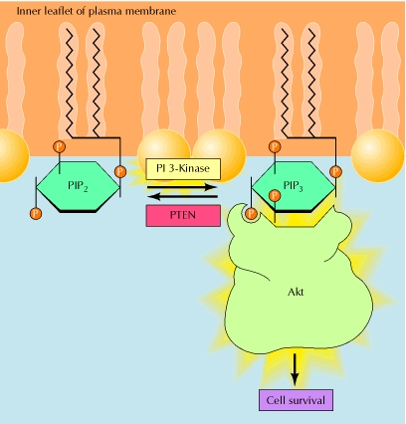
TSG and proliferation and survival
The tumor suppressor protein PTEN is a lipid phosphatase that dephosphorylates PIP₃ into PIP₂.
It counters the action of the oncogenes PI 3-kinase and Akt, which promote cell survival.

Slide 19
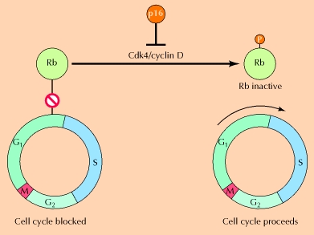
TSG and cell cycle
Rb inhibits progression past the restriction point in G₁.
Cdk4/cyclin D complexes promote passage through the restriction point by phosphorylating and inactivating Rb.
Inactivation of Rb results in increased cell cycle progression and tumor formation.

Slide 20
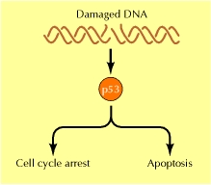
Role of p53
Loss of p53 prevents DNA damage-induced cell cycle arrest, leading to increased mutation frequencies and a general instability of the cell genome contributing to further alterations in oncogenes and tumor suppressor genes during tumor progression.

Slide 21
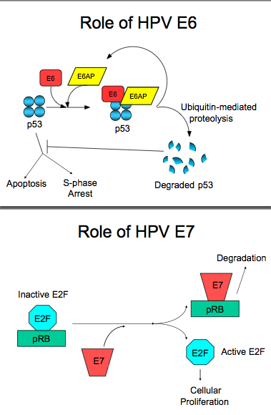
A mechanism of viral carcinogenesis
The E6 and E7 proteins of the human papillomavirus (HPV) block the function of the cellular Rb and p53 proteins.
In particular, E7 binds to Rb, and E6 stimulates the degradation of p53 by proteolysis.

Slide 22
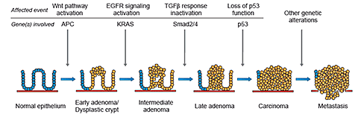
The multistep genetic model for the formation of colorectal cancer
Inactivation of TSGs and the activation of oncogenes leading to dyfunctional pathways.
Accumulation of mutations in a sequential manner, with mutations of some genes preceding that of others.
β-catenin
Fearon ER, Vogelstein B. A genetic model for colorectal tumorigenesis. Cell. 1990;61:759-767.

Slide 23
Personalized medicine is the way
Doctors are men who prescribe medicines of which they know little, to cure diseases of which they know less, in human beings of whom they know nothing.
Voltaire (1694-1778)

Slide 24
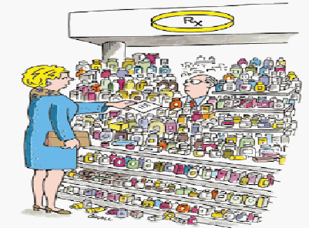
A future outlook
"Here's my
sequence...”
New Yorker, 2007

Slide 25
Remember:
Diseases are proteomic

