Slide 1
Body fluid Abnormalities Microcirculation Edema

Slide 2
Body fluid Abnormalities
1. Hypo-osmotic dehydration
2. Hypo-osmotic overhydration
3. Hyper-osmotic dehydration
4. Hyper-osmotic overhydration

Slide 3
Hypo-osmotic dehydration
Addison’s disease
Overuse of Diuretics
Vomiting & diarrhea

Slide 4
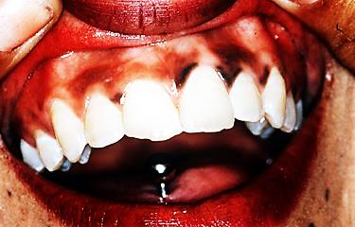
Addison’s disease / Hyperpigmentation

Slide 5
Hypo-osmotic overhydration
Due to excess ADH;
Syndrome of inappropriate ADH secretion (SIADH)
Ectopic ADH secretion; Bronchogenic cancer

Slide 6
Hyper-osmotic dehydration
Diabetes insipidus
(decrease ADH secretion)
Excessive sweating

Slide 7
Hyper-osmotic overhydration
Primary aldosteronism
Cushing’s syndrome

Slide 8
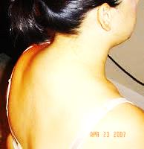
Cushing’s syndrome / Buffalo Hump

Slide 9
Regulation of fluid exchange between body Compartments
ICF & ECF;
Determined by osmotic effect of solutes across the cell membrane.
Plasma & interstitial spaces
Colloid osmotic force & hydrostatic force across the capillary membrane.

Slide 10
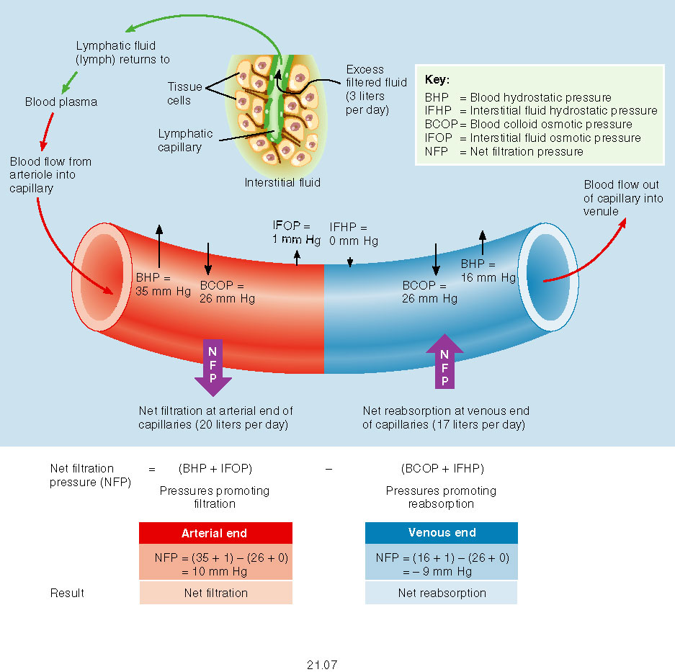
Starling Equilibrium for capillary exchange

Slide 11
Edema
EC edema
(abnormal accumulation of fluid in the interstitial space)
IC edema (cell swelling) due to;
Depression of cell metabolism
Lack of cell nutrition
Inflammation

Slide 12
Causes of EC edema
1. Increased capillary pressure;
Excess kidney retention
High venous pressure
Decreased arteriolar resistance

Slide 13
Causes of EC edema
2. Decreased plasma proteins:
Loss of proteins by nephritic syndrome, burns….
Failure to produce proteins; liver disease
Starvation (malnutrition)

Slide 14
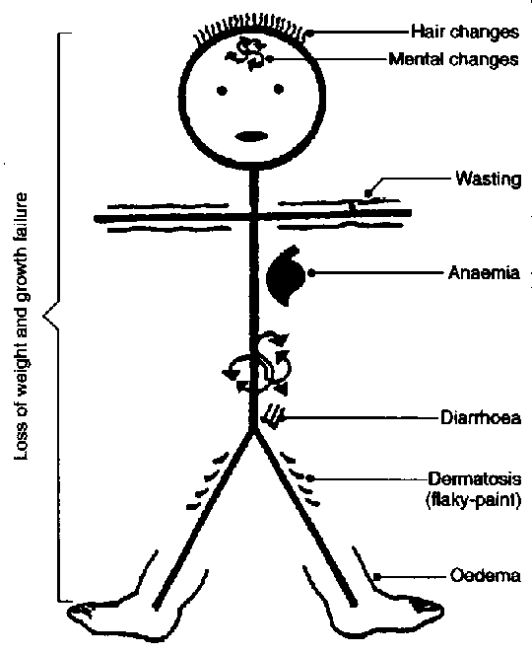
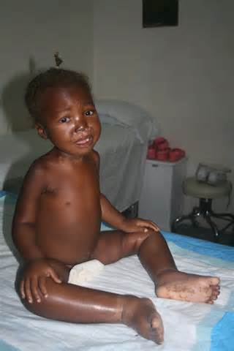
Malnutrition Kwashiorkor

Slide 15
Causes of EC edema
3. Increased capillary permeability;
Immune reactions
Infections
Toxins

Slide 16
Causes of EC edema
4. Lymphatic blockage:
After Radical mastectomy
After Radiation therapy
Filariasis/ Elephantiasis (Wuchereria Bancrofti)

Slide 17
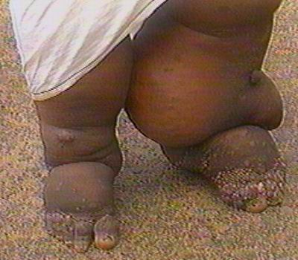
Filariasis/ Elephantiasis

