Slide 2
Lecture 10: Cell cycle
Dr. Mamoun Ahram
Faculty of Medicine
Second year, Second semester, 2014-2014
Principles of Genetics and Molecular Biology

Slide 3
The cell cycle
A typical eukaryotic cell cycle divides ~every 24 hours.
Mitosis and cytokinesis = ~1 hour
Interphase: cell growth and DNA replication occur in an orderly manner in preparation for cell division.
Yeast cells: 90 minutes
Zygote: no G1 or G2, but rapid S and M phases
Some cells (neve cells) enter a quiescent stage (G₀ phase)

Slide 4
Phases of cell cycle
G1: increased metabolism and cell growth; cells are dipoloid (2n)
S: DNA replication; cells are 2-4n
G2: metabolism and cell growth; cells are 4n
M: chromosomal segregation, nuclear and cell division (4n)

Slide 5
Regulation of cell cycle
Restriction point: a decision point in late G₁ regulated by the extracellular growth factors
If not there, cells enter G₀ phase where they are metabolically active without growth.

Slide 6
Checkpoints
DNA damage checkpoints: to ensure that incomplete or damaged DNA is not replicated and passed on to daughter cells.
Spindle assembly checkpoints monitor the alignment of chromosomes on the mitotic spindle.

Slide 7
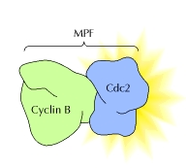
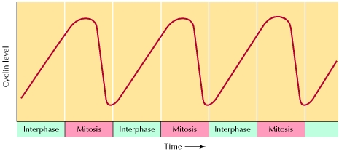
Regulators of cell cycle
Cyclins: proteins that accumulate throughout interphase and are rapidly degraded toward the end of mitosis.
Cyclin-dependent kinases (Cdk’s): bind to cyclins and get activated.
Cdk inhibitors: inhibit Cdk activity

Slide 8
Example of regulation of cell cycle progression

Slide 9
Mechanisms of Cdk regulation

Slide 10
Cells signaling and cell cycle
Growth factors regulate cell cycle progression through the G₁ restriction point by inducing synthesis of D-type cyclins via the Ras/Raf/ERK signaling pathway.
Defects in cyclin D regulation lead to the loss of growth regulation characteristic of cancer cells.

Slide 11
Retinoblastoma
When unphosphorylated, Rb binds to E2F proteins and represses transcription.
E2F is freed when Rb is phosphorylated by Cdk4, 6/cyclin D stimulating cell cycle progression through restriction point.

Slide 12
Cell cycle arrest by DNA damage
ATM and ATR are protein kinases
ATR is activated by single-stranded DNA damage.
ATM is activated by double-strand DNA damage.
ATR and ATM activate the checkpoint kinases, Chk1 and Chk2, respectively, which inhibit Cdc25 phosphatase.
Phosphatases cannot activate Cdk’s causing cell arrest.

Slide 13
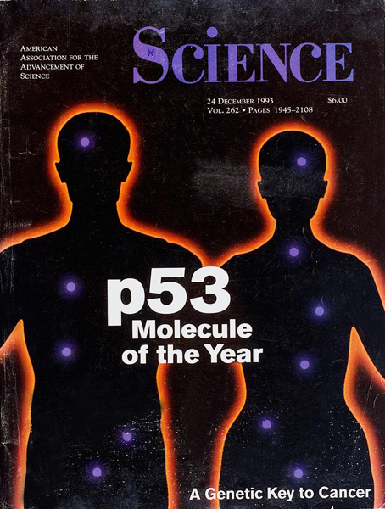
Role of p53 in cell cycle arrest
DNA damage results in phosphorylation of p53 protein stabilizing it.
Activated p53 activates expression of p21, which is a protein that inhibits a Cdk/cyclin complex.

