Slide 1
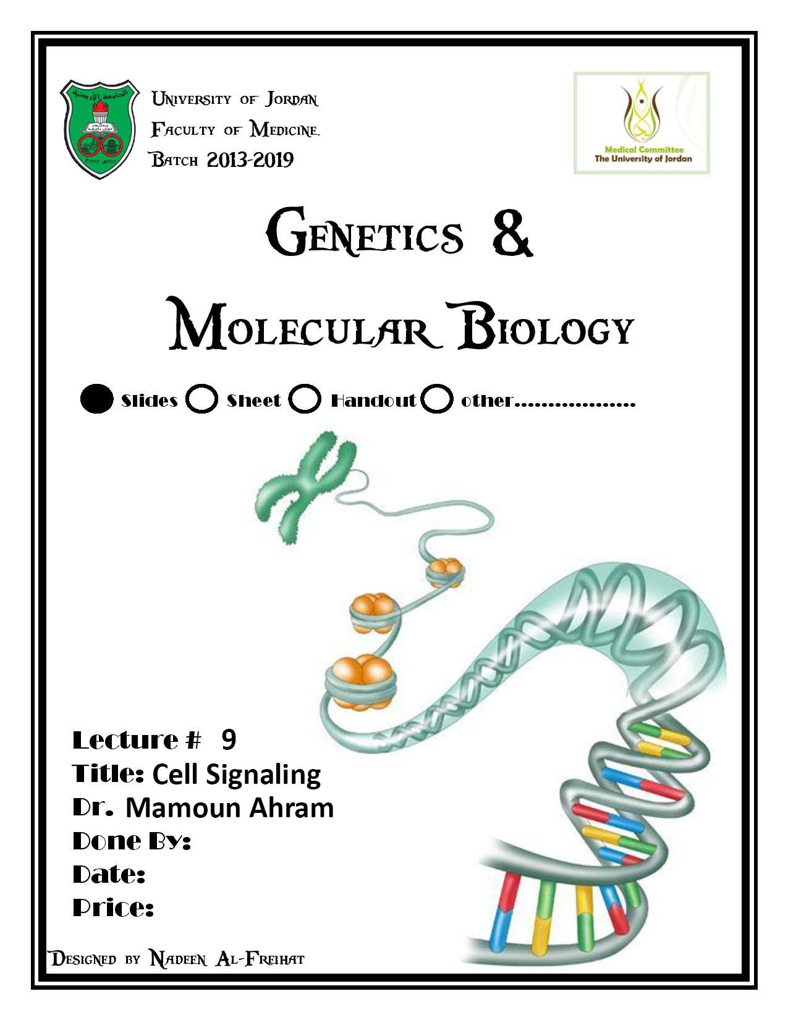

Slide 2
Lecture 9: Cell signaling
Dr. Mamoun Ahram
Faculty of Medicine
Second year, Second semester, 2014-2014
Principles of Genetics and Molecular Biology

Slide 3
Modes of cell siganling
Direct interaction of a cell with its neighbor
A molecule released by one cell acts on neighboring target cells.
Cells respond to signaling molecules that they themselves produce
Signaling molecules are secreted by endocrine cells and carried through the circulation to act on target cells at distant body sites.

Slide 4
Classification of signaling molecules
Peptides: growth factors (EGF), peptide hormones (insulin, glucagon), or neuropeptides (oxytocin, enkephalins)
Small molecule neurotransmitters: derived from amino acids like Epinephrine and thyroid hormone (tyrosine), serotonin (tryptophan).
Steroids: derived from cholesterol like estradiol, cortisol, calciferol (Vitamin D), and testosterone.
Eicosinoids: derivatives of arachidonic acid including prostaglandins, leukotrienes, and thromboxanes B.
Gasses: Nitric oxide (NO) and carbon monoxide (CO)

Slide 5
Mechanisms of action of neurotransmitter

Slide 6
Lipophilic hormones

Slide 7
Mechanism of action of steroid receptors
3. Dissociation of heat shock proteins
4. Dimerization
2. Hormone binding
5. Translocation
1. No ligand, NR is cytosolic
8. Gene expression
6. Specific NR-DNA binding

Slide 8
Gene regulation by the thyroid hormone receptor

Slide 9
Synthesis of nitric oxide (NO)

Slide 10
Mechanisms of action

Slide 11
Cell surface receptors

Slide 12
Players of signaling by cell surface receptors
Ligand (hormone, growth factor)
Receptor (GPCR, RTK)
Transducers (G protein, Ras)
Effector molecules (adenylate cyclase, MAPK, Ca²⁺)
Second messengers
Final target molecules (e.g., DNA, channel) → Response

Slide 13
Types of response
Primary response direct activation of a small number of specific genes (30 minutes).
Secondary response the protein products of the primary response activate other genes.

Slide 14
G protein-coupled receptors
A family of receptors composed of seven membrane-spanning α helices.
The binding of ligands to the extracellular domain of these receptors induces a conformational change that allows the cytosolic domain of the receptor to bind to a G protein.

Slide 15
Heterotrimeric G proteins
G proteins are composed of three protein subunits—α, β, and γ.
In the unstimulated state, the α subunit has GDP bound and the G protein is inactive.
When stimulated, the α subunit releases its bound GDP, allowing GTP to bind in its place.
This exchange causes the trimer to dissociate into active components: α subunit and a βγ complex.

Slide 16
G protein inactivation
The activity of the α subunit is terminated by hydrolysis of the bound GTP by an intrinsic GTPase activity, and the inactive α subunit (now with GDP bound) then reassociates with the βγ complex.

Slide 17
Types of G proteins
G_{a} class | Initiating signal | Downstream signal
G_{as} | β-Adrenergic receptor | Stimulates adenylate cyclase
G_{ai} | Acetylcholine, α-adrenergic | Inhibits adenylate cyclase
G_{aq} | Acetylcholine, α-adrenergic | Increases IP₃ and intracellular calcium
G_{at} | Photons | Stimulates cGMP phosphodiesterase
G_{a13} | Thrombin, other agonists | Stimulates Na⁺ and H⁺ exchange

Slide 18
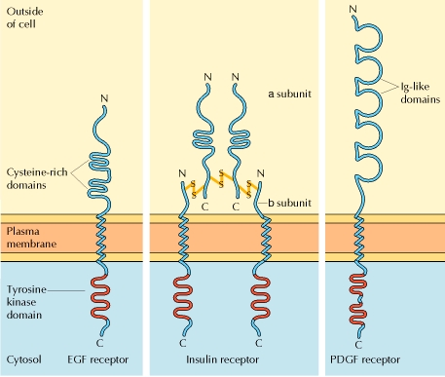
Receptor protein tyrosine kinase (RTK)
Some receptors are directly linked to intracellular enzymes.
RTKs have the enzymatic activity as part of the protein itself.
Binding of ligands extraellularly activates the cytosolic kinase domains, resulting in phosphorylation of both the receptors themselves and intracellular target proteins.

Slide 19
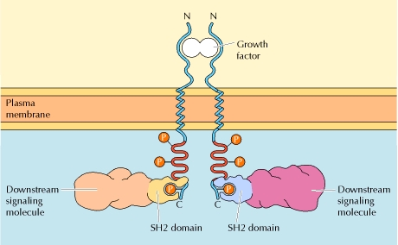
Mechanism of activation of RTKs

Slide 20
How does autophosphorylation activate signaling?
Autophosphorylation activates signaling by:
First, phosphorylation of tyrosines within the kinase domain increases the kinase activity
Second, phosphorylation of tyrosines outside the kinase domain creates high-affinity binding sites for the binding of other signaling proteins

Slide 21
Nonreceptor protein tyrosine kinases Cytokine receptor superfamily
Examples: JAK and Src

Slide 22
Other examples
Protein-tyrosine phosphatases: activation and inhibition roles
Protein-serine/threonine kinase: transforming growth factor β (TGF-β)
Receptor guanylyl cyclases
Protease-associated receptor: tumor necrosis factor (TNF)

Slide 23
Second messengers

Slide 24
Synthesis and degradation of cAMP

Slide 25
Regulation of protein kinase A by cAMP

Slide 26
Regulation of glycogen metabolism
No glycogen synthesis

Slide 27
Cyclic AMP-inducible gene expression
The free catalytic subunit of protein kinase A translocates into the nucleus and phosphorylates the transcription factor CREB (CRE-binding protein), leading to expression of cAMP-inducible genes.

Slide 28
Regulation by dephosphorylation
The phosphorylation of target proteins by protein kinase A is reversed by the action of protein phosphatase 1.

Slide 29
Phospholipids and Ca²⁺

Slide 30
Ca²⁺/calmodulin
Ca²⁺ binds to calmodulin, which regulates many proteins such as:
Ca²⁺/calmodulin-dependent protein kinases signals actin-myosin contraction.
CaM kinases regulates the synthesis and release of neurotransmitters.
CREB (at same site as PKA).

Slide 31
Why are second messengers good?
Second messengers are often free to diffuse to other compartments of the cell
The signal may be amplified significantly in the generation of second messengers
The use of common second messengers in multiple signaling pathways often results in cross-talk between different signaling pathways

Slide 32
Signaling pathways

Slide 33
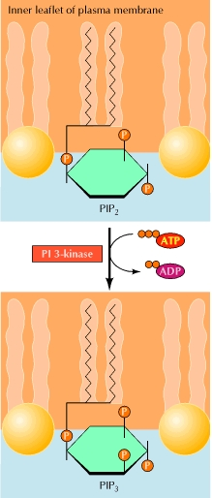
PI-3 kinase and AKT pathway
Cell survival

Slide 34
mTOR pathway and autophagy
X

Slide 35
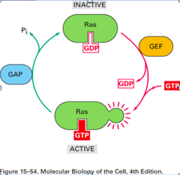
Ras activation by RTKs
Ras a member of the small GTP-binding protein

Slide 36
MAP kinase pathway

Slide 37
ERK induction of immediate-early genes
ERK translocates to the nucleus and phosphorylates the transcription factor Elk-1.
Elk-1 binds to the serum response element (SRE) in a complex with serum response factor (SRF).
Phosphorylation stimulates Elk-1 and expression of immediate-early genes.
These genes stimulate expression of secondary response genes.
The ERK signaling leads to cell proliferation, survival, and differentiation.

Slide 38
Regulation of gene expression by STATs
STATs (transcription factors) link non-receptor tyrosine kinase pathways (like JAK pathway) to MAP kinase-regulated RTK pathways.
Phosphorylation of STATs by the receptors themselves or receptor-associated kinases promotes their dimerization and translocation to the nucleus, where they stimulate transcription of their target genes.

Slide 39
NF-κB signaling
Tumor necrosis factor activates its receptor TNF receptor and induces inflammation and cell death via activation of the transcription factor NF-κB by stimulating the phosphorylation and degradation of IκB.

Slide 40
Wnt signaling
Wnt proteins are growth factors that bind to the Frizzled receptors and block β-catenin degradation.
β-catenin can then translocate into nucleus and activate gene expression by Tcf.
Remember:
β-catenin links cadherins to actin.

Slide 41
Role of adhesion molecules in signaling
Interaction of cadherins with cell surface receptors result in dual regulation and signaling and promotion of cell survival.

Slide 42
The Rho subfamily
Members of the Rho subfamily of small GTP-binding proteins (including Rho, Rac, and Cdc42) regulate the organization of the actin cytoskeleton (cell motility, cell adhesion, and cytokinesis).

Slide 43
Biological effects
Rho
Rac
Cdc42

