Slide 2
Lecture 8: the extracellular matrix and cell-cell interaction
Dr. Mamoun Ahram
Faculty of Medicine
Second year, Second semester, 2014-2014
Principles of Genetics and Molecular Biology

Slide 3
The extracellular matrix

Slide 4
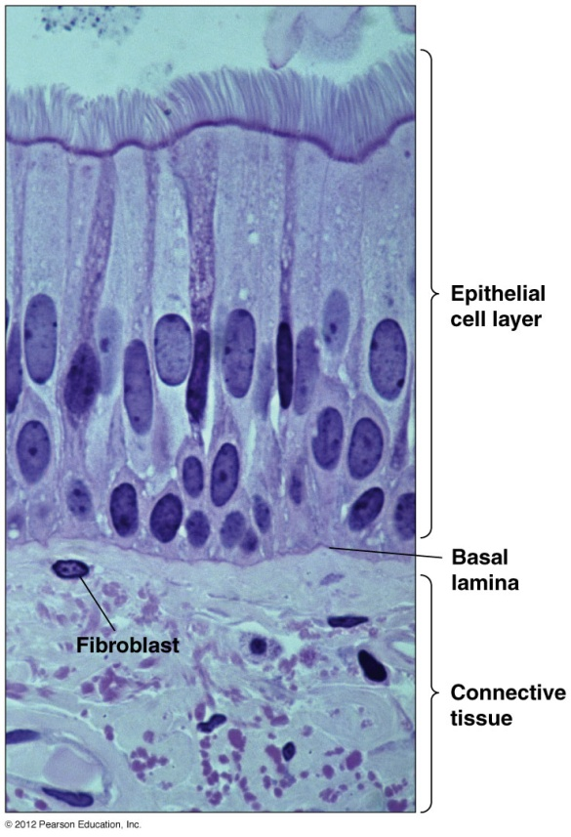
What is it?
The extracellular matrix fills the spaces between cells and binds cells and tissues together. Types:
Basal laminae: thin, sheetlike, structure upon which layers of epithelial cells rest
it supporting sheets of epithelial cells
It surrounds muscle cells, adipose cells, and peripheral nerves.
Connective tissues
Loose network of proteins and carbohydrates underneath epithelial cell layers where fibroblasts are distributed.
Others: bone, tendon, and cartilage.

Slide 5
Matrix structural proteins
Tough fibrous proteins embedded in a gel-like polysaccharide ground substance.
Adhesion proteins that link components of the matrix both to one another and to attached cells.
The of basal laminae is formed of matrix components that differ from those found in connective tissues.
Tendons contain a high proportion of fibrous proteins
Cartilage contains a high concentration of polysaccharides that form a firm compression-resistant gel.
In bone, the extracellular matrix is hardened by deposition of calcium phosphate crystals.

Slide 6
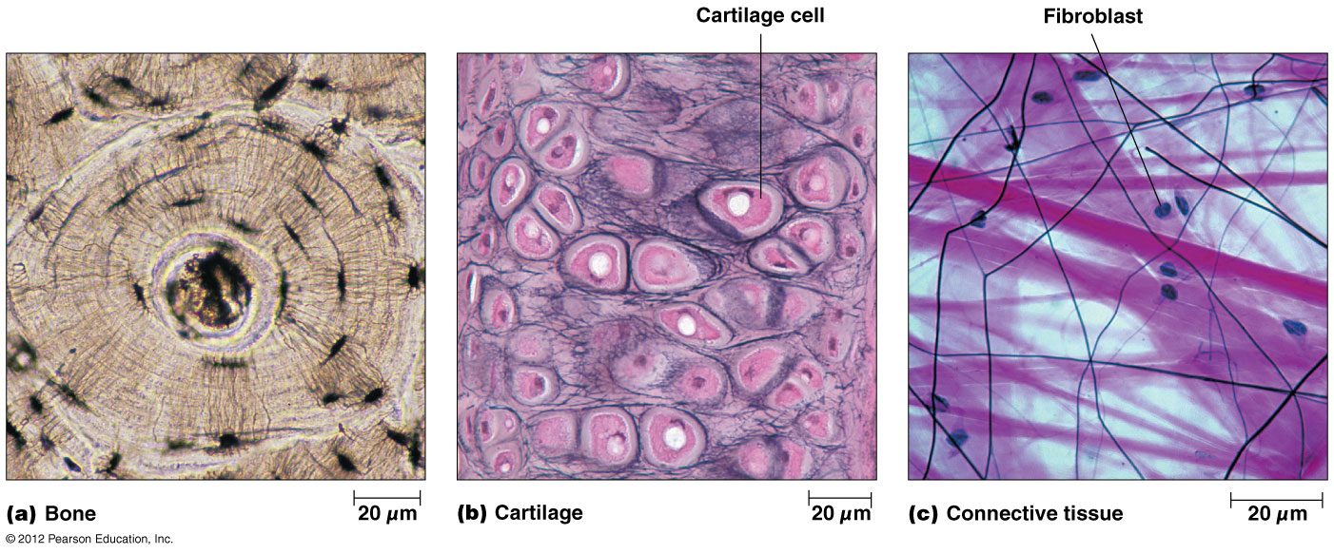

Slide 7
The collagens
The most abundant proteins in mammals (25% of the total protein mass).
Long, stiff, triple-stranded helical structure made of three α chains
A basic unit of mature collagen is called tropocollagen.
Rich in glycine (33%), proline (13%), and hydroxyproline (9%)
Sequence is (pro-Gly-X) or (hydroxypro-Gly-X)
Contains hydroxylysine (attachment of polysaccharides)
Crosslinking of chains via lysine and aldolysine via the action of lysyl oxidase

Slide 8
Types of collagens
30 collagen genes that form >20 different types of collagen that resist tissue stretching.
Types:
Fibrillar collagens
Fibril-associated collagens
Network-forming collagens
Anchoring fibrils
Transmembrane collagens

Slide 9
Types of fibrillar collagens
Type I: most connective tissues (Long, aligned in parallel to each other, and rigid (fit to be in bone structure)
Type II: cartilage and vitreous humor
smaller in diameter than type I and oriented randomly in the viscous proteoglycan matrix
rigid macromolecules, but compressible (to resist large deformations in shape and absorb shocks)
Type III: extensible tissues (skin and lung)
Type XI: cartilage
Type XXIV: bone and cornea
Type XXVII: eye, ear, and lung

Slide 10
Assembly of fibrillar collagens
After secretion, they assemble into collagen fibrils (thin structures visible in electron micrographs).
Collagen fibrils aggregate into collagen fibers (larger, cable-like bundles seen in the light microscope)

Slide 11
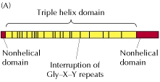
Others
Fibril-associated collagens
Collagen types IX and XII: link fibrils to one another and to other components in the ECM.
Network-forming collagens
Types IV: constituent of the basal laminae.
Anchoring fibrils
Associate network-forming collagens to fibrillar collagens

Slide 12
Synthesis of collagen
Individual collagen polypeptide chains are synthesized into the endoplasmic reticulum (ER) as pro-α chains.
In the ER, selected prolines and lysines are hydroxylated and some of the hydroxylysines are glycosylated.
One α chain combines with two others forming procollagen.
During or following exocytosis, extracellular enzymes, the procollagen peptidases, remove the N-terminal and C-terminal propeptides forming tropocollagen (or simply collagen).
Excision of both propeptides allows the collagen molecules to polymerize into normal fibrils in the extracellular space.

Slide 13
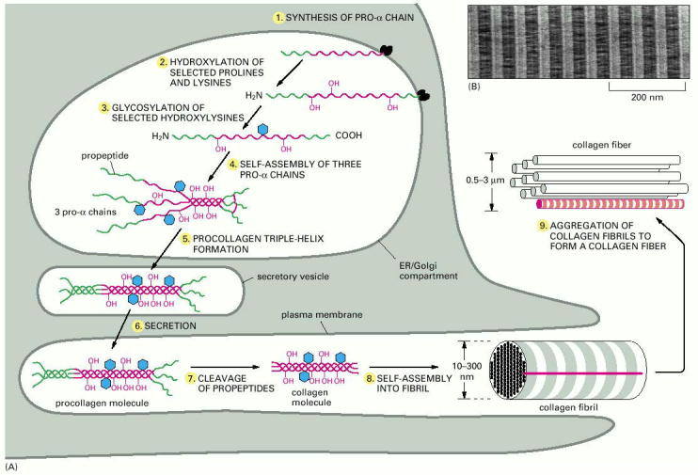

Slide 14
Fibrillar vs. network-forming collagens
The structure of network-forming collagens is interrupted by one or two short nonhelical domains, which makes the molecules more flexible than fibrillar collagen molecules.
Network-forming collagens are not cleaved after secretion and therefore retain their propeptides
Network-forming collagens do not aggregate with one another to form fibrils in the extracellular space.

Slide 15
Premature cleavage
The potentially catastrophic assembly of fibrils within the cell does not occur because:
The propeptides inhibit fibril formation.
Lysyl oxidase, which catalyzes formation of reactive aldehydes, is an extracellular enzyme.

Slide 16
Collagen-related diseases
Collagen is highly crosslinked in tissues where tensile strength is required such as Achilles tendon
If crosslinking is inhibited, the tensile strength of fibers is greatly reduced, collagenous tissues become fragile, and structures tend to tear (skin, tendon, and blood vessels)

Slide 17
Scurvy
Deficiency of vitamin C results in insufficient formation of hydroxyproline and, hence, poor synthesis of collagen, formation of unstable triple helices.
Nonhydroxylated procollagen chains are then degraded within the cell.
Symptoms: skin and gum lesions and weak blood vessels

Slide 18
Osteogenesis imperfecta (Brittle-bone disease)
“Osteogenesis imperfecta" = imperfect bone formation
A genetic disorder of several forms that cause fragile, soft, brittle, and easily broken bones.
Four types of osteogenesis imperfecta designated as type I through type IV
Type I: the mildest form of the condition
Type II: the most severe form that results in death in utero or shortly after birth
Milder forms generate a severe crippling disease

Slide 19
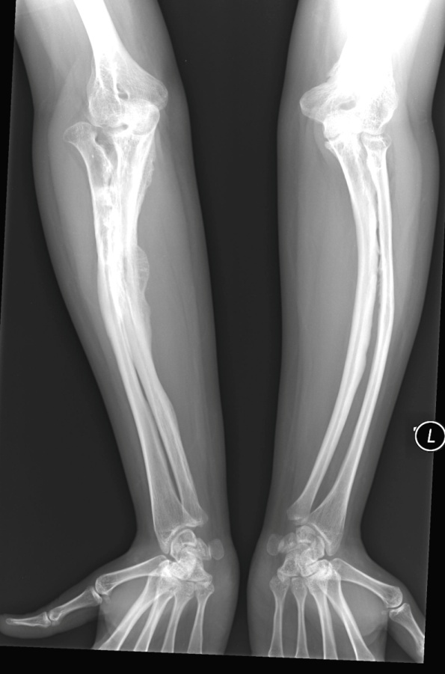
Mutations of OI
Mutations in the COL1A1 and COL1A2 genes that interfere with the assembly of type I collagen.
Defective collagen weakens connective tissues, particularly bone, resulting in the characteristic features of OI
OI types I, II, and IV have an autosomal dominant pattern of inheritance
One copy of the altered gene is sufficient to cause the condition

Slide 20
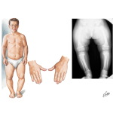
Chondrodysplasias
Mutations affecting type II collagen cause chondrodysplasias, characterized by abnormal cartilage, which leads to bone and joint deformities.

Slide 21
Ehlers-Danlos syndrome
A heterogeneous group of disorders that affect the skin, bones, blood vessels, and other organs.
The signs and symptoms vary from mild to life-threatening.
All result from defects in collagen synthesis and/or processing.
Mutations in type I, III, or V collagen or in the synthesis of collagen processing enzymes like procollagen N-peptidase, or lysyl hydroxylase
Major manifestations are skin fragility and hyperextensibility and joint hypermobility.

Slide 22
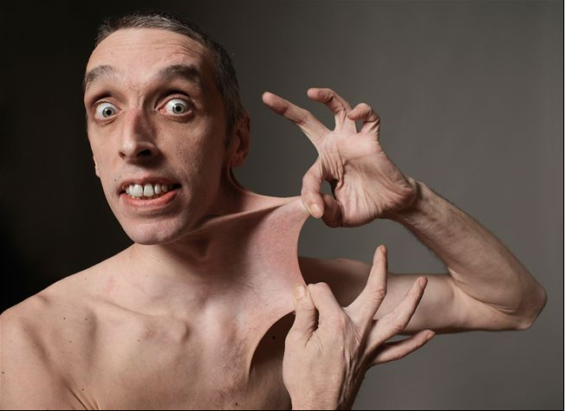
Type III EDS
The most clinically important mutations are found in the gene of type III collagen.
Since type III collagen is a major component of arteries, mutations affecting type III collagen result in fragile blood vessels.
Other symptoms include stretchy skin and hypermobile joints.

Slide 23
Elastin
The main component of elastic fibers is elastin
Highly hydrophobic
Rich in proline and glycine.
Contains some hydroxyproline, but no hydroxylysine
Not glycosylated

Slide 24
Formation of elastic network
Secretion of tropoelastin
Assembly into elastic fibers
Crosslinking via lysines

Slide 25
Elastin structure
The elastin protein is composed largely of two types of short segments that alternate along the polypeptide chain:
hydrophobic segments, which are responsible for the elastic properties of the molecule; and
alanine- and lysine-rich a-helical segments, which form cross-links between adjacent molecules

Slide 26
Function of elastic fiber
Elastin is the dominant extracellular matrix protein in arteries.
The normal elasticity of an artery restrains the proliferation of these cells.
Abnormal or deficiency of the elastin results in excessive proliferation of smooth muscle cells in the arterial wall and narrowing of the aorta.

Slide 27
Microfibrils
The elastin core is covered with a sheath of microfibrils (composed of a number of distinct glycoproteins, including the large glycoprotein fibrillin, which binds to elastin and is essential for the integrity of elastic fibers).
Marfan's syndrome: mutated fibrillin, rupture of aorta.

Slide 28
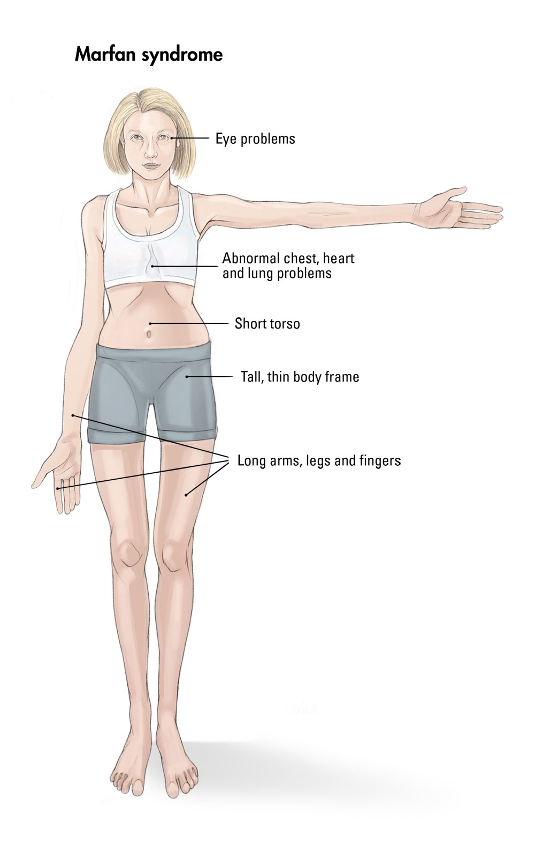
Marfan's syndrome
Due to mutated fibrillin
Rupture of aorta.
Others: A tall, thin build; Long arms, legs, fingers, and toes and flexible joints; Scoliosis, or curvature of the spine; A chest that sinks in or sticks out; Crowded teeth; Flat feet.

Slide 29
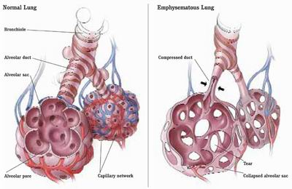
Emphysema (destructive lung disease)
Due to a dysfunctional alpha-1 antitrypsin deficiency leading to increased activity of elastase in lungs
The lysine to-glutamate mutation causes protein misfolding, formation of an aggregate and block of ER export.
Cigarette smoking also inactivates alpha 1-antitrypsin by oxidizing essential methionine residues, decreasing the enzyme activity by a factor of 2000.

Slide 30
Matrix polysaccharides
Glycosaminoglycans (GAGs): Polysaccharides of repeated disaccarides
One is either N-acetylglucosamine or N-acetylgalactosamine
The other is usually acidic (either glucuronic acid or iduronic acid) → highly negatively charged
Modified by a sulfate groups.
Exist as proteoglycans
Some are cell surface proteins with either transmembrane domains (syndecans) or GPI anchors (glycipans) interacting with integrins.
Hyaluronan: no sulfate, not a proteoglycan

Slide 31
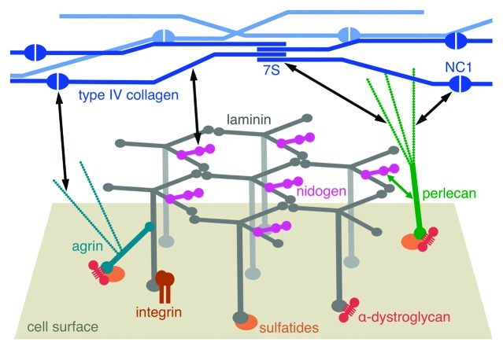
Perlecan
Proteoglycans bind to matrix proteins forming gel-like networks
Example: perlecan
Heparan sulfatee proteoglycan + collagen and laminin in basal laminae

Slide 32
Aggregan
A large proteoglycan consisting of more than 100 chondroitin sulfate chains joined to a core protein.
Multiple aggrecan molecules bind to long chains of hyaluronan that become trapped in the collagen network, forming large complexes in the ECM of cartilage.

Slide 33
Matrix adhesion proteins
They link matrix proteins with one another and to the surfaces of cells.
Fibronectin: the principal adhesion protein of connective tissues.
A dimeric glycoprotein that is crosslinked into fibrils by disulfide bonds.
Binds to collagen and GAGs
Binds to cell surface proteins like integrins linking cells to the ECM

Slide 34
Laminin
Found in basal laminae
T-shaped heterodimers with binding sites for cell surface receptors, type IV collagen, and perlecan.
laminins are tightly associated with another adhesion protein, called nidogen, which also binds to type IV collagen, all of which form crosslinked networks in the basal lamina.

Slide 35
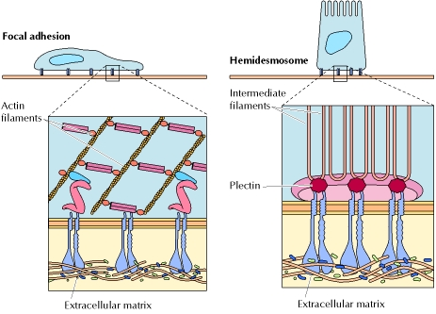
Cell-matrix interactions Role of integrins
integrins are a family of transmembrane heterodimers (α and β)
They bind to short sequences present in ECM proteins.
They also anchor the cytoskeleton at focal adhesions and hemidesmosomes.

Slide 36
Development of focal adhesion
Activation of integrin and binding to ECM
Recruitment of additional integrins forming focal complex
Development of focal adhesion

Slide 37
Cell-cell interaction

Slide 38
Cell Adhesion Molecules
Family | Ligands recognized | Stable cell junctions
Selectins | Carbohydrates | No
Integrins | Extracellular matrix | Focal adhesions and hemidesmosomes
 | Members of Ig superfamily | No
Ig superfamily | Integrins | No
 | Homophilic interactions | No
Cadherins | Homophilic interactions | Adherens junctions and desmosomes

Slide 39
Role of Selectins in leukocyte-endothelial cell interaction

Slide 40
Homophilic vs. heterophilic interaction

Slide 41
Cadherins
Selective adhesion between embryonic cells and formation of stable junctions between cells in tissues.
Classic cadherins
E-cadherin: epithelial cells
N-cadherin: neural cells
P-cadherin: placental cells
Desmosomal cadherins
7-Transmembrane cadherins

Slide 42
Adherens junctions

Slide 43
Desmosomes
Desmosomal cadherins
heterophilic interaction

Slide 44
Tight junctions
They are usually associated with adherens junctions and desmosomes in a junctional complex
Functions:
Separation of the two sides of cells
Example: lumen of the intestine from the underlying connective tissue
Block free passage of molecules (including ions) between the cells of epithelial sheets.
Separation of the apical and basolateral domains.

Slide 45
Molecular composition of tight junctions
a network of protein strands that continues around the entire circumference of the cell
Each strand in these networks is composed of transmembrane proteins (claudins, occludin, and JAMs) that bind to similar proteins on adjacent cells, thereby sealing the space between their plasma membranes

Slide 46
Tight junction proteins
The three proteins interact with similar proteins on adjacent cells.
They also interact with the actin cytoskeleton via zonula occludens protein.

Slide 47
Gap junctions
They provide direct connections between the cytoplasms of adjacent cells as open channels allowing ions and small molecules including signaling molecules to diffuse freely between neighboring cells, but preventing the passage of proteins and nucleic acids.

Slide 48
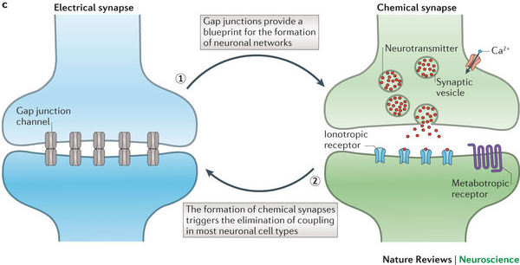
Molecular composition of gap junctions
They are made of transmembrane proteins called connexins where six of them assemble to form a connexon (a cylinder with an open aqueous pore in its center).
Specilaized connexon = electrical synapse

Slide 49
Gap junction diseases
Charcot-Marie-Toth disease (degeneration of peripheral myelinated nerves)
Deafness: inability to rapidly exchange K+
Cataracts: inability to obtain nutrients from the lens epithelial cells
Skin disease

