Slide 2
Lecture 7: the cytoskeleton and cell movement (Microtubules and intermediate filaments)
Dr. Mamoun Ahram
Faculty of Medicine
Second year, Second semester, 2014-2014
Principles of Genetics and Molecular Biology

Slide 3
Overview
Second predominant component of cytoskeleton
They are rigid hollow rods
They are dynamic structures that undergo continual assembly and disassembly within the cell.
Functions:
Cell shape
Cell movements (some forms of cell locomotion)
Intracellular transport of organelles
Separation of chromosomes during mitosis

Slide 4
Structure of microtubules
Microtubules are composed of a single type of globular protein, called tubulin.
Tubulin is a dimer consisting of two closely related polypeptides, α-tubulin and β-tubulin.
γ-tubulin is specifically localized to the centrosome.
It initiates microtubule assembly.

Slide 5
Polymerization of tubulin
Tubulin dimers polymerize to form protofilaments (a hollow core).
Protofilaments are arranged in parallel and are composed of head-to-tail arrays of tubulin dimers.
Microtubules are polar structures : a fast-growing plus end and a slow-growing minus end.
Polarity determines the direction of movement along microtubules.
Both α- and β-tubulin bind GTP

Slide 6
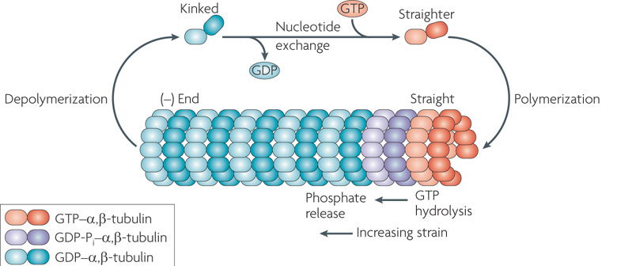
Treadmilling
Microtubules can undergo rapid cycles of assembly and disassembly (treadmilling) where tubulin molecules are continually lost from the minus end and replaced by the addition of tubulin molecules bound to GTP to the plus end.
The GTP bound to β-tubulin is hydrolyzed to GDP during or shortly after polymerization weakening the binding affinity and favoring depolymerization.

Slide 7
Dynamic instability (Rate of poymerization-depolymerization)
Catastrophe occurs when GTP is hydrolyzed at the plus end before new GTP-tubulin is added and there is a transition from growth to shrinkage.
On the other hand, transition from shortening to growth is called rescue.
Shrinkage
Growth

Slide 8
Drugs
Colchicine and colcemid bind tubulin, inhibit polymerization, and block mitosis.
Vinblastine and vincristine bind specifically to tubulin and prevent their polymerization to form microtubules.
Taxol stabilizes microtubule and blocks cell division.

Slide 9
Regulatory proteins
Microtubule-associated proteins (MAPs) such as polymerase regulate growth and shrinkage at the plus end.
depolymerases stimulate shrinkage by accelerating the dissociation of GTP-tubulin from the plus end.
CLASP, a MAP, prevent disassembly (catastrophe) and promote restarting growth (rescue).

Slide 10
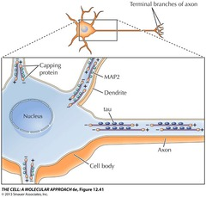
Organization of microtubules within cells Example: neuron
Neurons have two types of processes extend from the cell body:
Dendrites: short; receive stimuli from other nerve cells
Axon; long; carries impulses from the cell body to other cells
In dendrites, microtubules are bound to MAP2 and are oriented in both directions.
Microtubules in axons are bound to tau and are oriented with their plus ends pointing toward the tip of the axon.

Slide 11
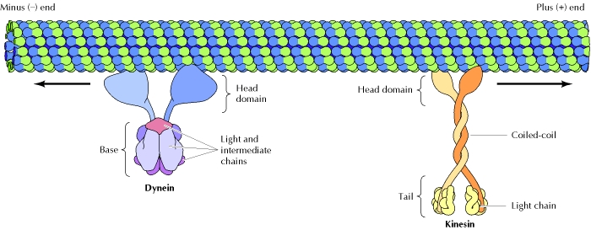
Vesicular transport
Microtubules-motor proteins such as kinesin and dynein move along microtubules in opposite directions
kinesin move toward the plus end and dynein toward the minus end.
In neurons, kinesin assists in transporting vesicles and organelles toward the end of the axon. It gets its energy from the hydrolysis of ATP that is bound to the head domain that also binds to microtubule. The tail portion binds to cell components (e.g., membrane vesicles and organelles.
The head domain of dynein forms the ATP-binding motor domains that are responsible for movement along microtubules. The basal portion of dynein is thought to bind to other subcellular structures, such as organelles and vesicles.

Slide 12
Organelle organizations
kinesin pulls the endoplasmic reticulum toward the cell periphery.
Kinesin positions lysosomes away from the center of the cell
Members of the kinesin family control the movements of mitochondria.
Cytoplasmic dynein positions the Golgi apparatus in the center of the cell.
Both kinesin and dynein transport selective mRNA molecules in cell.

Slide 13
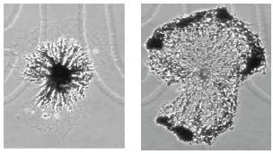
Stimulated movement
Organelles will often have both types of motors on their surface, allowing cells to adjust their position.
Melanocytes position the pigmented organelles, melanosomes, in response to the amount of light.
In the presence of ligh, kinesin moves melanosomes to the periphery of cells.
In the dark, dynein returns the melanosomes to the center of the cell.

Slide 14
Kinesins and diseases
Mutants in certain kinesin proteins reduce the ability of neurons move essential organelles from their cell bodies to their axons leading to neurodegeneration such as amyotrophic lateral sclerosis (ALS).
Mutations in kinesins lead to peripheral neuropathies such as Charcot-Marie-Tooth.

Slide 15
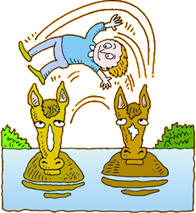
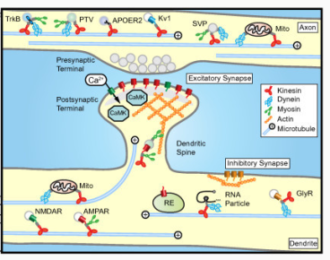
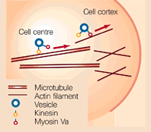
“Changing horses in midstream”
Myosins of actins transport organelles over shorter distances compared to microtubules’s kinesins and dyneins.
Kinesins and myosins transport organelles from the center of the cell towards the periphery, where myosins take over moving organelles near the plasma membrane.

Slide 16
Intermediate filaments

Slide 17
What are they?
Intermediate filaments have a diameter that is intermediate between those of actin filaments and microtubule.
They provide mechanical strength to cells and tissues.
They are composed of a variety of proteins, which are classified into 5 groups based on similarities between their amino acid sequences.

Slide 18
Types of IFs
Types I and II are expressed in epithelial cells with each type of cell synthesizing at least one type I (acidic) and one type II (neutral/basic) keratin.
Hard keratins are used for production of structures such as hair, nails, and horns.
Soft keratins are abundant in the cytoplasm of epithelial cells.
Type III:
Vimentin, which is found in fibroblasts, smooth muscle cells, and white blood cells.
Desmin is specifically expressed in muscle cells.
Type IV: neurofilament (NF) found in the axons of motor neurons.
Type V: nuclear lamins, omponents of the nuclear envelope.

Slide 19
Types of IFs
Type | Protein | Site of expression
I | Acidic keratins | Epithelial cells
II | Neutral or basic keratins | Epithelial cells
III | Vimentin | Fibroblasts, white blood cells, and other cell types
 | Desmin | Muscle cells
 | Glial fibrillary acidic protein | Glial cells
 | Peripherin | Peripheral neurons
IV | Neurofilament proteins
 | NF-L | Neurons
 | NF-M | Neurons
 | NF-H | Neurons
 | α-Internexin | Neurons
 | Nestin | Stem cells of central nervous system
V | Nuclear lamins | Nuclear lamina of all cell types

Slide 20
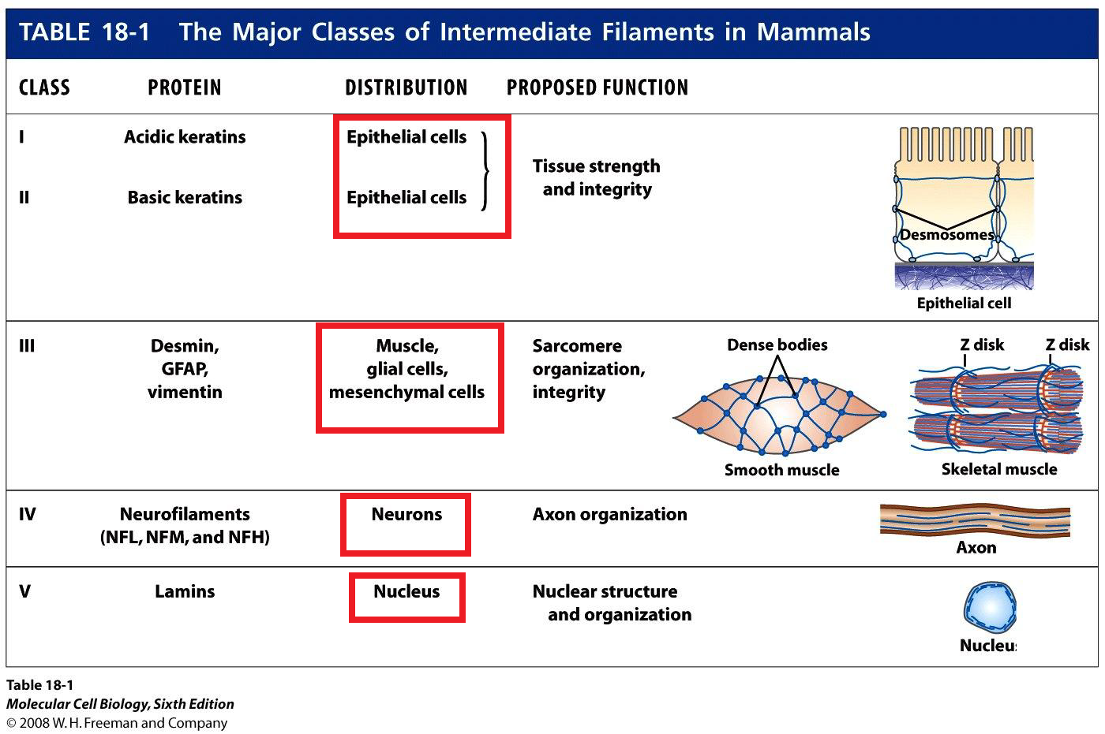
Types of IFs

Slide 21
Structure of IFs
A central α-helical rod domain for filament assembly
Flanking amino- and carboxy-terminal domains that vary among the different intermediate filament proteins in size, sequence, and secondary structure that determine the specific functions of the different intermediate filament proteins.

Slide 22
Assembly of IFs
No polarity
x8

Slide 23
Interaction of IF types
Keratin filaments are always assembled from heterodimers containing one type I and one type II polypeptide.
The type III proteins can assemble into filaments containing only a single polypeptide (e.g., vimentin) or consisting of two different type III proteins (e.g., vimentin plus desmin).
The type III proteins do not form copolymers with the keratins.
α-internexin, a type IV protein, can assemble into filaments by itself, but the NFs copolymerize to form heteropolymers.

Slide 24
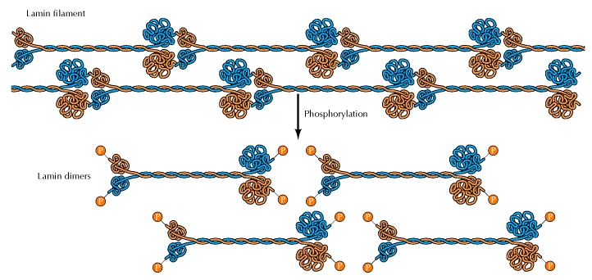
Relative to actins and microtubules
More stable
More dynamic within cells
Not regulated by GTP, but regulated by phosphorylation
When nuclear lamins and vimentins are phosphorylated, they are disassembled.

Slide 25
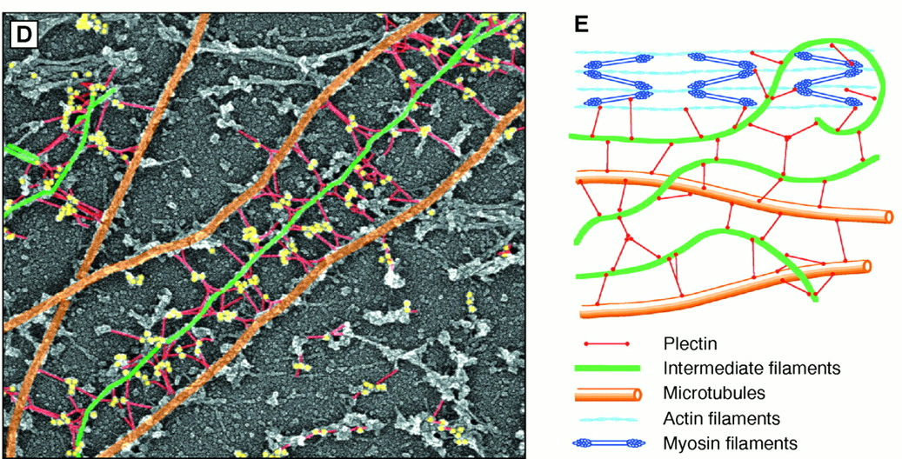
Intracellular Organization of IFs
Both keratin and vimentin filaments attach to the nuclear envelope to position and anchor the nucleus within the cell.
Ifs can associate not only with the plasma membrane but also with the actin filaments and microtubules.
IFs provide a scaffold that integrates the components of the cytoskeleton and organizes the internal structure of the cell.

Slide 26
Examples
Desmin connects the actin filaments in muscle cells to one another and to the plasma membrane, thereby linking the actions of individual contractile elements.
Neurofilaments in mature neurons are anchored to actin filaments and microtubules by neuronal members of the plakin family.
Neurofilaments provide mechanical support and stabilize the cytoskeleton in the long, thin axons of nerve cells.

Slide 27
Plectin (example)
Microtubules
IF
Plectin
Actin
Plectin bridges intermediate filaments to actin filaments and stabilizing them and increasing the mechanical stability of the cell.

Slide 28
The keratin filaments of epithelial cells are tightly anchored to the plasma membrane at two areas of specialized cell contacts, desmosomes and hemidesmosomes
Desmosomes
Hhemidesmosomes
Keratin filaments anchored to both sides of desmosomes serve as a mechanical link, thereby providing mechanical stability to the entire tissue.

Slide 29
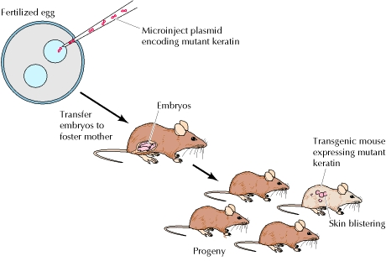
IFs and diseases
Previously, disruption of vimentin in fibroblast cells did not affect cell growth or movement.
Hypothesis: IFs are most needed to strengthen the cytoskeleton of cells in the tissues of multicellular organisms.
Support; transgenic mice expressing mutated kerains resulted in mice with severe skin abnormalities (blisters due to epidermal cell lysis following mild mechanical trauma).

Slide 30
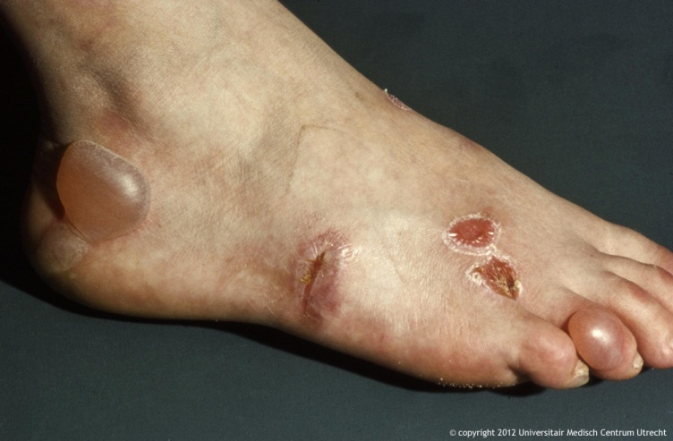
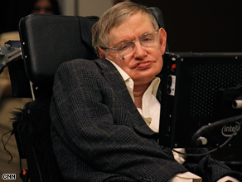
Human diseases
Human epidermolysis bullosa simplex is caused by keratin gene mutations that interfere with the normal assembly of keratin filaments.
Amyotrophic lateral sclerosis (ALS), also known as Lou Gehrig's disease is characterized by the accumulation and abnormal assembly of neurofilaments.

