Slide 2
Lecture 5: the nucleus
Dr. Mamoun Ahram
Faculty of Medicine
Second year, Second semester, 2014-2014
Principles of Genetics and Molecular Biology

Slide 3
Structure and function of a nucleus
A repository of genetic information
The nuclear membrane, known as the nuclear envelope, adds an additional level of gene regulation post-transcriptionally.

Slide 4
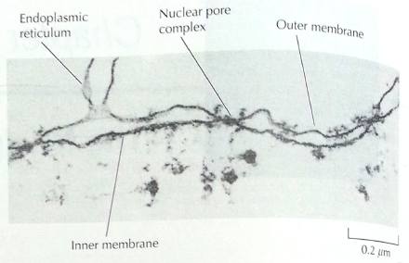
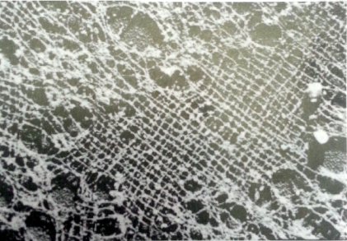
The nuclear envelope
The perinuclear space resembles the ER lumen
A two-membrane system
The outer membrane is continuous with the ER and is functionally similar to it with ribosomes on the outside surface, but it has different protein composition.
The inner membrane is unique having proteins that bind the lamina.
It is underlied by a matrix of proteins known nuclear lamina

Slide 5
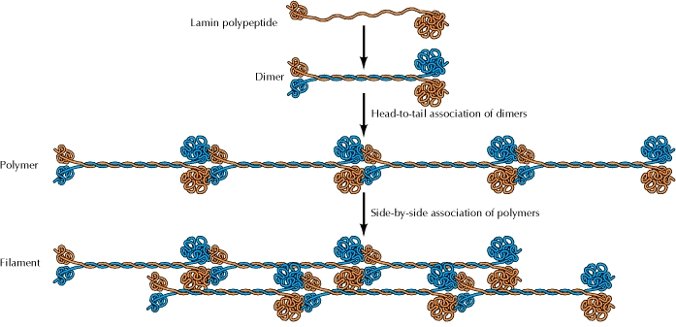
The nuclear lamina
a fibrous meshwork of proteins called lamins that provide structural support to the nucleus.
Three lamin genes that code for 7 proteins that form higher order structure

Slide 6
Nuclear envelope-lamina interaction
The LINC complex;
Connects the nuclear lamina with cytoskeleton
Lamina-chromatin interaction via DNA-binding proteins (histomes and non-histone proteins) localizes heterochromatin (inactive DNA) in the periphery of the nucleus.

Slide 7
Nuclear lamina diseases
X-linked Emery-Dreifuss muscular dystrophy: mutation in emerin
Autosomal dominant form of Emery-Dreifuss muscular dystrophy: mutations in lamins A and C
Mutations in A-type lamins can cause several other inherited disorders such as:
Marie-Charcot-Toth disease type 2B1 (muscle wasting)
Hutchinson-Gilford progeria (premature aging)
Dunnigan-type partial lipodystrophy
ONE GENE,
MANY DISEASES
“Gene expression” hypothesis explains tissue-specific changes
“Mechanical stress” hypothesis explains muscular dystrophy.

Slide 8
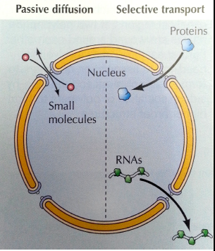
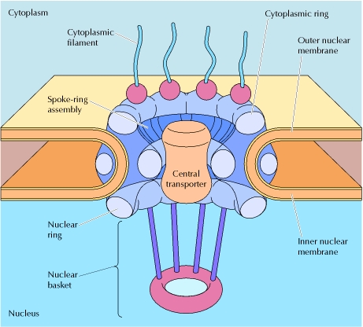
He nuclear pore complex
It is composed of nucleoporins.
It allows for molecular transport.
Spokes
Central
channel

Slide 9
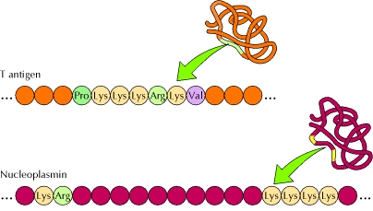
Nuclear localization sequence
They are recognized and targeted by nuclear transport receptors
Features:
basic amino acids
Continuous, bipartite, or structural (signal patch)
Signal patch
These can be mutated

Slide 10
Protein import across the nuclear pore: role of Ran
Regulation and distribution of Ran
Mechanism of protein import

Slide 11
Nuclear export
Complexes between target proteins bearing nuclear export signals (NES), exportins, and Ran/ GTP form in the nucleus.
Following transport through the nuclear pore complex, Ran GAP stimulates the hydrolysis of bound GTP, leading to formation of Ran/GDP and release of the target protein and exportin in the cytoplasm.
Exportin is then transported back to the nucleus.

Slide 12
Regulation of protein import

Slide 13
Regulation of steroid receptors (NR)
3. Dissociation of heat shock proteins
4. Dimerization
2. Hormone binding
5. Translocation
1. No ligand, NR is cytosolic
8. Gene expression
6. Specific NR-DNA binding

Slide 14
Main domains of NR
A ligand-binding domain (LBD)
A DNA-binding domain (DBD)
An activation function domain (AF) that regulates transcription.
These domain are independent of each other and can be separated.

Slide 15
Yeast two-hybrid system (p. 69)
It is used to test of two proteins interact.
Only if proteins X and Y physically interact with one another are the DBD and AD brought together to reconstitute a functionally active factor that binds to upstream specific sequences of the reporter gene and activates expression.
Watch this animation
http://www.sumanasinc.com/webcontent/animations/content/yeasttwohybrid.html

Slide 16
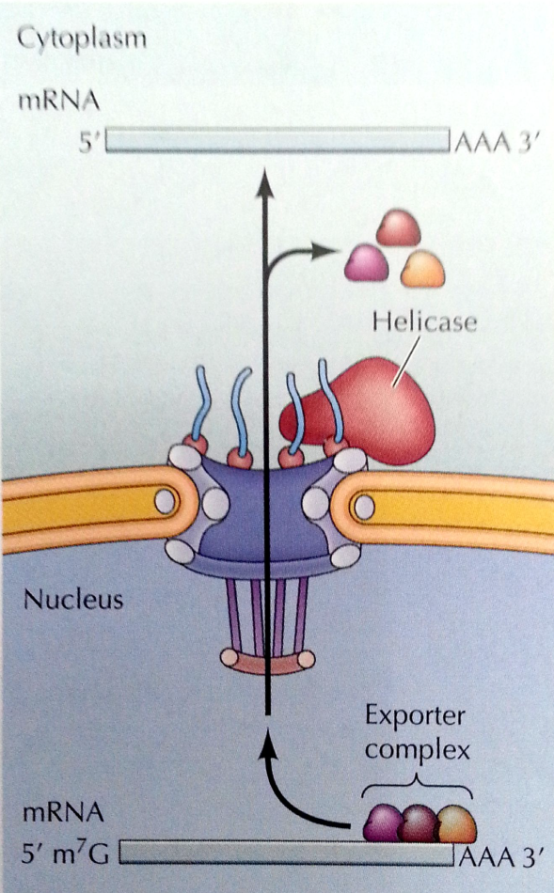
RNA transport
RNAs such as rRNA, tRNA, and miRNA are transported across the nuclear envelope as ribonucleoproteins in a Ran/GTP- and exportin-dependent manner, but mRNA is not.
Releases mRNA form proteins and prevents its recycle into the nucleus
A complex of proteins

Slide 17
Transport of small nuclear RNA (snRNA)
2. Formation of snRNPs
3. Import into nucleus by importin
1. Export into cytoplasm by exportin

Slide 18
Internal organization of the nucleus
Nuclear bodies: non-membranous, discrete regions with specific functions
Nucleolus: rRNA synthesis and processing
PML bodies: interact with chromatin and a site of accumulation of proteins such as transcription factors, chromatin-modifying proteins, and DNA repair enzymes
Cajal bodies: site for snRNP assembly
Nuclear speckles: RNA splicing

