Slide 1
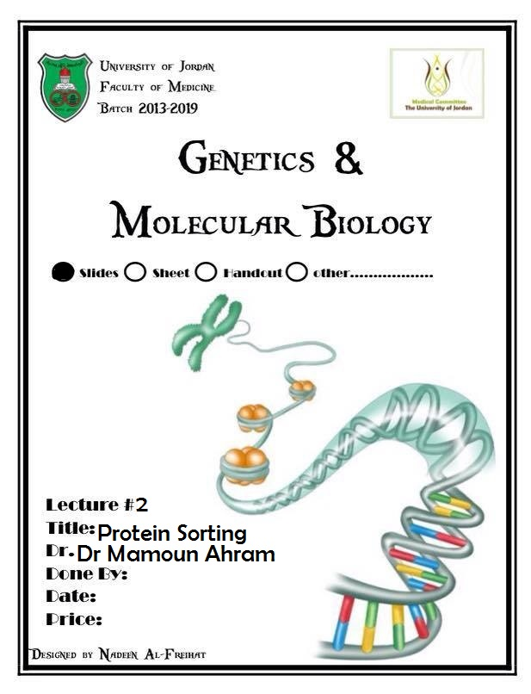

Slide 2
Lecture 2: Protein sorting (endoplasmic reticulum)
Dr. Mamoun Ahram
Faculty of Medicine
Second year, Second semester, 2014-2014
Principles of Genetics and Molecular Biology

Slide 3
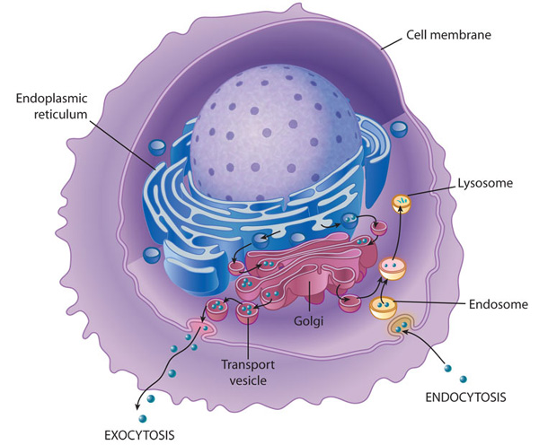
An overview

Slide 4
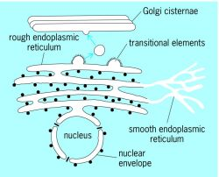
Endoplasmic reticulum (ER)
It is a network of membrane-enclosed tubules and sacs (cisternae) that extends from the nuclear membrane throughout the cytoplasm.
It is the largest organelle of most eukaryotic cells.
The rough ER: covered by ribosomes on its outer surface and functions in protein processing.
The smooth ER: lipid metabolism
Transitional ER: exit of vesicles to Golgi apparatus

Slide 5
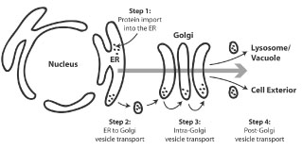
The secretory pathway
Secretory, ER, Golgi apparatus, and lysosomal proteins are initially targeted to the ER.
Most proteins are transferred into the ER while they are being translated on membrane-bound ribosomes (cotranslational translocation).
Cytosolic, nuclear, peroxisomal, and mitochondrial proteins are synthesized on free ribosomes and released into the cytosol.

Slide 6
Ribosomal and protein targeting
All protein synthesis initiates on ribosomes that are free in the cytosol.
Ribosomes are targeted for binding to the ER membrane by the amino acid sequence of the polypeptide at the amino terminus called a signal sequence.
It is then cleaved from the polypeptide chain during its transfer into the ER lumen.

Slide 7
Mechanism of translocation
Step 1: As the signal sequence emerges from the ribosome, it is recognized and bound by the signal recognition particle (SRP).
Step 2: The SRP escorts the complex to the ER membrane, where it binds to the SRP receptor.
Step 3: The SRP is released, the ribosome binds to a membrane translocation complex of Sec61 proteins, and the signal sequence is inserted into a membrane channel.
Step 4: Translation resumes, and the growing polypeptide chain is translocated across the membrane.
Step 5: Cleavage of the signal sequence by signal peptidase releases the polypeptide into the lumen of the ER.

Slide 8
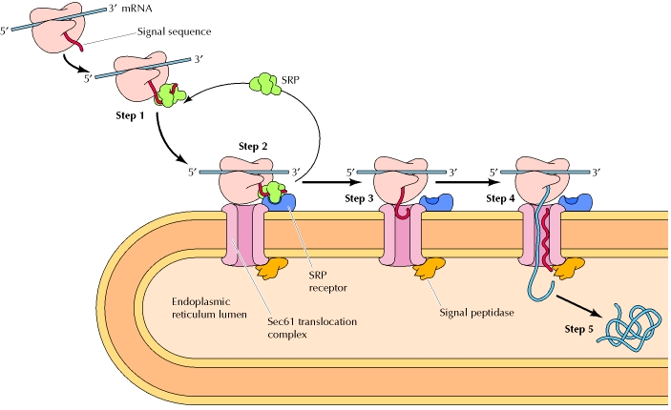

Slide 9
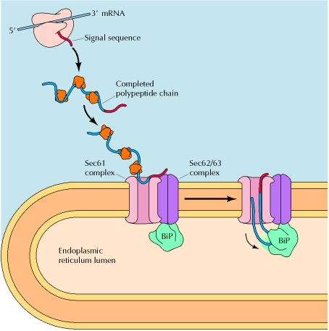
Posttranslational translocation
Proteins are synthesized on free ribosomes and remain unfolded by cytosolic chaperones.
Their signal sequences are recognized by a protein complex, which is associated with the translocon in the ER membrane.
The protein complex is also associated with a chaperone protein (BiP), which drives protein translocation into the ER.
Translocon

Slide 10
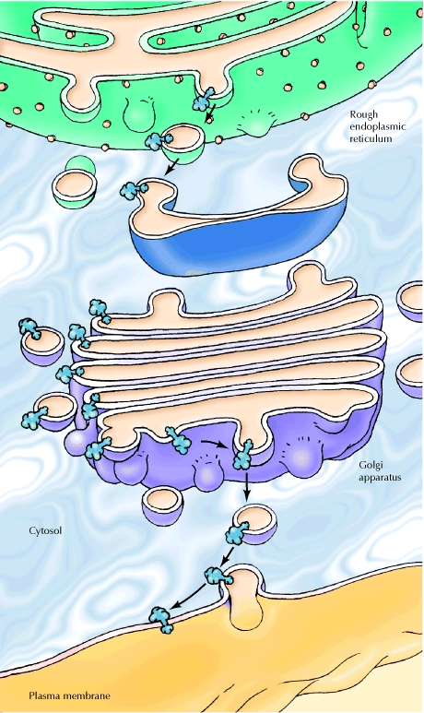
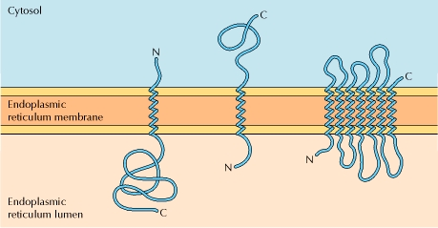
Pathways of protein sorting
Secretory, ER, Golgi apparatus, and lysosomal proteins are released into the lumen of the ER.
Membranous proteins are initially inserted into the ER membrane.
Considerations
Single vs. multiple membrane spanning region
Orientation of N- and C-termini
The lumens of the ER and Golgi apparatus are topologically equivalent to the exterior of the cell.

Slide 11
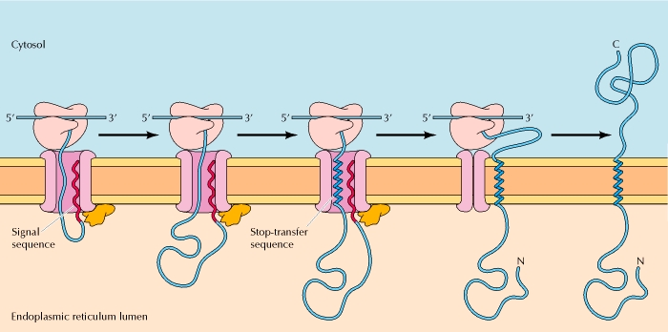
Insertion of a membrane protein (1) N-terminus: in C-terminus: out
The insertion of such proteins in the membrane involves two distinct elements:
A cleavable amino-terminal signal sequence that initiates translocation across the membrane
A transmembrane stop-transfer sequence that anchors the protein in the membrane.
Cleave signal sequence
Stop transfer
Close channel
Move laterally
Signal peptidase

Slide 12
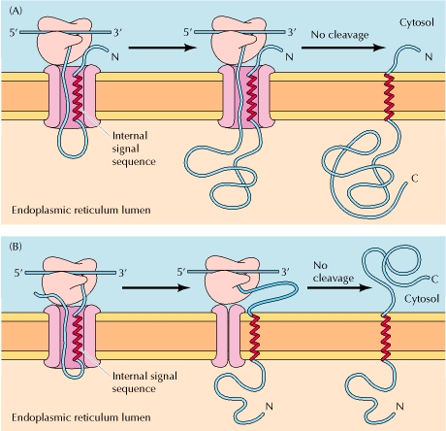
Insertion of a membrane protein (2)
The signal sequence is not cleaved and acts as a membrane-spanning sequence.
Close channel

Slide 13
Insertion of a membrane protein (3)
Close channel
Re-open
channel

Slide 14
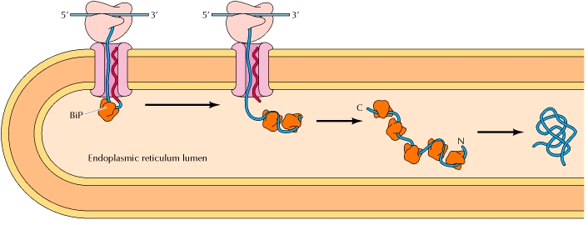
Once inside…
Assembly of multisubunit proteins
protein folding, assisted by the molecular chaperone, that keep protein folded until properly folded
disulfide bond formation by providing an oxidizing environment (the cysosol has a reducing environment) assisted by PDI

Slide 15
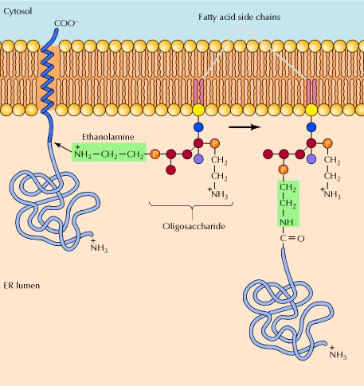
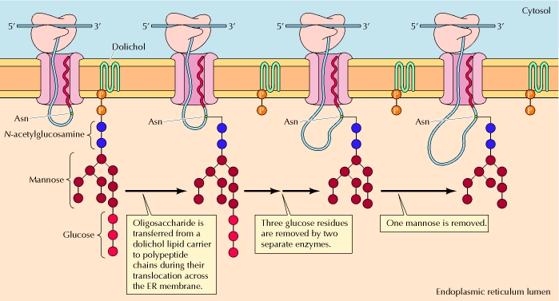
Once inside…
the initial stages of glycosylation at Asn-X-Ser/Thr
Addition of glycolipid anchors to some plasma membrane proteins.

Slide 16
Fate of a glycoprotein

Slide 17
Unfolded protein response (UPR)

Slide 18
Synthesis of phospholipids in ER
Enzymes are buried inside the membrane
phosphatase

Slide 19
Translocation of phospholipids across the ER membrane

Slide 20
Synthesis of ceramide

Slide 21
ER-Golgi intermediate compartment (ERGIC)
Note that topological orientation is maintained

Slide 22
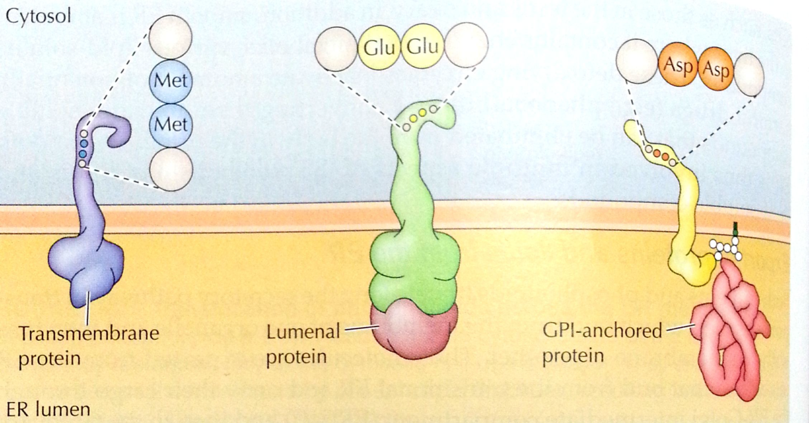
Protein sorting and retention
Many proteins with KDEL sequence (Lys-Asp-Glu-Leu) at C-terminus are retained in the ER lumen.
If sequence is deleted, the protein is transported to the Golgi and secreted from the cell.
Addition of the sequence causes a protein to be retained in the ER.
The retention of some transmembrane proteins in the ER is dictated by short C-terminal KKXX sequences.
Proteins bearing the KDEL and KKXX sequences appear to recycled back to the ER.
Membrane proteins contain di-acidic or di-Met signal sequences.
They can also function as carriers of of GPI-anchored and luminal proteins.

Slide 23
Synthesis of other lipids
Steroid hormones are synthesized from cholesterol in the ER
Large amounts of smooth ER are found in steroid-producing cells, such as those in the testis and ovary
Smooth ER is abundant in the liver, where it contains enzymes that metabolize various lipid-soluble compounds.
The detoxifying enzymes inactivate a number of potentially harmful drugs (e.g., phenobarbital) by converting them to water-soluble compounds that can be eliminated from the body in the urine

