Slide 2
Lecture 1: Introduction
Dr. Mamoun Ahram
Faculty of Medicine
Second year, Second semester, 2014-2014
Principles of Genetics and Molecular Biology

Slide 3
Syllabus and references
Part I: Cell biology (Dr. Mamoun Ahram)
The Cell: A Molecular Approach, Geoffrey M. Cooper and Robert E. Hausmann, 6th edition, Sinauer Associates, 2013.
Part II: Molecular biology (Prof. Said Ismail)
Mark's Basic Medical Biochemistry, Smith, Marks and Lieberman, Lippincott, Williams and Wilkins, 2009.
Part III: Genetics (Prof. Mohammad El-Khateeb
Emery's Elements of Medical Genetics, Muller & Young, Churchil Livingstone, 13th edition, 2011.

Slide 4
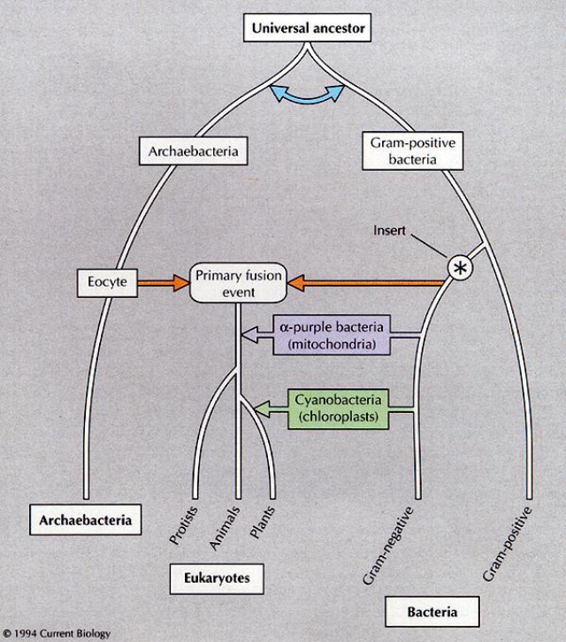
The origin of life

Slide 5
DNA homology

Slide 6
Humans and others

Slide 7
“We are all Arabs”!!
Arabia was indeed the first staging post in the spread of modern humans around the world.
The American Journal of Human Genetics 90, 1–9, February 10, 2012

Slide 8
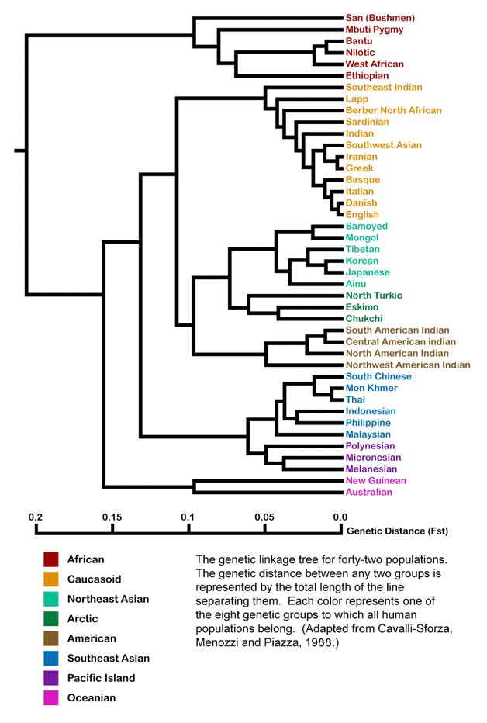
Genetic relatedness of world populations
Cavalli-sforza et al., 1988

Slide 9
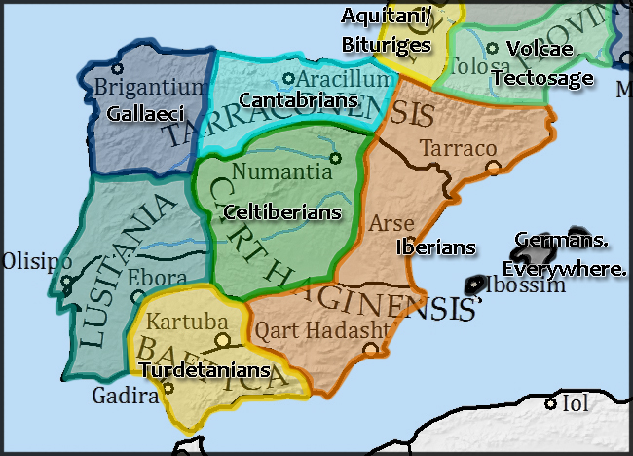
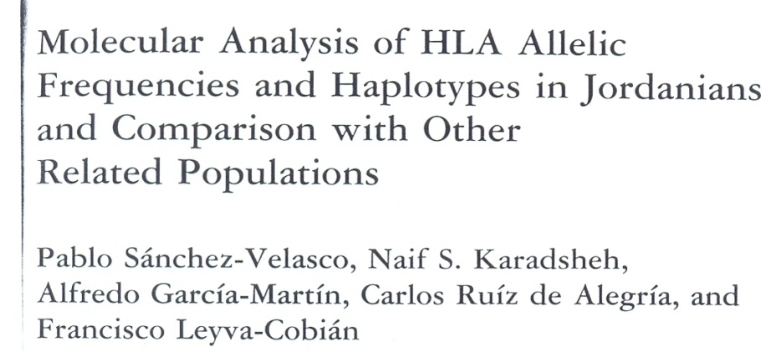
Hum Immunol. 2001 Sep;62(9):901-9.

Slide 10
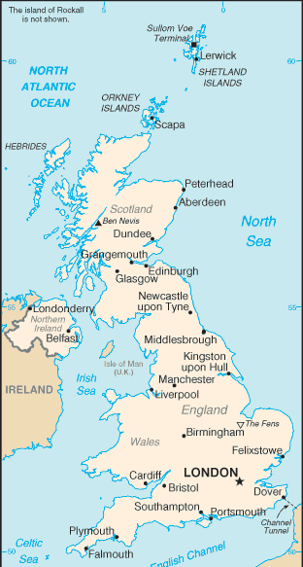
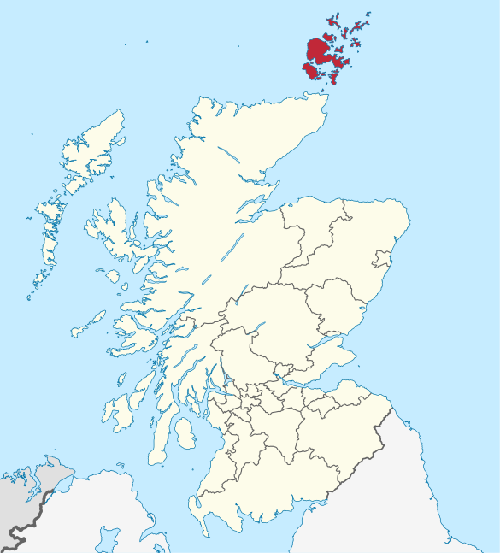
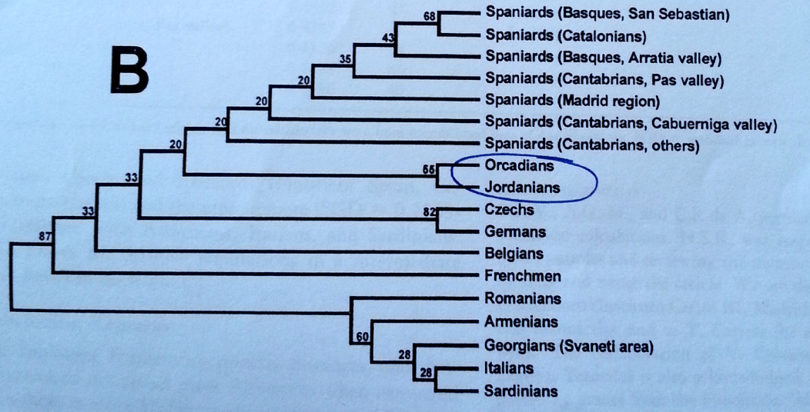

Slide 11
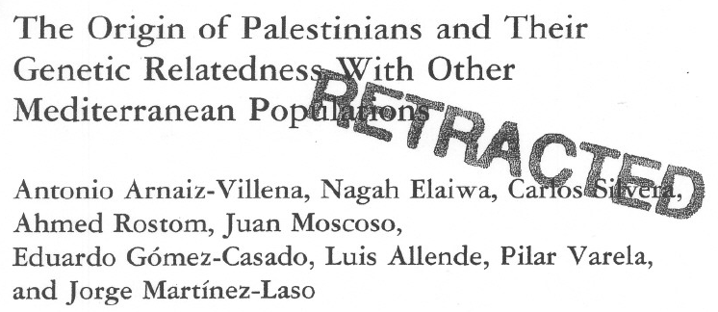

Slide 12
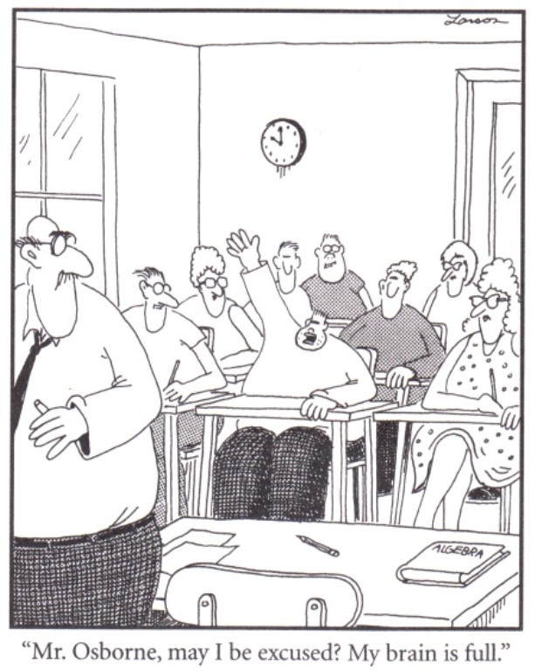
“Dr. Ahram

Slide 13
Model systems

Slide 14
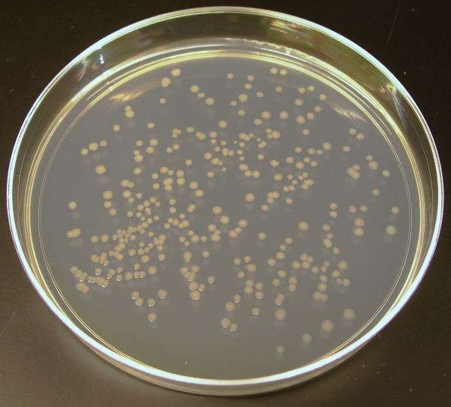
Prokaryotic cells (E. coli)
Simple, rapid growth, small genome.
They are ideal models to study basics of biochemistry and molecular biology.
E. coli is used to understand basic mechanisms of molecular genetics.
It has ~4.6m base pairs/4300 genes/1 chromosome.
They cannot be used to study aspects of eukaryotic cell structure and function.

Slide 15
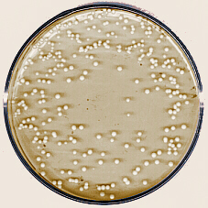
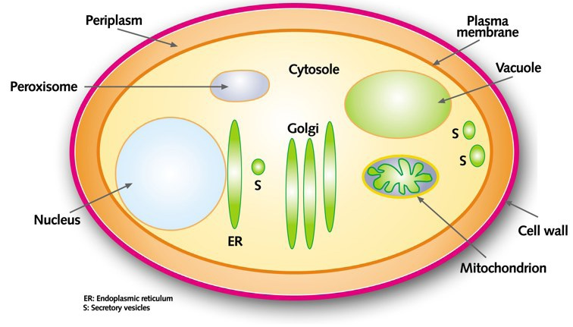
Yeast
The simplest eukaryotes with features of eukaryotic cells.
A distinct nucleus surrounded by a nuclear membrane
A cytoskeleton and subcellular organelles
Growth is rapid and as colonies.
12 million base pairs of DNA/6000 genes/ 16 chromosomes
Used to understand DNA replication, transcription, RNA processing, protein sorting, and regulation of cell division.

Slide 16
Dictyostelium discoideum
A cellular slime mold
More complex genome than yeast’s, but simpler than that of higher eukaryotes’.
can be readily grown in the laboratory and undergo genetic manipulations
Highly mobile cells used to study molecular mechanisms of animal cell movements.
Single cells can aggregate into multicellular structures

Slide 17
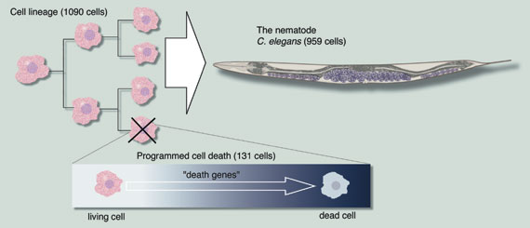
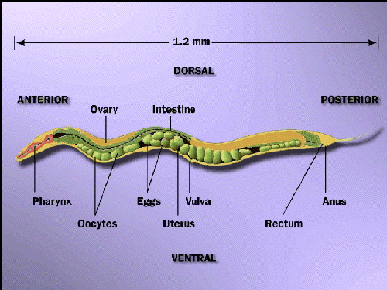
Caenorhabditis elegans
More complex eukaryotes
97m base pairs of DNA/~19,000 genes/6 chromosomes
easily grown in lab and genetically manipulated
Adult worms consist of only 959 somatic cells starting from 1090.
used for studies of animal development and cell differentiation and apoptosis

Slide 18
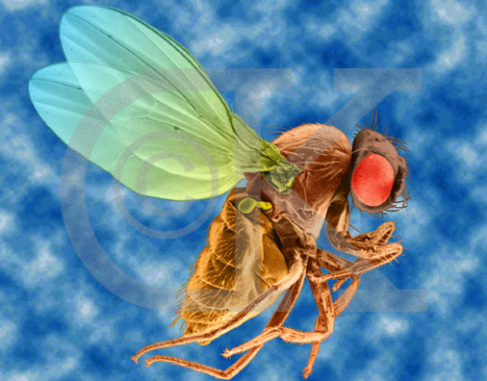
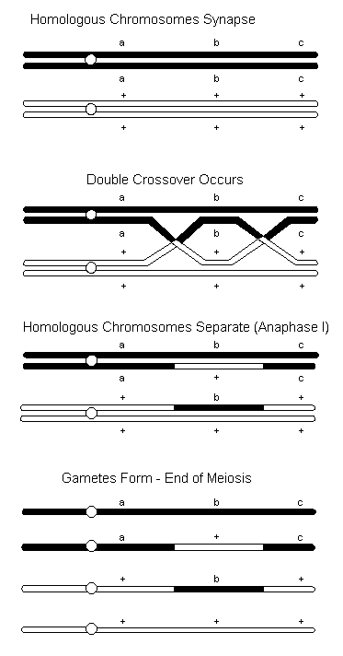
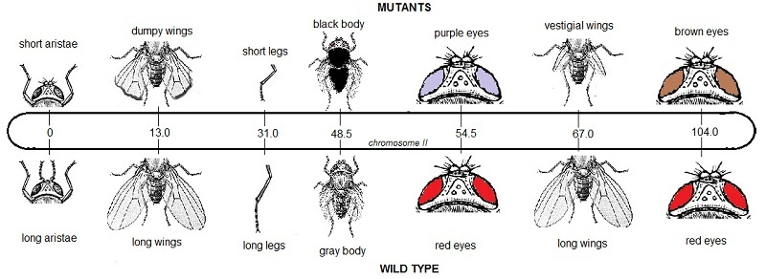
Drosophila melanogaster (The fruit fly)
180m base pairs, four chromosomes, 14,000 genes
Easily maintained and bred in the laboratory with short reproductive cycle (~2 weeks)
unravel genes involved in development and differentiation
Determine the relationship between genes and chromosomes

Slide 19
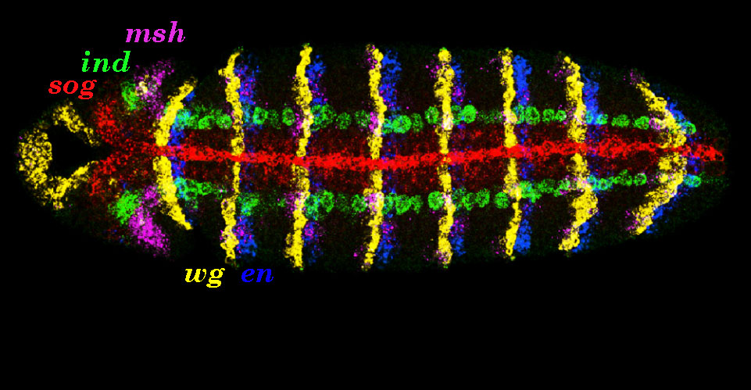
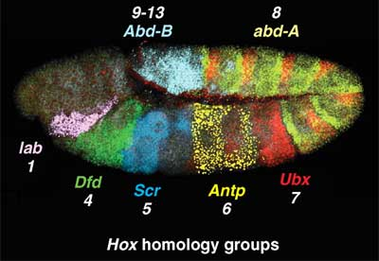
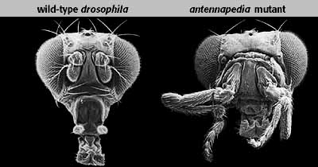
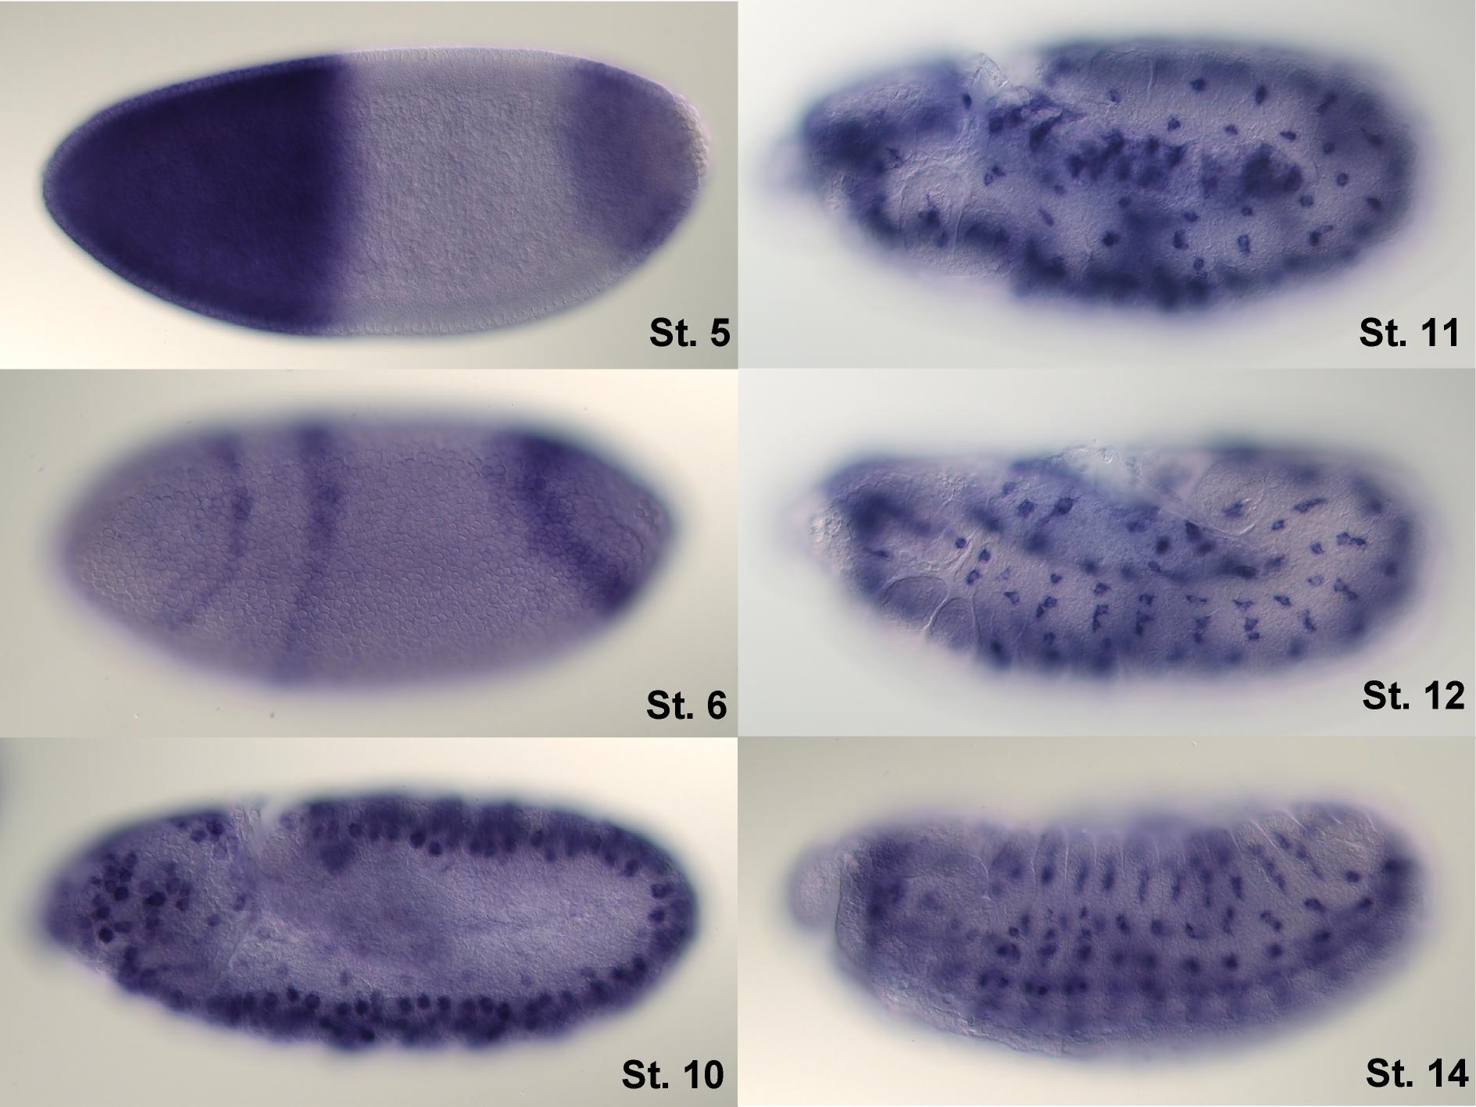

Slide 20
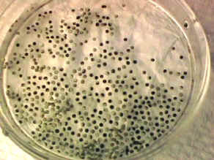
Xenopus laevis (a frog)
used in studies of early vertebrate development.
Xenopus eggs are large (a diameter of ~ 1 mm) and develop outside of the mother
stages of development can be studied in the laboratory.
Used in studying development, differentiation, and embryonic cell division.

Slide 21
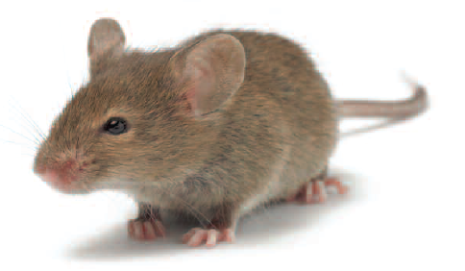
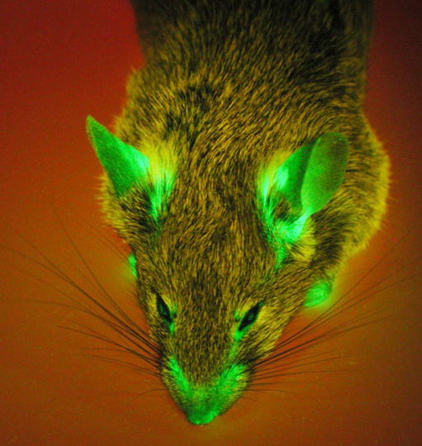
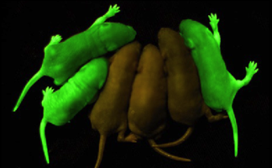
Mice
3000m base pairs, 20,000-25,000 genes/20 chromosomes
Transgenic mice with specific mutant genes introduced into the mouse germ line

Slide 22
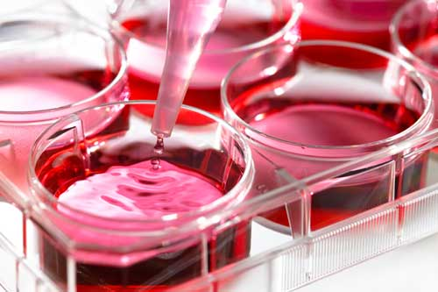
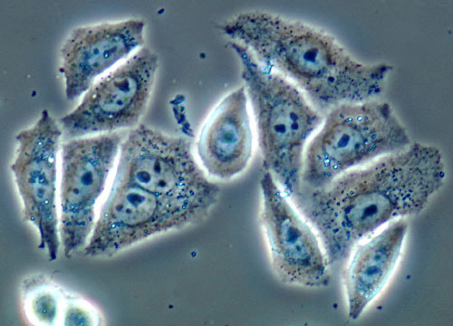
Cultured mammalian cells
Mammalian cells are isolated, get immortalized, and grown in dishes
can be manipulated under controlled laboratory conditions.
Uses: many aspects of mammalian cell biology, (DNA replication, gene expression, protein synthesis and processing, and cell division, etc.)

Slide 23
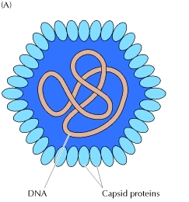
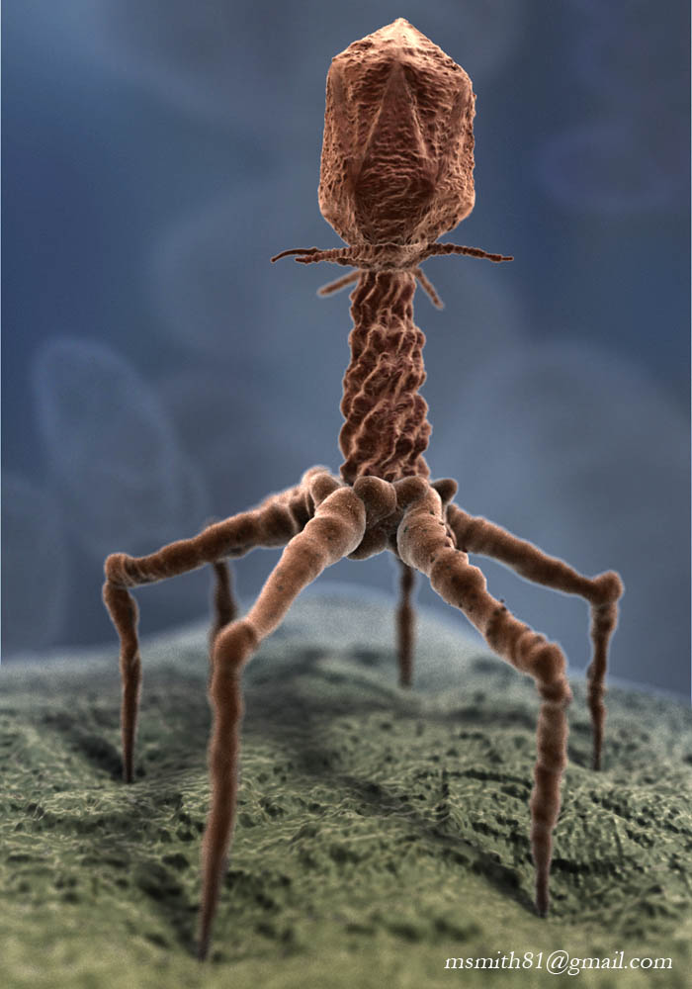
Viruses
intracellular parasites
They reproduce by infecting host cells and taking over the cellular machinery.
In their simplest forms, viruses consist of genomic nucleic acid surrounded by a protein coat.
Bacteriophages (bacterial viruses) allowed understanding basic molecular genetics.

Slide 24
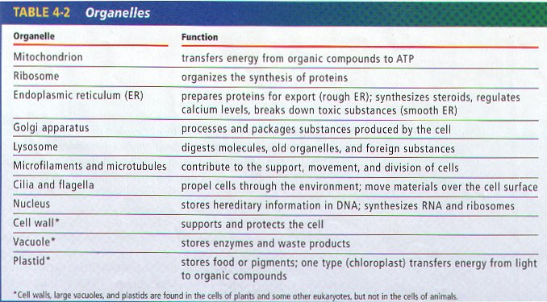
Organelles

