Slide 2
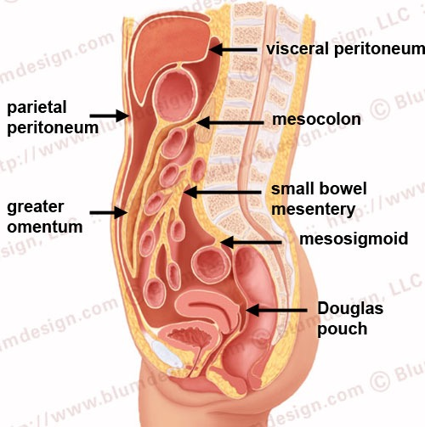
General features
The peritoneum is a thin serous membrane
Consisting of:
1- Parietal peritoneum
－lines the ant. Abdominal wall
2- Visceral peritoneum
covers the viscera
Peritoneum is continuous below with parietal peritoneum lining the pelvis
3- Peritoneal cavity
the potential space between the parietal and visceral layer of peritoneum
in male, is a closed sac
but in the female, there is a communication with the exterior through the uterine tubes, the uterus, and the vagina

Slide 3
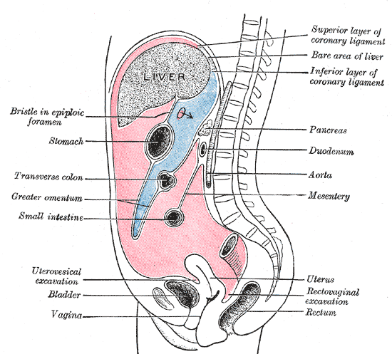
Peritoneum cavity divided into
Greater sac
Lesser sac
Communication between them by the epiploic foramen

Slide 4
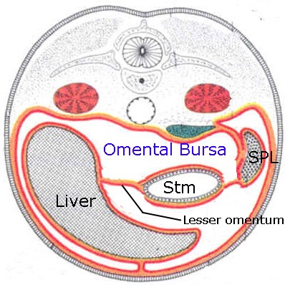
Deep to lesser omentum
Behind the stomach
Between two layers of greater omentum
Under the diaphragm and liver
Deep to lesser opening (Epiploic opening)

Slide 5
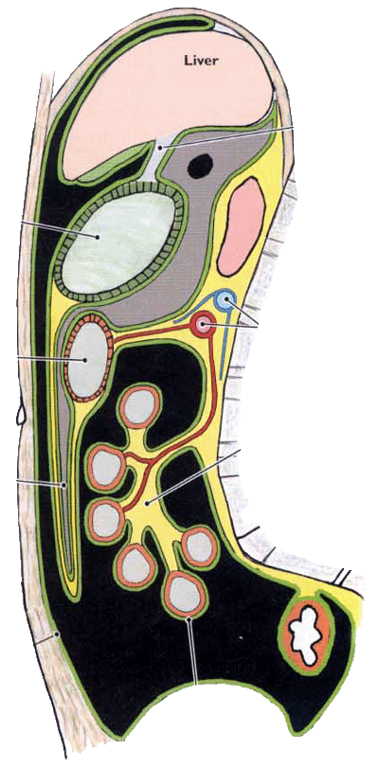
Walls：
Superior－peritoneum which covers the caudate lobe of liver and diaphragm
Anterior－lesser omentum, peritoneum of posterior wall of stomach, and anterior two layers of greater omentum

Slide 6
Inferior－conjunctive area of anterior and posterior two layers of greater omentum
Posterior－posterior two layers of greater omentum, transverse colon and transverse mesocolon, peritoneum covering posterior abdominal wall.

Slide 7
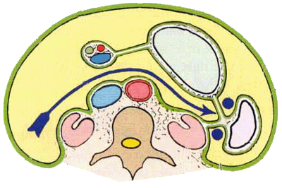
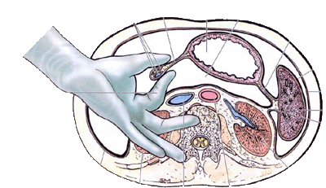
Omental bursa……cont
Left－
spleen,
gastrosplenic ligament
splenorenal ligament
Right－omental foramen

Slide 8
Deep to ant. Abdominal wall
Below the diaphragm
Above pelvic viscera
Out to:
Liver→ surround all the liver except
bare area
Stomach→ completely surrounded by peritoneum
Transverscolon
Greater omentum→ two layers of peritoneum from greater curvature of stomach
Duodenum→ just the anterior
surface covered by peritoneum
Small intestine → surrounds all the
intestine & form mesentery

Slide 9
Subdivided greater omentum into :
Antero- superior part
Postero - inferior part

Slide 10
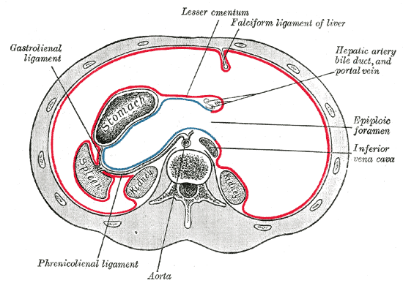
Antero – superior divided by Falciform ligament into:
Right part
Left part

Slide 11
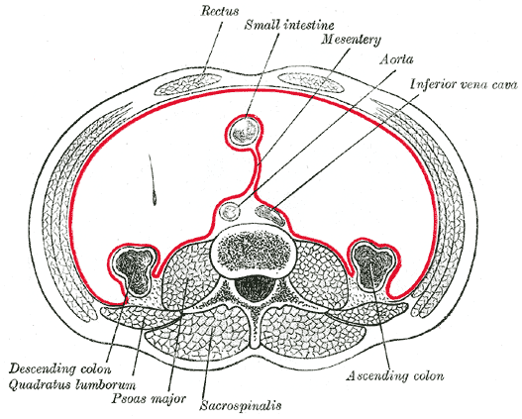
Poster – inferior divided by mesentery & small intestine into:
Right part
Left part

Slide 12
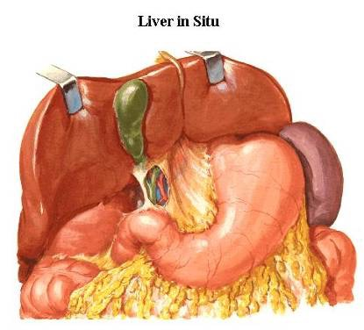
Omental (epiploic)foramen
Position:
lies between the liver and duodenum
just above the first part of the duodenum
behind the lesser omentum
infront of the inferior vena cava
short, vertically flattened passage, about 3cm

Slide 13
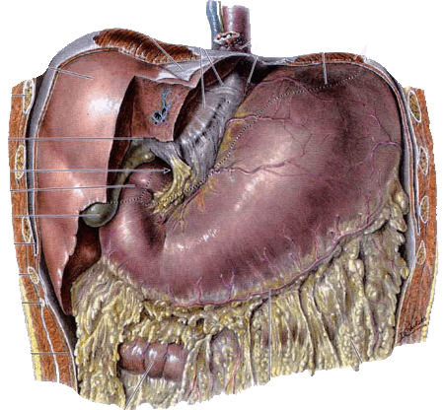
Omental foramen

Slide 14
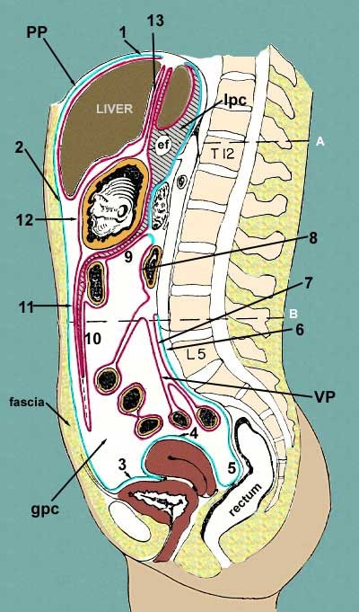
The omental bursa (lesser sac) communicates with the greater sac through the omental foramen.

Slide 15
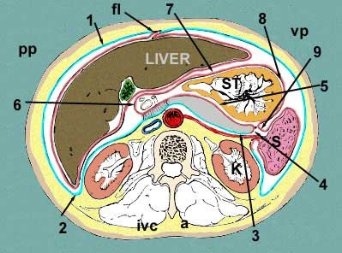
Boundaries
Anteriorlly
- Free border of lesser omentum contain
1- Bile duct( Rt & ant)
2- Hepatic artery(Lt & anT)
3- Portal vein(post.)
Posteriorly
I.V.C
Superiorly
Caudate process of caudate lobe of liver
Inferiorly
First part of duodenum

Slide 16
Function of the peritoneum
Secretes a lubricating serous fluid that continuously moistens the associated organs
Fat storage
Defense role→ the presence of lymphatic vessels & nodes
Support viscera

Slide 17
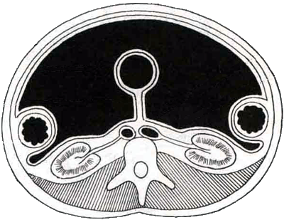
The relationship between viscera and peritoneum
Intraperitoneal viscera
viscera is almost totally covered with visceral peritoneum
example, stomach, 1st & last inch of duodenum, jejunum, ileum, cecum, vermiform appendix, transverse and sigmoid colons, spleen and ovary
Intraperitoneal viscera
Interperitoneal viscera
Retroperitoneal viscera

Slide 18
Retroperitoneal viscera
some organs lie on the posterior abdominal wall
Behind the peritoneum
they are partially covered by peritoneum on their anterior surfaces only
Example
kidney, suprarenal gland, pancreas, descending and ascending colon, upper 3rd of rectum
duodenum, and ureter, aorta and I.V.C

Slide 19
Interperitoneal viscera
Such organs are not completely wrapped by peritoneum
one surface attached to the abdominal walls or other organs.
Example
liver, gallbladder, urinary bladder and uterus

Slide 20
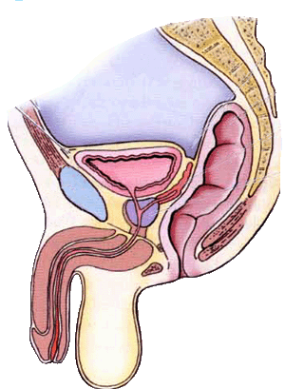
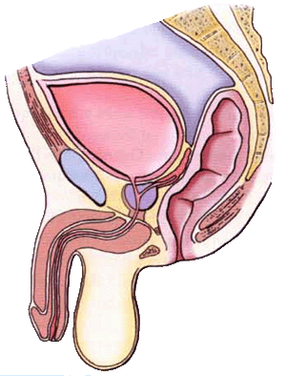
Interperitoneal viscera

Slide 21
Certain terms, often arbitrary, are commonly used for the peritoneal reflections.
A peritoneal reflection that connects the intestine and body wall is usually named according to the part of the gut to which it is attached.
For example, the reflection to jejunum and ileum is termed the mesentery, that to the transverse colon is the transverse mesocolon.
Some peritoneal reflections between organs or between the body wall and organs, are termed ligaments or folds. Most of such ligaments or folds contain blood vessels. Broad peritoneal sheets associated with stomach are termed omenta.

Slide 22
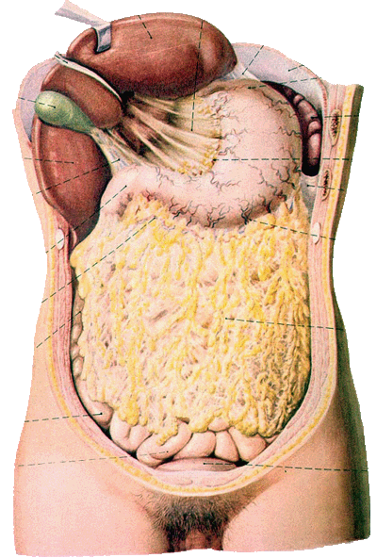
1- Omenta :
Two-layered fold of peritoneum that extends from stomach to adjacent organs
Two omenta
Lesser omentum
Greater omentum

Slide 23
Lesser omentum
Two-layered fold of peritoneum
- Extends from porta hepatis, fissure of ligamentum venosum and the diaphragm to lesser curvature of stomach and superior part of duodenum

Slide 24
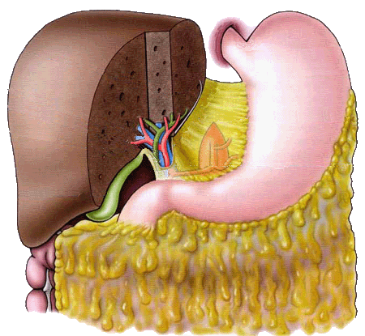
Hepatogastric ligament from porta hepatis to lesser curvature of stomach
Hepatoduodenal ligament
- Extends from porta hepatis
to superior part of
duodenum,
- at its free margine enclose 3 structures(3 key structures)
common bile duct→ Ant.
proper hepatic a→ At the Lt. of the common bile duct
hepatic portal v→ post.

Slide 25
Blood vessels→ Rt. & Lt. gastric vessels
Lymph nodes & lymphatic vessels
Fat
Autonomic N.S→ sympathetic + parasympathetic (vagus nerve)

Slide 26
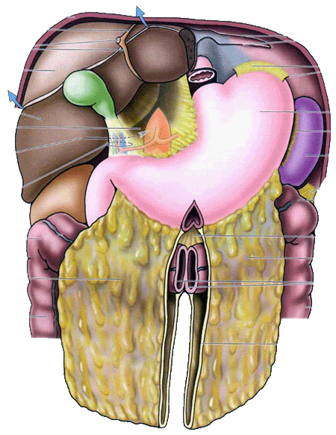
Greater omentum
It is the largest peritoneal fold.
It consists of a double sheet, folded on itself so that it is made up of four layers.
The anterior two layers descend from the greater curvature of stomach and superior part of duodenum and hangs down like an apron in front of coils of small intestine
then turn up on the back of itself, and ascend to the transverse
colon .
- the two layers are separated to cover the anterior and posterior surfaces of transverse colon. Then they form the transverse mesocolon

Slide 27
The upper part of the greater omentum which extends between the stomach and the transverse colon is termed the gastrocolic ligament.
In adult, the four layers of greater omentum are frequently adhered together, and are found wrapped about the organs in the upper part of the abdomen

Slide 28
Gastroepiploic vessels
Lymph nodes & lymphatic vessels
Fat
Autonomic N.S→ sympathetic + parasympathetic (vagus nerve)

Slide 29
① protective function: The greater omentum contains numerous fixed macrophages, which performs an important protective function.
② storehouse for fat: The greater omentum is usually thin, and presents a cribriform apperarance, but always contains some adipose tissue, which in fatty people is present in considerable quantity.
③ migration and limation: The greater omentum may limit spread of infection in the peritoneal cavity. Because it will migrate to the site of any inflammation in the peritoneal cavity and wrap itself around such a site, the greater omentum is commonly referred to as the “policeman” of the peritoneal cavity.

Slide 30
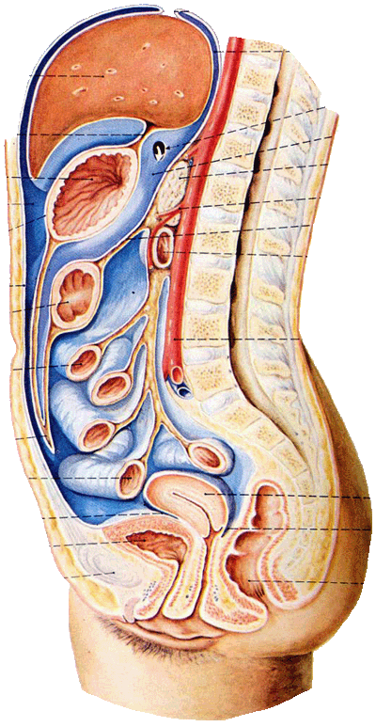
Lessor omentum
Greater omentum

Slide 31
－Two-layered fold of peritoneum that attach the intestines to the posterior abdominal wall

Slide 32
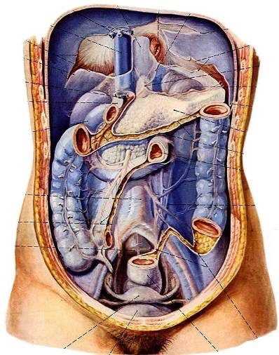
1- Mesentery of small intestine
-suspends the small intestine from the posterior abdominal wall
-Broad and a fan-shaped
Root of mesentery
15 cm long
Directed obliquely from left side of L2 vertebra to right sacroiliac joint

Slide 33
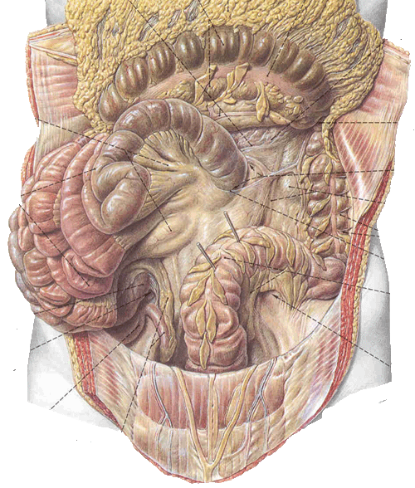
Contents of the mesentery
the jejunal and ileal branches of the superior mesenteric artery &veins
nerve plexuses
lymphatic vessels
the lymphatic nodes,
connective tissue
fat

Slide 34
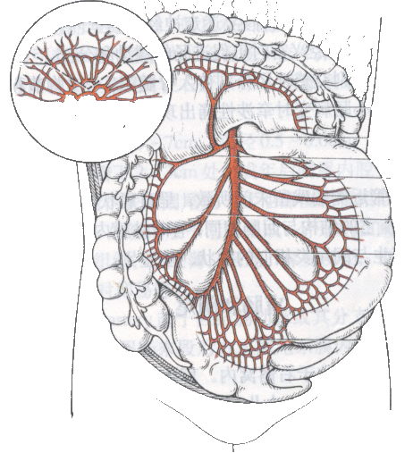
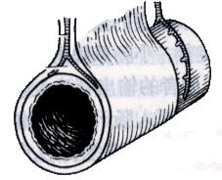

Slide 35
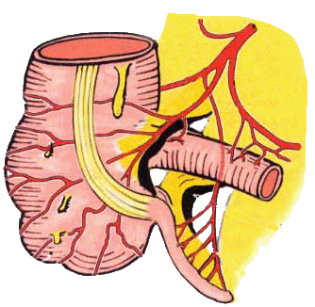
2- Mesoappendix
Triangular mesentery－extends from terminal part of ileum to appendix
Appendicular artery runs in free margin of the mesoappendix

Slide 36
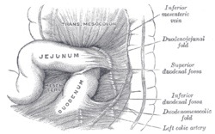
It is a broad fold
Connects the transverse colon to the anterior border of the pancreas.
Contents
- The blood vessels
- Nerves
- lymphatic's of the transverse colon.

Slide 37
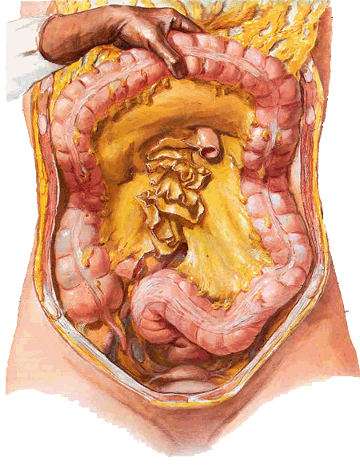
- It is a fold of peritoneum
attaches the sigmoid colon to the pelvic wall.
Contents
The sigmoid vessels
Lymphatic vessels
Nerves
The left Ureter descends into the pelvis behind its apex.

Slide 38
3- ligaments of the peritoneum

Slide 39
① The falciform ligament of liver
② The ligamentum teres hepatis
③ The coronary ligament
④ The right triangular ligament
⑤ The left triangular ligament
⑥ The hepatogastric ligament
⑦ The hepatoduonedenal ligament

Slide 40
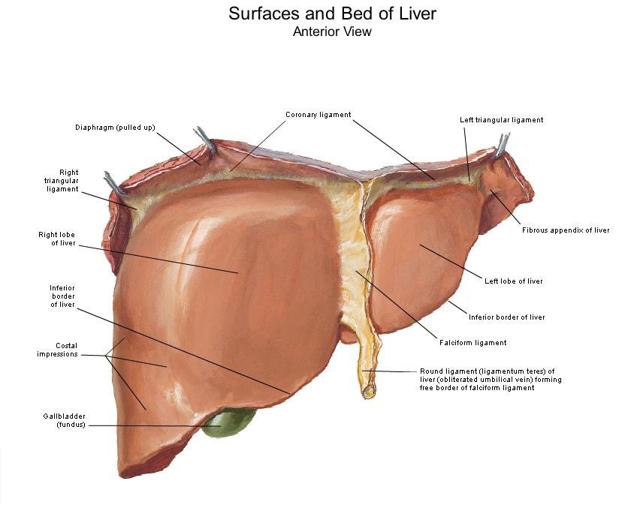

Slide 41
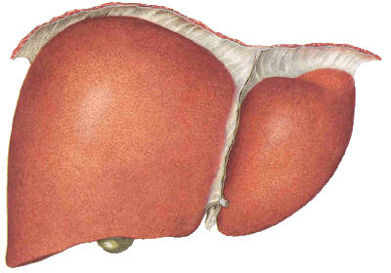
Falciform ligament of liver
Consists of double peritoneal layer
Sickeleshape
Extends from anterior abdominal wall (umbilicus) to liver
Free border of the ligament contains Ligamentum teres (obliterated umbilical vein)

Slide 42
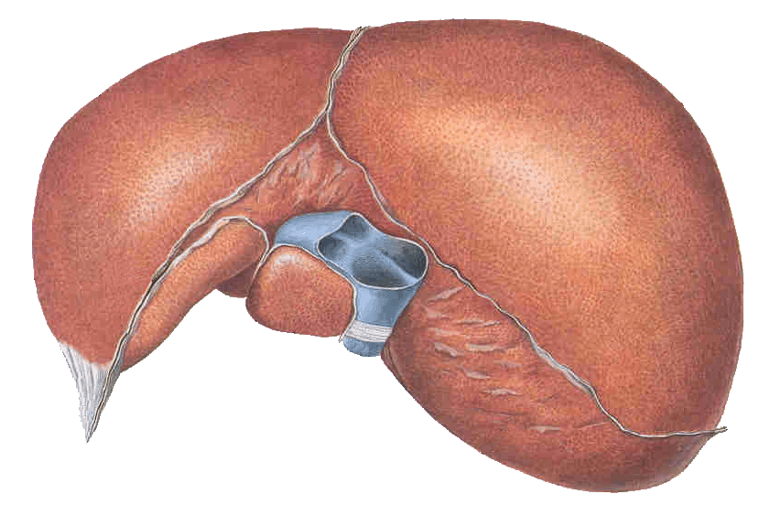
Coronary ligament the area between upper and lower layer of the coronary ligament is the bare area of liver which contract with the diaphragm;
Left and right triangular ligaments formed by left and right extremity of coronary ligament

Slide 43
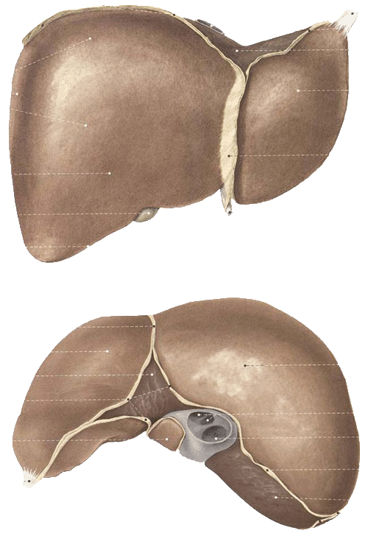
Hepatogastric ligament
Hepatoduodenal ligament

Slide 44
2- Ligaments of spleen
Gastrosplenic ligament
- Connects the fundus of stomach to hilum of spleen.
- Contents
the short gastric & left gastroepiploic vessels pass through it.
Splenorenal ligament
extends between the hilum of spleen and left kidney.
Contents
The splenic vessel
Lymphatic vessels ,nodes & nerve
the tail of pancreas

Slide 45
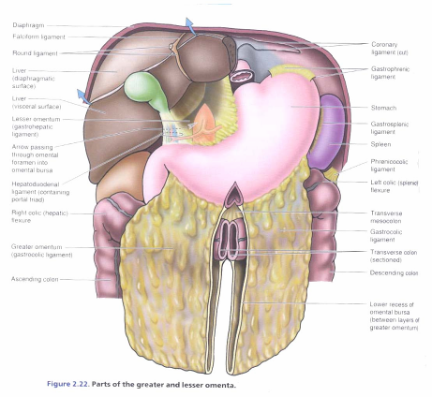
Phrenicosplenic ligament
Splenocolic ligament

Slide 46
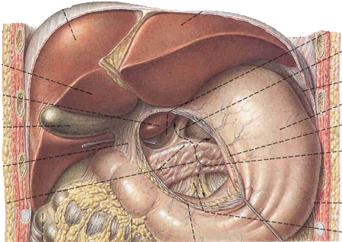
3- Ligaments of stomach
Hepatogastric ligament
Gastrosplenic ligament
Gastrophrenic ligament
Gastrocolic ligament
Gastropancrestic ligament

Slide 47
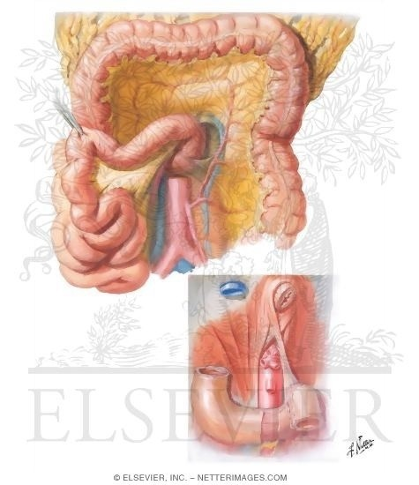
4. The suspensory ligament of duodenum Sometimes named Treitz ligament at the junction between duodenum & jejunum

Slide 48
5. The phrenicocolic ligament
It is a fold of peritoneum which is continued from the left colic flexure to the diaphragm opposite the 10th and 12th ribs.

Slide 49
In certain parts of the abdomen, peritoneal fold may bound recesses or fossae of the peritoneal cavity.
At the junction between intraperitoneal and retro peritoneal organs
These recesses are of surgical importance since they may become the site of internal herniae, that is, a piece of intestine may enter a recess and may be constricted (strangulated) by the peritoneal fold granding the entrance to the recess.
From a surgical point of view the omental bursa can be considered to belong to this category, with its opening at the epiploic foramen, bounded in front by the free border of the lesser omentum.
They are sometimes found in relation to the duodenum, cecum and sigmoid colon.

Slide 50
1. Duodenal Recesses
The superior duodenal recess or fossa
The inferior duodenal recess or fossa
The paraduodenal recess or fossa
The duodenojejunal recess or fossa
2. Cecal recesses
The superior ileocecal or fossa
The inferior ileocecal or fossa
The retrocecal recesses or fossa
The rectocolic recess or fossa
3. The intersigmoid recess

Slide 51
Superior duodenal fold and recess
Inferior duodenal fold and recess
Intersigmoid recess formed by the inverted
V attachment of sigmoid mesocolon

Slide 52
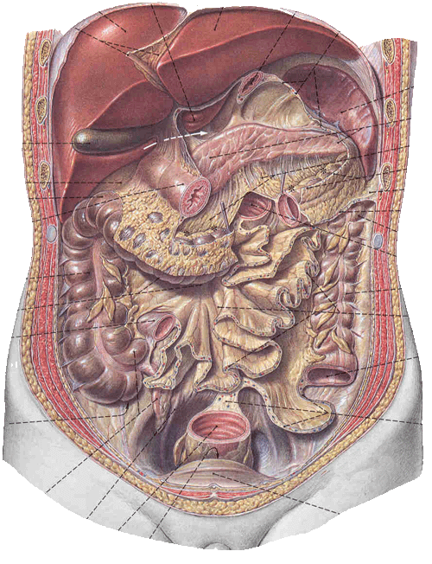
Retrocecal recess in which the appendix frequently lies
Hepatorenal recess lies between the right lobe of liver, right kidney, and right colic flexure, and is the lowest parts of the peritoneal cavity when the subject is supine

Slide 53
In the lesser pelvis, the peritoneum dips downwards forming a larger fossa, named pouch.
Clinical importants→ internal abdominal hernia

Slide 54
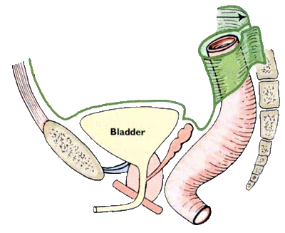
Pouches
In male
rectovesical pouch
lies between rectum and urinary bladder (or the seminal vesicles and ampullae ductus deferentes).
The rectovesical pouch is the lowest part of the peritoneal cavity in anatomical position in male.

Slide 55
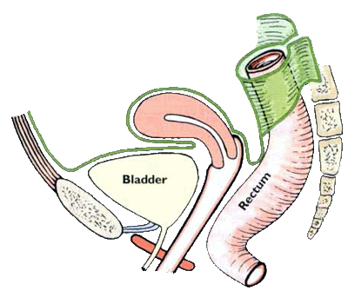
In female
1- Rectouterine pouch
between rectum and uterus
2- Vesicouterine pouch
between bladder and uterus
- The rectouterine pouch is formed
between the anterior surface of the
rectum and the posterosurface of the
uterus and the upper part of vagina.

Slide 56
2- The Vesicouterine pouch is formed between the anteroinferior surface of the uterus and the superior surface of the urinary bladder

Slide 57
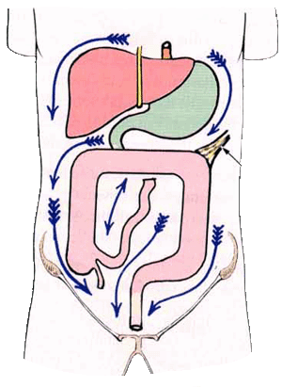
The transverse colon and transverse mesocolon divides the greater sac into
Supracolic compartments
Infracolic compartments.
- Rt.extraperitoneal space.( bara area of liver & diaphragm)
Supracolic compartments
Subphrenic space
Sub hepatic space

Slide 58
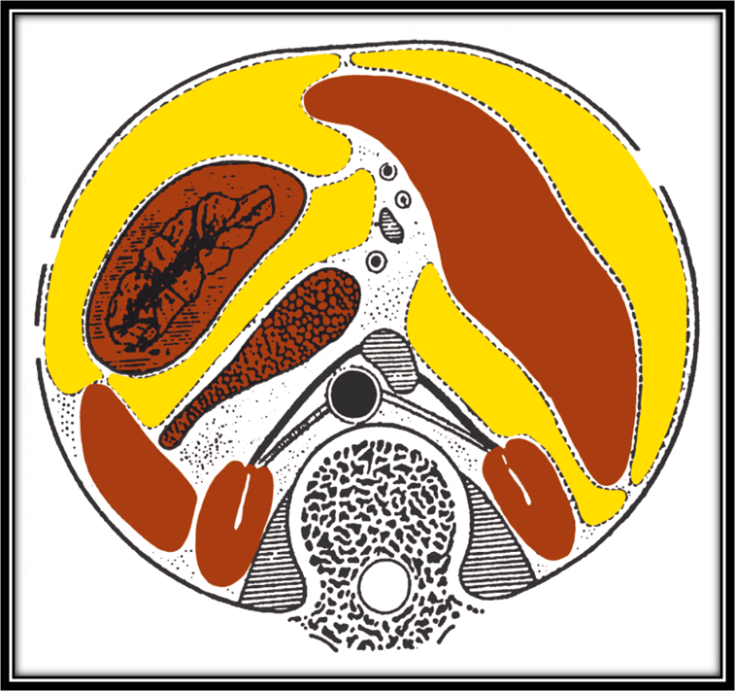
Subphrenic space
Divided by the attachment of Falciform ligament into
Rt.subphrenic space
Lt.subphrenic space

Slide 59
Subhepatic space divided into:
Rt.subhepatic space(morison’s pouch)
Lt.subhepatic space( lesser sac)

Slide 60
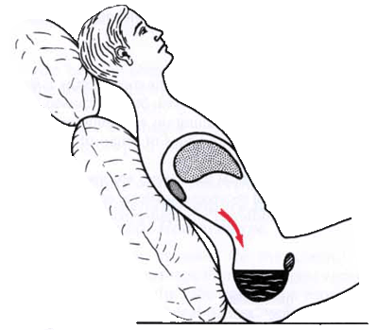

Slide 61
Infracolic compartment
- lies below the transverse colon and transverse mesocolon
Divided by root of the mesentery of small intestine into:
Rt. Infracolic compartment
Lt. infracolic compartment

Slide 62
Infracolic compartments
Right paracolic sulcus (gutter)
Subdivide into:
- Rt.medial.paracolic
- Rt.Lateral.paracolic
Rt.Lateral.paracolic communicates with the hepatorenal recess and the pelvic cavity.
It provides a route for the spread of infection between the pelvic and the upper abdominal region.

Slide 63
Subdivide into:
- Lt.medial.paracolic
- Lt.Lateral.paracolic
Lt. lateral paracolic separated from the area around the spleen by the phrenicocolic ligament( a fold of peritoneum that passes from the colic flexure to the diaphragm)
- Lt.medial.paracolic open to the outside through the pelvis

