Slide 1
Look back at what we discussed
H₀) - the “status quo”
H_{a}) - Research Hypothesis
H₀ rejected→ H_{a} supported → Theory supported
Confidence level
Errors in Hypotheses Testing:
Type I (alpha)
Type II (beta)
Significance level; Power; p-value
Notes:
The learning objectives for this session are the following:
To describe the difference between probability and non-probability sampling
To list the advantages & disadvantages of various types of probability and non-probability samples, and
To differentiate between sampling error and bias

Slide 2
Type I and Type II Errors
Your Statistical Decision
True state of Null hypothesis
H₀ True
(example: the drug doesn’t work)
H₀ False
(example: the drug works)
Reject H₀
(ex: you conclude that the drug works)
Type I error (α)
Correct
Do not reject H₀
(ex: you conclude that there is insufficient evidence that the drug works)
Correct
Type II Error (β)

Slide 3
REMEMBER TO START HERE!!!
Research Project | Hypotheses | Type I Error (usually set at 5%) | Type II Error (usually set at 20%)
Association exists between hospital stay & nosocomial infections | H₀: No Association H_{a}: Association | TRUTH: No Association but You REJECT H₀ | TRUTH: Association but You FAIL to reject H₀
Hospital stay increases proportion of nosocomial infections beyond x% | H₀: p ≤ point est. H_{a}: p > point est. | TRUTH: No actual increase but You REJECT H₀ | TRUTH: There is actual Incr. but You FAIL to reject H₀
Nosocomial infections causes an increase in Hospital stay by x% | ???

Slide 4
Populations and Samples
Quantitative Health Research Lecture # 6
Notes:
Welcome to introduction to sampling! Now that you are able to assemble the pieces of your study design and anticipate the need to minimize biases, let’s begin to look at how you will enroll study participants.

Slide 5
Learning Objectives
Define the concepts of population and sample
Distinguish between target and accessible population
Briefly discuss various types of probability and non-probability samples
Differentiate between sampling error and bias
Choose appropriate sampling formula
Notes:
The learning objectives for this session are the following:
To describe the difference between probability and non-probability sampling
To list the advantages & disadvantages of various types of probability and non-probability samples, and
To differentiate between sampling error and bias

Slide 6
Populations
It is the complete set of persons or objects that possess common characteristics of interest to the researcher.
It is rarely that the entire population is used in a study.
Target population
Accessible population

Slide 7
Target Population
The entire group of people or things that meet the designated set of criteria of interest to the researcher ; those to which study findings will be generalized.

Slide 8
Accessible Population
The available population among which sample is recruited.

Slide 9
What is Sampling?
Procedure by which SOME members of the population are selected as REPRESENTATIVES of the entire population
Notes:
First we need to know what is sampling?
Note: the instructor might decide to ask the participants this question and allow them to answer it before reading the definition.
Sampling is a procedure by which some members of the population are selected as representatives of the entire population.
The key words here are: some members, they could be events, items, or individuals, and representative. In order to be able to generalize the study results on the population, the sample drawn from that population should be representative. Whenever a sample is drawn from a population the researcher should assess how representative the data collected from the sample is to that of the entire population.

Slide 10
Why do we need a sample?
Make it easier: Gather information from large populations using smaller number of people
Reduce cost and time of study
Obtain accurate representation of a population
Notes:
Why do we need a sample?
Note: the instructor can ask this question and encourage participants, students to answer it for few minutes, before showing them the correct answers.
Sampling enables us to gather information on a large population without the need to survey or include every member of that population.
Sampling helps in reducing the cost and time of the study because it selects a specific number of the population to be studied rather than studying the entire population.
Sampling enables us to obtain accurate representation of the population.

Slide 11
Sampling Terminology
“Target population” = general population you want to know
“Elementary unit” = each individual in the population
“Sampling frame” = list of all elementary units
“Sample” = part of target population that you select for your study

Slide 12
Types of Sampling
Probability Sampling — Every unit in the population has a known probability of being selected
Non-Probability Sampling — The probability of being selected is unknown
Notes:
There are 2 types of Sampling:
Probability Sampling: Each unit in the population has an equal chance of being selected.
Non-Probability Sampling: The unit in the population is not randomly selected so the chance of being selected is not equal.

Slide 13
Probability Sampling
It involves the use of a random selection process to select sample from members or elements of a population.
Random selection does not mean haphazardly; it means application of a systematic scientific process of randomization.
Notes:
Dictionary definition of random is haphazardly, however it is not.

Slide 14
Cont’d
Random selection means that:
All element have an equal chance of being selected for the sample.
Selections are independent of each other.
Researcher does not enter into the selection of the sample.
Notes:
It is hoped that all variables of interest in the sample, approximately represent the entire population.

Slide 15
Sampling Elements
In Probability Sampling
Each element of the population has a known probability of selection
Notes:
A probability sample is one in which each element of the population has a known (non-zero) chance or probability of being selected. The “element” is the unit being sampled, such as individuals, households, communities, hospitals, or schools.
A sample is NOT truly a probability sample if some elements of the population cannot be selected, meaning they have a probability of zero. This may occur, for example, if you are conducting a household survey by telephone, but some households in your population do not have telephones.
All kinds of probability sampling methods rely on random selection to draw a sample of the study population.
A sample is also not truly a probability sample if probabilities of selection are not known.

Slide 16
A Sampling Frame is …
…a list from which the elements of the sample will be drawn
Notes:
A sampling frame is the list from which the elements of the sample will be drawn and has “the property that every element in the population has some chance of being selected in the sample...” Let’s say you are going to randomly select individuals in a city – the sampling frame may be the phone book. The phone book won’t list every individual person (just the households) but using it does give (almost) everyone the possibility of being selected.
Your sampling frame will be chosen based on the research question you are interested in, it is not randomly selected.
Taken from Levy, Paul S. and Stanley Lemeshow. Sampling of Populations. John Wiley & Sons, Inc. 1991

Slide 17
Types of Probability Sampling
Simple Random Sampling
Systematic Random Sampling
Stratified Random Sampling
Cluster Sampling
Multi-Stage Sampling
Notes:
Three types of Probability Sampling include: Also called “random sampling”.
Simple Random Sampling
Stratified Random Sampling
Cluster Sampling
Multi-Stage Sampling
The of probability sample is a random sample in which all elements or subjects of the population has a known chance of being selected.
Instructor: you may choose to explain the term probability or chance more, and use the rolling dice as a metaphor. Every time you roll a dice, each face (number) has an equal chance of appearing on top (1/6).
We will discuss each of these.

Slide 18
Simple Random Sample
Involves taking a random sample of n units from a population of size N.
Advantage: Simplicity (in smaller populations).
Disadvantage: It may not be as accurate as stratified sampling or as cheap as cluster sampling.
In the following diagram, 48 units are randomly sampled from the survey population of 400.

Slide 19
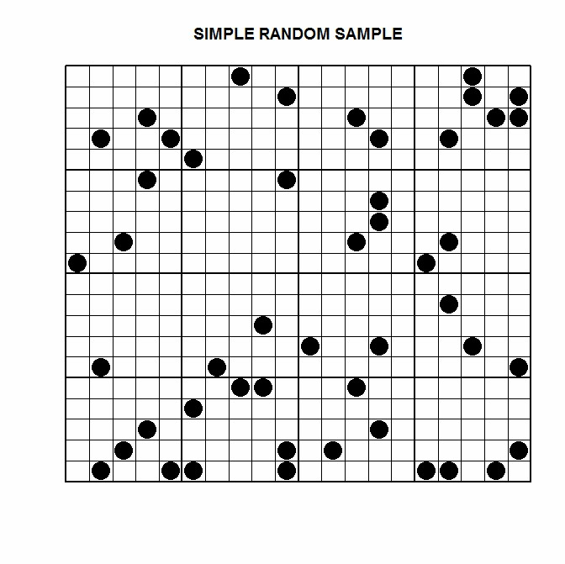

Slide 20
Stratified Sample
Involves dividing the population into non-overlapping blocks (strata) and taking a random sample(s) based around these blocks.
Example: It is known that male/female proportion in the population is 50/50%. Two random samples of equal size are made (one for males, and one for females) and surveyed, to estimate e.g. their employment status, opinions, buying habits etc.

Slide 21
Stratified Sample
Advantage: Accuracy.
Disadvantage: Requires prior information about the population being sampled.
In the following diagram, 3 units are randomly sampled from each of the 16 groups.

Slide 22
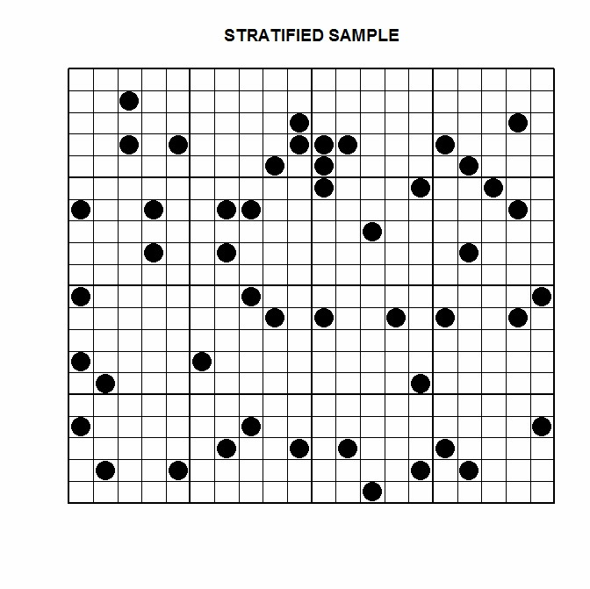

Slide 23
Cluster Sample
Involves sampling every unit from several randomly selected clusters. Like with stratified sampling, it involves dividing the population into non-overlapping blocks (clusters). The clusters usually relate to geographic proximity.
Advantage: Lower cost.
Disadvantage: If the variation between clusters is great relative to the variation within clusters, cluster sampling can result in inaccurate estimates.
In the following diagram, 3 of the 16 available clusters were randomly sampled.

Slide 24
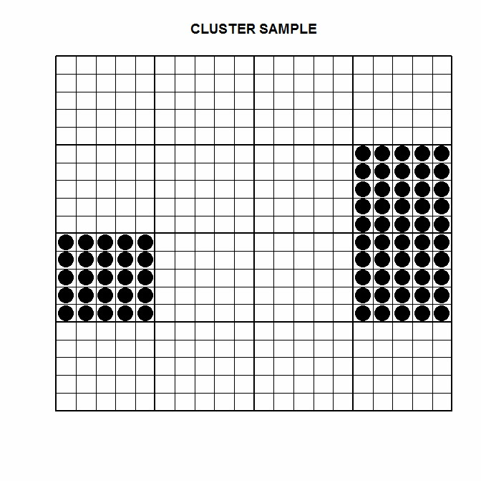

Slide 25
Systematic Sample
Involves sampling every k^{th} unit from a listed population.
Advantage: Simple to explain and carry out.
Disadvantage: Inaccurate if there are patterns in the data that repeat at the same intervals.
In the following two diagrams, every 10th and every 6th unit is sampled.

Slide 26
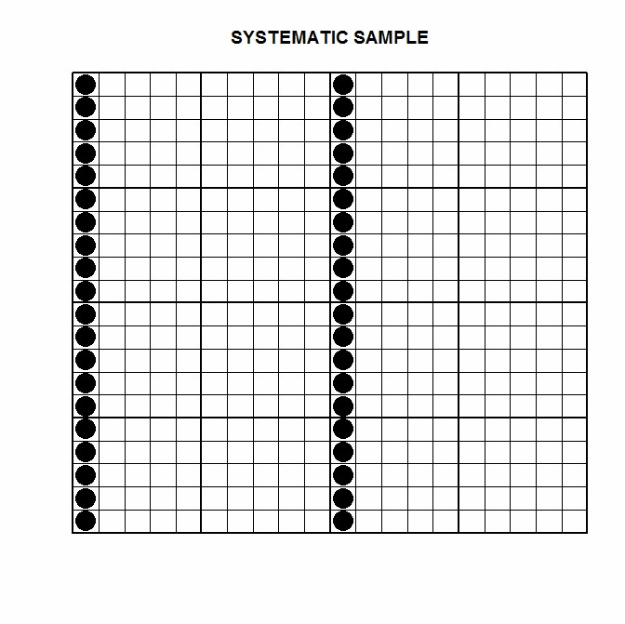

Slide 27
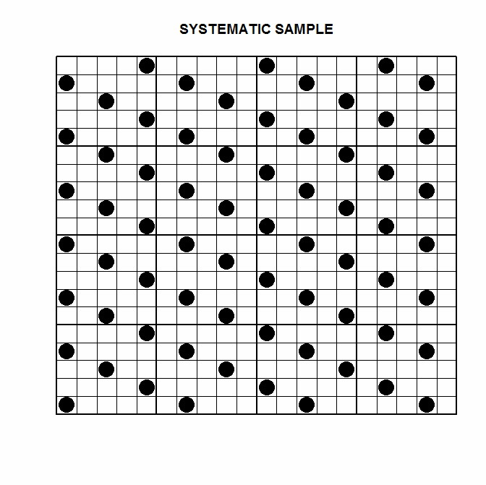

Slide 28
Two-Stage Sample
It is carried out in two stages.
1st diagram:
In the fist stage, 6 of the 16 available clusters were randomly sampled.
In the second stage, 12 units from each cluster were randomly sampled..

Slide 29
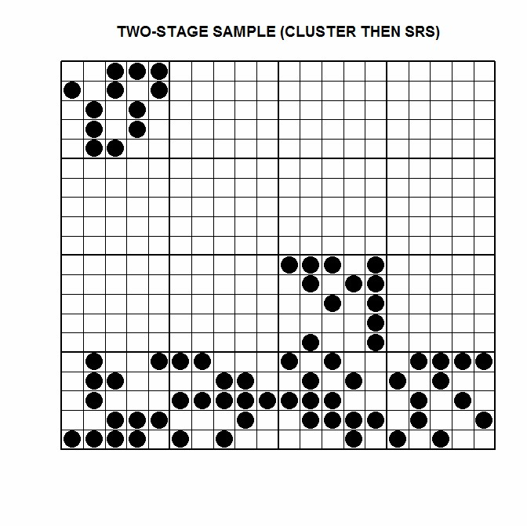

Slide 30
Two-Stage Sample
Carried out in two stages.
2nd diagram:
In the first stage, 6 of the 16 available clusters were randomly sampled.
In the second stage, 12 units were systematically sampled from each cluster, taking every second unit.

Slide 32
How to do Sampling
We will skip these slides if you feel comfortable with them
Notes:
You may have heard the term, “simple random sample.” Like the name suggests, it is a relatively simple concept! The first step in selecting a simple random sample is to list and then assign a number to each element in your sampling frame. The next step is to choose the elements in a way that insures that each element has exactly the same chance of being selected. Selecting the elements could be done with a computer, a random number table, or certain types of calculators.
Simple random samples are not always feasible because they can be expensive and not very practical – you would need a list of every single possible element in your sampling frame before you could even get started. Think about how tricky this would be if you were sampling individuals from a city of 2 million people!

Slide 33
* Simple Random Sampling
List sampling elements
Assign number to each element
Select elements randomly
Computer
Random number table
Calculators
Notes:
You may have heard the term, “simple random sample.” Like the name suggests, it is a relatively simple concept! The first step in selecting a simple random sample is to list and then assign a number to each element in your sampling frame. The next step is to choose the elements in a way that insures that each element has exactly the same chance of being selected. Selecting the elements could be done with a computer, a random number table, or certain types of calculators.
Simple random samples are not always feasible because they can be expensive and not very practical – you would need a list of every single possible element in your sampling frame before you could even get started. Think about how tricky this would be if you were sampling individuals from a city of 2 million people!

Slide 34
* Simple Random Sampling
Example: (Hospital satisfaction survey)
Sample size (n=50)
Use hospital records to create the sampling frame
Assign random numbers
Randomly select 50 patients
Conduct the survey
But, What about a City of 2 Million people?
Systematic Random Sampling
Notes:
Consider this scenario… you want to draw a sample of patients who were admitted to the Hospital (A) during the last 30 days to conduct a satisfaction survey with the services provided.
First, you need to decide on the number of patients needed for the survey, sample size (n), let’s say that you want n to be 50.
Second, create sampling frame, i.e. from the hospital records list names of all patients who were admitted during the last 30 days.
Third, assign a number to each of the names of patients in the sampling frame. This could be done using an excel sheet.
Forth, randomly select 50 of them. You can use tables of random digits or a calculator to generate the random numbers.
This way every patient will have an equal and independent probability or chance to be included in the survey.
However, those who are selected, by pure chance may happen to represent only one sector or segment of the population. For example, the 50 patients may be mainly males or females or of certain age group.

Slide 35
* Stratified Random Sampling
Similar to simple random sampling
Divide population into meaningful groups first (e.g. sex, age, race/ethnicity and socio-economic status)
Select random sample from each group
Notes:
In order to solve some of the over or under representation problems presented by simple random sampling in a large population, we could introduce stratified random sampling.
Stratified Random Sampling is similar to simple random sampling in that elements are listed, assigned numbers and selected randomly. The difference is that before the selection of the sample takes place the sampling frame is divided into meaningful groups first; characteristics such as sex, age, race/ethnicity and socio-economic status may be used to create the groups. Only then a random sample is selected from each group.
If you are concerned about selecting enough people from a group that makes up a small percentage of your population, this sampling method can be very helpful.

Slide 36
* Stratified Random Sampling
Example (from U.S.)
Divide patients into 3 groups as white, African American, and Hispanic
Create sampling frame for each group
Select a random sample from every group
Conduct the survey on the 50 racially diverse patients
Notes:
Stratified Random sampling
Example: Let’s consider the previous scenario of the hospital survey of the 50 patients.
If you want to ensure that you included in the survey sample diverse patients with respect to race/ ethnicity ; you need to apply stratification of the study population.
First, divide the patients who were admitted to the hospital within the last 30 days into 3 groups according to their race, i.e. white, African American, and Hispanic.
Second, create a sampling frame for each one of the 3 groups (strata).
Third, assign random numbers and randomly select a sample from each of these groups. The sampling sizes will either be equal (disproportional) or proportional to the size of the stratum.
By doing this, you ensured that the survey sample included representatives of every race and the patients you selected were diverse.
The third type of probability sampling after simple and stratified random sampling is cluster sampling.

Slide 37
* Cluster (Area) Sampling
Deal with a scattered population over a large area
Reduces travelling time and cost
Clusters are geographical areas such as state, city, county, district
Notes:
Cluster or area sampling is mainly used when dealing with a scattered population over a large geographic area.
This method will help in reducing travelling time and cost to reach the study sample.
Clusters refer to clearly delineated geographic areas, such as state, city, county, district, etc.

Slide 38
* Cluster Sampling
Can involve more than one random selection process (multi-stage)
Divide sampling frame into clusters
Conduct random sample of clusters
Collect data
Potentially more efficient than simple random samples
WHO: 30 x 7
30 villages, 7 children sampled from each village
Notes:
Cluster sampling also involves random sampling but can do so in more than one stage. This can actually makes things easier than a simple random sample. An example might be helpful in explaining cluster sampling: Let’s say you want to sample households from your country of 22 million people – making that list might not only be difficult, it might be impossible. If you were using cluster sampling, the first thing you would do is list the clusters you are interested in (in this example each cluster is a city) - this would be much easier than listing all the households in the country! – and then randomly select the predetermined number of clusters you want. You can choose to collect information from all elements in the cluster or move on to a second-stage of sampling in which you list all the elements in each selected cluster and randomly sample from those (third-, forth-, etc stages can also be done.) This process is more efficient that conducting a simple random sample of the entire population.
A commonly used sampling scheme, the “30x7” sample was developed by the World Health Organization with the aim of calculating the prevalence of immunized children within +/- 10 percentage points. The “30x7” refers to the numbers used; 30 villages were originally selected and then seven children were randomly selected per village. This design has been adopted for other purposes. This sampling scheme is thought to be sufficient for most sampling of community health factors.

Slide 39
* Multi-Stage Sampling
Combination of multiple stages
Very large population or scattered across a large geographic area
Examples:
U.S. Behavioral Risk Factors Surveillance System (BRFSS), and National Health Interview Survey NHIS
WHO-led national surveys
Notes:
Multi stage sampling: is a combination of different types of probability sampling methods.
As the name implicates it is done in stages.
It is used when dealing with a very big population (Nation wide surveys), or a population scattered across a large geographic area.
Examples:
National surveys such as
U.S. Behavioral Risk Factors Surveillance System (BRFSS), and National Health Interview Survey NHIS
WHO-led national surveys
Instructor: It is optional to mention the steps of multi-stage sampling.
Steps:
Divide the country into clusters (areas) usually called Primary Sampling Units (example counties)
Randomly select a number of subgroups or smaller geographic areas within the chosen PSU, example you choose districts within counties
Randomly select neighborhoods or households from the selected districts to be surveyed or studied.

Slide 40
* Multi-Stage Sampling
Steps:
Divide the country into clusters (areas) usually called Primary Sampling Units (e.g. governorates)
Randomly select a number of subgroups or smaller geographic areas within the chosen PSU, example you choose districts within governorates
Randomly select neighborhoods or households from the selected districts to be surveyed or studied.
Notes:
Multi stage sampling: is a combination of different types of probability sampling methods.
As the name implicates it is done in stages.
It is used when dealing with a very big population (Nation wide surveys), or a population scattered across a large geographic area.
Examples:
National surveys such as
U.S. Behavioral Risk Factors Surveillance System (BRFSS), and National Health Interview Survey NHIS
WHO-led national surveys
Instructor: It is optional to mention the steps of multi-stage sampling.
Steps:
Divide the country into clusters (areas) usually called Primary Sampling Units (example counties)
Randomly select a number of subgroups or smaller geographic areas within the chosen PSU, example you choose districts within counties
Randomly select neighborhoods or households from the selected districts to be surveyed or studied.

Slide 41
Think Back!
What do you think are some advantages and disadvantages of simple random, stratified random, and cluster sampling?
<In-Class Exercise>
Notes:
Think back!
What do you think are some advantages and disadvantages of simple random, stratified random, and cluster sampling?
Possible answers:
Simple Random: Adv – intuitively simple ; Dis – can be very difficult logistically
Stratified Random: Adv – Can be used to help ensure you have enough people in a sub-population to have sufficient statistical power; Dis – may require more complicated analysis (weighting) if you want to generalize findings to the sampling frame
Cluster sampling: Adv – can be very efficient; Dis – slightly more complicated to carry out
Sometimes it is not possible to select a random sample and therefore researchers have to use alternative ways and select a non random sample.

Slide 42
Types of Non-Probability Sampling
Convenience sampling
Volunteer
Snowball
Purposive sampling
Quota surveys
Notes:
Here are some examples of non-probability sampling that we will discuss:
Convenience sampling
Volunteer
Snowball
Purposive sampling
Quota surveys

Slide 43
Important Concepts
Non-Probability Sampling
Cannot assess reliability
NOT randomly drawn
Cannot generalize results beyond sample
Notes:
Important concepts to remember in non-probability sampling are the following:
There is no way to assess the probability (chance) of being selected with a non-probability sample.
These samples are NOT randomly drawn.
You cannot generalize results beyond the sample.

Slide 44
Convenience Sampling
Also called: purposive/accidental
Easy-to-access subjects selected
Examples:
People shopping at a certain store
People who pass a given street corner
People at your workplace
Notes:
Convenience sampling is also called non-purposive, haphazard or accidental sampling.
In conveniences samples, subjects are selected because it is easy to access them. For examples, someone taking a survey might stand in front of a retail store, and interview people entering the store. Or, an interviewer might stop people passing by on a street corner. A common convenience sample for pilot testing questionnaires is a sample of people at your workplace.

Slide 45
Purposive Sampling
Judgment used to select subjects
May end up being more representative than random sample but no way to assess reliability
Example
Patients who visit clinic on “typical” day
Notes:
In purposive sampling, the researcher’s judgment is used to select subjects. This type of sampling may end up being more representative than random sample but there is no way to assess the reliability of the estimates, which is a significant disadvantage.
One example of purposive sampling would be when the researcher chooses what she believes to be a “typical day” to interview people in a medical clinic, such as a Tuesday in March, instead of randomly selecting a day, which could end up being the day before or after a weekend or holiday.

Slide 46
Volunteer Sampling
Subjects are people who volunteer their services to be in the study (for free or for incentives)
May be the only choice, if randomization would be unethical (when would this happen?)
Not usually representative
Examples
Volunteers for clinical trials
People who respond to an ad and participate in study or focus group meeting
Notes:
Volunteer sampling
Subjects are people who volunteer their services to be in the study (for free or for incentives)
May be the only choice, if randomization would be unethical (when would this happen?)
Not usually representative
Examples
Volunteers for clinical trials
People who respond to an ad and participate in study or focus group meeting

Slide 47
Snowball Sampling
Relies on referrals from initial subjects to identify and bring in additional subjects
Especially useful when desired sample characteristic is rare, population is inaccessible, or hard to find
Not usually representative unless almost everyone in the desired population is enrolled
Example
Study of STD among homeless people
Notes:
Snowball Sampling
Relies on referrals from initial subjects to identify and bring in additional subjects
Especially useful when desired sample characteristic is rare, population is inaccessible, or hard to find
Not usually representative unless almost everyone in the desired population is enrolled
Such as:
Study of STD among homeless people:
Study sample is collected by identifying one homeless person with STD and then asking that person for his/her contacts whom are like the first subject are homeless and may have STD and then the contacts are asked to identify others who they know as homeless and may have STD, and so on. The sample increases in size gradually as snowball.

Slide 48
Quota Survey
Predetermined number of subjects selected in different groups
Example: Knocking on doors down a street until 5 female heads-of-household have been interviewed
Quota sampling can either be proportional or non-proportional.
Example: 60% females & 40% males. Quota=10: find 6 females & 4 males.
Notes:
A third type of non-probability sampling is quota surveying. This involves choosing a predetermined number of subjects in different groups and continuing to sample until you have reached that number.
An example of a quota survey is when staff working on a study go down a street knocking on doors for interviews until 5 female-headed households have been interviewed.
Instructor: You may decide to explain the 2 types of quota sampling if you think is necessary
Quota sampling can either be proportional or non-proportional.
For example, if your study design required a sample of 60% females and 40% males, you could select a proportional sample by knocking on doors until you find 6 females and 4 males.

Slide 49
Think Back!
What are some of the major differences
between probability sampling and
non-probability sampling?
We will see in the coming slides.
Notes:
Think back!
What are some of the major differences between probability sampling and non-probability sampling?
Note to instructor: the next several slides highlight advantages and disadvantages of probability and non-probability sampling relative to one another; this slide allows the students to start thinking about these but you should not spend too much time here as they will be doing more brainstorming during the following slides.

Slide 50
One important difference is that probability sampling allows for determining the reliability of the results, i.e generalizability of the results
Notes:
One important difference is that probability sampling allows for determining the reliability of the results, i.e generalizability of the results.

Slide 51
Advantages of Probability Sampling
Known estimates of variability (reliability)
Generalizable results
Random element helps obtain representativeness
Notes:
Note to instructor: Allow students to brainstorm answers to this question before clicking to reveal the bullet points on the slide
Advantages of Probability Sampling:
Known estimates of probability/ chance to be selected – this is the primary advantage
Generalizable results; remember that it is perfectly valid to generalize your results to the sampling frame.
Random element helps obtain – though does not guarantee – representativeness.

Slide 52
Disadvantages of Probability Sampling
Requires more time and greater expense
Can involve complicated sample size calculations
Mostly require computer use
Notes:
Note to instructor: Allow students to brainstorm answers to this question before clicking to reveal the bullet points on the slide
Disadvantages of Probability Sampling:
Requires more time and possibly greater expense
Can involve complicated sample size calculations (which we’ll talk about during the next presentation)
May require computer use to generate the random numbers

Slide 53
Advantages of Non-Probability Sampling
Easy
Potentially good for sampling from certain populations (difficult-to-reach population)
Notes:
Note to instructor: Allow students to brainstorm answers to this question before clicking to reveal the bullet points on the slide
Advantages of Non-Probability Sampling
Easy, no need to go through the any randomization process.
Potentially good for sampling from certain populations, such as difficult to reach populations like the homeless. It would be easier to walk down the street and interview all of the homeless people you meet rather than trying to generate a list of individuals who may be highly mobile and difficult to locate.

Slide 54
Disadvantages of Non-Probability Sampling
Probability or chance estimates not possible
Not as rigorous as probability sampling
Notes:
Note to instructor: Allow students to brainstorm answers to this question before clicking to reveal the bullet points on the slide
Disadvantages of Non-Probability Sampling
This is very important! Again, non-probability sampling does not allow quantitative assessment of chance or probability.
Not as rigorous as probability sampling

Slide 55
Sampling Error & Bias
Notes:
In the next section, we will discuss how to differentiate between sampling error and bias.

Slide 56
Sampling Error
It is in statistical terms; not a mistake.
Results from using sample as opposed to entire population
Typically decreases as the sample size increases
Dependent on the variability of the characteristic of interest
Can be measured and controlled
http://www.statcan.ca/english/edu/power/ch6/sampling/sampling.htm
Notes:
First, what is sampling error?
When we talk about sampling error we are talking about a statistical term, not about a mistake. Sampling error describes the difference in a result that you obtain because you took a sample, instead of gathering data from an entire population. Sampling error usually decreases as the sample size increases (but not proportionally).
Sampling error is dependent on the variability of the characteristic of interest in the population and can be measured and controlled in probability sample surveys.
Taken from “Statistics Canada” http://www.statcan.ca/english/edu/power/ch6/sampling/sampling.htm

Slide 57
Sampling Bias
Some sources
Random sampling failure
Omission of specific population subgroups
Measurement error (poor questions, miscalibrated devices, systematic laboratory errors)
Non-equal probability sampling
Difficult to measure
Notes:
Sampling bias is not the same as sampling error! Bias can be intuitively thought of as measurement error; even if the sampling methods used were valid – you weren’t measuring exactly what you thought you were measuring.
This type of error is very difficult to measure. Sample bias may arise from a large variety of sources, including, but not limited to:
Failure to adhere to the random sampling procedures.
Omission of specific subgroups of the population from the sampling frame and therefore from the sample.
Faulty measuring devices (this may be in terms of the specific questions used in a questionnaire, and may also arise in a survey that involves taking physical measurements, when the measuring device is incorrect, e.g., using a tape measure that has been stretched, so that all measurements are too small).
Violations of equal probability of selection principles because of duplicate listings in the sampling frame, or other causes.
Non-response to a survey by specific subgroups of the population that are relevant to the measures of concern in the survey.

Slide 58
Sampling Bias
Does NOT decrease as sample size increases
May increase
Can be present even with 100% sample (Census)
Cannot be calculated
Notes:
Sample bias has the following attributes:
Sample bias does not decrease with sample size and may even increase, depending on the source of the bias.
Sample bias can even be present in a census (a 100 % survey), if it arises from measurement problems and instrument problems.
Sample bias cannot be calculated in most cases and bears no relation to sample size, population size, or variability of the measures being collected.

Slide 59
Sampling Bias
Non-random
Occurs when selecting study sample
Under the researcher’s control
Affects validity of results
Notes:
Sampling bias is non random, i.e. not due to chance
It occurs when selecting the study sample
It is under the control of the researcher
It affects validity of results

Slide 60
Sampling Error or Bias?
One of the questions on your questionnaire is very difficult to interpret and respondents often can’t answer it.
Is this sampling error or sampling bias?
Notes:
Sampling Error or Bias?
One of the questions on your questionnaire is very difficult to interpret and respondents often can’t answer it. Sampling Error or Bias?
Note to instructor: Give students opportunity to suggest answers at this time. The correct answer is BIAS.
As a follow up, ask the students, How would you minimize this type of bias? Careful wording of questions and pilot testing of questionnaires is essential to ensure that questions are perceived by respondents as intended by the researchers.

Slide 61
Sampling Error or Bias?
In a city-wide survey of randomly selected households with children under the age of 5 years, many residents in one neighborhood refuse to participate.
Is this sampling error or sampling bias?
Notes:
Here is another situation for you to consider: In a city-wide survey of randomly selected households with children under the age of 5 years, many residents in one neighborhood refuse to participate.
Is this Sampling Error or Bias?
Instructor answer: This is BIAS. If sampled households that refuse to participate are different in important ways than households that do participate, the resulting data will be biased.

Slide 62
Sampling Error or Bias?
In a city-wide survey of randomly selected households with children under the age of 5 years, some residents in one neighborhood refuse to participate.
Is this sampling error or sampling bias?
Notes:
Here is another situation for you to consider: In a city-wide survey of randomly selected households with children under the age of 5 years, many residents in one neighborhood refuse to participate.
Is this Sampling Error or Bias?
Instructor answer: This is TYPE-I ERROR. It happened due to chance>>Random Error.

Slide 63
Sampling Error or Bias?
In a city-wide survey of randomly selected households with children under the age of 5 years, no residents in one neighborhood were asked to participate.
Is this sampling error or sampling bias?
Notes:
Here is another situation for you to consider: In a city-wide survey of randomly selected households with children under the age of 5 years, by chance no residents in one neighborhood were asked to participate.
Is this Sampling Error or Bias?
Instructor answer: This is SAMPLING ERROR. Unlike the previous slides, the households in the neighborhood were not even included in the sample. If ALL houses in the city were surveyed, the residents of this neighborhood would have had the opportunity to participate.

Slide 64
Summary
Probability sampling = method of efficiently selecting study participants so results of the study will be generalizable to the source population
Random chance plays role in probability sampling, and can result in a sample that is not representative of the source population (sampling error)
Notes:
To summarize what we covered in this session:
Probability sampling is a method of efficiently selecting study participants such that the results of the study will be generalizable to the source population
Random chance plays a role in probability sampling, and can result in a sample that is not representative of the source population (sampling error)
Non-probability sampling is a relatively easy sampling method that can be ideally used when the sampled subjects are likely to be representative of the source population
Sampling bias is under the researcher’s control and it can affect validity of the results while sampling error is not. Also, sampling error can be minimized by increasing the sample size.

Slide 65
Summary (Cont’d)
Non-probability sampling is a relatively easy sampling method but should only be used if sampled subjects are likely to be representative of the source population
Sampling bias is under the researcher’s control and it can affect validity of the results while sampling error is not. Also, sampling error can be minimized by increasing the sample size.
Notes:
To summarize what we covered in this session:
Probability sampling is a method of efficiently selecting study participants such that the results of the study will be generalizable to the source population
Random chance plays a role in probability sampling, and can result in a sample that is not representative of the source population (sampling error)
Non-probability sampling is a relatively easy sampling method that can be ideally used when the sampled subjects are likely to be representative of the source population
Sampling bias is under the researcher’s control and it can affect validity of the results while sampling error is not. Also, sampling error can be minimized by increasing the sample size.

Slide 66
References
Levy, Paul S. and Stanley Lemeshow. Sampling of Populations. John Wiley & Sons, Inc. 1991
Trochim (2008) Research Methods Knowledge Base, online book: http://www.socialresearchmethods.net/kb/sampling.php
Sampling Slides, authour unknown. www.ssc.wisc.edu/~oliver/SOC357/Lectures%20and%20Notes/
SamplingBigSlides.pdf
Gay & Airasian, Educational Research: Competencies for analysis and application. 6 ed. New Jersy: MERRILL
Statistics Canada
http://www.statcan.ca/english/edu/power/ch6/sampling/sampling.htm
Notes:
References

Slide 67
Determining Sample Size
The (n) is particularly important prior to conducting a statistical survey
To determine sample size, must use a sample size determination formula
Sample size should be large enough to represent the population. If too small the results cannot be generalized to the entire population.
Notes:
Determining the appropriate sample size (n) is important because it affects the statistical results.
Sample size should be large enough to represent the population. If the sample size is too small the results can not be generalized to the entire population.
To determine the right sample size, a specific formula is used. This is further explained in “sample size” when studying biostatistics.

Slide 68
Sample Size Estimation
REMEMBER that You DON’T have to remember any of these formulas.
You only HAVE TO know which Formula to choose.
Notes:
In the next section, we will discuss….

Slide 69
Types of Problems in Medical Research
1. Estimation: (Prevalence/Descriptive Study)
1A- Given proportion of prevalence
1B- Given mean & standard deviation
2. Testing hypothesis: (Cohort/ Case-Control/ Clinical Trial)
2A- Given two proportion or incidence rates
2B- Given two group means & standard deviations

Slide 70
1. Estimation (Prevalence/Descriptive St.)
Formulae
&
Problems

Slide 71
1A. Descriptive study
When PROPORTION is the parameter of our study
n = Z²_{α} * p * q/d²
where
z = standardized normal deviate (Z value)
p = Proportion or prevalence of interest (from pilot study or literature survey) expressed in percentage form
q = 100-p
d = clinically expected variation (precision)

Slide 72
Example
From a pilot study it was reported that among headache patients 28% had vascular headache. It was decided to have 95% CI and 10% variability in the estimated 28%. How many patients are necessary to conduct the study.

Slide 73
ANSWER
p = 28%, q = 72%
Z α = 1.96 for α at 0.05
d = 10% of 28% = 2.8
n = (1.96)² * 0.28* 0.72 /(0.028)² = 987.8

Slide 74
1A. Descriptive study (Cont’d)
Survey sample for finite population (N)
$Sample size n=DEFF∗\frac{\frac{z^{2}p\left(1−p\right)}{e^{2}}}{(1+(z^{2}∗\frac{p\left(1−p\right)}{e^{2}N})}$
where
DEFF = Design Effect
z = standardized normal deviate (Z value)
p = Proportion or prevalence of interest (from pilot study or literature survey) expressed in percentage form
q = 1-p
e = Margin of error (precision) N = Population size

Slide 75
1B. When MEAN is the parameter of our study
n = Z²α* S²/d²
Where
Z = Standardized Normal Deviate (Z value)
S = Sample standard deviation
d = Clinically expected variation

Slide 76
Example
In a Health survey of school children it is found that the mean hemoglobin level of 55 boys is 10.2/100 ml with a standard deviation of 2.1 & Clinically meaningful difference is 0.8
Mean = 10.2
Standard Deviation = 2.1
Z α = 1.96 for α at 0.05
d = 0.8
n = (1.96)² * 2.1²/(0.8)² = 26

Slide 77
2. Testing Hypothesis
Formulae
&
Problems

Slide 78
2A. When MEAN is the parameter of our study
n = (Z_{α +} Z_{β})² *S ² * 2/d²
Where
Z_{α} = Z value for α error
Z_{β} = Z value for β error
S = Common standard deviation between two groups
d = Clinically meaningful difference

Slide 79
Example: Quantitative
An investigator compares the change in blood pressure due to placebo with that due to a drug. If the investigator is looking for a difference between groups of 5 mmHg, then with a between – subject, SD as 10 mmHg, how many patients should he recruit?

Slide 80
ANSWER
n = (Z_{α +} Z_{β})² *S ² * 2/d²
Z_{α = 1.96 at α = 5%}
Z_{β = 1.28 at β = 10%}
_{S = 10mmHg}
d = 5mmHg
n = (1.96 + 1.28)² * 10² * 2 / 5²
Hence, n = 85

Slide 81
2B. When PROPORTION is the parameter of our study
Formula:
n = Z²α[P₁(1-P₁) + P₂(1-P₂)]/d²,
where,
n = sample size
Z²α = confidence interval
P₁ = estimated proportion (larger)
P₂ = estimated proportion (smaller)
d = Clinically meaningful difference

Slide 82
EXAMPLE
What sample size to be selected from each of two groups of people to estimate a risk difference to be within 3 percentage points of true difference at 95% confidence when anticipated P1 & P2 are 40% & 32% respectively.

Slide 83
ANSWER
Available information:
n = Z²α[P₁(1-P₁) + P₂(1-P₂)]/d²,
zα = 1.96
P1 = .40
P2 = .32
d = 0.03
n = (1.96)²[ .40(1-.40) + .32(1-.32)] / (.03)²
n = 1953

Slide 84
SUMMARY: Steps in Estimating Sample Size
1. Identify the major study variables.
2. Determine the types of estimates of study variables, such as means or proportions.
3. Select the population or subgroups of interest (based on study objectives and design).
4a. Indicate what you expect the population value to be.
4b. Estimate the standard deviation of the estimate.

Slide 85
SUMMARY: Steps in Estimating Sample Size
5. Decide on a desired level of confidence in the estimate (confidence interval).
6. Decide on a tolerable range of error in the estimate (desired precision).
7. Compute sample size, based on study assumptions.

Slide 86
REFERNCES
Lwanga SK, Lemeshow S. Sample size determination in health studies - A practical manual. 1st ed. Geneva: World Health Organization; 1991.
Zodpey SP, Ughade SN. Workshop manual: Workshop on Sample Size Considerations in Medical Research. Nagpur: MCIAPSM; 1999
Rao Vishweswara K. Biostatistics A manual of statistical methods for use in health , nutrition and anthropology. 2nd edition. New Delhi: Jaypee brothers;2007
VK Chadha . Sample size determination in health studies. NTI Bulletin 2006,42/3&4, 55 - 62

