Slide 1
Neurotransmitters
Lec 7

Slide 2
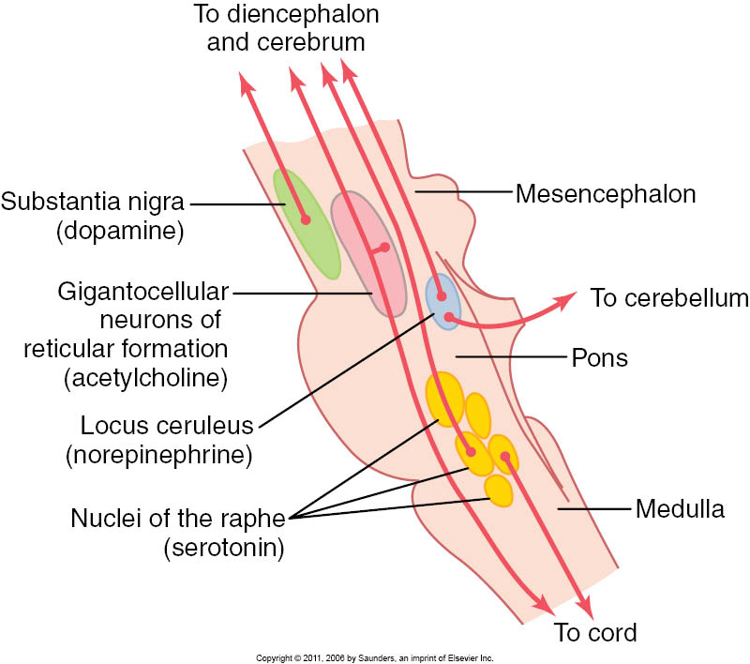

Slide 3
Norepinephrine (NE) / Locus ceruleus
Physiology; NE plays a part in controlling alertness, attention, and memory, it plays important role in causing dreaming (REM sleep).
Pathology;
Manic-depressive illness (Bipolar disease)

Slide 4
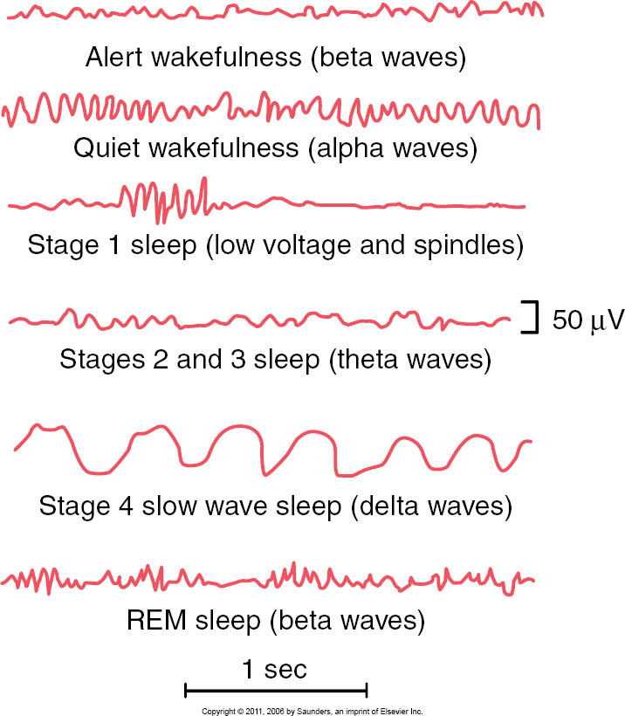

Slide 5
Serotonin / Raphi Neucleus
Physiology; Serotonin plays an important role in many behaviors including sleep, appetite, memory, sexual behavior, and mood. Serotonin may play a role in inhibiting transmission of pain in the Spinal Cord.
Pathology; when serotonin decreases in brain it causes; Depression , Insomnia.

Slide 6
Reward & Punishment centers

Slide 7
What is addiction?
1. Exposure/feeling of wellbeing
2. Exposure seeking behavior
3. Tolerance
4. Withdrawal
5. dependence

Slide 8
Norepinephrine
Serotonin
Anxiety
Irritability
Impulse
Impulse
Impulse
mood emotion
cognitive function
Sex
Energy
Interest
Appetite
Mood, Emotion,
Cognitive
Function
Motivation
Aggression
Drive
Dopamine
Notes:
Jour of Psychopharm 11(4 )supp;1997. Pg S27

Slide 9
Acetylcholine (Ach)
Physiology;
Ach (Cholinergic) neurons projecting to hippocampus are involved in memory, while projections from nucleus basalis of Meynert, amygdala & the entire neocortex are involved in motivation, perception & cognition.
Pathology;
In Alzheimer's disease there is extensive Cholinergic loss leading to Dementia.

Slide 10

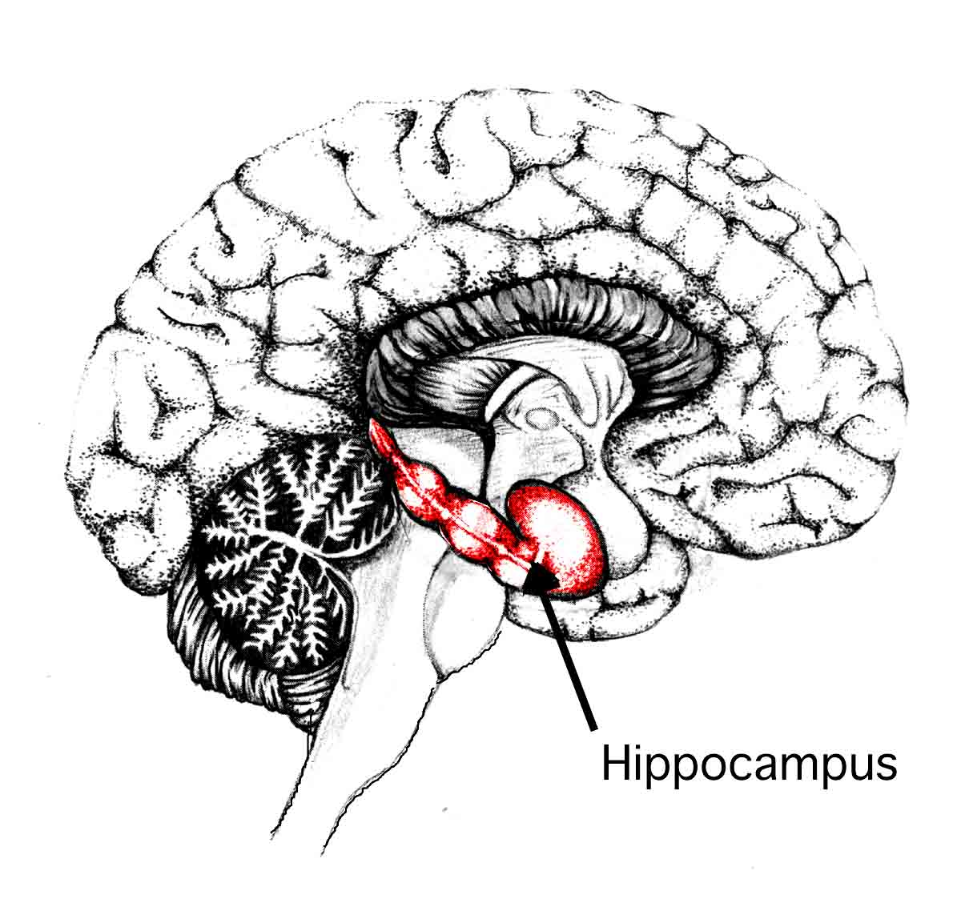
Hippocampus

Slide 11
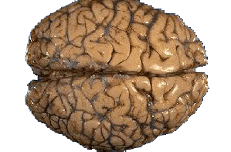
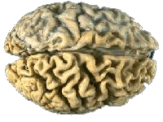
Normal vs AD Brain

