Slide 1
Neurotransmitters
Lec 6

Slide 2
Chemical synapses

Slide 9
Dopamine / Substantia Nigra
Physiological Role; controlling movement, thought processes, emotions, and the pleasure centers of the brain (Ventral tegmental area “VTA” & Nucleus accumbens).
Pathology; Destruction of the dopaminergic neurons in the substantia nigra is the basic cause of Parkinson's disease.
Schizophrenic patients indicate elevated level of D₂ receptors

Slide 10
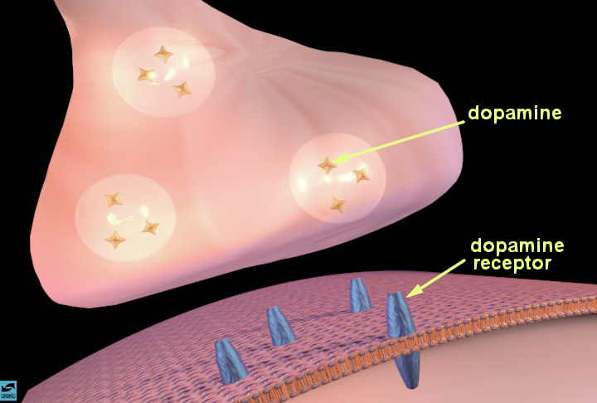
Notes:
Slide 4: The synapse and synaptic neurotransmission
Describe the synapse and the process of chemical neurotransmission. Indicate how vesicles containing a neurotransmitter, such as dopamine (the stars), move toward the presynaptic membrane as an electrical impulse arrives at the terminal. Describe the process of dopamine release (show how the vesicles fuse with the presynaptic membrane). Once inside the synaptic cleft, the dopamine can bind to specific proteins called dopamine receptors (in blue) on the membrane of a neighboring neuron. Introduce the idea that occupation of receptors by neurotransmitters causes various actions in the cell; activation or inhibition of enzymes, entry or exit of certain ions. State that you will describe how this happens in a few moments.

Slide 11
