Slide 1
Junctions & Synapses
Lec 5

Slide 2
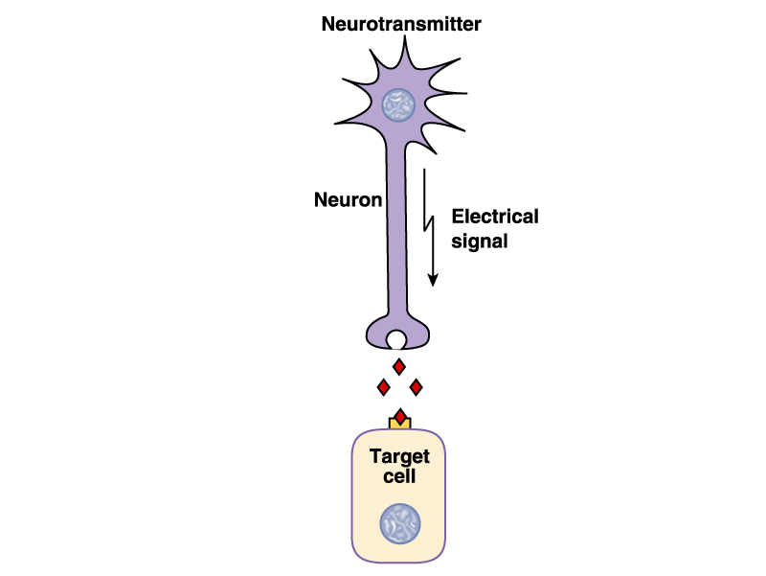

Slide 3
Types of Synapses
1. Chemical synapse
2. Electrical synapse (Gap junction)

Slide 4
Chemical synapse

Slide 5
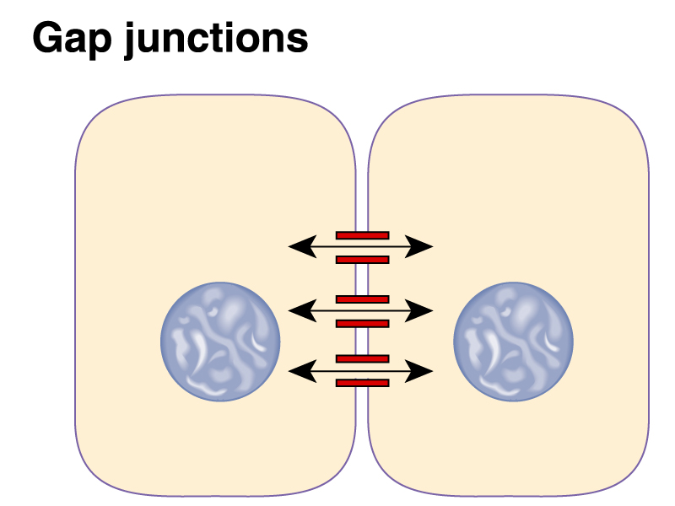
Electrical synapse

Slide 6
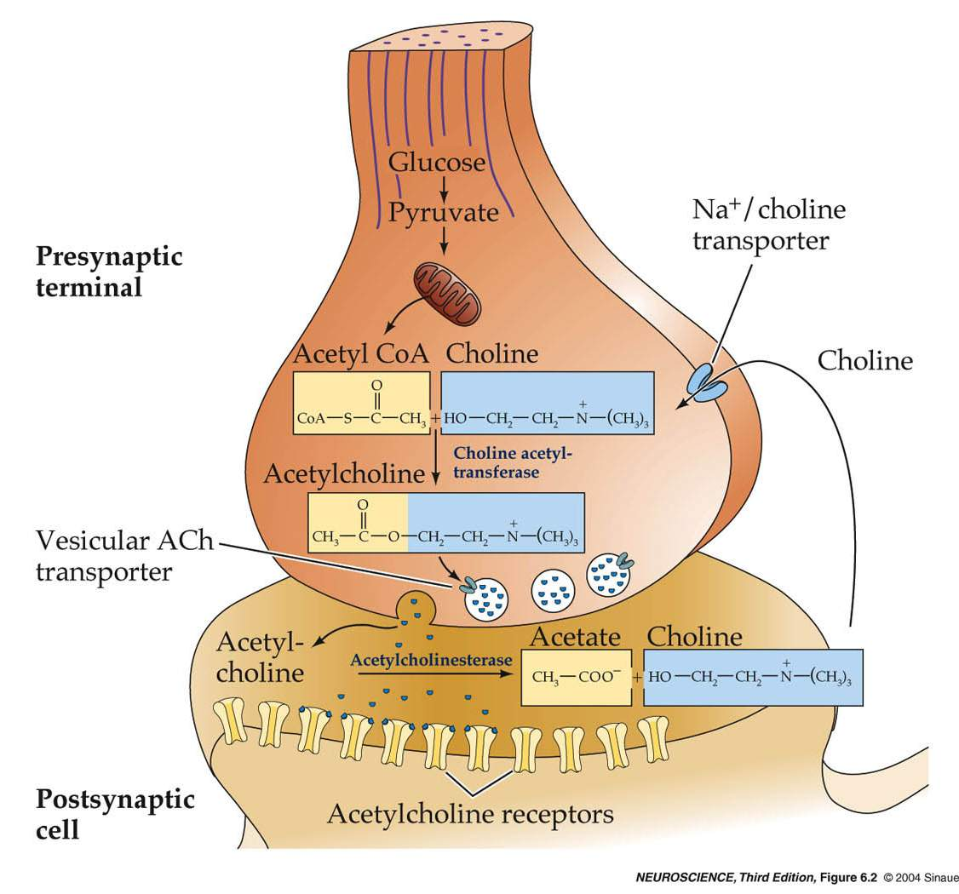
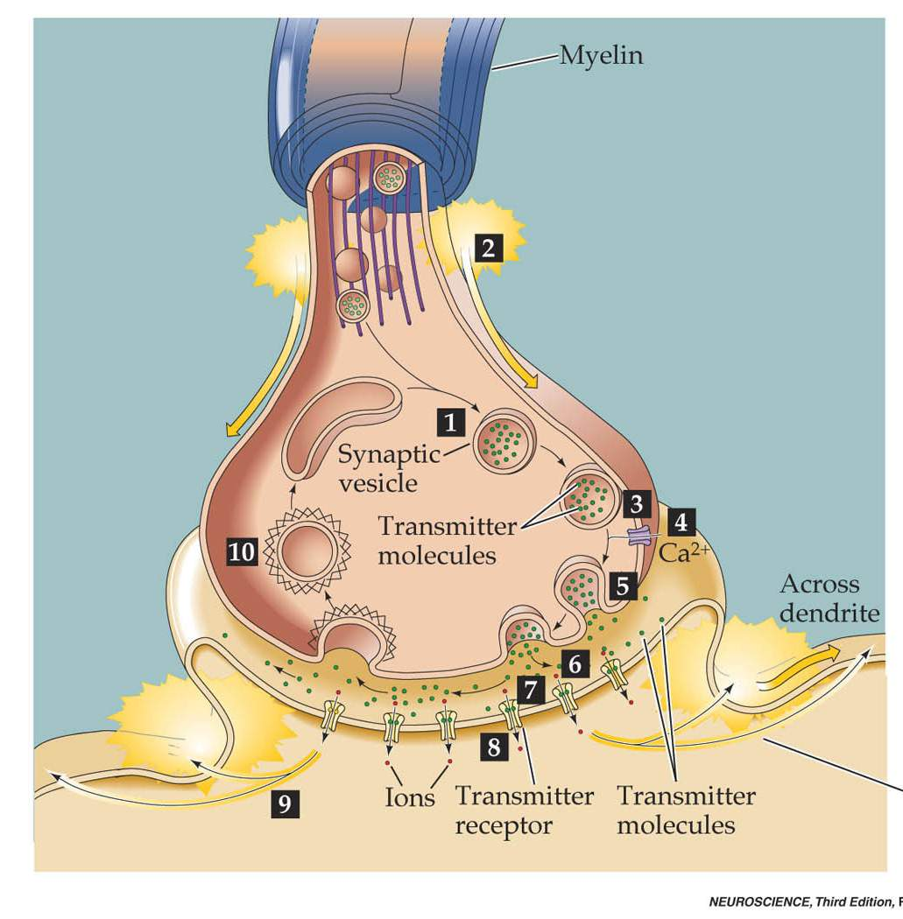
Synaptic Transmission at the NMJ

Slide 7
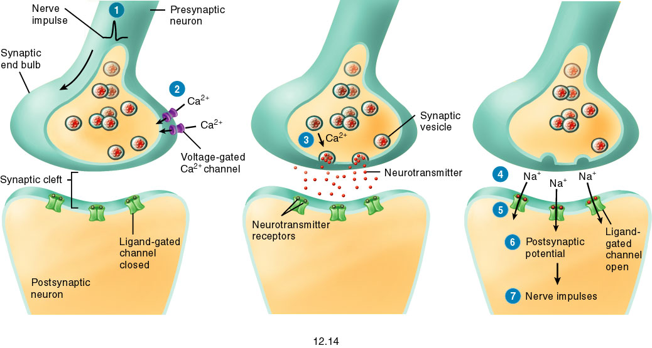
Fig. 12.14

Slide 8
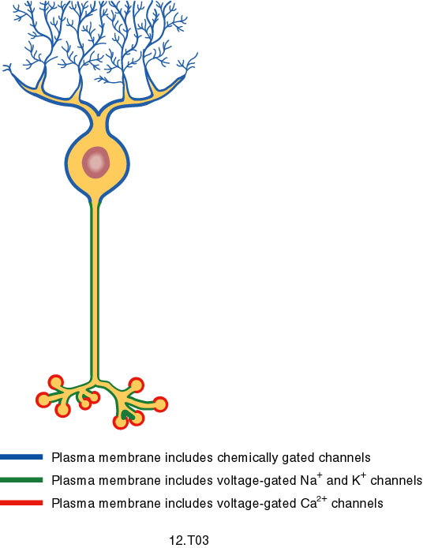
Fig. 12.T03

Slide 9
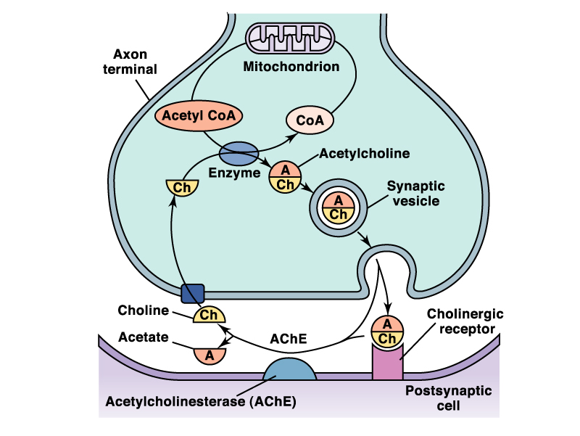

Slide 10
Neuromuscular junction(NMJ) At NMJ for Acetylcholine to be released we need; 1. AP arrives to nerve terminal 2. Ca⁺² influx to nerve terminal

Slide 11
Substances working on the NMJ
1. Prevent Acetylcholine (Ach) release at the NMJ:
“Botulinum toxin”
2. Competitive antagonist on Ach receptors:
Tubocurarine (muscle relaxant in surgery)
3. Anti-cholinesterase drugs:
Diiso propyl flurophosphate (nerve gas)
Neostigmine (treatment of Myasthenia gravis)
(Terminate curare effect )

Slide 13
