Slide 1
Body fluid Regulation & abnormalities
Lec 10

Slide 3
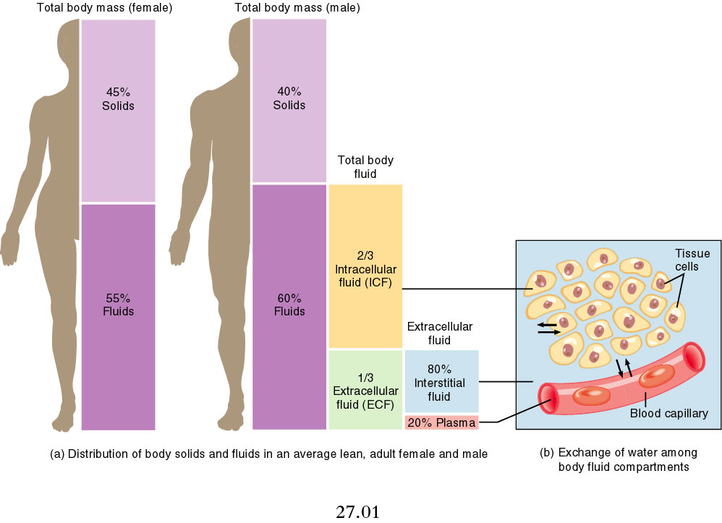
Distribution of total body water

Slide 4
Factors affecting total body water:
1. gender
2. age
3. Total body fat

Slide 5
Body fluid compartments;
1. intracellular (2/3)
2. Extracellular (1/3);
A. Interstitial fluid
B. Plasma

Slide 6
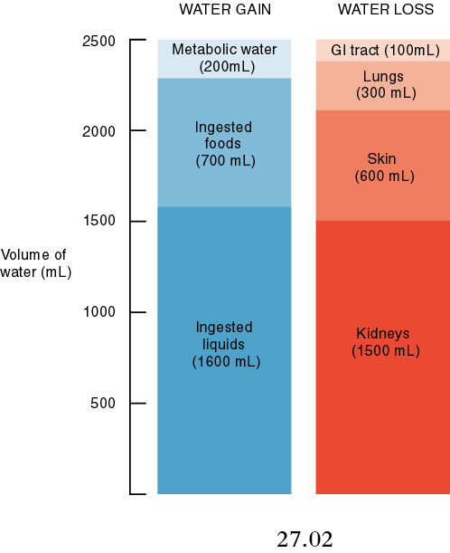
Daily input & output

Slide 7
Regulation of fluid exchange between body Compartments
ICF & ECF;
Determined by osmotic effect of solutes across the cell membrane.
Plasma & interstitial spaces
Colloid osmotic force & hydrostatic force across the capillary membrane.

Slide 9
Why its important to maintain body fluid in critically ill patients?
1. Dehydration will lead to hypovolemia and renal impairment.
2. Over-hydration will lead to pulmonary edema and heart failure.

