Slide 1
Urothelial tumors
Tumors in the collecting system above the bladder are relatively uncommon.
These tumors are classified into :
1 benign papilloma.
2-papillary urothelial neoplasms of low
grade
3-papillary urothelial carcinoma of high
grade

Slide 2
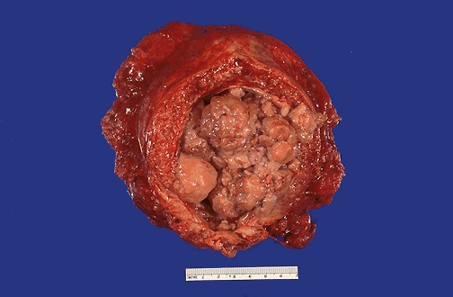
Transitional cell carcinoma of UB

Slide 3
Urothelial (transitional) cell carcinomas
Low-grade carcinomas are always papillary and are rarely invasive.
they may recur after removal.
The extent of invasion and spread (staging) at the time of initial diagnosis is the most important prognostic factor

Slide 4
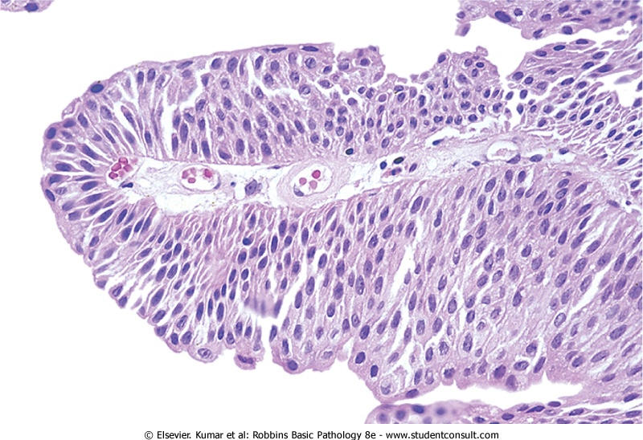
Papillary Urothelial (transitional) carcinoma-low grade

Slide 5
squamous cell carcinomas
only 5% of bladder cancers are squamous cell carcinomas.
Associated with chronic inflammation and stone formation, also Schistosomiasis infection

Slide 6
Clinical Course of bladder cancer
Painless hematuria is the dominant clinical presentation of all tumors.
M:F 3:1
50 to 70 years.
Prognosis
low-grade shallow lesions have good prognosis.
High grade lesions with deep penetration of the bladder wall→5-year survival rate is less than 20%.

Slide 7
Predisposing factors :
Bladder cancer is not familial.
factors implicated in the causation:
1- 50 X more common in those exposed to
β-naphthylamine.
2-Cigarette smoking.
3-Chronic cystitis.
4-Schistosomiasis of the bladder.
5-drugs as cyclophosphamide.

Slide 8
Treatment:
transurethral resection is both diagnostic and therapeutic
bacille Calmette-Guérin (BCG)➔ granulomatous reaction; triggers local immune response
Follow-up for recurrence with periodic cystoscopy and urine cytologic studies for the rest of their lives.
Radical cystectomy and chemotherapy for advanced cases

Slide 9
UROGENITAL SYSTEM LAB -1

Slide 10
Prevalence in children?
LM findings?
IF findings?
EM findings?

Slide 11
Minimal change disease
Prevalence in children? M/C NS
LM findings?none
IF findings? none
EM findings? Effaced podocyte foot processes

Slide 12
Prevalence in adults, children?
LM findings?
IF findings?

Slide 13
Focal and segmental glomerulosclerosis
Prevalence in adults? m/c 1* NS in adults
LM findings? Segmental sclerosis affecting some of the glomeruli.
IF findings? Usually negative

Slide 14
Types?
Causes of 2dry?

Slide 15
Membraneous glomerulopathy
Types? 1ry and 2rdy
Causes of 2dry?
Drugs
heavy metals
Infections
malignancy

Slide 16
Types?
Characteristic
IF findings?
Outcome?

Slide 17
Rapidly Progressive (Crescentic) Glomerulonephritis
Types? I, II , III
Characteristic
IF findings? Depends on type …
Outcome? poor

Slide 18
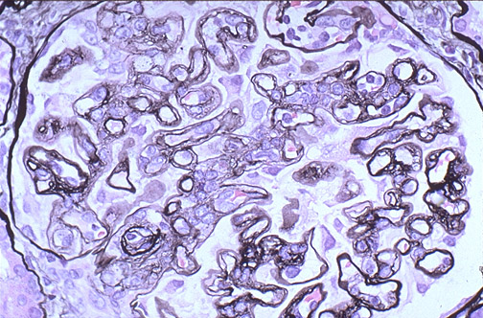
What type of special stain is this?
What is the characteristic light microscopic finding you see here.

Slide 19
MPGN
What type of special stain is this?
What is the characteristic light microscopic finding you see here.

Slide 20
Causes ?
Consequences?

Slide 21
hydronephrosis
Causes ? Congenital and acquired
Consequences? Chronic renal failure if cause not treated early

Slide 22
Pyelonephritis
m/c microorganism?
Risk factors?
Complications?

Slide 23
Renal Cysts
Describe what you see.
what is the clinical significance of this condition?

Slide 24
Renal Cycts
Describe what you see.
what is the clinical significance of this condition?
name types and their genetic abnormalities.

Slide 25
Renal tumors
what is the type of this tumor?
Name a genetic predisposing factor for it?

Slide 26
Renal tumors
what is the type of this tumor?
Name a genetic predisposing factor for it?
what is the peak age group of patients?

Slide 27
Renal tumors
Types?
describe the morphology of this lesion.
name a paraneoplastic syndrome associated with this tumor.

Slide 28
Bladder tumor
Type?
Risk factors?

