Slide 1
INFLAMMATION LECTURE 5
DR HEYAM AWAD

Slide 2
MOROHOLOGY OF ACUTE INFLAMMATION
DILATED BLOOD VESSELS.
OEDEMA.
INFLAMMATORY CELLS.

Slide 3
MORPHOLOGY OF ACUTE INFLAMMATION
SEROUS INFLAMMATION.
FIBRINOUS INFLAMMATION.
SUPPURATIVE INFLAMMATION, ABSCESS.
ULCERATION

Slide 4
SEROUS INFLAMMATION
CELL- POOR FLUID.
CLASSICAL EXAMPLE: SKIN BLISTERS DUE TO BURNS OR VIRAL INFECTION.

Slide 5
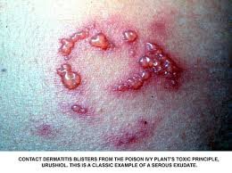
SEROUS INFLAMMATION

Slide 6
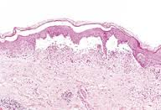
SEROUS INFLAMMATION.

Slide 7
FIBRINOUS INFLAMMATION
INCREASED PERMEABILITY.....EXUDATION OF FLUID AND LARGE MOLECULES SUCH AS FIBRINOGEN.
FIBRIN FORMED AND DEPOSITED IN EXTRACELLULAR SPACES.

Slide 8
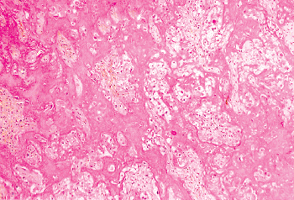
FIBRIN

Slide 9
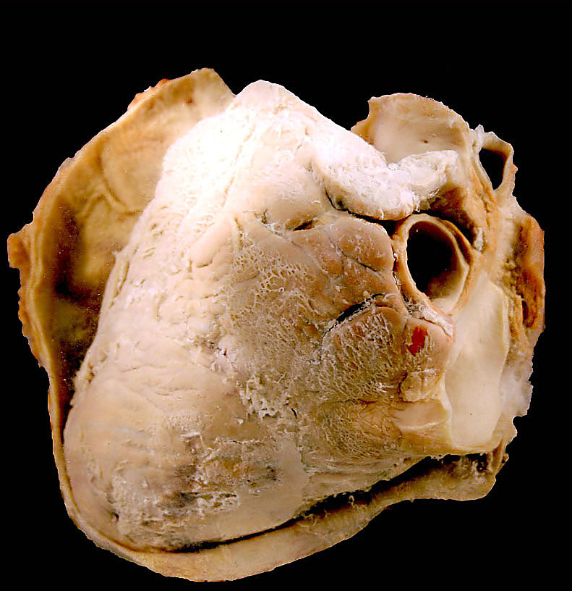

Slide 10
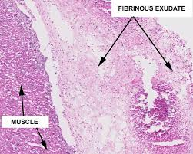

Slide 11
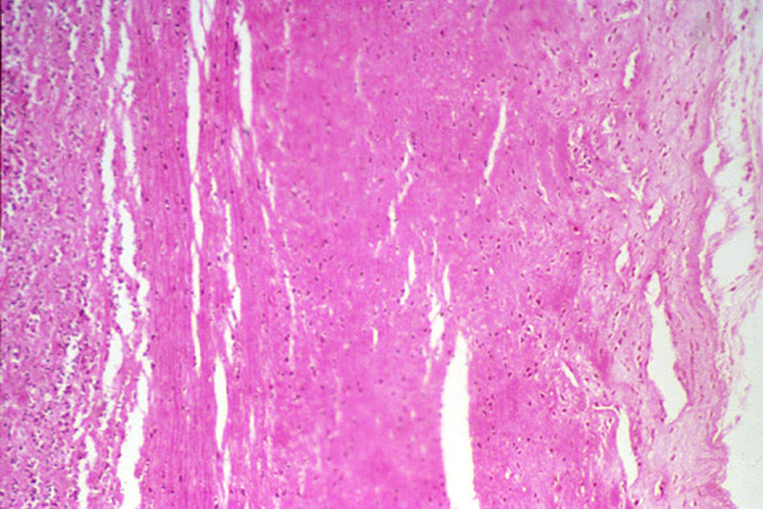

Slide 12
SUPPURATIVE INFLAMMATION
PUS = NEUTROPHILS, NECROTIC DEBRIS, FLUID.
CAUSED BY BACTERIAL INFECTION.

Slide 13
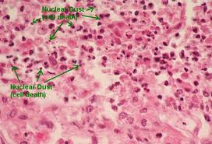

Slide 14
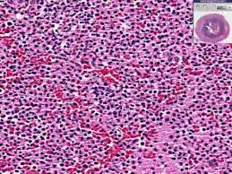

Slide 15
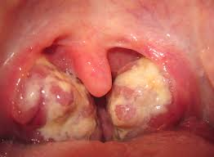
SUPPURATIVE TONSILLITIS

Slide 16
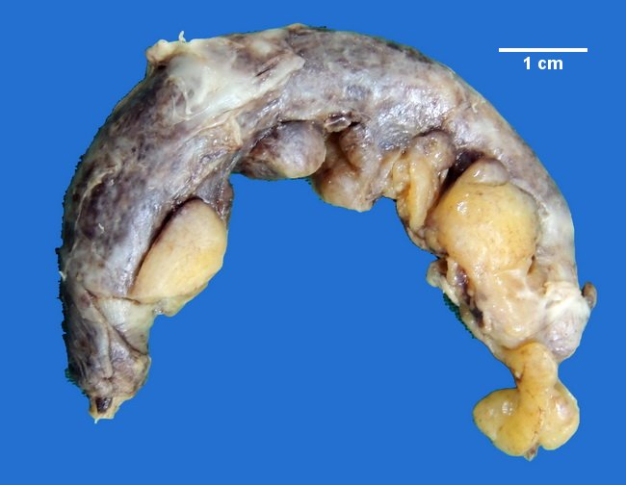
SUPPURATIVE APPENDICITIS

Slide 17
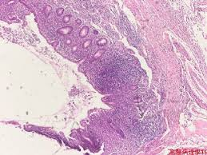
SUPPURATIVE APPENDICITIS

Slide 18
ULCERATION
LOCAL DEFECT CAUSED BY SLOUGHING OF NECROTIC TISSUE.

Slide 19
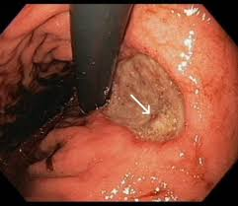
GASTRIC ULCER

Slide 20
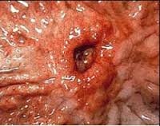

Slide 21
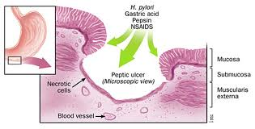
GASTRIC ULCER

Slide 22
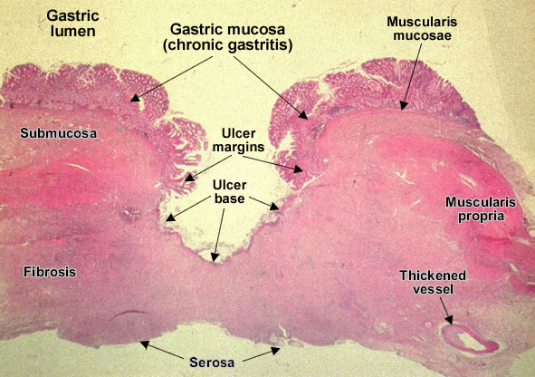

Slide 23
OUTCOMES OF ACUTE INFLAMMATION
COMPLETE RESOLUTION.
HEALING BY CONNECTIVE TISSUE.
PROGRESSION TO CHRONIC INFLAMMATION.

Slide 24
COMPLETE RESOLUTION
INJURY LIMITED OR SHORT LIVED.
LITTLE TISSUE DESTRUCTION.
REMOVAL OF CELLULAR DEBRIS AND PATHOGENS BY MACROOGAGES AND RESORPTION OF OEDEMA FLUID BY LYMPHATICS.

Slide 25
HEALING BY CONNECTIVE TISSUE FORMATION
SCARRING OR FIBROSIS.
HAPPENS AFTER:
SIGNIFICANT TISSUE DESTRUCTION
TISSURE INCAPABLE OF REGENERATION.
ABUNDANT FLUID THAT CANNOT BE CLEARED.

Slide 26
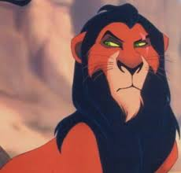

Slide 28
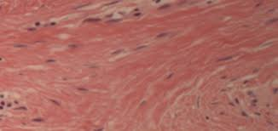

Slide 29
SYSTEMATIC EFFECT OF INFLAMMATION
FEVER.
CYTOKINES STIMULATE PROSTAGLANDIN PRODUCTION....FEVER.
SERUM PROTEINS...CRP, FIBRINOGEN, SERUM AMYLOID A.
ACT AS OPSONINS.

Slide 30
SYSTEMIC EFFCTS
LEUKOCYTOSIS.
CYTOKINES STIMULATE PRODUCTION OF WBCs FROM THEIR PRECURSORS IN BONE MARROW.

