Slide 1
INFLAMMATION LECTURE 4
DR HEYAM AWAD

Slide 2
CHEMICAL MEDIATORS OF INFLAMMATION
VASOACTIVE AMINES.
AA METABOLITES.
CYTOKINES.
COMPLEMENT SYSTEM.

Slide 3
VASOACTVE AMINES
HISTAMINE.
VASODILATOR AND INCREASES VASCULAR PERMEABILITY.
SECRETED MAINLY FROM MAST CELLS AND OTHER INFLAMMATORY CELLS.
ACTS VIA H1 RECEPTOR.

Slide 4
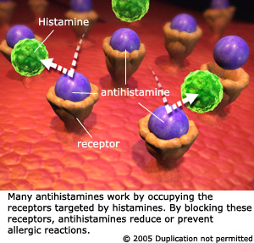
ANTIHISTAMINES

Slide 5
VASOACTIVE AMINES
SEROTONIN.
VASOCONSTRICTOR.
?ROLE IN INFLAMMATION????

Slide 6
ARACHIDONIC ACID

Slide 7
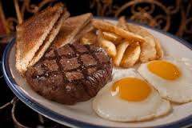

Slide 8
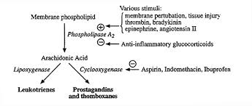

Slide 9
PROSTAGLANDINS
PGD2 AND PGE2
VASODILATORS.
INCREASE VASCULAR PERMEABILITY.

Slide 10
PROSTAGLANDINS
PROSTACYCLIN = PGI2.
VASODILATOR AND INHIBITS PLATELET AGGREGATION.
ENDOTHELIAL CELLS.
THROMBOXANE A2
VASOCONSTRICTOR AND PROMOTES PLATELET AGGREGATION
PLATELETS.

Slide 12
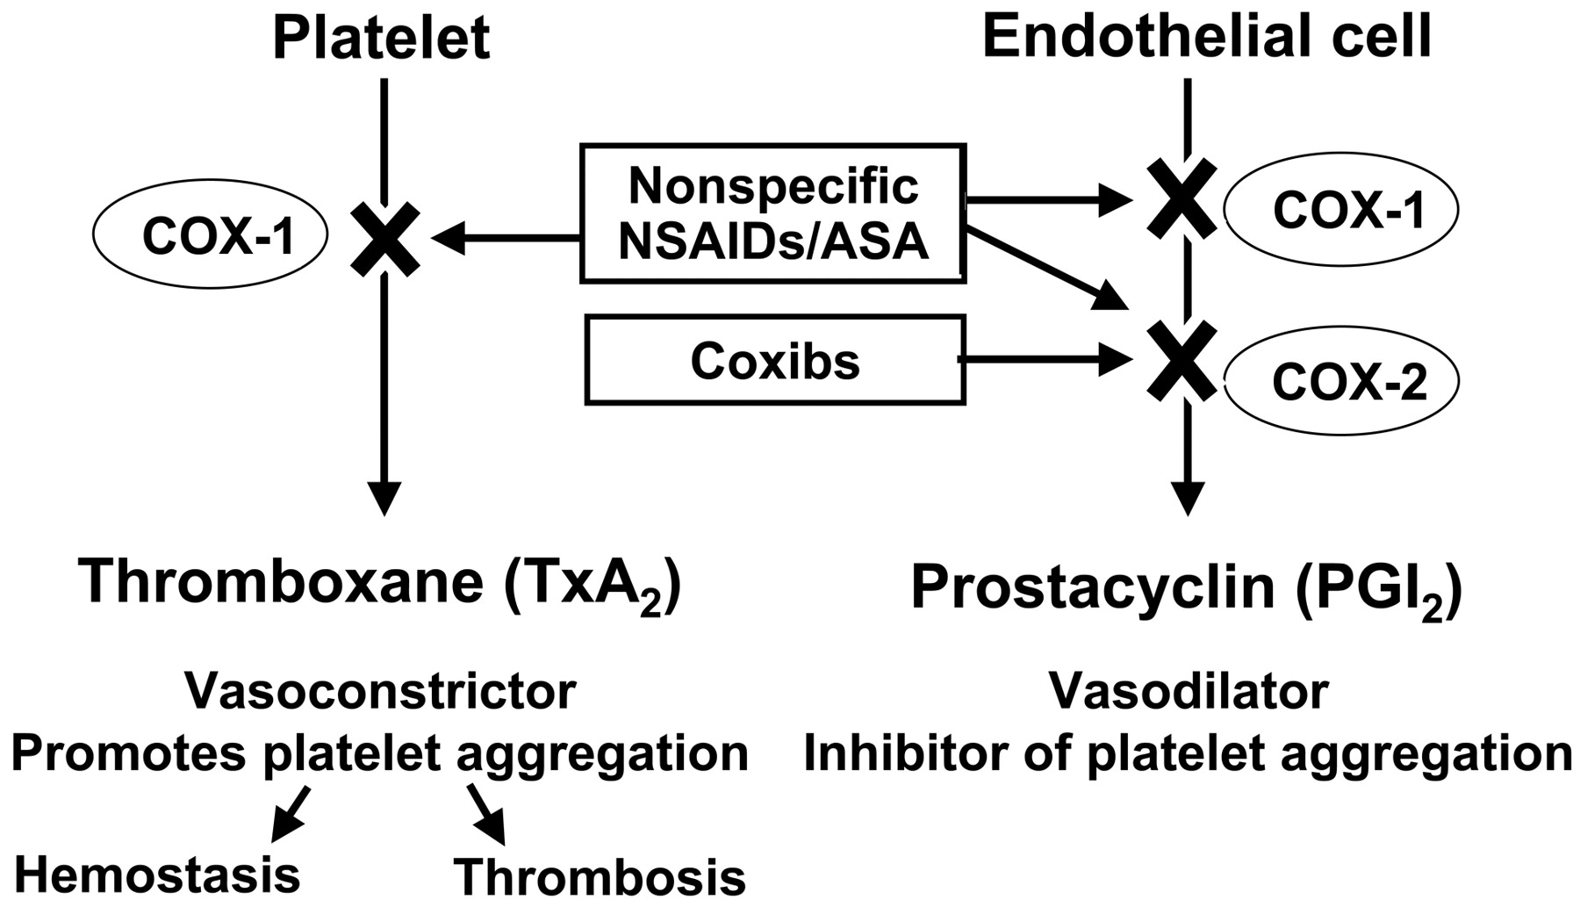

Slide 13
LEUKOTRIENES
LT B4.....CHEMOTAXIX.
LTC4, LTD4, LTE4....BRONCHOSPASM AND INCREASED VASCULAR PERMEABILITY.

Slide 14
LIPOXINS
LIPOXIN A4 AND B4.
ANTI-INFLAMMATORY ACTION.

Slide 15
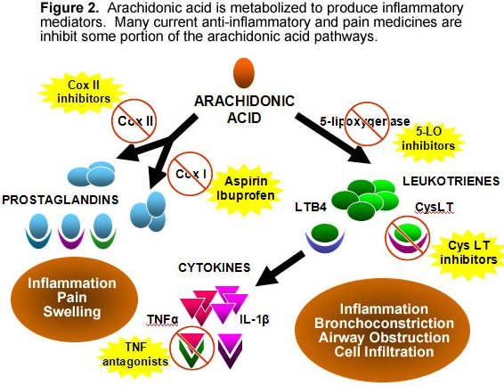

Slide 16
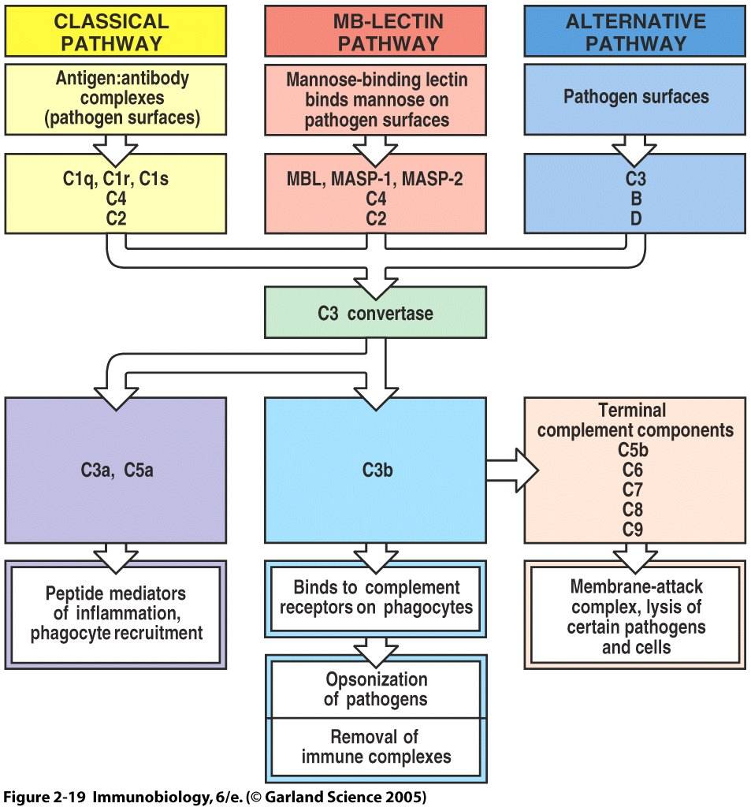
COMPLEMENT SYSTEM

Slide 17
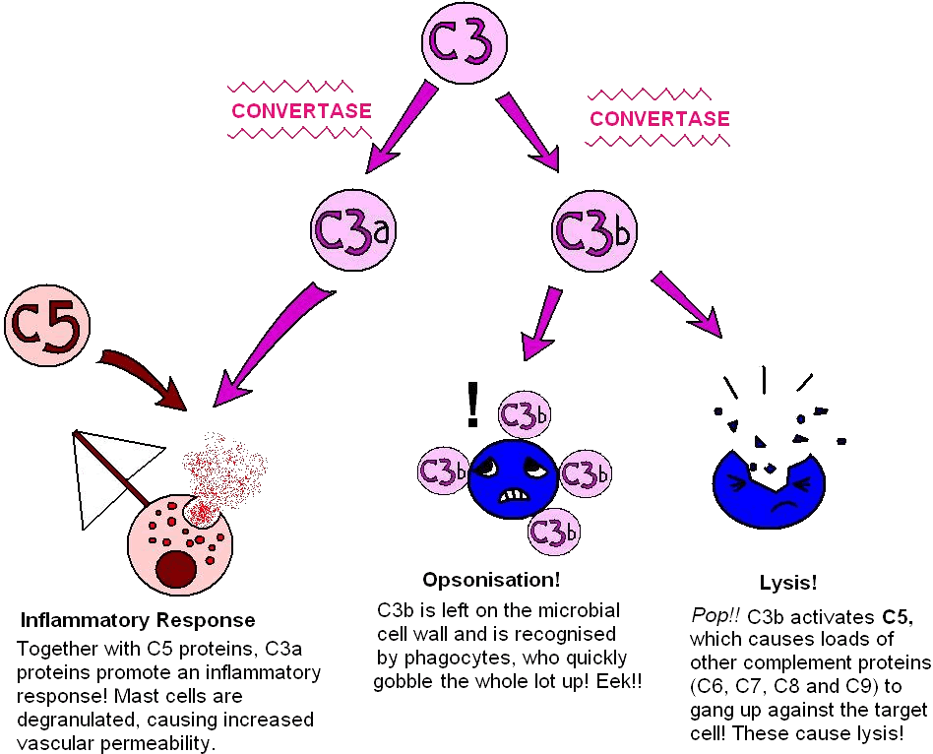

Slide 19
CYTOKINES
IL1 AND TNF.
CHEMOKINES
OTHERS

Slide 20
IL1 AND TNF
ENDOTHELIAL ACTIVATION.
INCREASED EXPRESSION OF ENDOTHELIAL ADHESION MOLECULES.
INCRESE OTHER MEDIATORS: OTHER CYTOKINES, GROTH FACTORS, AA METABOLITES.

Slide 21
IL1 AND TNF
LEUKOCYTE ACTIVATION.
TNF AUGMENTS RESPONSE OF NEUTROPHIL TO OTHER STIMULI AND A CTIVATES MICROBICIDAL ACTIVITY OF MACROPHAGES.
IL1 ACTIVATES COLLAGEN SYNTHESIS BY FIBROBLASTS.

Slide 22
IL1 AND TNF
SYSTEMIC ACUTE PHASE RESPONSE ;
FEVER.
CASHEXIA (TNF)
SEPSIS

Slide 23
CHEMOKINES
SMALL PROTEINS THAT ACT AS CHEMOATTRACTANTS TO SPECIFIC TYPES OF CELLS.
IL8....NEUTROPHILS.
LYMPHOTACTIN....LYMPHOCYTES.

Slide 24
OTHER MEDIATORS
PAF
PLATELET AGGREGATION.
VASOCONSTRICTION.
BRONCHOCONSTRICTION.

Slide 25
OTHER MEDIATORS
KININS

