Slide 1
Implantation

Slide 2
The human oocyte is fertilized in the lateral third of the uterine tube
the zygote undergoes cell division as it is moved passively toward the uterus
Through successive mitoses, a compact collection of cells, the morula, is formed
morula, covered by the zona pellucida, is about the same size as the fertilized oocyte. The cells that result from segmentation of the zygote are called blastomeres
Because the zygote does not grow in size, at each division the blastomeres become smaller.

Slide 3
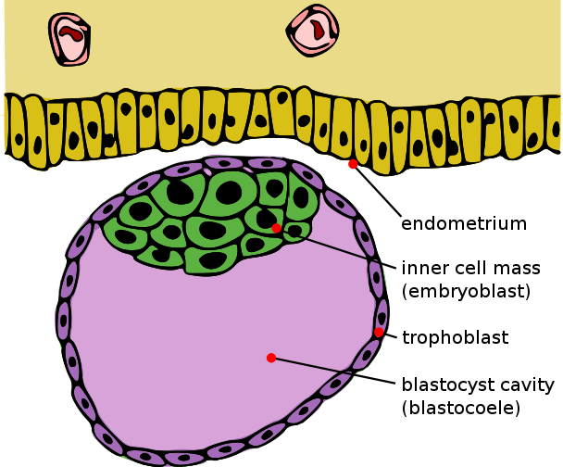
At the center of the morula a liquid-filled cavity develops and the blastomeres arrange themselves in a peripheral layer (trophoblast) while a few blastomeres accumulate inside the cavity (inner cell mass).
This embryo is now called a blastocyst, which is the stage at which it arrives in the uterus
This happens on approximately the fourth or fifth day after ovulation

Slide 4
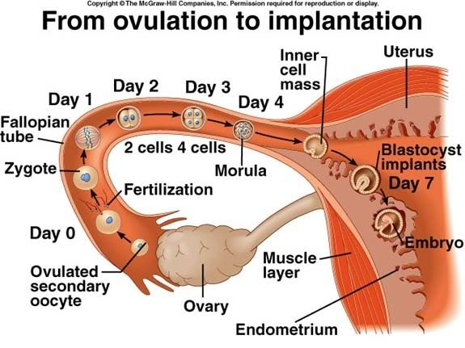
In the human, trophoblastic cells over the embryoblast pole begin to penetrate between the epithelial cells of the uterine mucosa about the sixth day
Attachment and invasion of the trophoblast involve integrins, expressed by the trophoblast, and the extracellular matrix molecules laminin and fibronectin.
Integrin receptors for laminin promote attachment, while those for fibronectin stimulate migration.
These molecules also interact along signal transduction pathways to regulate trophoblast differentiation so that implantation is the result of mutual trophoblastic and endometrial action.
.

Slide 5
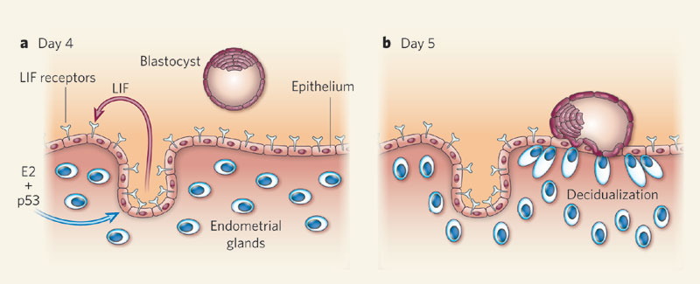
The blastocyst remains in the lumen of the uterus for 2 or 3 days, immersed in the secretion of the endometrial glands, and comes into contact with the surface of the endometrium
The zona pellucida is then dissolved, allowing cells of the trophoblast to interact directly with cells of the uterine surface epithelium. (on the 5th day)
Implantation, or nidation, involves the attachment of the embryo to the endometrial epithelial cells and its penetration into the lamina propria
This type of implantation is called interstitial and occurs in humans and a few other mammals.

Slide 6
The trophoblastiv cells invade the endometrioum by a process of histolysis
It forms a hole by which the blastocyst can enter
The first part of the implant is called embryonic pole
The last part is called the abembryonic pole.

Slide 7
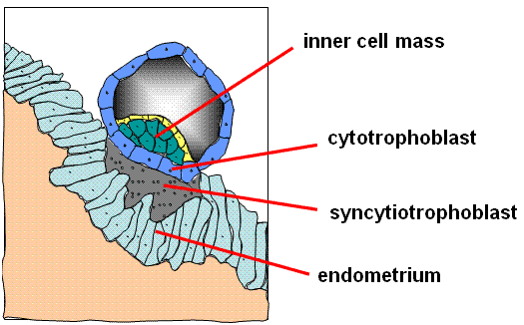
The process starts around the seventh day
At the eighth day of development, the blastocyst is partially embedded in the endometrial stroma.
In the area over the embryoblast, the trophoblast has differentiated into two layers:
(a) an inner layer of mononucleated cells, the cytotrophoblast,
(b) an outer multinucleated zone without distinct cell boundaries, the syncytiotrophoblast

Slide 8
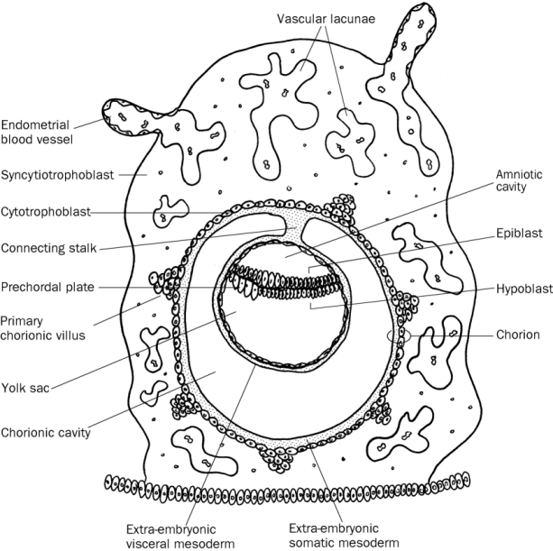
Mitotic figures are found in the cytotrophoblast but not in the syncytiotrophoblast.
Thus, cells in the cytotrophoblast divide and migrate into the syncytiotrophoblast, where they fuse and lose their individual cell membranes.
Cells of the inner cell mass or embryoblast also differentiate into two layers:
a) a layer of small cuboidal cells adjacent to the blastocyst cavity, known as the hypoblast layer,
(b) a layer of high columnar cells adjacent to the amniotic cavity, the epiblast layer
Together, the layers form a flat disc.

Slide 9
At the same time, a small cavity appears within the epiblast.
This cavity enlarges to become the amniotic cavity.
Epiblast cells adjacent to the cytotrophoblast are calle amnioblasts; together with the rest of the epiblast, they line the amniotic cavity
on about the ninth day after ovulation, the embryo is totally submerged in the endometrium, from which it will receive protection and nourishment during pregnancy.
So the on the 9th or the 10th day the opening is closed by a fibrin clot and the epithelium regenrates
Finally, the whole embryo is embedded in the endometrium. Eventually, the syncytiotrophoblasts come into contact with maternal blood and form chorionic villi. This is the initiation of forming the placenta.

Slide 10
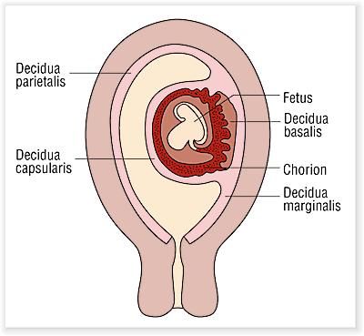
The placenta is a temporary organ and is the site of physiological exchanges between the mother and the fetus
It consists of a fetal part (chorion) and a maternal part (decidua basalis)
Thus the placenta is composed of cells derived from two genetically distinct individuals.
The decidua basalis supplies maternal arterial blood to, and receives venous blood from, spaces that exist inside the placenta.
The placenta is also an endocrine organ, producing hormones such as HCG, a placental prolactin, estrogens, and progesterone.

Slide 11
During implantation of the embryo, the endometrial connective tissue goes through profound changes
The fibroblasts of the lamina propria become enlarged and round and exhibit the characteristics of protein-synthesizing cells.
They are now called decidual cells, and the whole endometrium is called the decidua.
Based on the endometrial region, the decidua can be classified as the decidua basalis, situated between the embryo and the myometrium
the decidua capsularis, situated between the embryo and the lumen of the uterus
and the decidua parietalis, the remainder of the decidua
Hence, by the end of the first week of development, the human zygote has passed through the morula and blastocyst stages and has begun implantation in the uterine mucosa

Slide 12
Infertility
Infertility is a problem for 15% to 30% of couples.
Male infertility may be a result of insufficient numbers of sperm and/or poor motility.
Infertility in a woman may be due to a number of causes, including occluded oviducts (most commonly caused by pelvic inflammatory disease), hostile cervical mucus, immunity to spermatozoa, absence of ovulation, and others.

Slide 13
In vitro fertilization (IVF)
In vitro fertilization (IVF) of human ova and embryo transfer is a frequent practice conducted by laboratories throughout the world.
Follicle growth in the ovary is stimulated by administration of gonadotropins.
Fertilized eggs are monitored to the eight-cell stage and then placed in the uterus to develop to term.

Slide 14
Contraceptive Methods
The contraceptive pill is a combination of estrogen and the progesterone analogue progestin, which together inhibit ovulation but permit menstruation.
The intrauterine device (IUD) is placed in the uterine cavity. Its mechanism for preventing pregnancy is not clear but may entail direct effects on sperm and oocytes or inhibition of preimplantation stages of development.
Vasectomy and tubal ligation are effective means of contraception, and both procedures are reversible, although not in every case.

Slide 15
Ectopic pregnancy
In cases of abnormal nidation, the embryo may implant itself in the oviduct (ectopic pregnancy).
In this case, the lamina propria reacts like the endometrium, forming numerous decidual cells
Because of its small diameter, the oviduct cannot contain the growing embryo and bursts, causing extensive hemorrhage that can be fatal if not treated immediately.

Slide 16
Placenta previa
The initial attachment of the embryo usually occurs on the ventral or dorsal walls of the corpus of the uterus
Sometimes the embryo attaches close to the internal os. In this case the placenta will be interposed between the fetus and the vagina, obstructing the passage of the fetus at parturition
This situation, called placenta previa, must be recognized by the physician, and the fetus must be delivered by cesarean section; otherwise, the fetus may die
Sometimes, the embryo attaches to the epithelium of the uterine tube. Very rarely the zygote may enter the abdominal cavity, attach to the peritoneum, and develop there.

