Slide 2
Human papillomavirus
Faris Bakri

Slide 3
Introduction
Papillomaviruses found in animals
Common in humans
Produce skin and mucus membranes tumors
HPV are species specific
1907: warts were of viral origin

Slide 4
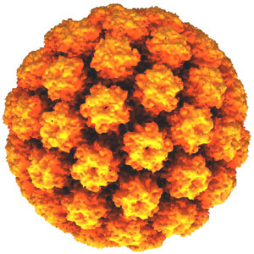
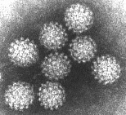
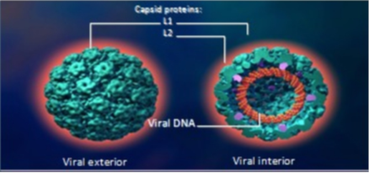
Virology
Nonenveloped
Icosahedral capsid
Double stranded DNA

Slide 5
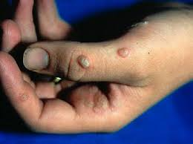
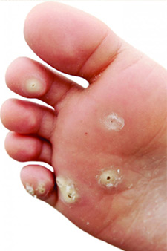
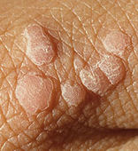
Epidemiology
HPV over 100 types
Common warts:
70% of cutaneous warts
4-20% of people (school children)
Plantar warts
34% of cutaneous warts
adults
Flat warts
4% of cutaneous warts
Children

Slide 6
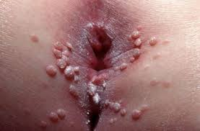
Genital warts
Very common
Most common STD in USA
Condyloma accuminata
1% in population

Slide 7
Transmission
Cutaneous warts:
? close contact + minor trauma
Genital warts:
Sexual contact

Slide 8
Tumors
Cervical cancer
Types 16, 18, 31, 45
Squamous cell cancer
Vaginal Vulvar
Anal
Penile
Nose, paranasal sinuses, oropharynx, esophagus

Slide 9
Risk factors for cervical cancer
Smoking
Multiparity
Long term oral contraceptive
Cervical inflammation
Immunosuppression
Genetic

Slide 10
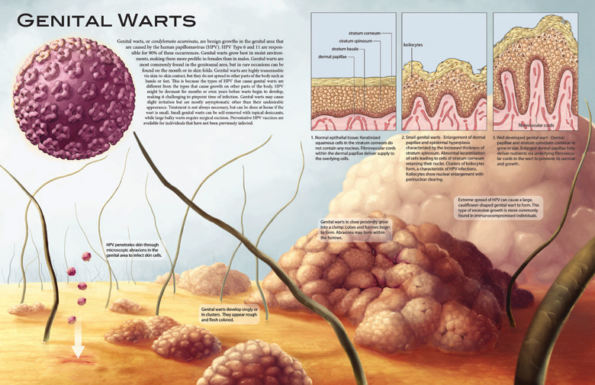
Pathogenesis
Incubation period
3-4 m

Slide 11
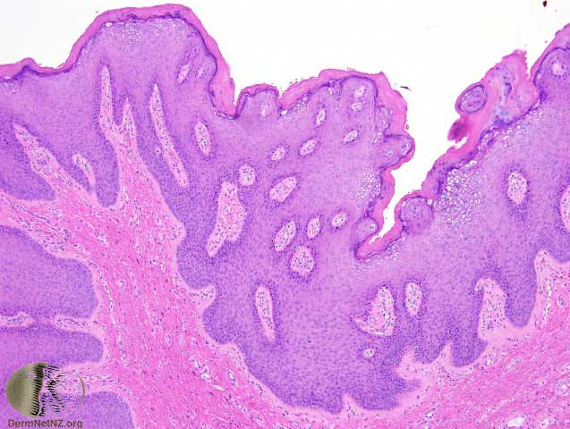

Slide 12
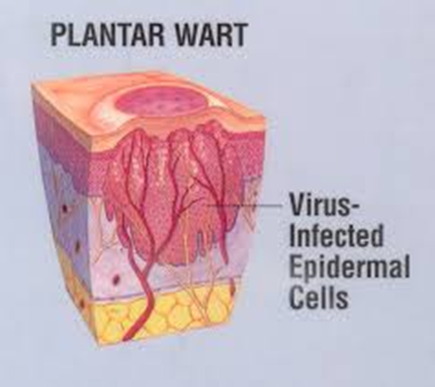

Slide 13
Cutaneous warts
Deep plantar
Young adults + adolescents
Raised bundles of soft keratotic fibers
2mm – 1 cm diameter
Shaving reveals punctate bleeding vessels
Painful

Slide 14
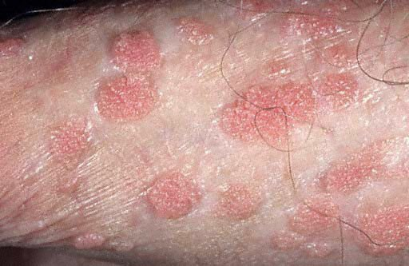
Common warts
Well demarcated
Hyperkeratotic papules
Dorsum of hands, between fingers, around nails
1 cm
Mosaic warts

Slide 15
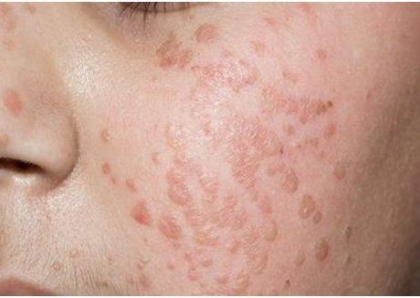
Plane warts
Children
Multiple
Slightly elevated papules
Face, neck, hands

Slide 16
Diagnosis
Clinically
Biopsy
Rule out invasive cancer
DNA
Staining

Slide 17
Treatment
No highly effective treatment
Only decrease clinical manifestation
Salicylic acid
75% response rate
Cryotherapy
Laser

Slide 18
Prevention
Avoid contact with lesions
Swimming pools: protective equipment
Condoms (genital warts)
Pap smear (cervical cancer)

