Slide 1
Histology Lab (2)/slides by , Duha NAJI .

Slide 2
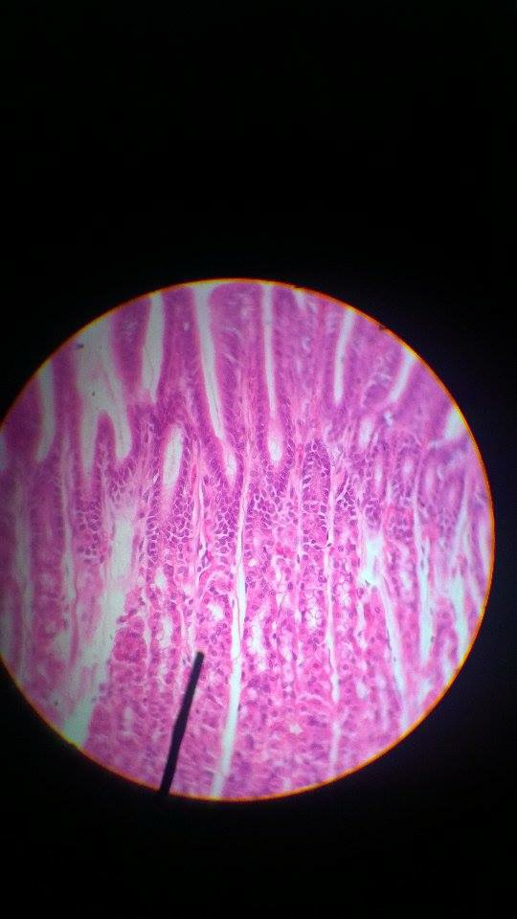
Stomach :
-Fundus or Body
-Gastric pits ( Foveolae )>> histological definition .
Mucous surface cell.
Parietal Cell = Oxyntic Cell.
- Peptic cell = Chief cell .

Slide 3
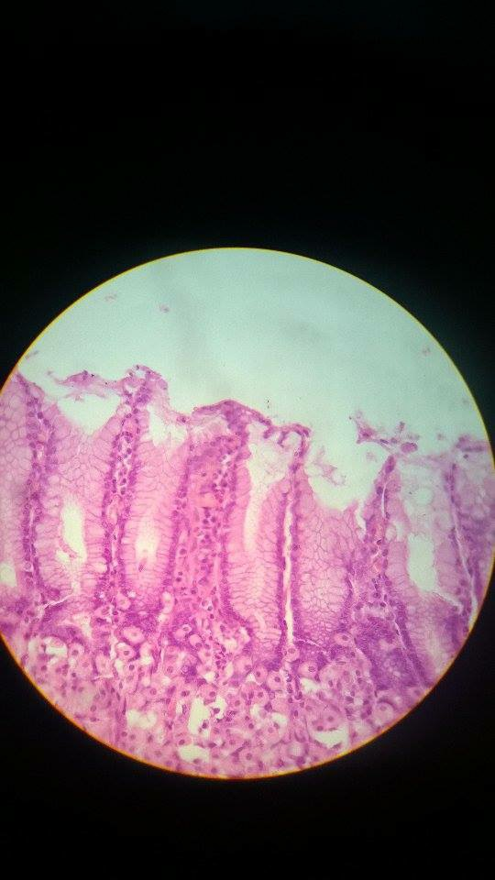
Stomach
Fundus or body .( histological )
Justify your study ?!

Slide 4
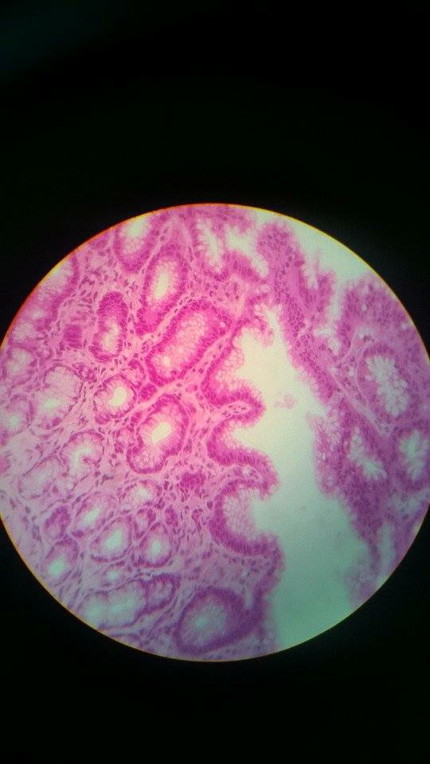
Stomach .
Pylorus region .
Gastric pits lined by mucous surface cell .
Notice the pyloric sphincter .
>> In which layer the sphincter is ?
In the muscularis externa.
Is it anatomical or physiological sphincter ? Why ?! It’s anatomical because there is a true thickening in the inner circular muscles .

Slide 5
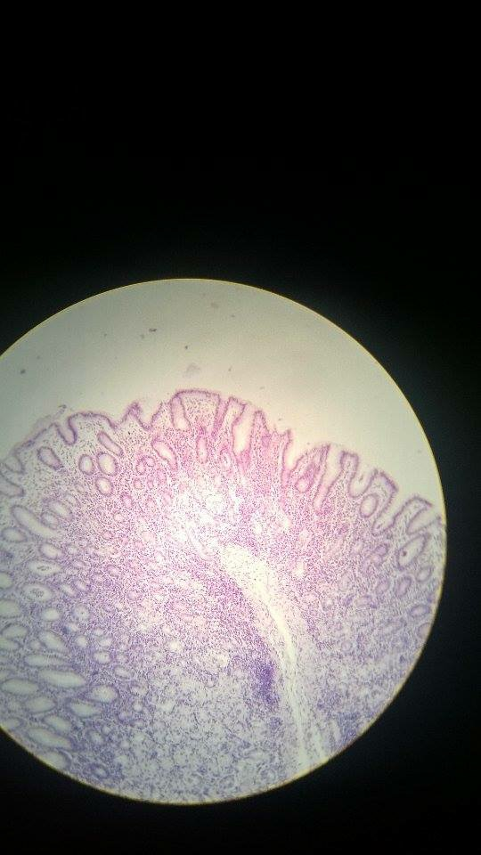
-Stomach
Pylorus region
Notice the length of gastric pits . ( they’re long ! )
In lamina propria , you find MALT , which is Mucosal Associated Lymph Tissue .
Glands .

Slide 6
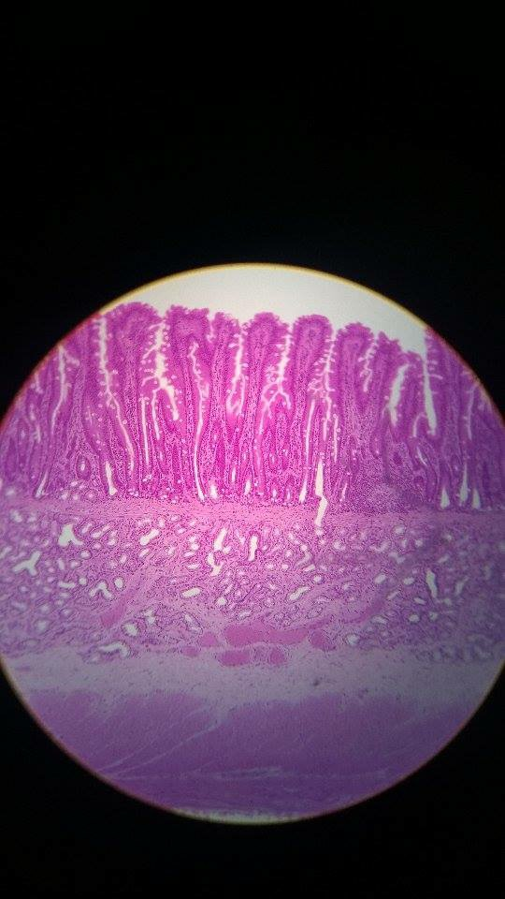
-Small Intestine .
Duodenum .
What is the land mark for this part ?
Brunner’s gland in the submucosa .
Look for parasympathetic ganglion
Myenteric plexus = Auerbach’s plexus

Slide 7
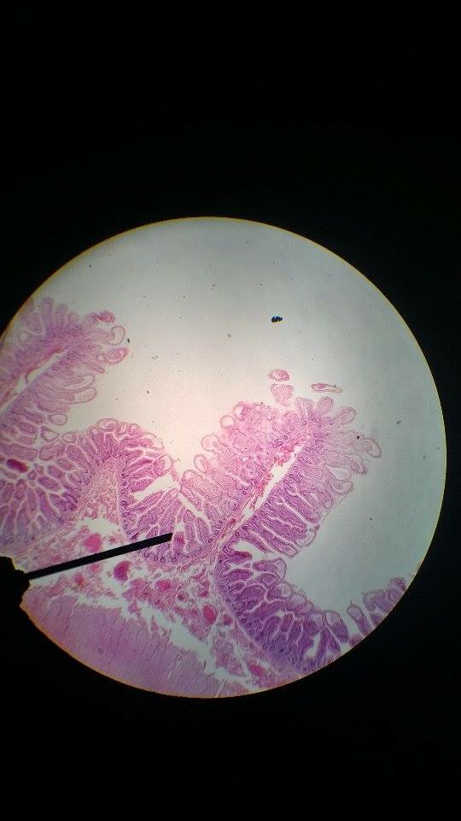
-Small Intestine .
-Jejunum .
What’s the landmark for small intestine ? VILLI
What’s the landmark for jejunum ? plicae circularis which is finger-like in shape.
Look for microvilli , Paneth cells and goblet cells .

Slide 8
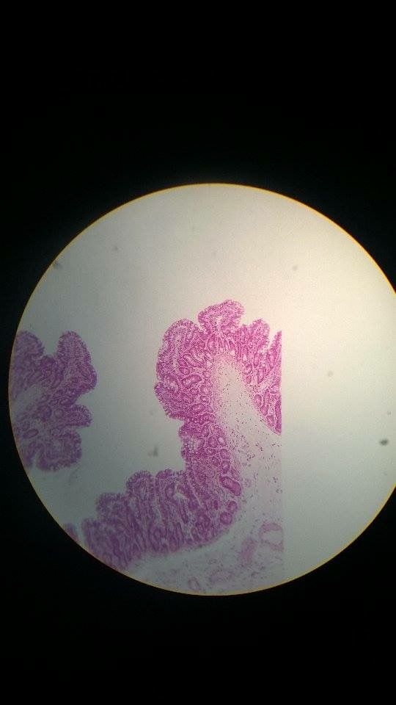
-Small Intestine .
Jejunum .
Look for Paneth cells .

Slide 9
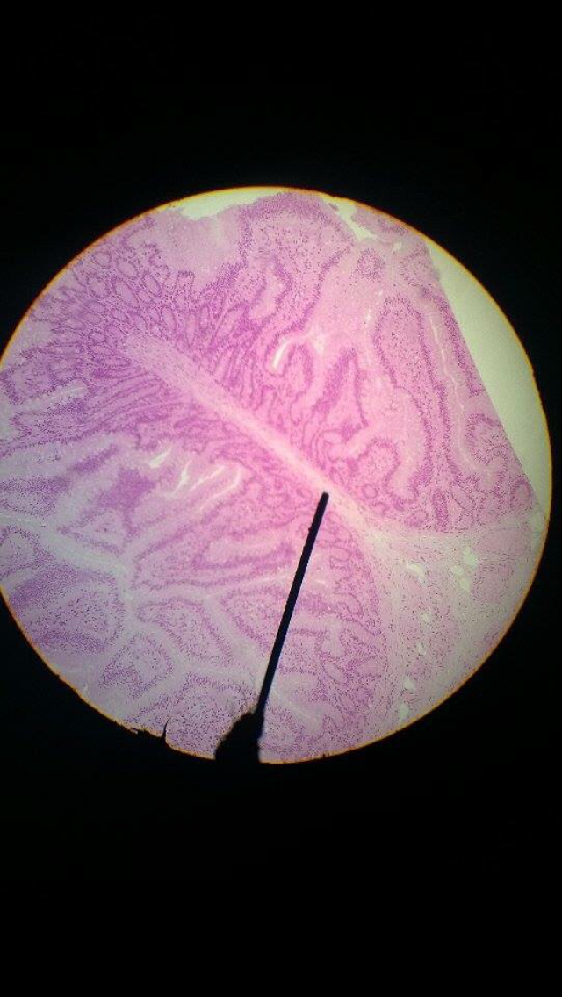
Small Intestine .
Ileum .
What’s the land mark for Ileum ?
Peyer’s Pathch

Slide 10
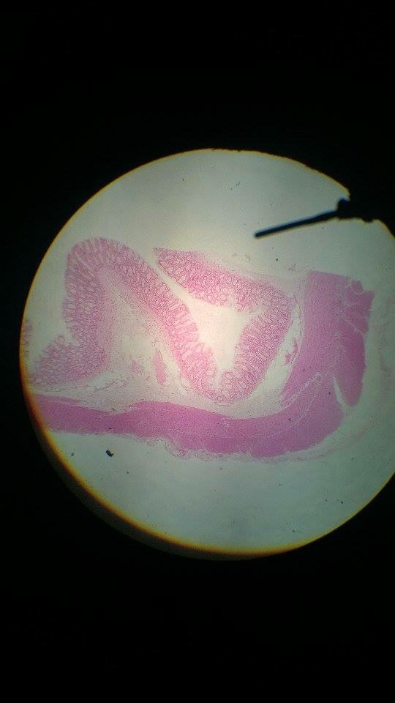
Large Intestine .
Colon .
No villi .
Taenia Coli ( muscular externa )
Single tubular gland .
In which layer the thickness is more ?
Musularis externa
Parasympathetic Ganglion ( plexus ).

Slide 11
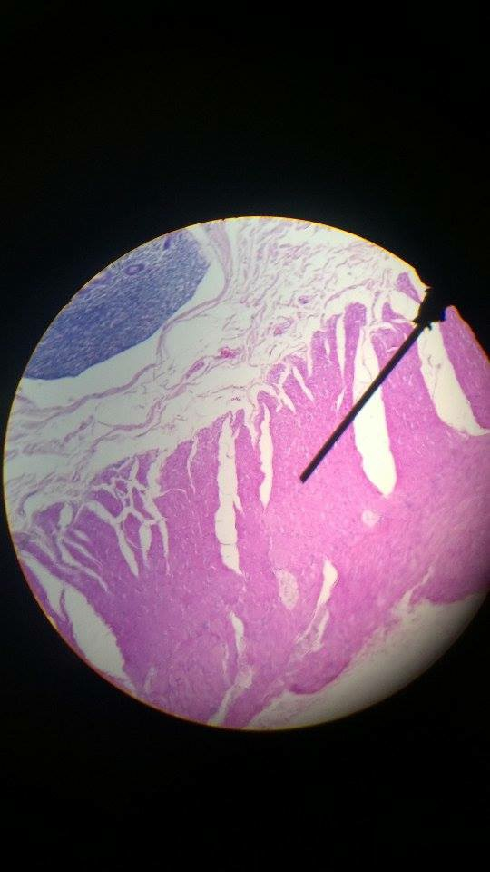
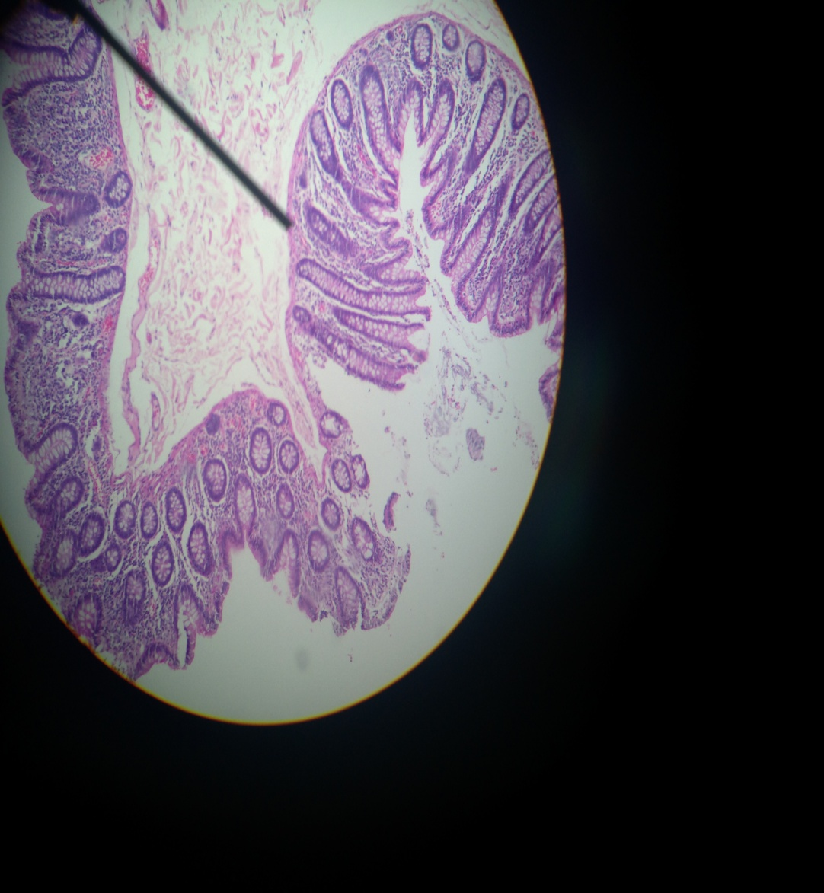
-Colon .
Solitary lymphatic nodule .
Simple tubular gland .
Parasympathetic ganglion cells .(postganglionic )

Slide 12
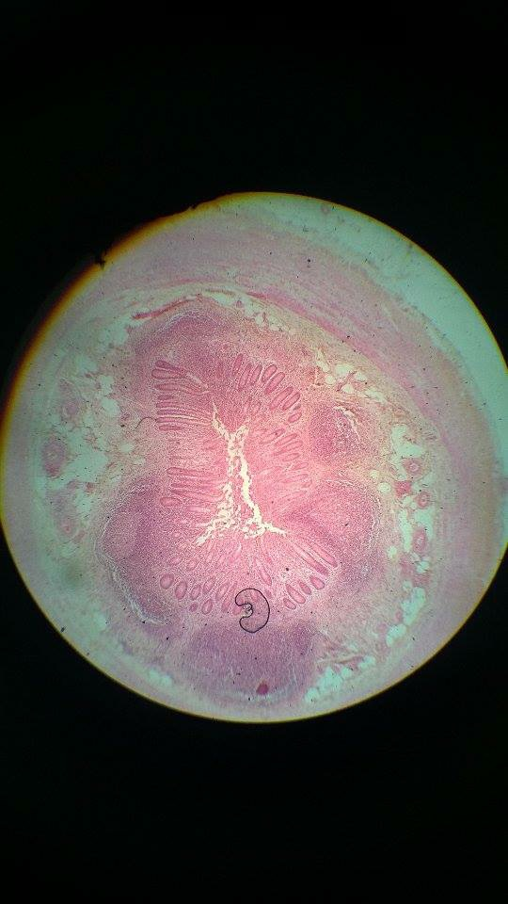
Appendix .
It’s known as tonsil of the abdomen , why ?!
Because it’s a lymphoid tissue .
Few goblet cells .
Few crypts .

