Slide 1
HISTOLOGY LAB (1)/SLIDES BY , DUHA NAJI .

Slide 2
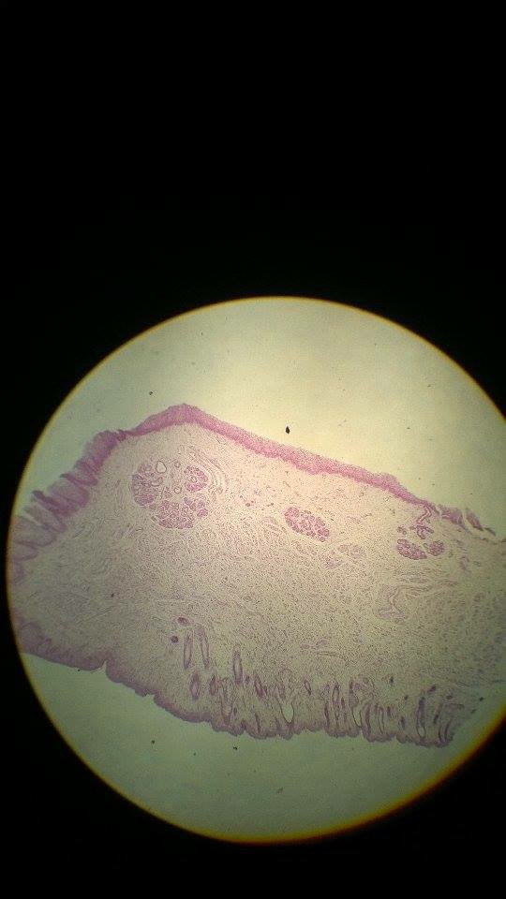
Midline through the lip
External surface ( hairy skin ).
Transition zone (vermilion border )>> devoid of sweat & sebaceous glands .
Oral mucosa ( inner surface )>> thick epithelium + labial glands .
Bulk : skeletal muscles >> Orbicularis Oris .

Slide 3
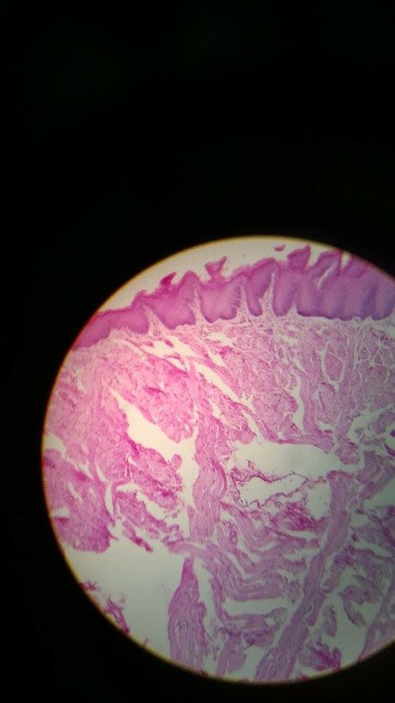
-Tongue .
Faliform papillae.
No taste buds ( important )

Slide 4
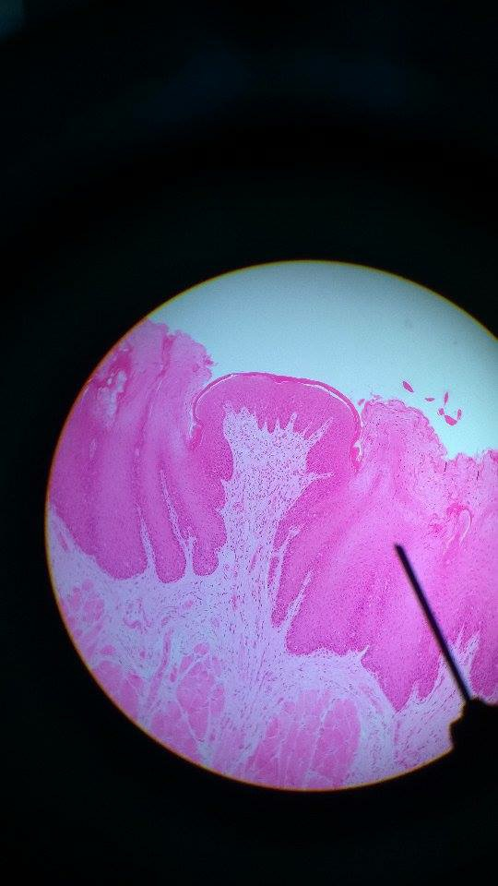
-Tongue .
Fungiform papillae .
Central .
On which surface the taste buds present in these papillae ?
On the upper part of these papillae (dorsum of the tongue ).

Slide 5
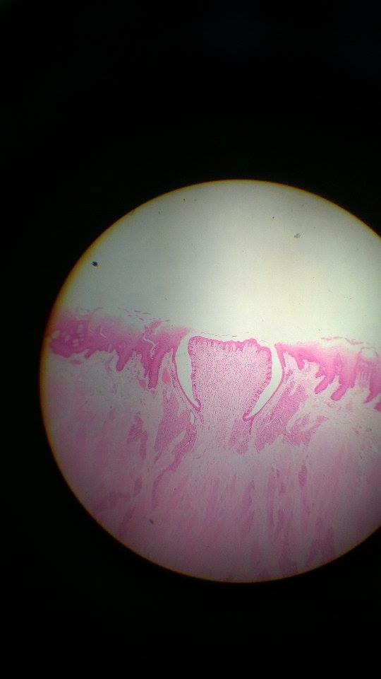
Tongue .
Circumvallate papillae .
Lateral .
Taste buds on the lateral side .
Von Ebner’s gland ( serous gland ).

Slide 6
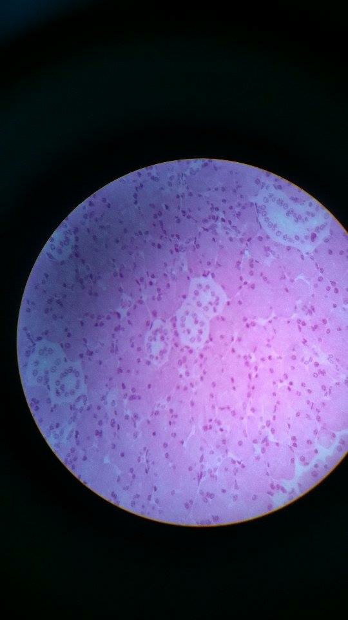
-Salivary gland .
-Parotid ( mostly serous )
-Compound tubuloalveolar >> for all salivary glands .
- Intercalated & striated ducts .

Slide 7
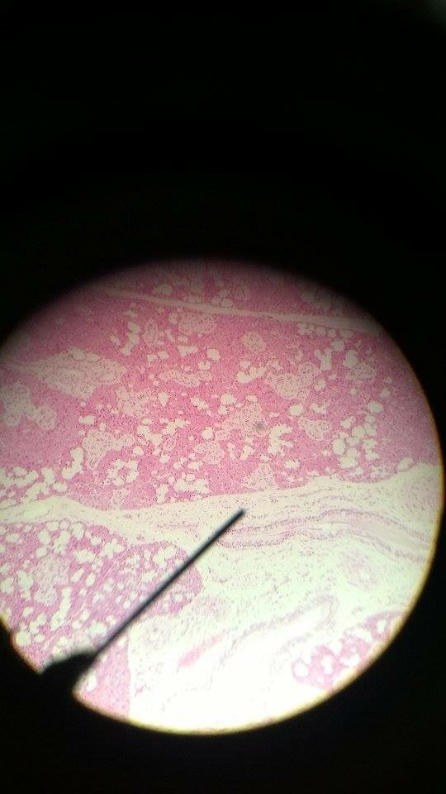
Submandibular gland .
(seromucous ) >> mixed
- Complicated duct system (i.e. many striated ducts ).

Slide 8
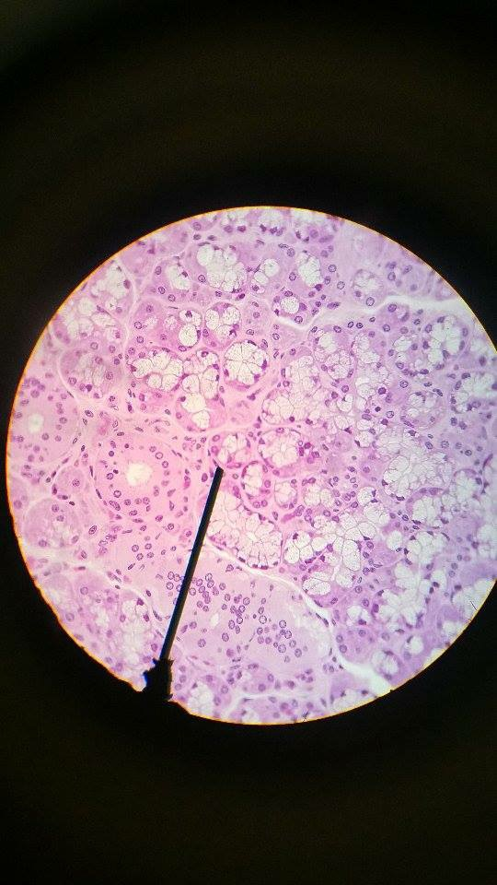
Sublingual gland .
(mostly mucous )
Look for serous demilune .
Non-complicated duct system .
Very little intercalated ducts .
Many striated ducts .

Slide 9
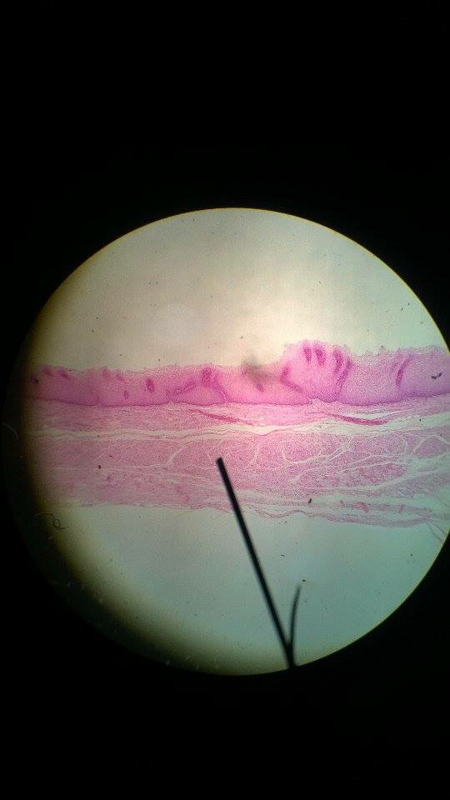
-Longitudinal section .
Esophageal-stomach junction = Cardia .
Esophageal cardiac gland >> in lamina propria .

Slide 10
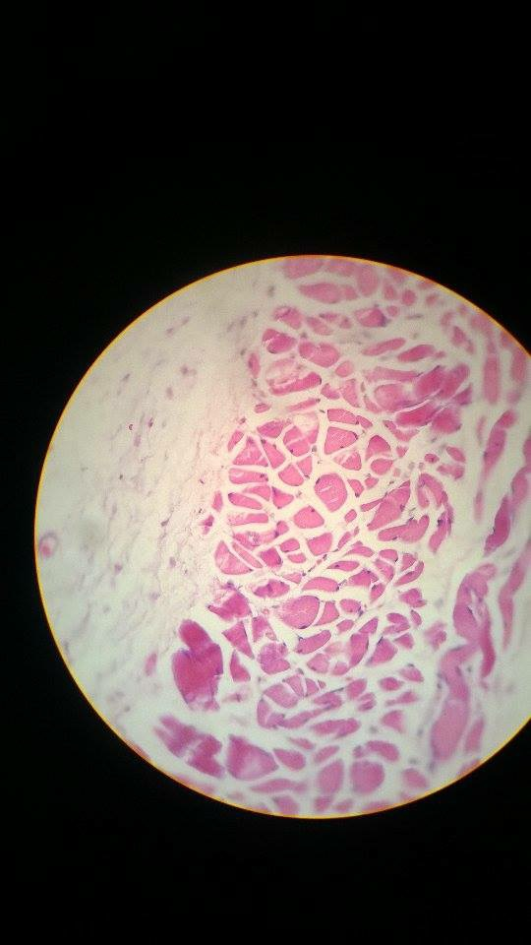
-Esophagus
-Transverse section .
-Upper third .
-What type of muscles present ?
Skeletal (striated) muscles .

Slide 11
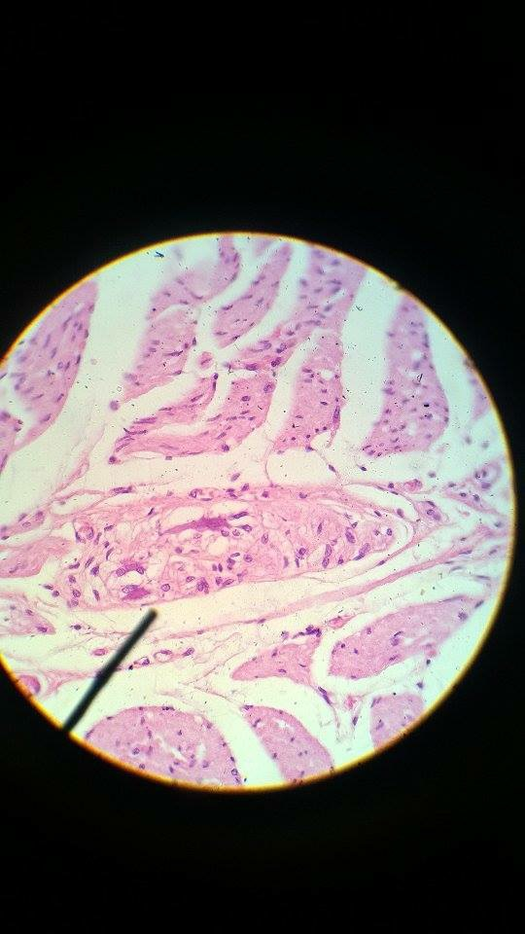
Esophagus .
Lymphoid tissue .( MALT)
Proper esophageal gland ( in the submucosa )
Parasympathetic ganglion = Intramural (Auerbach’s ) plexus >> postganglionic

