Slide 1
THE MIDDLE MEDIASTINUM

Slide 2
Middle mediastinum
Contains
THE Pericardial Sac
INCLUDES
Heart
Origins of the great vessels:
Ascending Aorta
Pulmonary trunk
Lower half of superior vena cava
Small part of inferior vena cava
very small part of
Pulmonary veins

Slide 3
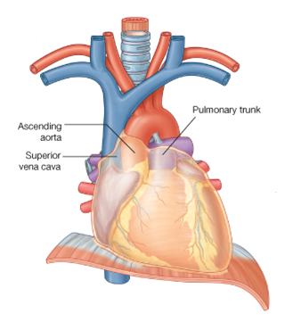
Ascending Aorta
The ascending aorta lies within the fibrous pericardium
(what does this mean?)
Begins at the base of the left ventricle
Ends at the level of the sternal angle, where it becomes continuous with the arch of the aorta
At its root it possesses three bulges, the sinuses of the aorta
Branches
The right coronary artery
The left coronary artery

Slide 4
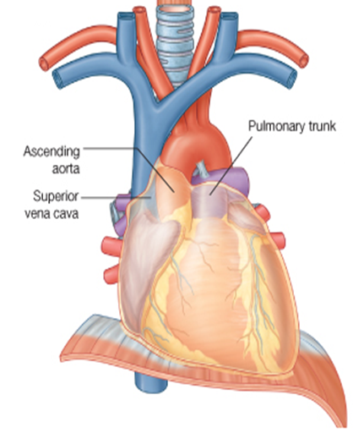
The pulmonary trunk
The pulmonary trunk is contained within the pericardial sac
(Middle mediastinum)
It arises from
the right ventricle
at the
opening of
the pulmonary trunk
Lies initially anterior and then to the left of the ascending aorta.
IMPORTANT FOR THE PRACTICAL

Slide 5
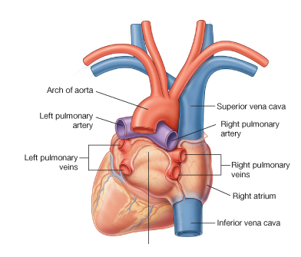
At approximately the level of the intervertebral disc between vertebrae TV and TVI
divides into the:
Angle of LOUIS
Right pulmonary artery
Left pulmonary artery
POSTEROR VEIW

Slide 6
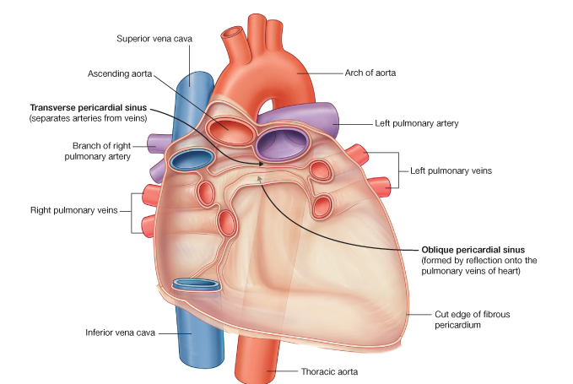
The inferior half of the superior vena cava is located within the pericardial sac
the inferior vena cava enters the fibrous pericardium. A short portion of this vessel is within the pericardial sac before entering the right atrium

Slide 7
THE PERICARDIUM

Slide 8
Pericardium
is a fibroserous sac surrounding the heart and the roots of the great vessels.
It consists of two components:
1- The Fibrous Pericardium
2- The Serous Pericardium
The fibrous pericardium is a tough connective tissue outer layer

Slide 9
The serous pericardium is thin and consists of two parts:
1-THE PARIETAL LAYER lines the inner surface of the fibrous

Slide 10
2-THE VISCERAL LAYER (epicardium) of serous pericardium adheres to the heart and forms its outer covering
The narrow space created between the two layers of serous pericardium, containing a small amount of fluid, is the pericardial cavity.

Slide 11
ANATOMY OF THE HEART

Slide 12
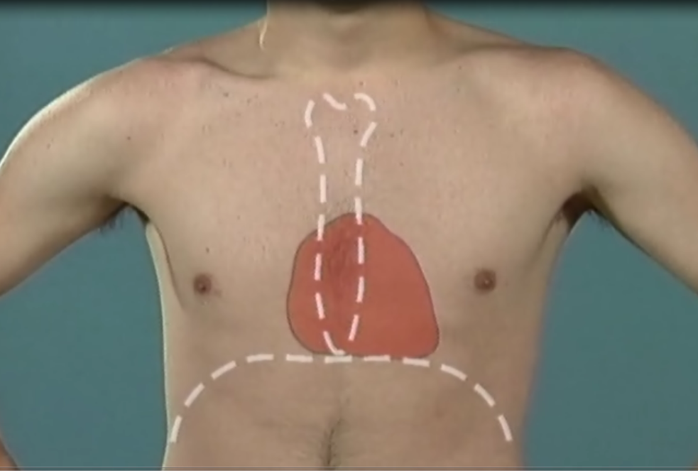

Slide 13
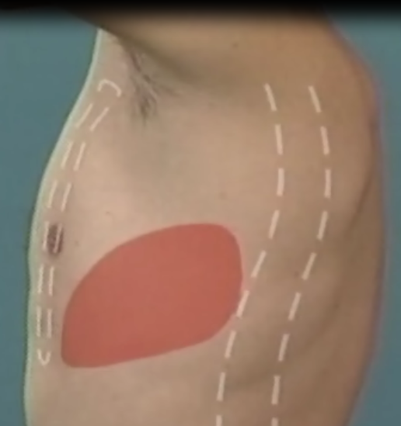

Slide 14
The Heart
The general shape of the heart is that
of a pyramid
that has fallen over and
is resting on one of its sides.
The apex of the heart,
formed by the left ventricle
is directed downward, forward, and to the left
It lies
at the level of the fifth left intercostal space, 3.5 in. (9 cm) from the midline.
The base of the heart, or the posterior surface, is formed mainly by the left atrium,

Slide 15
The sides of the pyramid consist of:
1-a diaphragmatic (inferior)
2-anterior (sternocostal) surface
3-right pulmonary surface
4-left pulmonary surface

Slide 16
Borders of the Heart
The right border is formed by the right atrium;
The left border, by the left auricle; and below, by the left ventricle
These borders are important to recognize when examining a radiograph of the heart.
the apex is formed by the left ventricle.
The lower border is formed mainly by the right ventricle but also by the right atrium;

Slide 17
Grooves on its (heart) external surfaces
Anterior view
The anterior interventricular sulcus is on the anterior surface of the heart and
The coronary sulcus circles the heart, separating the atria from the ventricles
The posterior interventricular sulcus is on the diaphragmatic surface of the heart
Posterior view

Slide 18
Chambers of the Heart
The heart is divided by septa into four chambers:
1-THE RIGHT ATRIUM
2-LEFT ATRIUM
3- THE RIGHT VENTRICLE
4-LEFT VENTRICLE
The walls of the heart are composed of cardiac muscle,
1- The myocardium; covered externally with serous pericardium,
2-The epicardium; and lined internally with a layer of endothelium,
3-The endocardium.

Slide 19
1-RIGHT ATRIUM
The right atrium consists of a main cavity and a small outpouching, the auricle.

Slide 20
Openings into THE RIGHT ATRIUM
1-The superior vena cava opens into the upper part of the right atrium
2-The inferior vena cava opens into the lower part of the right atrium
3-The coronary sinus, which drains most of the blood from the heart wall
4-The right atrioventricular orifice is guarded by THE TRICUSPID VALVE

Slide 21
Fetal Remnants in the right Atrium
The fossa ovalis and anulus ovalis.
These latter structures lie on the atrial septum, which separates the right atrium from the left atrium
The fossa ovalis is a shallow depression, which is the site of the foramen ovale in the fetus
The anulus ovalis forms the upper margin of the fossa.
Why the embryo needs this opining?

Slide 22
2-RIGHT VENTRICLE
TRABECULAE CARNEAE.
The trabeculae carneae are composed of three types.
One of these types is the papillary muscles, being attached by their bases to the ventricular wall;
their apices are connected by fibrous chords
(the chordae tendineae)
to the
cusps of the tricuspid valve

Slide 23
The right ventricle
communicates with
the right atrium through
THE RIGHT ATRIOVENTRICULAR ORIFICE
and with the pulmonary trunk through
THE PULMONARY ORIFICE
The tricuspid valve guards the right atrioventricular orifice and consists of three cusps formed by a fold of endocardium with some connective tissue

Slide 24
Left Atrium
consists of a main cavity and a left auricle.
Behind it lies the fibrous pericardium separates it from the esophagus (remember that the esophagus has a close relationship with the left atrium)
The interior of the left atrium is smooth, but the left auricle possesses muscular ridges as in the right auricle

Slide 25
Openings into the Left Atrium
A-The four pulmonary veins, two from each lung, open through the posterior wall and have no valves.
B-The left atrioventricular orifice

Slide 26
Left Ventricle
The walls of the left ventricle are three times thicker than those of the right ventricle. (The left intraventricular blood pressure is six times higher than that inside the right ventricle.)
There are well-developed TRABECULAE CARNEAE,.
The part of the ventricle below the aortic orifice is called
The left ventricle communicates with the left atrium through THE ATRIOVENTRICULAR ORIFICE and with the aorta through THE AORTIC ORIFICE.

Slide 27
No chordae or papillary muscles are associated with these valves
The pulmonary valve guards the pulmonary orifice and
The aortic valve guards the aortic orifice consists of three semilunar cusps.
One cusp is situated on the anterior wall (right cusp) and two are located on the posterior wall (left and posterior cusps).
Behind each cusp the aortic wall bulges to:
form an aortic sinus.
1-The anterior aortic sinus gives origin to the right coronary artery,
2-the left posterior sinus gives origin to the left coronary artery
Read only

Slide 28
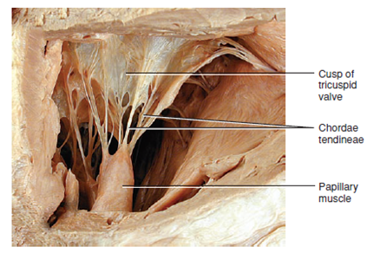
The Tricuspid Valve
guards the right atrioventricular orifice
consists of three cusps The bases of the cusps are attached to the fibrous ring of the skeleton of the heart
Whereas:
their free edges and are attached to the chordae tendineae.
The chordae tendineae connect the cusps to the papillary muscles.

Slide 29
The mitral valve
guards the left atrioventricular orifice
It consists of two cusps.

Slide 30
Arterial Supply of the Heart
The arterial supply of the heart is provided by :
1-THE RIGHT CORONARY ARTERY
2-LEFT CORONARY ARTERIY
which arise from the ascending aorta immediately above the aortic valve

Slide 31
Venous Drainage of the Heart
Most !blood from the heart wall drains into the right atrium through
THE CORONARY SINUS
which lies in the posterior part of the atrioventricular groove

Slide 32
tributaries of the coronary sinus.
GREAT CARDIAC VEIN
SMALL CARDIAC VEINS
MIDDLE CARDIAC VEINS

Slide 33
Conducting System of the Heart
The normal heart contracts rhythmically at about 70 to 90 beats per minute in the resting adult.
The rhythmic contractile process originates spontaneously in the conducting system and the impulse travels to different regions of the heart, so the atria contract first and together, to be followed later by the contractions of both ventricles together. The slight delay in the passage of the impulse from the atria to the ventricles allows time for the atria to empty their blood into the ventricles before the ventricles contract.
Read only

Slide 34
THE CONDUCTING SYSTEM OF THE HEART
consists of specialized cardiac muscle present in
THE SINUATRIAL NODE
THE ATRIOVENTRICULAR NODE
THE ATRIOVENTRICULAR BUNDLE
RIGHT AND LEFT TERMINAL BRANCHES
THE SUBENDOCARDIAL PLEXUS OF PURKINJE FIBERS

