Slide 1

Health Systems, Management, and Organization in Global Health
Dr. Sireen Alkhaldi
Department of Family and Com. Med.
Global Health Course /
Summer Semester 2014/ 2015
Textbook: Understanding Global health,
Markle W, Fisher M, and Smego R. (2nd ed. 2014)

Slide 2
Introduction to Health Systems
Have you ever wondered why, in light of great scientific advances, modern communications, and the availability of many treatments and preventive measures for most diseases in low- and middle-income countries (LMICs), those diseases still persist, and with high prevalence and incidence?
This is the conundrum we are going to explore in this lecture, as it relates to the organization, management, and delivery of services to reach those in need for them in LMICs.

Slide 3
Introduction to Health Systems
It is important to understand how services that maintain, improve, and restore health are provided to individuals and populations in both urban and rural areas.
The perspective often used in understanding the delivery of health and medical services is that of a “system”. From systems theory, we understand a system as the continuum of inputs, processes, and outputs. Health Systems are:
1. The required resources, including human, mechanical, material, and financial.
2. The formal and informal organizational interactions and conversion of these resources in the provision of services to individuals and populations to help them maintain good or acceptable health status when perceived in need.

Slide 4
Introduction to Health Systems
3. The final product of “health” (definition of health?). Can be the ability to live one’s life in a manner compatible with achieving one’s social and personal goals, with dignity and human rights.
Health systems are Open Systems: interact with external environment, are influenced by it, and must adjust to the environment to survive over time. They are open to the local, national, international and global influences.
Health systems are one of the several determinants of health, and high-performing health systems can improve the health of populations.
What then makes a health system good?
What makes it equitable?
How does one evaluate a health system or its components?

Slide 5
Health Systems
Although health systems are complex, proper health system stewardship and management offers the potential for coordination of multi- and intersectoral services.
Health services providers may be from the public and/or the private sector, and how they interact and are coordinated are all issues of great concern with the health system.
In the Health Systems perspective we get out of the “health” box, in thinking that only medical services and technologies are important; rather, in Systems perspective, we address inequalities in income and housing, seatbelt laws, safe roads, antismoking legislation, firearm legislation, workplace safety all help to maintain good health.

Slide 6
The Performance of Health Systems
To assess performance of health systems, we must measure it against the objectives and intended outcomes of a health system.
The Objectives for health systems are:
1. Improving the health of the populations they serve: measured by life expectancy, maternal mortality, and infant mortality in addition to its distribution across the population.
2. Responding to peoples’ expectations: patient preferences does impact health service utilization (in LMICs people go to private even when free public service is available).

Slide 7
The Performance of Health Systems
3. Providing financial protection against the costs of ill health: Health care costs are unpredictable, and may be catastrophic (in China, bankruptcies due to medical expenditures accounted for a third of rural poverty in 2004). Universal coverage may not reduce financial burden because many barriers of health insurance plans such as co-payment and ceiling may prevent patients using them. Payment should be progressive (related to ability to pay).
4. Equity and fairness in the distribution of the above three objectives (across population subgroups).

Slide 8
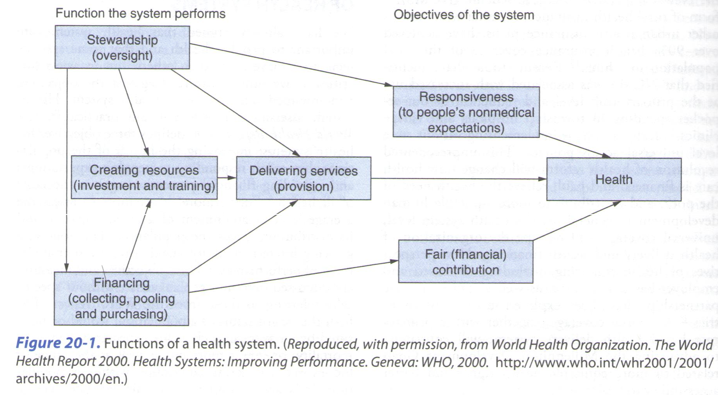
Functions of the Health System

Slide 9
Functions of Health Systems
The formal health care system may not be the only or even the main provider of care to the population, but it nevertheless has several functions that promote the objectives of health (figure 20-1).
These functions are:
Stewardship
Creation of resources
Delivery of services
Financing

Slide 10
Functions of Health Systems
Stewardship is oversight of the components and functions of the health system, and it is the function that is best done by national governments.
However, national governments tend to neglect this function because of lack of budget, managerial capacity, data, and the unorganized nature of many LMIC health systems.
The focus of many national health systems has been on service delivery, with most of the budget taken up by curative care, particularly staff salaries and large city services.
Creating resources refers to investment in infrastructure and education and training of health professionals. Usually undertaken by the public sector, but some countries have private sector that include medical schools and high technology facilities (In Nepal, 18 medical schools only 2 of which are public).

Slide 11
Functions of the Health System
Service Provision has traditionally been the main role of the health care system, but there are difficulties with public management in LMICs such as poor incentives for public providers leading to poor quality of care (especially responsiveness) and the widespread use of the private sector providers.
As a result, some specialists suggest that the government’s role should be to purchase services (from private providers) and monitor the quality, as part of the financing function.

Slide 12
Functions of the Health System
Financing : Revenue to fund health systems may come from income taxes, like in the UK and Canada, employment insurance schemes, as in most of Latin America, the purchase of private insurance, OR out-of-pocket payments by patients at the point of care as in India.
Because health expenditures of individuals are unpredictable, prepayment systems with significant coverage protect from impoverishment due to health care expenditures.
Prepayment based on ability to pay (rather than probability of illness) allow for cross-subsidy from the rich to the poor, and from the healthy to the sick. In a sufficiently large risk pool, the costs will be more predictable and with an appropriate mix of young, old, rich, poor, healthy and sick, the costs will be affordable for all.
Health systems financed by income tax provide the greatest potential for pooling risk, whereas out-of-pocket is the worst in fair financing.

Slide 13
The structure of Health Systems
Health systems in industrialized countries are highly structured and were developed in a context of economic stability, laws and regulations, efficient systems for taxation, with sufficient number of skilled personnel to run these institutions.
These conditions are still not found in most LMICs.
In the second half of the 20th century, many developing countries established national health systems designed to provide comprehensive services for the whole population (like the UK health system). However, many countries did not fund or staff these services sufficiently to achieve their stated goals, either due to financial crisis or a lack of commitment to population health and universality.

Slide 14
The structure of Health Systems
Most LMIC governments’ incapacity to provide comprehensive health services has led to the emergence of other service providers to meet growing patient demand. In these mixed health systems, the distinction between public and private are blurred.
The more important distinction is between the organized sector (subject to some measures of government oversight), and the unorganized or informal sector (local rules).
The former includes public services and licensed private providers, and the latter includes market-based services (unlicensed private providers) and the non-market-based services (provided by household members, neighbors, and community members.
In Niger, 16% of deliveries are attended by trained birth attendants (organized sector), so the vast majority of obstetric services are provided by family members at home (non-marketized sector) or by traditional midwife charging fees (local marketized sector).

Slide 15
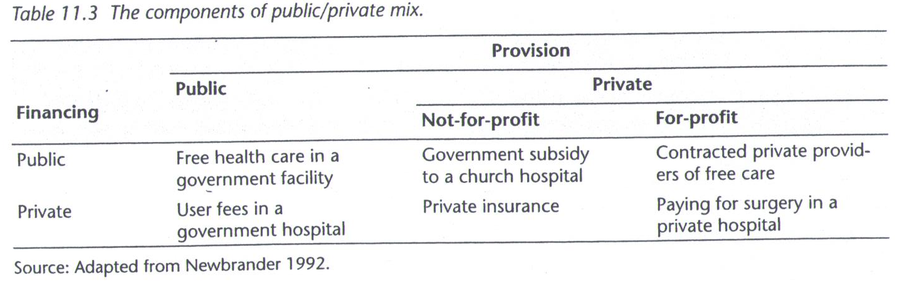

Slide 18
Population Formal Coverage by source (%) in 2010)in Jordan

Slide 20
Regulation of Health Matters
Regulation is a core function of government that cannot be delegated to other system actors. The regulatory system focuses on health system components such as: licensing and registration, salary, training, high-technology equipment and waiting times for patients to access them, pharmaceutical safety and pricing, movement from primary to tertiary level, accreditation, budgets, guidelines, and insurance plans.
Decentralization: Governments implement policies to guide service delivery such as Decentralization, the delegation of decision-making power from central to local levels of government, including forms of community participation.
Privatization: most countries have health systems in which both public and private sectors play a role. The degree to which each is allowed to flourish is usually controlled by the government. Whether governments should be involved in care provision or contract it out to the private sector and regulate quality, still debatable.

Slide 21
Regulation of Health Matters
Private/ public partnerships: LMIC governments enter into partnerships with the private sector for the delivery of variety of medical interventions . Large NGOs like Oxfam can deploy large sums of money and a lot of personnel. The WHO has emphasized the partnership with the private sector in dealing with worldwide health problems including the infectious diseases in order to achieve health system goals.
Contracting: in health care, there are many patient-based services that can be more efficiently delivered by outside organizations. This led to contracting out for some services (outsourcing) whose quality can be easily assessed, and for which there are a number of providers competing to provide the service (e.g. laundry, laboratory, food production, maintenance).
Accreditation: a system of competency criteria are implemented, for patients and communities to be assured that they are getting good health services provider, (e.g. JCI), but lacking in LMICs.

Slide 22
Any Questions?

