Slide 1
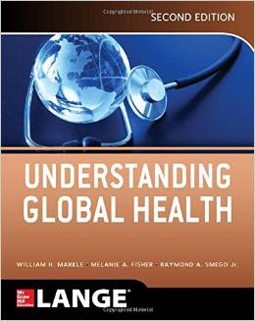
Economics and
Global Health
Dr. Sireen Alkhaldi
Department of Family and Com. Med.
Global Health Course
Summer Semester 2014/ 2015
Textbook: Understanding Global health,
Markle W, Fisher M, and Smego R.
(2nd ed. 2014)

Slide 2
Economics of Global Health
Learning Objectives:
Understand how poverty can affect health, and how health problems can result in poverty.
Describe four key mechanisms by which health can affect wealth.
Show the relationship between health and economics looking at three key diseases (malaria, tuberculosis, and HIV/AIDS.
Outline four key factors in choosing the type of health care financing system.
Describe five major financing methods for health care.

Slide 3
What is Global Health?
There are different views on the definition of “global health”:
Global Health is collaborative trans-national research and action for promoting health for all.
Global Health is health issues that transcend national boundaries and governments and call for actions on the global forces that determine the health of people.
Global health is worldwide improvement of health, reduction of disparities, and protecting against global threats that disregard national borders.
Global Health is “An area of study, research, and practice that places priority on improving health and achieving equity in health for all people worldwide”

Slide 4
What is Global Health?
Global Health, international, and public health: all attempt to address the same underlying social, economic, and environmental factors that affect the health of populations whether locally, nationally, or globally.
Historically, compared with the collective impact of improved living conditions including nutrition, sanitations, housing, education and income, the impact of disease-oriented medical care on the overall health status of a country has been relatively small.

Slide 5
What is “Health”?
“Health is a state of complete
physical, mental and social
well-being and not merely
the absence of disease
or infirmity.”
(WHO 1948)

Slide 6
The Absence of “Health”
Disease = changes in cells, tissues or organs that affect their function or survival
Illness = how a person sees their health status
Sickness = social functioning, society’s perception of a person’s health status

Slide 7
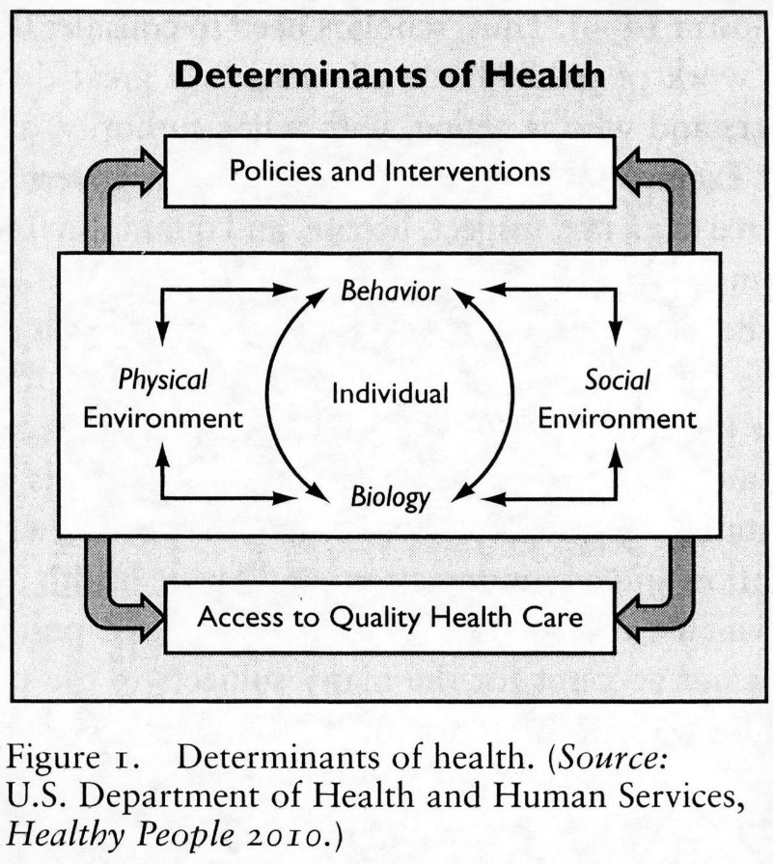
The Determinants of Health

Slide 8
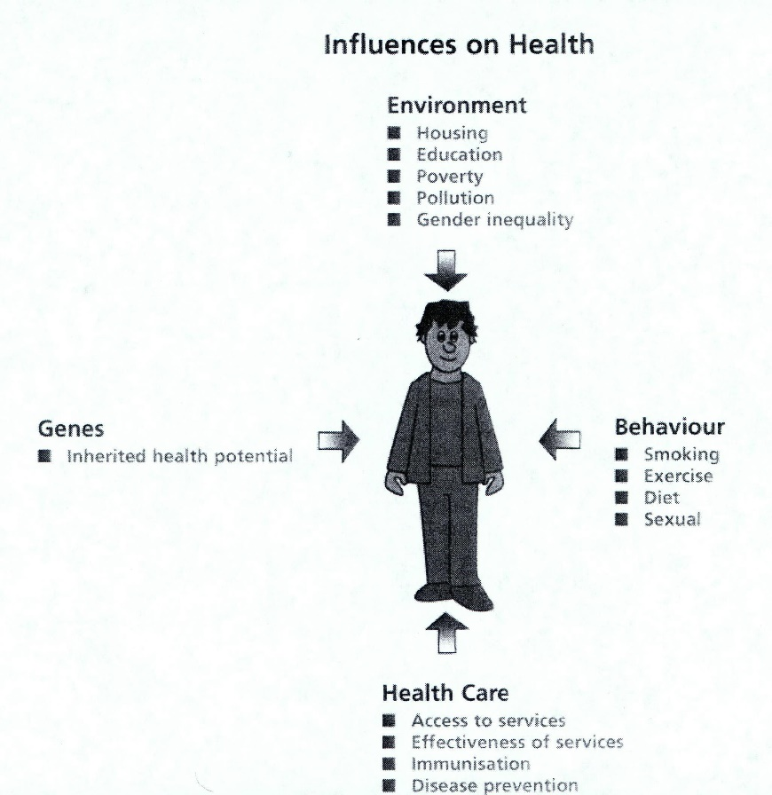
Influences on the Health of an Individual

Slide 9
What is Economics?
'Economics' A social science that studies how individuals, governments, firms and nations make choices on allocating scarce resources to satisfy their unlimited wants.
Economics is the science that deals with the production, distribution, and consumption of commodities.

Slide 10
What is Health Economics?
Health economics is a branch of economics concerned with issues related to efficiency, effectiveness, value and behavior in the production and consumption of health and health care.
In broad terms, health economists study the functioning of health care systems and health-affecting behaviors such as smoking.

Slide 11
Economics and Health
For a long time, it has been recognized that there is a relationship between health and wealth.
Three possible different pathways may explain this relationship:
1. Increased wealth leads to health
2. Improved health leads to wealth.
3. The relationship is caused by a third unknown factor.

Slide 12
The Mechanisms from Wealth to Health
In general, wealthier nations are healthier nations.
Higher incomes provide the ability to purchase many goods and services that promote better health, including higher quality food, access to cleaner water, safe sanitation, and higher quality and more complete health services both on a societal and individual level.
Preston noted a strong relationship between health and wealth, and suggested that there is a significant gain in health ( as measured by life expectancy) with wealth up to $1000 per capita. However, Preston noted that after exceeding $1000 per capita, additional wealth did not lead to significant increase in life expectancy.

Slide 13
Correlation Between Wealth and Health
Also, income inequality may lead to poor health. In the Whitehall study of 10,000British civil servants, mortality rates were 3.5 times higher for lower grade workers compared to administrators.
Wealth can also increase health indirectly through education.

Slide 14
The Mechanisms from Health to Wealth
Four major mechanisms link health to increased wealth:
1. Improved productivity: Healthier individuals are more energetic and less likely to miss work due to illness (↑productivity with ↑ calorie intake up to 2000kcal).
2. Increased investment in human capital: Poor health conditions decrease life expectancy, and reduce the amount of human capital investment. Children with poor health may be sick or have less energy to go to school, and have poor learning capacity in school.

Slide 15
The Mechanisms from Health to Wealth, cont.
3. Increased investment in physical capital: better health leads to more savings for retirement, which increases investment in physical capital, with the hope of future returns. With sick employees, money is spent to compensate for productivity loss, and less money is available to invest in physical capital.
4. Utilizing the demographic dividend: a large working age population relative to the younger and older dependent populations. This gives a window of opportunity for economic growth (Irish economic boom in 1980s and 1990s).

Slide 16
Economic Impact of Three Key Diseases
Malaria, tuberculosis, and HIV/AIDS are examples of diseases that have significant economic impacts on populations:
Malaria: (infects 200 million each year and about 1million deaths).
Malaria in a country reduces the gross national product to half (How?). Control of malaria has historically been associated with economic well-being (e.g. ↓ Malaria in Greece ↑ foreign investment ).
Tuberculosis: (infects 8.7 million each year and kills 1.4 million).
TB affects working-age population between 15 and 54. On average, 3 to 4 months of work is lost per year ( 20-30% loss of annual household income). Without proper treatment, 50-60% of those infected will die.
TB and poverty are interlinked. TB may lead to sale of assets to pay for drugs, reducing food intake for children, and decreasing educational opportunity (a classic example of poverty and poor health.

Slide 17
Economic Impact of Three Key Diseases, cont,
HIV/AIDS has a large impact on development because it targets people in working-age, accounting for 65% of deaths.
HIV/AIDS: It reduces the capacity to invest in human capital, which in turn leads to a further inability to identify and treat HIV/AIDS. This leads to the inability to deal with the consequences of the HIV/AIDS epidemic.
HIV/AIDS impacts development in sub-Saharan Africa. HIV/AIDS increases dependency ratio, with high burden on women and working-age populations to support the HIV/AIDS orphans. Spending on HIV/AIDS is 1/3 of total health care costs, and ½ public health spending in many countries.
In Cote d’Ivoire, 10% ↑ in HIV/AIDS results in 6.8 -10% ↑ in cost for companies.

Slide 18
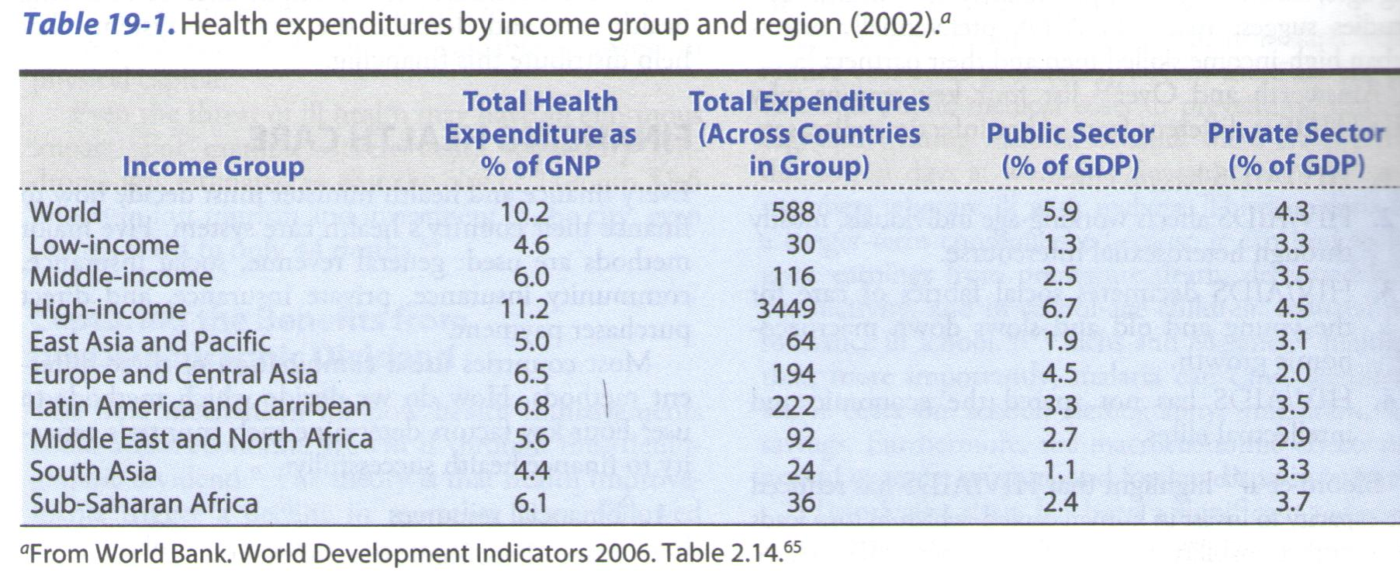
The Impact of Health Care on the Economy
One of the largest budgetary items in any government is health care spending, it accounts for 8% of global GDP, but rises to as much as 16%of GDP in the United States.

Slide 19
Financing Health Care
Every Finance and Health minister must decide how to finance their country’s health care system
Five major methods are used: general revenue (tax), social insurance, community insurance, private insurance, and direct purchaser payment (out-of-pocket).
Most countries use a combination of these different methods. How do we decide which method to use?
Four key factors determine each country’s capacity to finance health successfully (prioritization methods for the decision to financing):
1. Financial resources: ability to generate revenues determines financing.
2. Stage of economic development: ↑ income→ ↑ spending on health.
3. Ability to administer financial services: ability to set up and monitor a system, and effectively enforce health care regulations and legislations.
4. Political will and structure: priority of health for the government relative to other sectors like defense (primary interest in Canada and Cuba).

Slide 20
Financing Systems
The five major financing systems in use around the world today:
1. Direct Purchaser Payment: (User Fees, Fee for Service, Out-of Pocket Payment, copayment): in developing countries, used alone or in conjunction with other financing mechanisms. The World Bank was a proponent of user fees for health services. It badly affects the poor (will not use care until they are extremely sick). Removing user fees (free service), that may adversely affect primary health services (take away resources to more expensive higher level services).
2. Community Insurance: Prepayment scheme. Pooling resources to decrease individual risk. A community may be a village or employee group that negotiates with suppliers for discounted health services. It involves primary care services provision and contracts with secondary and tertiary providers. It requires significant community membership, or adverse selection will occur. There is concern of moral hazard.

Slide 21
Financing Systems
3. Social Insurance: An extension of the community health insurance. Refers to collecting funds in advance to purchase H. C. in the future. They have their own H. C. networks. Funds are raised through employers or governments. In France, social insurance is compulsory for all citizens. In other countries it is provided for people in formal work force.
4. General Taxation: In many countries, general taxes may support H.C. As countries become wealthier, a higher amount of H.C. spending is financed by general taxes (income tax, sales tax, import tax, …), H.C. will suffer with economic downturn. Advantage: strong source of steady revenue, progressive improves equity, pools health risks across entire population. This requires strong administrative infrastructure especially to collect taxes.

Slide 22
Financing Systems, cont.
5. Private Insurance: purchasing insurance voluntarily from individual competitive sellers. Premium are based on purchaser's risk and not on ability to pay. They can define preferences for different services depending on income level. Most prevalent in wealthier countries without general taxation scheme. Companies build loyalty by providing health insurance benefits for employees. Adverse selection always occurs; insurers prefer the healthiest, and the sickest prefer to get the best insurance. The sick are faced with very high premiums. High administrative and marketing costs add to the H.C. insurance. Best example is the U.S. with the highest cost of care in the world, and 45 million uninsured individuals.

Slide 23
Questions?

