Slide 1
بسم الله الرحمن الرحيم
الحمد لله رب العالمين والصلاة والسلام علي سيدنا محمد الصادق الوعد الأمين ، اللهم أخرجنا من ظلمات الجهل والوهم ، إلى نور المعرفة والعلم..

Slide 2
Emerging & Re-emerging Infectious Diseases
Infectious Diseases a Challenge to Global Health

Slide 3
Outline Of Presentation
Infectious diseases- trends
Definition of emerging & re-emerging diseases
Factors contributing to emergence
Examples
Public health response

Slide 4
Infectious Disease
1900 - Leading Causes of Death
  Tuberculosis
  Pneumonia and Influenza
  Heart Disease
  Diarrhea / Enteritis
  Cerebrovascular Disease
  Nephritis / Nephrosis
  Unintended Injury
  Cancer
  Diphtheria
  Typhoid Fever
1992 - Leading Causes of Death
  Heart Disease
  Cancer
  Cerebrovascular Disease
  COPD
  Unintended Injury
  Pneumonia / Influenza
  Diabetes Mellitus
  HIV/AIDS
  Suicide
  Homicide / Legal Intervention
Notes:
Over the years, prominent health concerns have shifted from infectious diseases to chronic, behavior-related diseases. However, contemporary thought must include an examination of infectious disease control.
One of the more contemporary threats to well-being is the issue of emerging infectious diseases, a relative new-comer to the study of public health.

Slide 5
Infectious Disease- Trends
Receded in Western countries 20th century
Urban sanitation, improved housing, personal hygiene, antisepsis & vaccination
Antibiotics further suppressed morbidity & mortality
Notes:
Infectious diseases keep emerging and re-emerging . It is there fore imperative that while efforts for control of well established communicable disease must continue relentlessly, a regular vigil must be maintained on the behavior of emerging and re- emerging diseases.

Slide 6
Infectious Disease- Trends
Since last quarter of 20th century- New & Resurgent infectious diseases
Unusually large number- Rotavirus, Cryptosporidiosis, HIV/AIDS, Hantaviraus, Lyme disease, Legionellosis,
Hepatitis C……

Slide 7
Infectious Diseases: A World in Transition
AIDS
Avian Influenza
Ebola
Marburg
Cholera
Rift Valley Fever
Typhoid
Tuberculosis
Leptospirosis
Malaria
Chikungunya
Dengue
JE
Antimicrobial resistance
UP
?
DOWN
Guinea worm Smallpox
Yaws
Poliomyelitis
Measles
Leprosy
Neonatal tetanus

Slide 8
Definition
Emerging infectious disease
Newly identified & previously unknown infectious agents that cause public health problems either locally or internationally

Slide 9
Definition
Re-emerging infectious disease
Infectious agents that have been known for some time, had fallen to such low levels that they were no longer considered public health problems & are now showing upward trends in incidence or prevalence worldwide

Slide 10
Factors Contributing To Emergence
AGENT
Evolution of pathogenic infectious agents
(microbial adaptation & change)
Development of resistance to drugs
Resistance of vectors to pesticides
Notes:
Increasing virulence of microbes like Influenza A virus, which exhibits frequent changes in its antigenic structure giving rise to new strains with endemic and pandemic propensities.

Slide 11
Factors Contributing To Emergence
HOST
Human demographic change (inhabiting new areas)
Human behaviour (sexual & drug use)
Human susceptibility to infection (Immunosuppression)
Poverty & social inequality
Notes:
Host factors contributing to emergence are:
Mass migration of people provoked by natural and man made disaster with concomitant rehabilitation of displaced people in temporary human settlements under unhygienic conditions.
Uninhibited and reckless industrialization leading to migration of labor population from rural to urban areas in unhygienic squatter settlements
International travel as a result of trade and tourism contributing to global dispersion of disease agents, disease reservoirs and vectors
Changes in lifestyle that promote unhealthy and risk prone behavior patterns affecting food habits and sexual practices.
Declining immunity of as a result of HIV infection, which make him vulnerable to a host of infections.

Slide 12
Factors Contributing To Emergence
ENVIRONMENT
Climate & changing ecosystems
Economic development & Land use (urbanization, deforestation)
Technology & industry (food processing & handling)
Notes:
Environmental sanitation characterized by unsafe water supply , improper disposal of solid and liquid waste, poor hygienic practices and congested living conditions all contribute to emergence of infection.
Climatic changes resulting from global warming inducing increased surface water evaporation , greater rainfall changes in the direction of bird migration and changes in the habitat of disease vectors are also contributory factors.

Slide 13
CONTD.
International travel & commerce
Breakdown of public health measure (war, unrest, overcrowding)
Deterioration in surveillance systems (lack of political will)

Slide 14
Uncontrolled Urbanization &
Population Displacement
Growth of densely populated cities- substandard housing, unsafe water, poor sanitation, overcrowding, indoor air pollution (>10% preventable ill health)
Problem of refugees & displaced persons
Diarrhoeal & Intestinal parasitic diseases, ARI
Lyme disease (B. burgdorferi)- Changes in ecology, increasing deer populations, suburban migration of population

Slide 15
Human Behaviour
Unsafe sexual practices (HIV, Gonorrhoea, Syphilis)
Changes in agricultural & food production patterns- food-borne infectious agents (E. coli)
Increased international travel (Influenza)
Outdoor activity.

Slide 16
Average annual number of global airline passengers by decade, 1950-2010
Million of Passenger (Mil)
IATA 2010
Decade

Slide 17
Antimicrobial Drug Resistance
Causes:
Wrong prescribing practices
non-adherence by patients
Counterfeit drugs
Use of anti-infective drugs in animals & plants

Slide 18
CONTD.
Loss of effectiveness:
Community-acquired (TB, Pneumococcal) &
Hospital-acquired (Enterococcal, Staphylococcal
Antiviral (HIV), Antiprotozoal (Malaria), Antifungal

Slide 19
Antimicrobial Drug Resistance
Consequences
Prolonged hospital admissions
Higher death rates from infections
Requires more expensive, more toxic drugs
Higher health care costs

Slide 20
ENVIRONMENT
Climate change
Mega-cities
Migration
Vector
proliferation
Pollution
Exploitation
Population
Growth
Antibiotics
HUMAN
Vector
resistance
Zoonosis
Food
production
VECTORS
ANIMALS
Intensive farming
Transmission

Slide 21
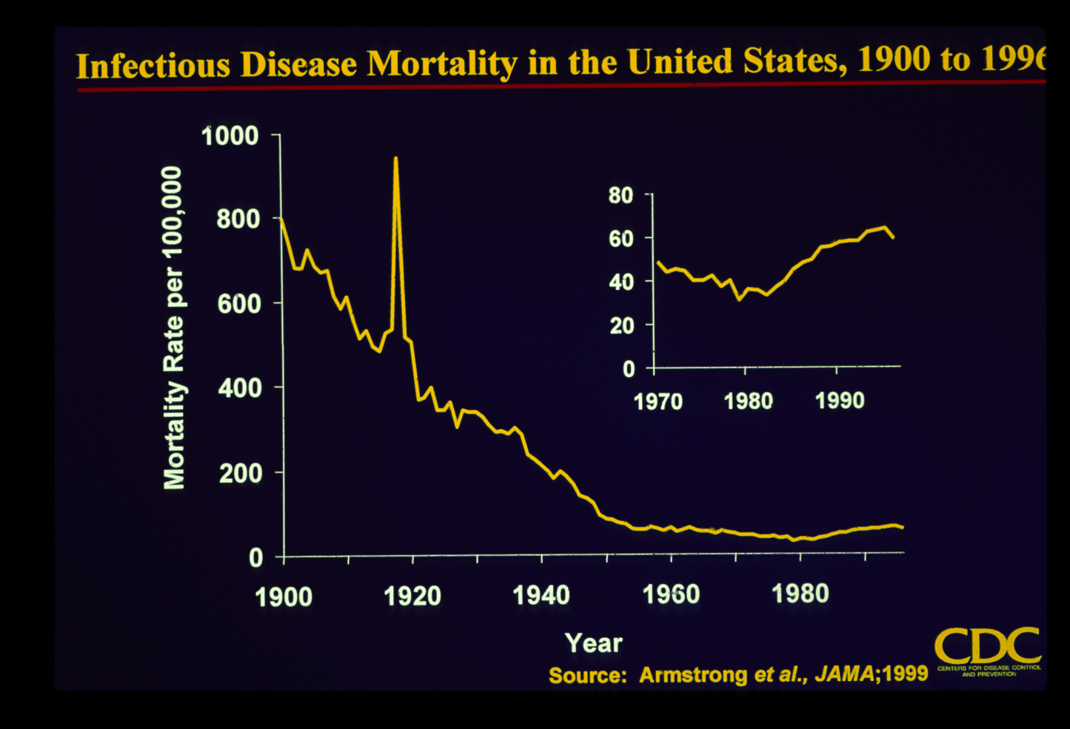

Slide 22
Pathogenic Microbes Identified as Threats to Humans Since 1973
1973 - Rotavirus
1977 - Ebola virus
1977 - Legionella pneumophila
1980 - HTLV 1
1981 -Toxin-producing Staphylococcus aureus
1982 - Escherichia coli O157:H7
1982 - Borrelia burgdorferi
1983 - HIV
1983 - Helicobacter pylori
1989 - Hepatitis C
1992 - Vibrio cholerae O139
1993 - Hantavirus
1994 - Cryptosporidium
1996 - nvCJD
1997 - HVN1
CIA, 2000
Notes:
Since 1973, a number of new pathogenic microbes have emerged worldwide among human populations. Among them, ebola virus, E. coli O157:h7, H. Pylori, and hantavirus.

Slide 23
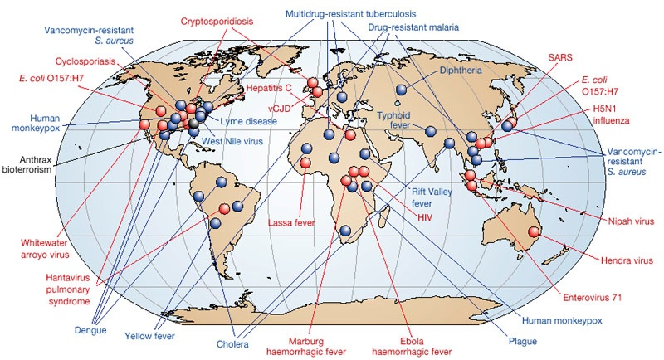
The Global Threat of Infectious Diseases
Emerging and re-emerging diseases
A/H1N1
A/H1N1
Dengue
Chikungunya
Dengue
Emerging diseases
Adapted from Morens, Folkers, Fauci 2004 Nature 430; 242-9
Re-emerging diseases

Slide 24

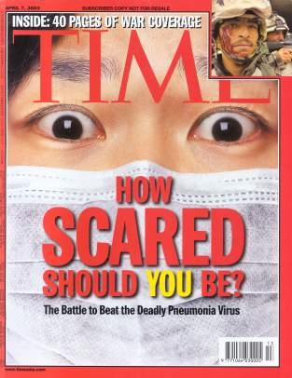

Microbial Threats to Health

Slide 25
Major Infectious Disease Epidemics since 1980
Dengue/DHF-1970s, SE Asia, global
HIV/AIDS-1980s-Africa,global
Drug resistant TB-1990s, US, global
Cholera-1991-Americas
Plague-1994-India, global
Foot & Mouth disease-1995,2000- Taiwan & UK
West Nile-1990s-Mediterranean, Americas
BSE-1990s- UK, Canada, US
Swine fever, 1996- Netherlands
H5N1 influenza-1997- HK-global
Nipah encephalitis-1998-Malaysia,Asia
SARS-2002- Asia, global
Chikungunya-2004-Africa, Asia
H1N1 influenza-2009-Mexico?,global

Slide 26
Examples of Emerging Infectious Diseases
Hepatitis C- First identified in 1989
In mid 1990s estimated global prevalence 3%
Hepatitis B- Identified several decades earlier
Upward trend in all countries
Prevalence >90% in high-risk population

Slide 27
CONTD.
Zoonoses- 1,415 microbes are infectious for human
Of these, 868 (61%) considered zoonotic
70% of newly recognized pathogens are zoonoses

Slide 28

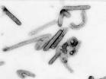

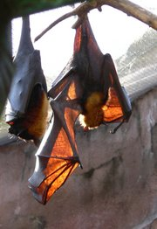
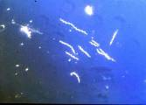


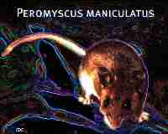
Emerging Zoonoses: Human-animal interface
Avian influenza virus
Bats: Nipah virus
Ebola virus
Marburg virus
Borrelia burgdorferi: Lyme
Deer tick (Ixodes scapularis)
Mostomys rodent: Lassa fever
Hantavirus Pulmonary Syndrome

Slide 29
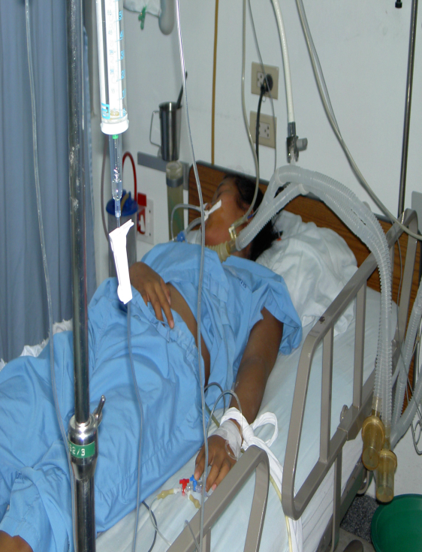
SARS: The First Emerging Infectious Disease Of The 21st Century
No infectious disease has spread so fast and far as SARS did in 2003
Notes:
SARS was first recognized at the end of
February 2003 in Hanoi, Viet Nam.
case, a middle-aged man business man who has traveled
extensively in South-East Asia before becoming unwell,
was admitted to hospital in Hanoi on 26 February 2003
with a high fever, dry cough, myalgia and mild sore throat.
Over the following 4 days he developed symptoms of adult
respiratory distress syndrome, requiring ventilator support,
and severe thrombocytopenia. Despite intensive
therapy he died on 13 March after being transferred to an
isolation facility in Hong Kong SAR.
On the basis of data from the SARS foci in Hanoi and Hong
Kong SAR, the incubation period has been estimated to be
2.7 days, but usually 3.5 days. Attack rates of >56% among
health care workers caring for patients with SARS is consistent
in both the Hong Kong and Hanoi foci.

Slide 30
Lesson learnt from SARS
An infectious disease in one country is a threat to all
Important role of air travel in international spread
Tremendous negative economic impact on trade, travel and tourism, estimated loss of $ 30 to $150 billion

Slide 31
CONTD.
High level commitment is crucial for rapid containment
WHO can play a critical role in catalyzing international cooperation and support
Global partnerships & rapid sharing of data/information enhances preparedness and response

Slide 32
بسم الله الرحمن الرحيم
الحمد لله رب العالمين والصلاة والسلام علي سيدنا محمد الصادق الوعد الأمين ، اللهم أخرجنا من ظلمات الجهل والوهم ، إلى نور المعرفة والعلم..

Slide 33
Highly Pathogenic Avian Influenza (H5N1)
Since Nov 2003, avian influenza H5N1 in birds affected 60 countries across Asia, Europe, Middle-East & Africa
>220 million birds killed by AI virus or culled to prevent further spread
Majority of human H5N1 infection due to direct contact with birds infected with virus
Notes:
Avian influenza (“bird flu”) is an infectious disease of birds caused by type A strains of the influenza virus. The infection can cause a wide spectrum of symptoms in birds, ranging from mild illness, which may pass unnoticed, to a rapidly fatal disease that can cause severe epidemics.
Avian influenza viruses do not normally infect humans. However, there have been instances of certain highly pathogenic strains causing severe respiratory disease in humans. In most cases, the people infected had been in close contact with infected poultry or with objects contaminated by their faeces. Nevertheless, there is concern that the virus could mutate to become more easily transmissible between humans, raising the possibility of an influenza pandemic.

Slide 34
Novel Swine origin Influenza A (H1N1)
Swine flu causes respiratory disease in pigs – high level of illness, low death rates
Pigs can get infected by human, avian and swine influenza virus
Occasional human swine infection reported
In US from December 2005 to February 2009, 12 cases of human infection with swine flu reported

Slide 35
Swine Flu
Influenza A (H1N1)
March 18 2009 – ILI outbreak reported in Mexico
April 15th CDC identifies H1N1 (swine flu)
April 25th WHO declares public health emergency
April 27th Pandemic alert raised to phase 4
April 29th Pandemic alert raised to phase 5

Slide 36
Influenza A (H1N1)
By May 5th more than 1000 cases confirmed in 21 countries
Screening at airports for flu like symptoms (especially passengers coming from affected area)
Schools closed in many states in USA
May 16th India reports first confirmed case
Stockpiling of antiviral drugs and preparations to make a new effective vaccine

Slide 37
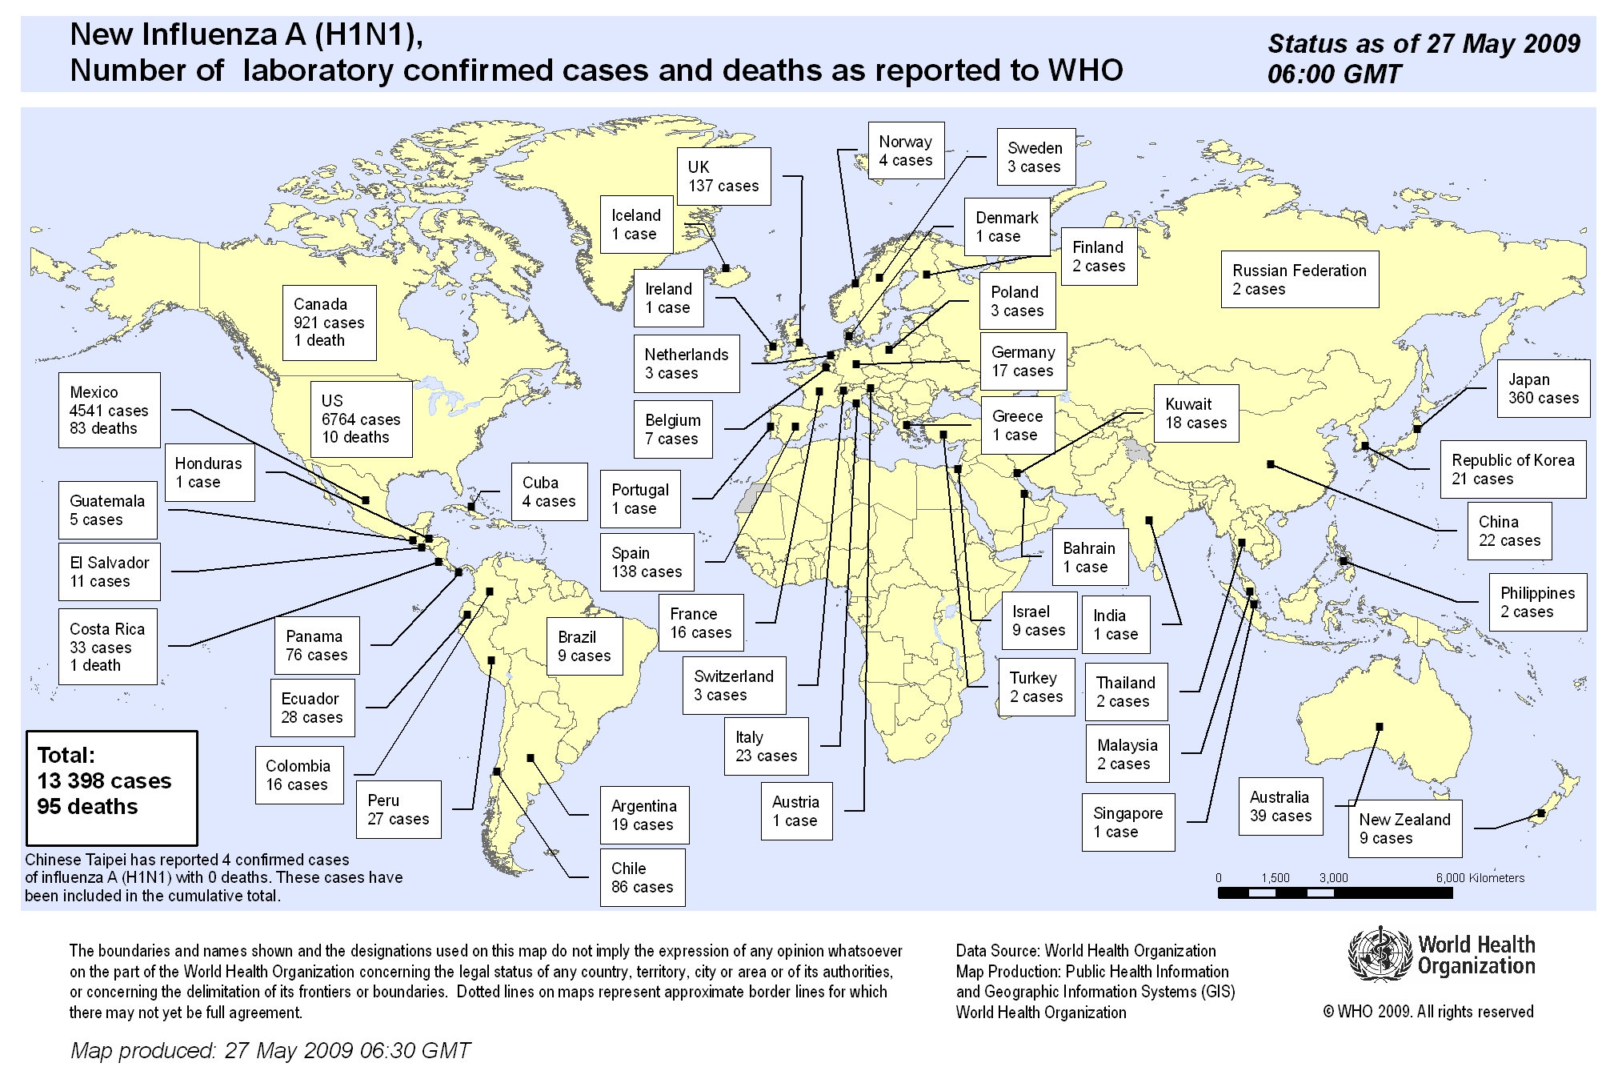
37

Slide 38
Pandemic HINI (Swine flu)
Worldwide- 162,380 cases
1154 deaths
India- 558 cases
1 death

Slide 39
Examples of Re-Emerging Infectious Diseases
Diphtheria- Early 1990s epidemic in Eastern Europe(1980- 1% cases; 1994- 90% cases)
Cholera- 100% increase worldwide in 1998 (new strain eltor, 0139)
Human Plague- India (1994) after 15-30 years absence. Dengue/ DHF- Over past 40 years, 20-fold increase to nearly 0.5 million (between 1990-98)
Notes:
In India, plague reemerged in August 1994, when it was detected in the Beed district of Maharashtra. This was followed by pneumonic plague in Surat in Gujarat state, resulting in over 50 deaths and inducing a mass exodus of people. Eventually plague was reported from 12 Indian states.

Slide 41
CHolera
Cholera: An infectious disease characterized by intense vomiting and profuse watery diarrhea and that rapidly leads to dehydration and often death. Cholera is caused by infection with the bacteria Vibrio cholerae, which may be transmitted via infected fecal matter, food, or water.

Slide 42
cholera
With modern sanitation, cholera is no longer as common as it once was, but epidemics still occur whenever people must live in crowded and unsanitary conditions, such as in refugee camps. The disease is treated with intravenous fluids and with antibiotics. Cholera has also been known as Asian cholera, due to its one-time prevalence in that area of the world.

Slide 43
Weekly epidemiological record: cholera articles
The Weekly Epidemiological Record (WER) serves as an essential instrument for the rapid and accurate dissemination of epidemiological information on cases and outbreaks of diseases under the International Health Regulations and on other communicable diseases of public health importance, including emerging or re-emerging infections.

Slide 44
Cholera
Vibrio cholerae
Sub-Saharan Africa affected
  Democratic Republic of Congo
  Uganda
  Rwanda
  Burundi
  Tanzania
  Kenya
  Sierra Leone
  Cameroon
Over a 3 month period in 1997 outbreaks in Kenya & Tanzania, over 400 killed
Cases reported in 2000
  Federated States of Micronesia
    954 cases / 9 deaths
  Somalia
    2,232 cases / 230 deaths
  Madagascar
    15,173 cases / 860 deaths
Notes:
Cholera

Slide 45
Dengue
Most important mosquito-borne disease, worldwide
Aedes aegypti
Affected regions
  Indian Subcontinent
  Southeast Asia
  Southern China
  Central and South America
  Caribbean
  Mexico
  Africa
Symptoms similar to those of influenza
Notes:
Dengue

Slide 46
Diarrheal Diseases
Organisms most frequently associated with diarrhea in young children / estimated percentage of cases seen at health centers in the developing countries
  Rotavirus - 15-25%
  Enterotoxigenic Escherichia coli - 10-20%
  Shigella - 5-15%
  Salmonella (non-typhoid) - 1-5%
  Campylobacter jejuni - 10-15%
  Cryptosporidium - 5-15% (PAHO, 2000)
Oral rehydration therapy (ORT) is one way of combating diseases within this classification
Notes:
Diarrheal Diseases

Slide 47
Diphtheria
Corynebacterium diphtheriae
Good example of how political issues can influence the reemergence of a disease
Very contagious and potentially life-threatening
Large epidemics in the Soviet Republics, Algeria, China, and Ecuador.
Notes:
Diphtheria

Slide 48
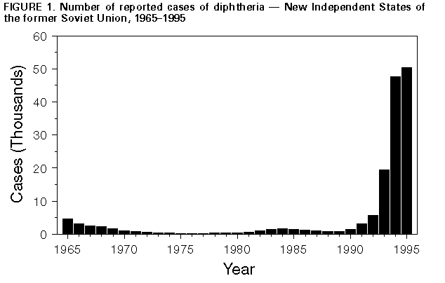
Source: Morbidity and Mortality Weekly Report. (1996). August 16, 1996 / 45(32);693-697
Notes:
This chart illustrates the impact of political transition on the prevalence of diphtheria in the former Soviet Union.

Slide 49
Escherichia coli O157:H7
Food-borne
First recognized as a cause of illness in 1982 during an outbreak of severe bloody diarrhea
Annually
  73,000 cases
  61 deaths
Primarily transmitted via ingestion of meat that has not been properly cooked
Person-to-person, contaminated drinking water, consumption of contaminated plant products (CDC, 2000⁶)
Notes:
Escherichia coli O157:H7

Slide 50
Ebola
Filovirus
Fifteen global outbreaks since 1967 Breman, van der Groen, Peters, & Haymann (1997)
Major human outbreaks
  Sub-Saharan Africa
    Kikwit
    Zaire
    Sudan
    Gabon
Notes:
Ebola

Slide 51
Ebola Virus and the Global Community
Source: Benini, A. A, & Bradford, 2000
Notes:
The global impact of Ebola virus

Slide 52
Hantavirus
Also known as...
  Sin Nombre virus (responsible for most hantaviral infections in the U.S.) Wells, et al, (1997)
  Convict Creek virus
  Muerto Canyon virus
First recognized in 1993
  Four corners region of the U.S.
  Has been identified in the U.S. from CA to FL
Mortality rate, 50%
Associated disease
  Hantavirus pulmonary syndrome (HPS)
Notes:
Hantavirus

Slide 53
Helicobacter pylori
Bacterium
Believed to be the etiologic agent in
  90% of duodenal ulcers
  80% of gastric ulcers
Discovered as culprit in 1982
Large portion of world population infected
Related chronic disease
  Gastric cancer
Notes:
Helicobacter pylori
H. pylori is an excellent example of how an infectious organism is related to a chronic disease, in this case gastric cancer.

Slide 54
Listeriosis
Listeria monocytogenes
Common among individuals who work with animals
Causes spontaneous abortion and stillbirth in domestic animals
Primarily affects
  Pregnant women
  Newborns
  Elderly
  Immuno compromised adults (Canadian Institute of Public Health Inspectors, 2000)
Notes:
Listeriosis

Slide 55
Malaria
Malaria is caused by a parasite called Plasmodium, which is transmitted via the bites of infected mosquitoes. In the human body, the parasites multiply in the liver, and then infect red blood cells.

Slide 56
Malaria
Symptoms of malaria include fever, headache, and vomiting, and usually appear between 10 and 15 days after the mosquito bite. If not treated, malaria can quickly become life-threatening by disrupting the blood supply to vital organs. In many parts of the world, the parasites have developed resistance to a number of malaria medicines.
.

Slide 57
Malaria
Key interventions to control malaria include: prompt and effective treatment with artemisinin-based combination therapies; use of insecticidal nets by people at risk; and indoor residual spraying with insecticide to control the vector mosquitoes

Slide 58
Malaria
300 million infected each year
Regions
  Asia
  Africa
  South / Central Americas
>1 million deaths annually
  Mostly infants and children (National Institutes of Health, 2000)
Notes:
Malaria

Slide 59
Tuberculosis
Tuberculosis (TB) is caused by a bacterium called Mycobacterium tuberculosis. The bacteria usually attack the lungs, but TB bacteria can attack any part of the body such as the kidney, spine, and brain. If not treated properly, TB disease can be fatal.

Slide 60
Tuberculosis
Chronic bacterial infection
Principal infectious cause of death worldwide
  Three million deaths annually
  One-third of world population infected with M. Tuberculosis (OSHA, 2000)
Outbreak locations
  Jails / prisons
  Hospitals
  Nursing homes
  Homeless shelters
Notes:
Tuberculosis

Slide 61
Tuberculosis
Estimated 15 million Americans with latent infections
Minorities affected disproportionately [as is the case with many other infectious diseases]
  54% active M. Tuberculosis cases (1995) reported among African American and Hispanic populations
  An additional 17.5% among Asians
In some U.S. sectors, morbidity rates surpass those of poorest countries
Notes:
Tuberculosis

Slide 62
Cases of M. Tuberculosis by Year of Diagnosis, 1953-1999
Source: Centers for Disease Control and Prevention, 2000¹
Notes:
TB cases, U.S., 1953-1999

Slide 63
West Nile Encephalitis
Mosquito-borne infection
Outbreaks evident in Egypt, Asia, Israel, South Africa, parts of Europe and Australia
No recorded cases in the U.S. prior to 1999
Culex pipiens mosquito (the common house mosquito) associated with West Nile virus
Transmission: Bird ---> mosquito ---> human
  American crows most commonly infected, yet confirmed in other species (State of New York, Department of Health, 2000)
  May also infect other mammals such as horses
  62 cases 7 deaths
Notes:
West Nile Encephalitis

Slide 64
Institute of Medicine
Demographic shifts
Advances in technology / industry
Economic development and change in land use patterns
Travel / commerce
Microbial adaptation / change
Breakdown of the public health infrastructure
Notes:
A number of reasons have been offered to explain the emergence of new pathogenic organisms. The Institute of Medicine offers an explanation above.

Slide 65
Drug Resistance
Drug Resistance
  Gonorrhea, malaria, childhood ear infections
  Resistance is a factor in most nosocomial infections
  More effective medications are needed
    In some U.S. clinics, 30% of cases of gonorrhea resistant to penicillin or tetracycline or both
  MDR-TB
Inappropriate use of antibiotics is a salient factor in drug resistance
Notes:
One of the most important medical issues related to emerging infections is the concern of drug resistance. Examples include strains of gonorrhea, and malarial infections that are now resistant to traditional drugs. Multi-drug-resistant tuberculosis is also a concern.
Perhaps the primary reason for drug resistance is the 1) inappropriate use of “silver bullets” or antibiotics on the part of the patient (compliance) and 2) over prescription of medications on the part of the physician.

Slide 66
Infectious Diseases and Chronic Diseases
Emerging evidence that a substantial proportion of human cancers are caused by infectious diseases (~15%) (Valerie Beal, Speaker, 2nd International Conference on Emerging Infectious Diseases)
  1911 - Rous Sarcoma
  1932 - Shope Skin Tumor
  1960 - Feline Leukemia
  1978 - HPV, Skin Cancer
  1981 - HBV, HCV, Liver Cancer
  1981 - EBV, non Hodgkin's Lymphoma
  1983 - HPV, Cervical Cancer
Notes:
There is overwhelming evidence that many chronic diseases have a causal relationship with infectious diseases. Examples include HPV and skin cancer, as well as cervical cancer in females, Epstein-Barr virus and non Hodgkin's lymphoma, and hepatitis B virus and liver cancer. These associations serve only to exacerbate the global threat of disease emergence / reemergence.

Slide 67
CDC’s (center for disease control) Response to EIDs
Goal I: Surveillance and Response
Goal II: Applied Research
Goal III: Infrastructure and Training
Goal IV: Prevention and Control
Notes:
Many international organizations have developed plans of action specific to EIDs. The response by the Centers for Disease Control and Prevention includes four broad goals.

Slide 68
Suggestions for Enhanced Public Health
Public health education
Continued collaborative efforts on the part of the international community
Government funding for biomedical and educational efforts
Recognition of infectious diseases that pose the greatest risk to public health
As usual, more research is needed...
Notes:
In order to combat emerging infectious diseases, a number of public health measures must be augmented or continued. At the forefront of prevention is public health education. Members of the global community should be educated about EIDs as well as vaccinated against them where possible. Nations of the world should also pool their financial as well as academic resources. Finally, additional governmental funding should be offered to combat the threat of emerging infectious diseases.

Slide 69
Solutions
Public health surveillance & response systems
Rapidly detect unusual, unexpected, unexplained disease patterns
Track & exchange information in real time
Response effort that can quickly become global
Contain transmission swiftly & decisively

Slide 70
GOARN
Global Outbreak Alert & Response Network
Coordinated by WHO
Mechanism for combating international disease outbreaks
Ensure rapid deployment of technical assistance, contribute to long-term epidemic preparedness & capacity building
Notes:
The Global Outbreak Alert and Response Network (GOARN) is a technical collaboration of existing institutions and networks who pool human and technical resources for the rapid identification, confirmation and response to outbreaks of international importance. The Network provides an operational framework to link this expertise and skill to keep the international community constantly alert to the threat of outbreaks and ready to respond.
The Global Outbreak Alert and Response Network contributes towards global health security by:
combating the international spread of outbreaks
ensuring that appropriate technical assistance reaches affected states rapidly
contributing to long-term epidemic preparedness and capacity building.

Slide 71
Solutions
Internet-based information technologies
Improve disease reporting
Facilitate emergency communications &
Dissemination of information
Human Genome Project
Role of human genetics in disease susceptibility, progression & host response

Slide 72
Solutions
Microbial genetics
Methods for disease detection, control & preventio
Improved diagnostic techniques & new vaccines
Geographic Imaging Systems
Monitor environmental changes that influence disease emergence & transmission

Slide 73
Key tasks - carried out by whom?
Global
Regional
Synergy
National

Slide 74
What skills are needed?
Public Health
Infectious diseases
Telecom. & Informatics
International field experience
Laboratory
Epidemio-
logy
Information management
Multiple expertise needed !

Slide 75
Conclusions
Emerging infectious diseases are omnipotent and will continue to command attention.
  EID’s are most deleterious in
  1) developing nations and 2) among children, the elderly, females, and those with weakened immune systems
EID’s are controllable!
Notes:
Conclusions

Slide 76
It is the responsibility of the global community to continue to develop / refine public health infrastructures to deal with burgeoning crises.
Initiatives must be developed in order to overcome social, religions, and regional barriers to prevention and control.

Slide 77
Global Disease Intelligence:
A world on the alert
Collection
Verification Distribution
Response

Slide 78


