Slide 1
GALL BLADDER

Slide 2
Cholelithiasis (Gallstones)
Gallstones afflict 10-20% of adult populations in
northern hemisphere Western countries.
Adult prevalence rates are higher in Latin American countries (20-40%)
low in Asian countries (3%-4%).
In the United States there are about 1 million new cases of gallstones diagnosed annually, and two-thirds of these individuals undergo surgery.

Slide 3
There are two main types of gallstones.
1- cholesterol stones (80% )
crystalline cholesterol monohydrate.
2-pigment stones.
bilirubin calcium salts

Slide 4
Risk Factors for Gallstones
Cholesterol Stones
Demography: Northern Europeans, North and South Americans,
Americans, Mexican Americans.
Advancing age
Female sex hormones
Female gender
Oral contraceptives
Pregnancy
Obesity
Rapid weight reduction
Gallbladder stasis
Inborn disorders of bile acid metabolism
Hyperlipidemia syndromes

Slide 5
Pathogenesis and Risk Factors
Bile is the only significant pathway for elimination of excess cholesterol from the body, either as free cholesterol or as bile salts.
Cholesterol is water insoluble and is rendered water soluble by aggregation with bile salts and lecithins secreted into bile.
When cholesterol concentrations exceed the solubilizing capacity of bile (supersaturation), cholesterol can no longer remain dispersed and nucleates into solid cholesterol monohydrate crystals.

Slide 6
Cholesterol gallstone formation involves :
1-Supersaturation of the bile with cholesterol
2-Establishment of nucleation sites by microprecipitates of calcium salts
3-Hypomobility of the gallbladder (stasis),
which promotes nucleation
4-Mucus hypersecretion to trap the crystals,
enhancing their aggregation into stones.

Slide 7
The pathogenesis of pigment stones is
also complex.
The presence of unconjugated bilirubin in the biliary tree increases the likelihood of pigment stone formation, as occurs in :
1-hemolytic anemias.
2-infections of the biliary tract.

Slide 8
Pigment Stones
Demography: Asian more than Western,
rural more than urban
Chronic hemolytic syndromes
Biliary infection
Gastrointestinal disorders: ileal disease (e.g., Crohn disease), ileal resection or bypass, cystic fibrosis with pancreatic insufficiency

Slide 9
Age and gender.
The prevalence of gallstones increases throughout life.
In the United States, less than 5-6% of the population younger than age 40 has stones.
25-30% of those older than 80 years.
• F:M 2:1

Slide 10
Ethnic and geographic.
Gallstones are more prevalent in Western industrialized societies and uncommon in developing societies.
Cholesterol gallstone prevalence approaches 75% in Native American populations-the Pima, Hopi, and Navajos
Pigment stones are rare.
The prevalence seems to be related to biliary
cholesterol hypersecretion.

Slide 11
Heredity.
Family history alone imparts increased risk, as do a variety of inborn errors of metabolism such as those associated with impaired bile salt synthesis and secretion.
Environment.
Estrogenic influences, including oral contraceptives and pregnancy, increase hepatic cholesterol uptake and synthesis, leading to excess biliary secretion of cholesterol.
Obesity, rapid weight loss, and treatment with the hypocholesterolemic agent clofibrate are also strongly associated with increased biliary cholesterol secretion.

Slide 12
Acquired disorders.
Any condition in which gallbladder motility
is reduced predisposes to gallstones.
E.g pregnancy
rapid weight loss spinal cord injury

Slide 13
Cholesterol stones
arise exclusively in the gallbladder
consist of 50-100% cholesterol.
Pure cholesterol stones are pale yellow; increasing proportions of calcium carbonate, phosphates, and bilirubin impart gray-white to black discoloration
Single – several
Most cholesterol stones are radiolucent, although as many as 20% may have sufficient calcium carbonate to render them radiopaque.

Slide 14
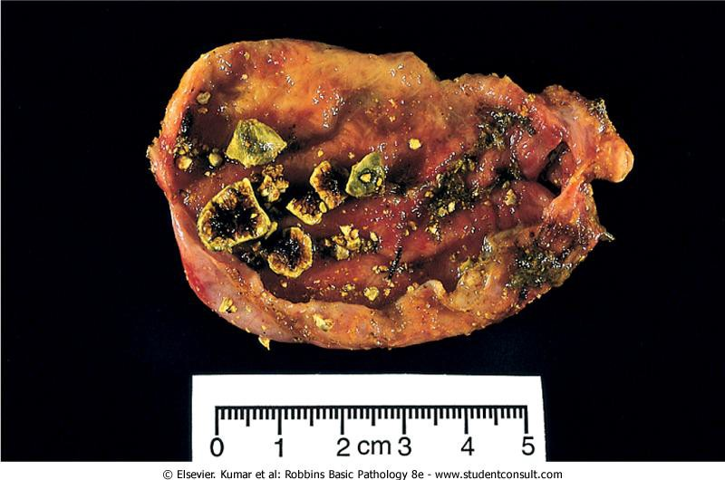
Cholesterol gallstones. Mechanical manipulation during laparoscopic cholecystectomy
has caused fragmentation of several cholesterol gallstones, revealing interiors that are
pigmented because of entrapped bile pigments

Slide 15
Pigment stones
may arise anywhere in the biliary tree and are
trivially classified as black or brown.
black pigment stones are found in sterile gallbladder bile, while brown stones are found in infected intrahepatic or extrahepatic ducts.
The stones contain calcium salts of unconjugated bilirubin and lesser amounts of other calcium salts, mucin glycoproteins, and cholesterol.

Slide 16
Black stones are usually small and present
in large quantities and crumble easily.
Brown stones tend to be single or few in number and are soft with a greasy, soaplike consistency that results from the presence of retained fatty acid salts released by the action of bacterial phospholipases on biliary lecithins.

Slide 17
50-75% of black stones are radiopaque. because of calcium carbonates and phosphates content.
Brown stones are radiolucent.

Slide 18
Clinical features
70-80% remain asymptomatic throughout life
20-30% become symptomatic at the rate of 1-
3% per year.
pain tends to be excruciating, either constant or "colicky" (spasmodic) from an obstructed gallbladder or when small gallstones move down-stream and lodge in the biliary tree.
Inflammation of the gallbladder, in association with stones, also generates pain.

Slide 19
Complications include:
1- empyema
2- perforation
3- fistulae
4- inflammation of the biliary tree
5- obstructive cholestasis or pancreatitis.
6- intestinal obstruction ("gallstone ileus").

Slide 20
Cholecystitis
1-Acute
Acute calculous cholecystitis
Acute non-calculous cholecystitis
2-Chronic
3-Acute superimposed on chronic
Almost always occurs in association with
gallstones

Slide 21
Acute calculous cholecystitis
Acute inflammation of a gallbladder that contains stones is termed acute calculous cholecystitis.
It is precipitated by obstruction of the
gallbladder neck or cystic duct.
It is the most common major complication of gallstones and the most common reason for emergency
cholecystectomy.

Slide 22
Symptoms may be mild and resolve without medical
intervention-emergency.
Acute calculous cholecystitis is initially the result of chemical irritation and inflammation of the gallbladder wall in the setting of obstruction to bile outflow.
The action of phospholipases derived from the mucosa hydrolyzes biliary lecithin to lysolecithin which is toxic to the mucosa.
The normally protective glycoprotein mucous layer is disrupted exposing the mucosal epithelium to the direct detergent action of bile salts.

Slide 23
PGs released within the wall of the distended gallbladder contribute to mucosal and mural inflammation.
Distention and increased intraluminal pressure may also compromise blood flow to the mucosa.

Slide 24
Acute Non-Calculous
Cholecystitis
5-12% of gallbladders removed for acute
cholecystitis contain no gallstones.
Most of these cases occur in seriously ill patients:
(1) the postoperative state after major, nonbiliary
surgery
(2) severe trauma (e.g., motor vehicle accidents)
(3) severe burns
(4) sepsis

Slide 25
Mechanism:
1-dehydration
2-gallbladder stasis
3-sludging
4-vascular compromise
5-bacterial contamination.

Slide 26
Chronic Cholecystitis
It is due to repeated bouts of acute cholecystitis, but in most instances it develops without any history of acute attacks.
It is almost always associated with gallstones.
Gallstones do not seem to have a direct role in the initiation of inflammation or the development of pain, because chronic acalculous cholecystitis causes symptoms and morphologic alterations similar to those seen in the calculous form.

Slide 27
Supersaturation of bile predisposes to both chronic inflammation and stone formation.
Escherichia coli and enterococci, can be cultured from the bile in only about one- third of cases.
Unlike acute calculous cholecystitis, stone obstruction of gallbladder outflow in chronic cholecystitis is not a requisite.

Slide 28
The symptoms of chronic cholecystitis are similar to those of the acute form and range from biliary colic to indolent right upper quadrant pain and epigastric distress.

Slide 29
Complications:
1-Bacterial superinfection with cholangitis or sepsis
2-Gallbladder perforation and local abscess
formation
3-Gallbladder rupture with diffuse peritonitis
4-Biliary enteric (cholecystenteric) fistula, with drainage of bile into adjacent organs, entry of air and bacteria into the biliary tree, and potentially gallstone-induced intestinal obstruction (ileus)
5-Aggravation of preexisting medical illness, with
cardiac, pulmonary, renal, or liver decompensation

Slide 30
Carcinoma of the Gallbladder
Carcinoma originating from the epithelial lining of the organ, is the most frequent malignant tumor of the biliary tract.
F>M
7th decade of life
It is more frequent in Mexico and Chile.
In USA is highest in Hispanics and Native Americans.
The mean 5-year survival has remained at a
dismal 5% rate.

Slide 31
Risk Factors
Gallstones are present in 60-90% of cases.
In Asia, where pyogenic and parasitic diseases of the biliary tree are more common, gallstones are less important.
Gallbladders containing stones or infectious agents develop cancer as a result of recurrent trauma and chronic inflammation.
The presence of a abnormal
choledochopancreatic duct junction is
considered to be a risk factor.

Slide 32
Exophytic or infiltrating tumors
Most carcinomas of the gallbladder are
adenocarcinomas.
They may be papillary, poorly differentiated, or undifferentiated infiltrating tumors.
About 5% are squamous cell carcinomas
or have adenosquamous differentiation.
A minority are carcinoid tumors.

Slide 33
By the time gallbladder cancers are discovered, most have invaded the liver directly and many have extended to the cystic duct and adjacent bile ducts and portal hepatic lymph nodes.
The peritoneum, GIT, and lungs are less common sites of seeding.

Slide 34
Clinical Features
Preoperative diagnosis of carcinoma of the gallbladder is the exception, occurring in fewer than 20% of patients.
Presenting symptoms are insidious and typically indistinguishable from those associated with cholelithiasis: abdominal pain, jaundice, anorexia, and nausea and vomiting.
The fortunate person develops early obstruction and acute cholecystitis before extension of the tumor into adjacent structures or undergoes cholecystectomy for coexistent symptomatic gallstones.

