Slide 1
Gi tract embryology 1

Slide 2
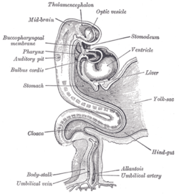
Development of the oral cavity
The mouth has 2 sources of development:
1. depression in the stomodeum (lined with ectoderm)
2. cephalic end of the foregut(lined with endoderm)
These two points are separated by the buccopharyngeal membrane
During the 3rd week of development the membrane disappears

Slide 3
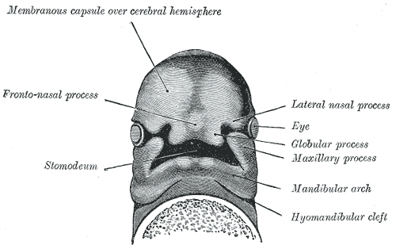
If the membrane persists (we create an imaginary line), it will extend to:
Body of sphenoid
Soft palate
Inner surface of the mandible, inferior to the incisor teeth
Structures that are anterior to this plane are ectodermic in origin(epithelium) like:
Hard palate
Sides of the mouth
Lips
Enamel of the teeth

Slide 4
Structures situated posterior to this plane are derived from endoderm:
Tongue
Soft palate
Palatoglossus and palatopharyngeal folds
Floor of the mouth

Slide 5
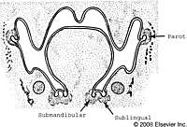
Development of the salivary glands
During the 7th week it arises as a solid outgrowth of cells from the walls of the developing mouth
These cells will grow into the underlying mesenchyme
The epithelial buds will go through repeated branching to form solid ducts
The ends of these ducts will form the secretory acini, and they will both go through canalization

Slide 6
The surrounding mesenchyme will condense to form:
The capsule of the gland
Septa that divide the gland into different lobes and lobules
The ducts and acini of the parotid gland are both derived from the ectoderm
Submandibular and sublingual glands are derived from the endoderm

Slide 7
Tongue
The tongue appears in embryos of approximately 4 weeks in the form of two lateral lingual swellings and one medial swelling, the tuberculum impar
These three swellings originate from the first pharyngeal arch.
A second median swelling, the copula, or hypobranchial eminence, is formed by mesoderm of the second, third, and part of the fourth arch.
Finally, a third median swelling, formed by the posterior part of the fourth arch, marks development of the epiglottis.

Slide 8
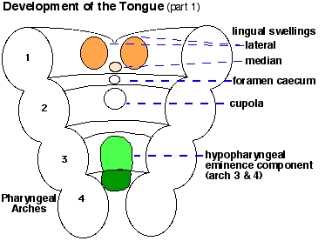
Immediately behind this swelling is the laryngeal orifice, which is flanked by the arytenoids swellings
As the lateral lingual swellings increase in size, they overgrow the tuberculum impar and merge, forming the anterior two-thirds, or body, of the tongue
Since the mucosa covering the body of the tongue originates from the first pharyngeal arch, sensory innervation to this area is by the mandibular branch of the trigeminal nerve.
The body of the tongue is separated from the posterior third by a V-shaped groove, the terminal sulcus

Slide 9
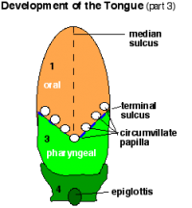
The posterior part, or root, of the tongue originates from the second, third, and part of the fourth pharyngeal arch.
The fact that sensory innervation to this part of the tongue is supplied by the glossopharyngeal nerve indicates that tissue of the third arch overgrows that of the second.
The epiglottis and the extreme posterior part of the tongue are innervated by the superior laryngeal nerve, reflecting their development from the fourth arch.

Slide 10
Some of the tongue muscles probably differentiate in situ, but most are derived from myoblasts originating in occipital somites.
Thus, tongue musculature is innervated by the hypoglossal nerve.
Special sensory innervation (taste) to the anterior two thirds of the tongue is provided by the chorda tympani
branch of the facial nerve, while the posterior third is supplied by the glossopharyngeal nerve.

Slide 11
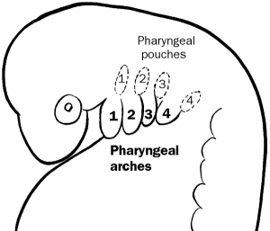
Development of the pharynx
The pharynx develops in the neck from the endoderm of the foregut
The endoderm is separate from the surface ectoderm by mesenchyme
The mesenchyme in each side splits up to 5-6 arches
Each arch forms a swelling on the surface of the walls of the foregut
As a result of these swellings a series of clefts are seen between the arches….pharyngeal clefts
Similar grooves are found on the lateral walls of the foregut…..pharyngeal pouches
The foregut on this level is known as the pharynx

Slide 12
Development of the anterior abdominal wall
Following the segmentation of the mesoderm, the lateral mesoderm divides into:
Somatic layer
Splanchic layer
Both lined by endo and ectoderm
The ant. Abdominal wall is derived from the somatoplueric mesoderm and they retain their innervation from the ventral rami of the spinal nerves
The somatoplueric mesoderm then tangentially divides into three layers:
Ext. oblique
Int. oblique
Trans. abdominus

Slide 13
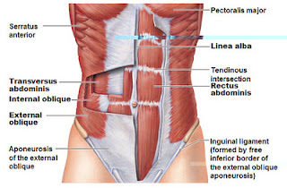
The rectus abdominus muscle retains the indications of the segmental origin (the presence of tendinous intersections)
Finally the abd. Wall right and left sides of mesenchyme fuses together at 3 months into the midline to form the linea alpa.
On either side of the lina alpa the rectus muscles lies within their rectus sheaths

Slide 14
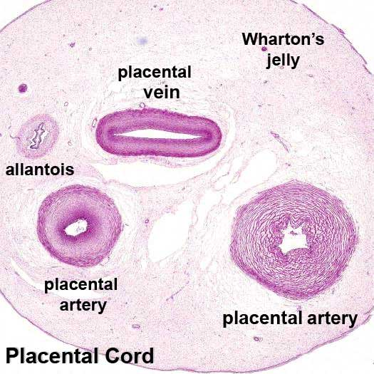
Development of the umblicus and the umblical cord
The amnion and the chorion fuse together
The amnion encloses the body stalk and the yolk sac with their blood vessels to form the tubular umbilical cord
The mesenchyme core of the cord (whartons jelly) form a loose connective tissue which embed the following:
Remains of yolk sac
Vittelline duct
Remains of allantois
Umbilical blood vessels
We have 2 arteries that carries deoxygenated blood from the fetus to the chorion (placenta)
2 veins carry oxygenated blood from the placenta
, but the right vein will soon disappear

Slide 15
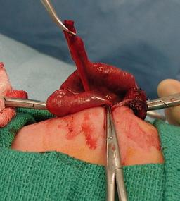
Vitelline Duct Abnormalities
In 2 to 4% of people, a small portion of the vitelline duct persists, forming an outpocketing of the ileum, Meckel’s diverticulum or ileal diverticulum
In the adult, this diverticulum, approximately 40 to 60 cm from the ileocecal valve on the antimesenteric border of the ileum, does not usually cause any symptoms.
However, when it contains heterotopic pancreatic tissue or gastric mucosa, it may cause ulceration, bleeding, or even perforation.

Slide 16
Sometimes both ends of the vitelline duct transform into fibrous cords, and the middle portion forms a large cyst, an enterocystoma, or vitelline cyst

Slide 17
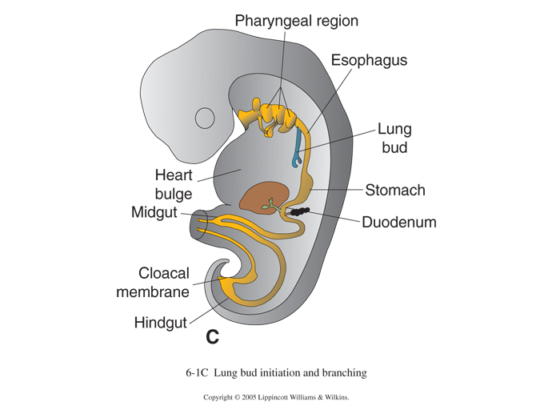
Formation of the Lung Buds
When the embryo is approximately 4 weeks old, the respiratory diverticulum (lung bud) appears as an outgrowth from the ventral wall of the foregut
The location of the bud along the gut tube is determined by signals from the surrounding mesenchyme, including fibroblast growth factors (FGFs) that “instruct”the endoderm.
Hence epithelium of the internal lining of the larynx, trachea, and bronchi, as well as that of the lungs, is entirely of endodermal origin.
The cartilaginous, muscular, and connective tissue components of the trachea and lungs are derived from splanchnic mesoderm surrounding the foregut

Slide 18
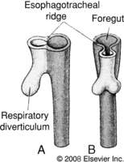
Initially the lung bud is in open communication with the foregut
When the diverticulum expands caudally, however, two longitudinal ridges, the tracheoesophageal ridges, separate it from the foregut
Subsequently, when these ridges fuse to form the tracheoesophageal septum, the foregut is divided into a dorsal portion, the esophagus, and a ventral portion, the trachea and lung buds
The respiratory primordium maintains its communication with the pharynx through the laryngeal orifice

