Slide 1
GI Histology 3

Slide 2
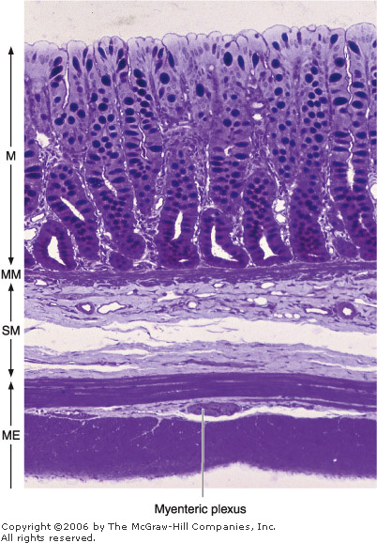
Large Intestine
The large intestine consists of a mucosal membrane with no folds except in its distal (rectal) portion
No villi are present in this portion of the intestine
The intestinal glands are long and characterized by a great abundance of goblet and absorptive cells and a small number of enteroendocrine cells
The absorptive cells are columnar and have short, irregular microvilli
The large intestine is well suited to its main functions: absorption of water, formation of the fecal mass, and production of mucus.

Slide 3
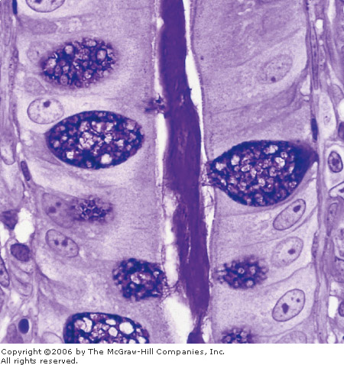
Mucus is a highly hydrated gel that not only lubricates the intestinal surface but also covers bacteria and particulate matter.
The absorption of water is passive, following the active transport of sodium out of the basal surfaces of the epithelial cells

Slide 4
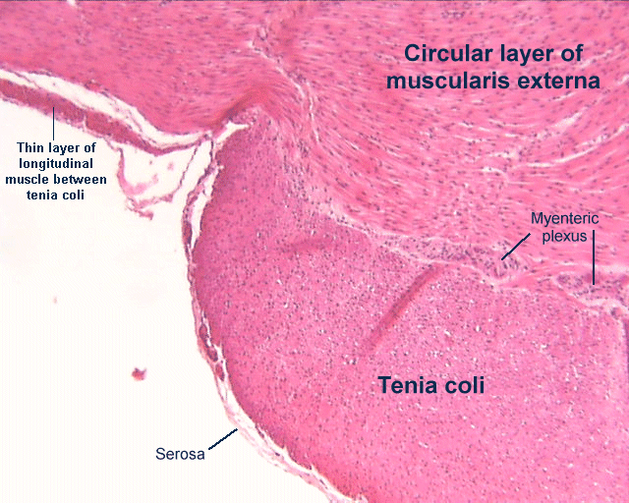
The lamina propria is rich in lymphoid cells and in nodules that frequently extend into the submucosa
This richness in lymphoid tissue (GALT) is related to the abundant bacterial population of the large intestine.
The muscularis comprises longitudinal and circular strands
This layer differs from that of the small intestine, because fibers of the outer longitudinal layer congregate in three thick longitudinal bands called teniae coli.
In the intraperitoneal portions of the colon, the serous layer is characterized by small, pendulous protuberances composed of adipose tissue—the appendices epiploicae.

Slide 5
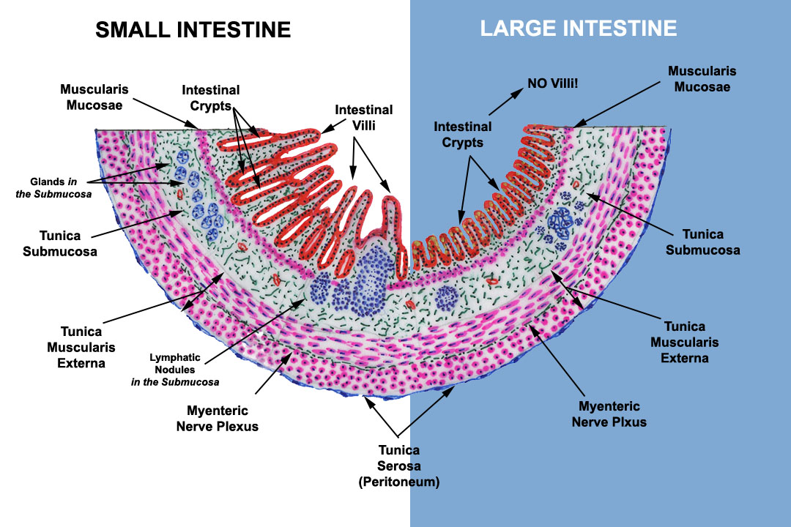
So the differences between the small and large intestine are :
Mucosa is thicker and contains crypts but no Vili
Simple columnar epithelium with an abundance of goblet cells
Crypts are longer , more closely packed and there is no paneth cells
Lamina propria is reduced, and it contains solitary lymph nodes.
The muscualris layer is well developed.

Slide 6
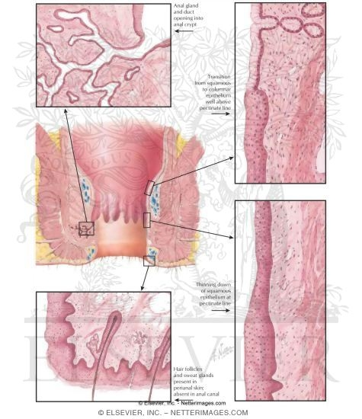
In the anal region, the mucous membrane forms a series of longitudinal folds, the rectal columns of Morgagni
These columns connects to the anal orifice to form the anal valves and sinuses.
About 2 cm above the anal opening, the intestinal mucosa is replaced by stratified squamous epithelium
In this region, the lamina propria contains a plexus of large veins that, when excessively dilated and varicose, produces hemorrhoids.
The muscularis layer gives rise to the anal sphincter
The adventitia layer connects the anal canal to the surrounding structures.

Slide 7
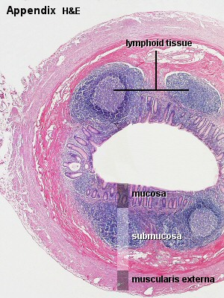
Appendix
The appendix is an evagination of the cecum
is characterized by a relatively small, narrow, and irregular lumen
caused by the presence of abundant lymphoid follicles in its wall , that form a circular layer in the mucosa and may infiltrate the submucosa.
Although its general structure is similar to that of the large intestine (same epithelium) , it contains fewer and shorter intestinal glands and has no teniae coli.
Covered entirely by serosa (mesoappendix)

Slide 8
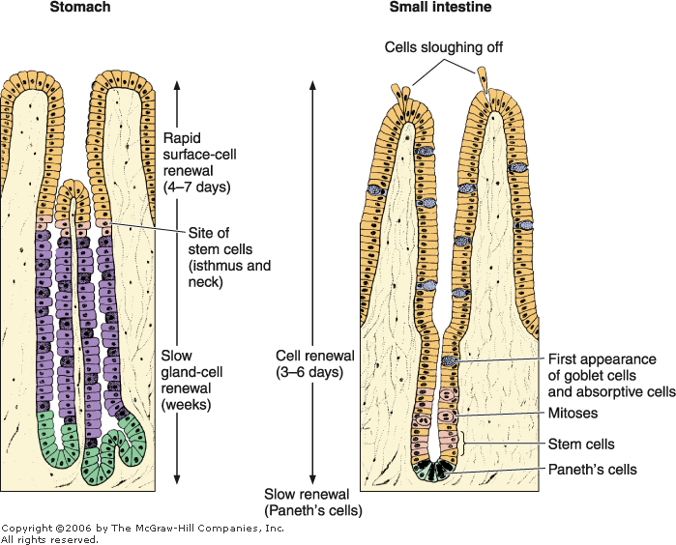
Cell Renewal in the Gastrointestinal Tract
The epithelial cells of the entire gastrointestinal tract are constantly being cast off and replaced with new ones formed through mitosis of stem cells
These stem cells are located in the basal layer of the esophageal epithelium, the neck of gastric glands, the lower half of the intestinal glands and the bottom third of the crypts of the large intestine
From this proliferative zone in each region, cells move to the maturation area, where they undergo structural and enzymatic maturation, providing the functional cell population of each region
In the small intestine the cells die by apoptosis in the tip of the villi or are sloughed off by mechanical action during function.

Slide 9
Liver
The liver is the second-largest organ of the body (the largest is the skin) and the largest gland, weighing about 1.5 kg
The liver is the organ in which nutrients absorbed in the digestive tract are processed and stored for use by other parts of the body
It is thus an interface between the digestive system and the blood
Most of its blood (70-80%) comes from the portal vein, arising from the stomach, intestines, and spleen; the smaller percentage (20-30%) is supplied by the hepatic artery
All the materials absorbed via the intestines reach the liver through the portal vein, except the complex lipids (chylomicrons), which are transported mainly by lymph vessels.

Slide 10
The position of the liver in the circulatory system is optimal for gathering, transforming, and accumulating metabolites and for neutralizing and eliminating toxic substances.
Elimination occurs in the bile, an exocrine secretion of the liver that is important for lipid digestion
The liver also has the very important function of producing plasma proteins, such as albumin, other carrier proteins, coagulation factors, and growth factors.

Slide 11
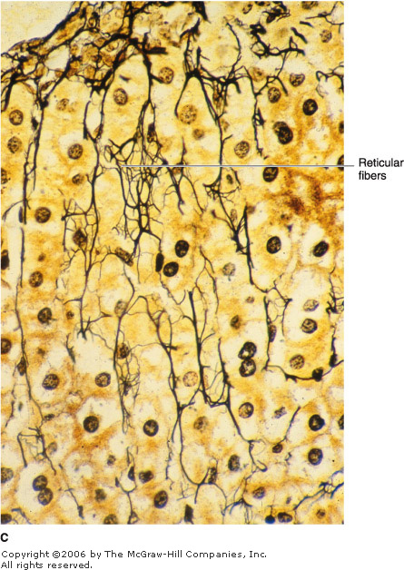
Stroma
The liver is covered by a thin connective tissue capsule (Glisson's capsule)
becomes thicker at the hilum, where the portal vein and the hepatic artery enter the organ and where the right and left hepatic ducts and lymphatics exit
These vessels and ducts are surrounded by connective tissue all the way to their termination (or origin) in the portal spaces between the liver lobules.
At this point, a delicate reticular fiber network that supports the hepatocytes and sinusoidal endothelial cells of the liver lobules is formed.

Slide 12
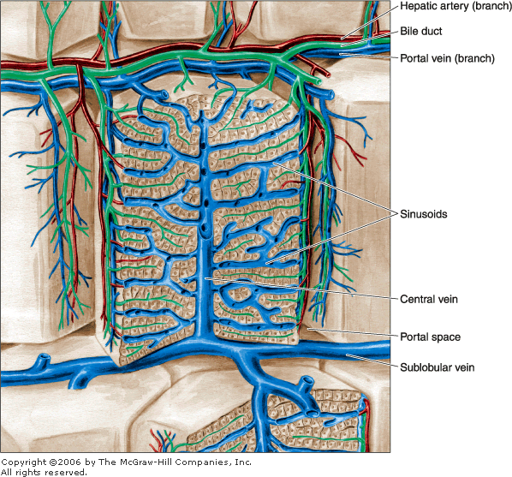
The Liver Lobule
The basic structural component of the liver is the liver cell, or hepatocyte
These epithelial cells are grouped in interconnected plates and constitute two-thirds of the mass of the liver
In light-microscope sections, structural units called liver lobules can be seen
The liver lobule is formed of a polygonal mass of tissue about 0.7 x 2 mm in size
with portal spaces at the periphery and a vein, called the central or centrolobular vein, in the center

Slide 13
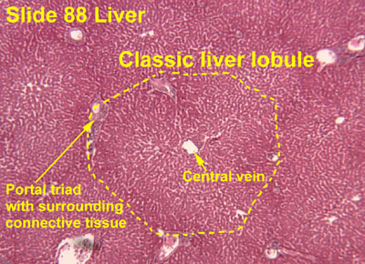
Portal spaces, regions located in the corners of the lobules, contain connective tissue, bile ducts, lymphatics, nerves, and blood vessels
The human liver contains three to six portal spaces per lobule, each with a venule (a branch of the portal vein),
an arteriole (a branch of the hepatic artery),
a duct (part of the bile duct system),
and lymphatic vessels
The venule contains blood coming from the superior and inferior mesenteric and splenic veins, and it’s the largest structure.
The arteriole contains oxygen-rich blood coming from the celiac trunk of the abdominal aorta.
The duct, lined by cuboidal epithelium, carries bile synthesized by the hepatocytes and eventually empties into the hepatic duct

Slide 14
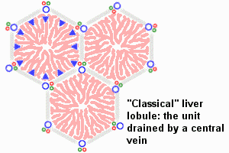

Slide 15
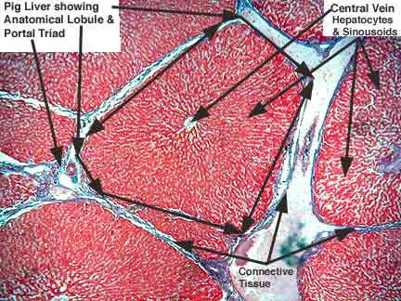
In certain animals (eg, pigs), the lobules are separated by a layer of connective tissue
This is not the case in humans, where the lobules are in close contact along most of their length, making it difficult to establish the exact limits between different lobules.

Slide 16
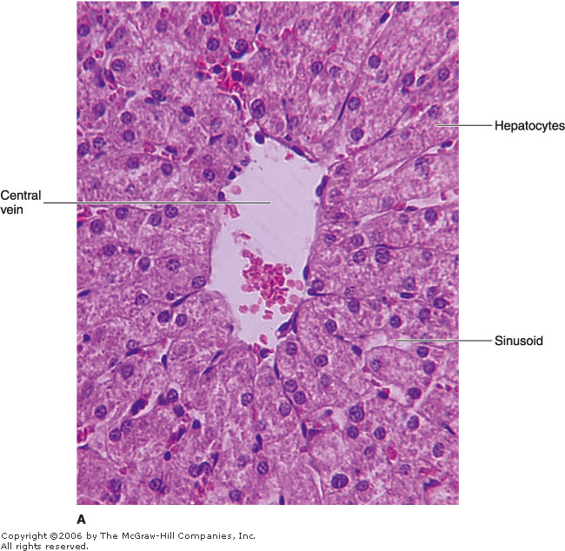
The hepatocytes in the liver lobule are radially disposed and are arranged like the bricks of a wall
These cellular plates are directed from the periphery of the lobule to its center and anastomose freely, forming a labyrinthine and spongelike structure
The space between these plates contains capillaries, the liver sinusoids
sinusoidal capillaries are irregularly dilated vessels composed solely of a discontinuous layer of fenestrated endothelial cells.
The fenestrae are about 100 nm in diameter, have no diaphragm, and are grouped in clusters
There are also spaces between the endothelial cells, which, together with the cellular fenestrae and a discontinuous basal lamina (depending on the species), give these vessels great permeability.

Slide 17
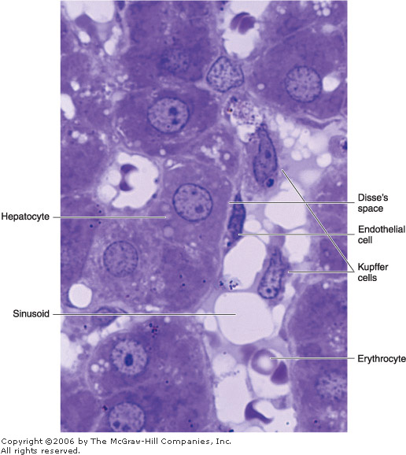
A subendothelial space known as the space of Disse separates the endothelial cells from the hepatocytes
The fenestrae and discontinuity of the endothelium allow the free flow of plasma but not of cellular elements into the space of Disse
Thus permitting an easy exchange of molecules (including macromolecules) from the sinusoidal lumen to the hepatocytes and vice versa
Which allows the release of the large number of macromolecules (eg, lipoproteins, albumin, fibrinogen) secreted into the blood by hepatocytes and also it enables the liver takes up and catabolizes many of these large molecules
The basolateral side of the hepatocyte, which lines the space of Disse, contains many microvilli and demonstrates endocytic and pinocytic activity.

Slide 18
The sinusoid is surrounded and supported by a delicate sheath of reticular fibers
In addition to the endothelial cells, the sinusoids contain macrophages known as Kupffer cells
These cells are found on the luminal surface of the endothelial cells, within the sinusoids
Their main functions are to metabolize aged erythrocytes, digest hemoglobin, secrete proteins related to immunological processes, and destroy bacteria that eventually enter the portal blood through the large intestine
Kupffer cells account for 15% of the liver cell population. Most of them are located in the periportal region of the liver lobule, where they are very active in phagocytosis

Slide 19
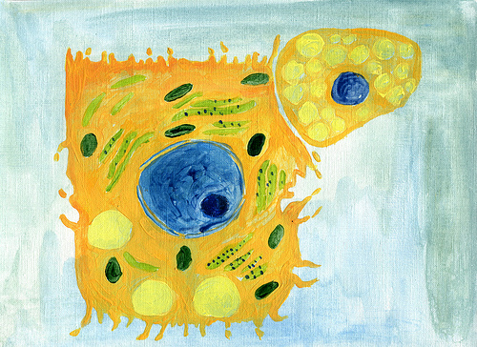
In the space of Disse (perisinusoidal space), fat-storing cells, also called stellate or Ito's cells, contain vitamin A rich lipid inclusions
In the healthy liver, these cells have several functions, such as
uptake, storage, and release of retinoids
synthesis and secretion of several extracellular matrix proteins and proteoglycans
secretion of growth factors and cytokines, and the regulation of the sinusoidal lumen diameter in response to different regulators (eg, prostaglandins, thromboxane A₂).

Slide 20
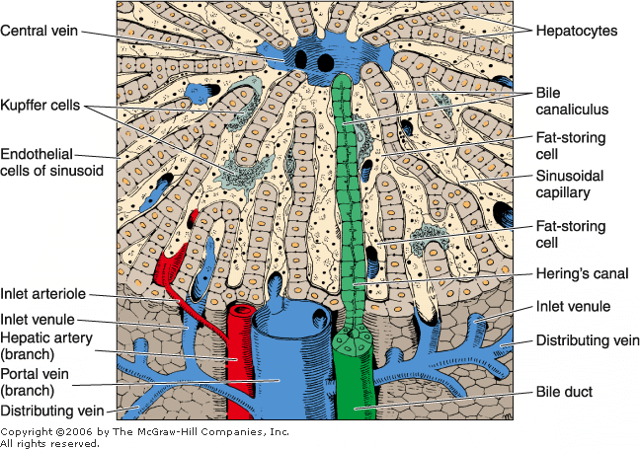
The Hepatocyte
Hepatocytes are polyhedral, with six or more surfaces, and have a diameter of 20-30 um
the cytoplasm of the hepatocyte is eosinophilic, mainly because of the large number of mitochondria and some smooth endoplasmic reticulum
Hepatocytes located at different distances from the portal spaces show differences in structural, histochemical, and biochemical characteristics
The surface of each hepatocyte is in contact with the wall of the sinusoids, through the space of Disse, and with the surfaces of other hepatocytes
Wherever two hepatocytes abut, they delimit a tubular space between them known as the bile canaliculus
At the periphery, bile enters the bile ductules, or Hering's canals composed of cuboidal cells

Slide 21
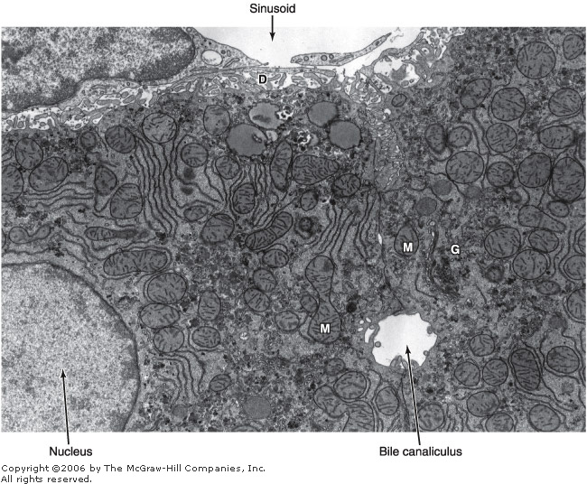
The canaliculi, the first portions of the bile duct system, are tubular spaces 12 um in diameter
They are limited only by the plasma membranes of two hepatocytes and have a small number of microvilli in their interiors
The cell membranes near these canaliculi are firmly joined by tight junctions
Gap junctions are frequent between hepatocytes and are sites of intercellular communication
The bile flow therefore progresses in a direction opposite to that of the blood, ie, from the center of the lobule to its periphery.

Slide 22
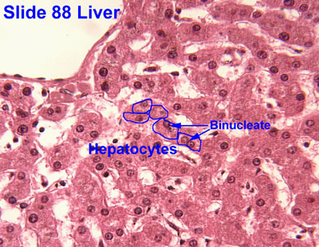
The surface of the hepatocyte that faces the space of Disse contains many microvilli that protrude into that space, but there is always a space between them and the cells of the sinusoidal wall
The hepatocyte has one or two rounded nuclei with one or two nucleoli
Some of the nuclei are polyploid
In the hepatocyte, the rough endoplasmic reticulum forms aggregates dispersed in the cytoplasm; these are often called basophilic bodies
Several proteins (eg, blood albumin, fibrinogen) are synthesized on polyribosomes in these structures
the smooth endoplasmic reticulum is responsible for the processes of oxidation, methylation, and conjugation required for inactivation or detoxification of various substances before their excretion from the body.

Slide 23
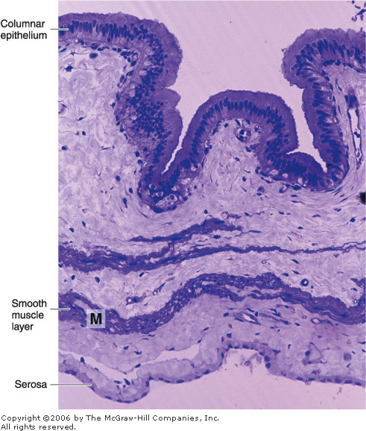
Gallbladder
The gallbladder is a hollow, pear-shaped organ attached to the lower surface of the liver
It can store 30-50 mL of bile.
The wall of the gallbladder consists of a mucosa composed of simple columnar epithelium and lamina propria, a layer of smooth muscle, a perimuscular connective tissue layer, and a serous membrane
The mucosa has abundant folds that are particularly evident when the gallbladder is empty
The epithelial cells are rich in mitochondria
All these cells are capable of secreting small amounts of mucus
Tubuloacinar mucous glands near the cystic duct are responsible for the production of most of the mucus present in bile( no goblet cells).

Slide 24
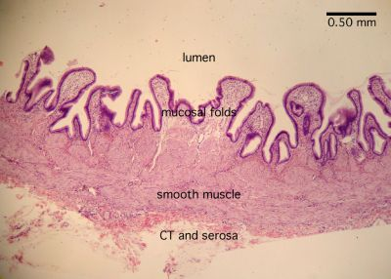
The main function of the gallbladder is to store bile, concentrate it by absorbing its water, and release it when necessary into the digestive tract
Contraction of the smooth muscle of the gallbladder is induced by cholecystokinin, a hormone produced by enteroendocrine cells located in the epithelial lining of the small intestine
Release of cholecystokinin is, in turn, stimulated by the presence of dietary fats in the small intestine.
No muscularis mucosa or submucosa
The muscularis externa is composed of irregular(oblique) smooth muscles with collagen and elastic fibers in between.
No peristaltic movements.

Slide 25
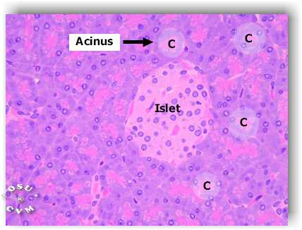
Pancreas
The pancreas is a mixed exocrine-endocrine gland that produces digestive enzymes and hormones
The enzymes are stored and released by cells of the exocrine portion, arranged in acini
The hormones are synthesized in clusters of endocrine epithelial cells known as islets of Langerhans
exocrine portion of the pancreas is a compound acinar gland, similar in structure to the parotid gland

Slide 26
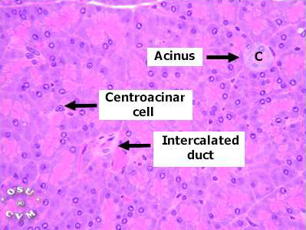
Differences between the parotid and the pancreas
In histological sections, a distinction between the two glands can be made based on the absence of striated ducts and the presence of the islets of Langerhans in the pancreas
Another characteristic detail is that in the pancreas the initial portions of intercalated ducts penetrate the lumens of the acini
Nuclei, surrounded by a pale cytoplasm, belong to centroacinar cells that constitute the intraacinar portion of the intercalated duct
These cells are found only in pancreatic acini
Intercalated ducts are tributaries of larger intralobular ducts that, in turn, form larger interlobular ducts lined by columnar epithelium, located within the connective tissue septa.
There are no striated ducts in the pancreatic duct system.

Slide 27
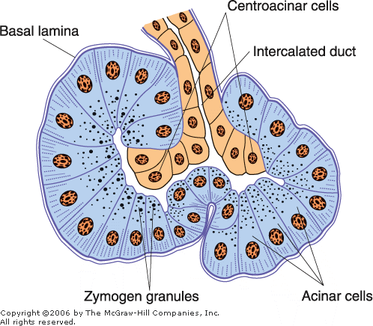
The exocrine pancreatic acinus is composed of several serous cells surrounding a lumen
These cells are highly polarized, with a spherical nucleus, and are typical protein-secreting cells.
The number of zymogen granules present in each cell varies according to the digestive phase and attains its maximum in animals that have fasted
thin capsule of connective tissue covers the pancreas and sends septa into it, separating the pancreatic lobules
The acini are surrounded by a basal lamina that is supported by a delicate sheath of reticular fibers.
The pancreas also has a rich capillary network, essential for the secretory process.

Slide 28
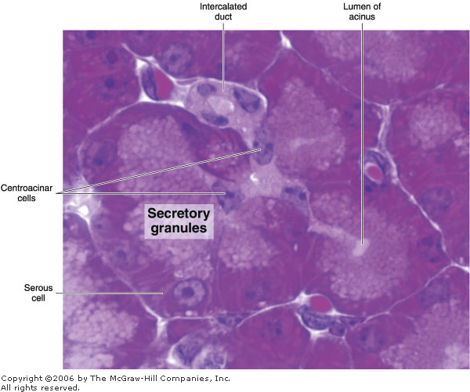
The exocrine pancreas secretes 1500-3000 mL of isosmotic alkaline fluid per day containing water, ions, and several proteases
trypsinogens 1, 2, and 3,
chymotrypsinogen,
proelastases 1 and 2, protease E
, kallikreinogen,
procarboxypeptidases A1, A2, B1, and B2),
amylase, lipases (triglyceride lipase, colipase, and carboxyl ester hydrolase), phospholipase A₂,
and nucleases (deoxyribonuclease and ribonuclease)
The majority of the enzymes are stored as proenzymes in the secretory granules of acinar cells, being activated in the lumen of the small intestine after secretion
Enterokinase, an intestinal enzyme, cleaves trypsinogen to form trypsin, which then activates the other proteolytic enzymes in a cascade.
Pancreatic secretion is controlled mainly through two hormones secretin and cholecystokinin that are produced by enteroendocrine cells of the intestinal mucosa (duodenum and jejunum

