Slide 1
GI Histology 1

Slide 2
Objectives
Describe the cells of the GI tract and their function
Describe the histological features of each part of the GI tract.
Differentiate between different parts of the GI tract
Appreciate the histopathology of the GI tract
Describe the histological basis of some clinical problems

Slide 3
The digestive system consists of the digestive tract—oral cavity, esophagus, stomach, small and large intestines, rectum, and anus—and its associated glands—salivary glands, liver, and pancreas.
Its function is to obtain the molecules necessary for the maintenance, growth, and energy needs of the body from ingested food.
Large molecules such as proteins, fats, complex carbohydrates, and nucleic acids are broken down into small molecules that are easily absorbed through the lining of the digestive tract, mostly in the small intestine.
Water, vitamins, and minerals are also absorbed from ingested food. In addition, the inner layer of the digestive tract is a protective barrier between the content of the tract's lumen and the internal milieu of the body.

Slide 4
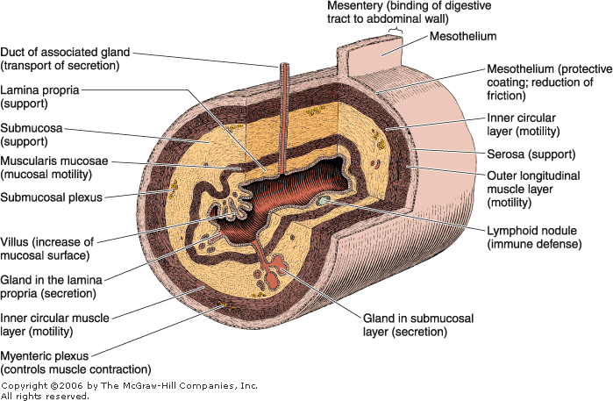
General Structure of the Digestive Tract
The entire gastrointestinal tract presents certain common structural characteristics
is a hollow tube composed of a lumen whose diameter varies, surrounded by a wall made up of four principal layers: the mucosa, submucosa, muscularis, and serosa.
The mucosa comprises an epithelial lining; a lamina propria of loose connective tissue rich in blood and lymph vessels and smooth muscle cells, sometimes also containing glands and lymphoid tissue
and the muscularis mucosae, usually consisting of a thin inner circular layer and an outer longitudinal layer of smooth muscle cells separating the mucosa from the submucosa. The mucosa is frequently called a mucous membrane.

Slide 5
The submucosa is composed of dense connective tissue with many blood and lymph vessels and a submucosal (also called Meissner's) nerve plexus.
It may also contain glands and lymphoid tissue.
The muscularis contains smooth muscle cells that are spirally oriented and divided into two sublayers according to the main direction the muscle cells follow
In the internal sublayer (close to the lumen), the orientation is generally circular; in the external sublayer, it is mostly longitudinal
The muscularis also contains the myenteric (or Auerbach's) nerve plexus, which lies between the two muscle sublayers
blood and lymph vessels in the connective tissue between the muscle sublayers.

Slide 6
The serosa is a thin layer of loose connective tissue, rich in blood and lymph vessels and adipose tissue, and a simple squamous covering epithelium (mesothelium).
In the abdominal cavity, the serosa is continuous with the mesenteries and with the peritoneum
In places where the digestive organ is bound to other organs or structures, however, the serosa is replaced by a thick adventitia, consisting of connective tissue containing vessels and nerves, without the mesothelium.

Slide 7
Basic mucosal forms in the GI tract
Protective : stratified squamous epithelium that is found in the oral cavity, pharynx, the esophagus and the anal canal
Seceretory : the mucosa consists of a long closely packed tubular glands, found in the stomach
Absorptive ; the mucosa is arranged in a fingerlike projections called vili with intervening short glands called crypts, that is typical for the small intestine.
In the duodenum some crypts extend from the muscularis mucosa to the submucosa (Brunners Gland)
Absorptive/protective ; the mucosa is arranged into closely packed tubular glands specialised for water absorption and mucus secreting goblet cells
It lines the whole large intesine

Slide 8
The Oral Cavity
The oral cavity is lined with stratified squamous epithelium, keratinized or nonkeratinized, depending on the region
The keratin layer protects the oral mucosa from damage during masticatory function and is present mostly in the gingiva (gum) and hard palate
The lamina propria in these regions has several papillae and rests directly on bony tissue.
Nonkeratinized squamous epithelium covers the soft palate, lips, cheeks, and the floor of the mouth.
The lamina propria has papillae, similar to those in the dermis of the skin, and is continuous with a submucosa containing diffuse small salivary glands.
In the lips, a transition from the oral nonkeratinized epithelium to the keratinized epithelium of the skin can be observed.
The soft palate has a core of skeletal muscle, numerous mucous glands, and lymphoid nodules in its submucosa.

Slide 9
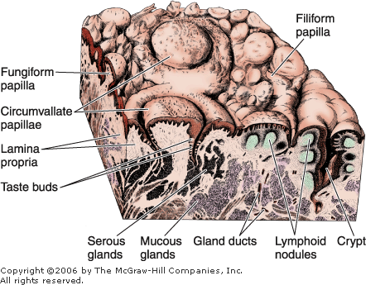
Tongue
The tongue is a mass of striated muscle covered by a mucous membrane whose structure varies according to the region
The muscle fibers cross one another in three planes; they are grouped in bundles, usually separated by connective tissue
Because the connective tissue of the lamina propria penetrates the spaces between the muscular bundles, the mucous membrane is strongly adherent to the muscle
The mucous membrane is smooth on the lower (ventral) surface of the tongue
The tongue's dorsal surface is irregular, covered anteriorly by a great number of small eminences called papillae.

Slide 10
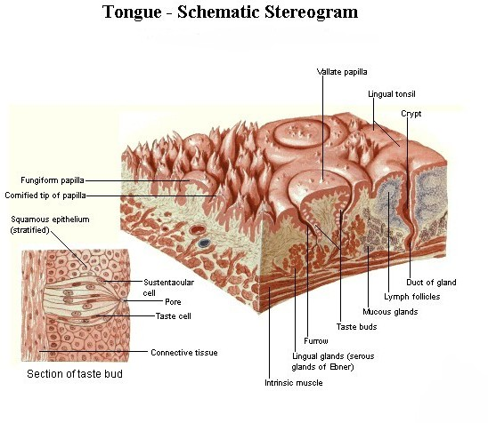
The posterior one-third of the dorsal surface of the tongue is separated from the anterior two-thirds by a V-shaped boundary
Behind this boundary, the surface of the tongue shows small bulges composed mainly of two types of small lymphoid aggregations:
small collections of lymphoid nodules
and the lingual tonsils, where lymphoid nodules aggregate around invaginations (crypts) of the mucous membrane

Slide 11
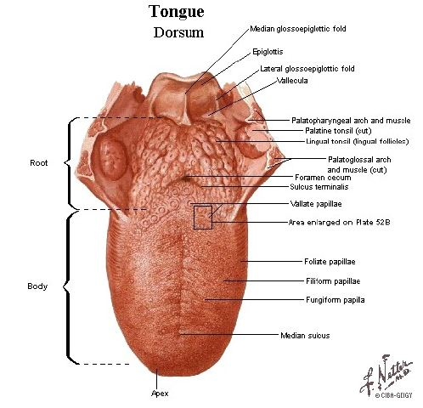
Papillae
Papillae are elevations of the oral epithelium and lamina propria that assume various forms and functions. There are four types
Filiform Papillae
Filiform papillae have an elongated conical shape; they are quite numerous and are present over the entire surface of the tongue
Their epithelium, which does not contain taste buds, is keratinized.

Slide 12
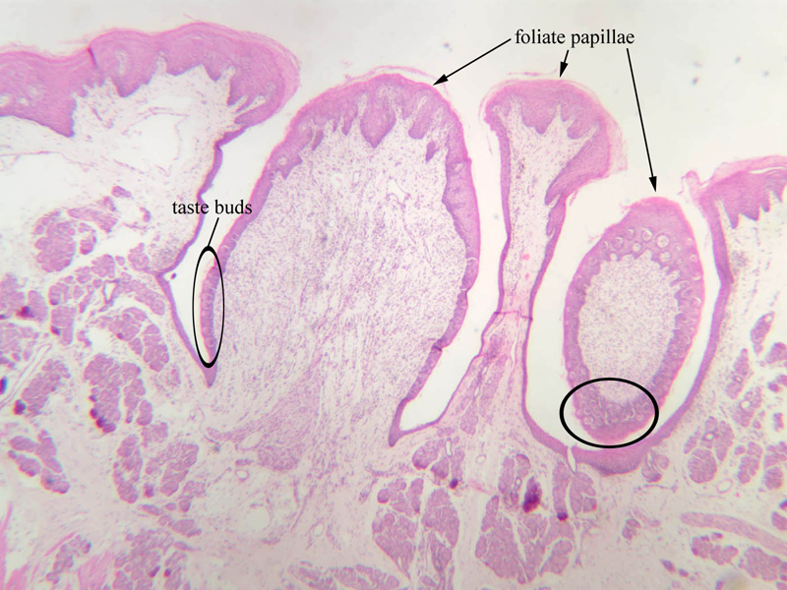
Fungiform Papillae
Fungiform papillae resemble mushrooms in that they have a narrow stalk and a smooth-surfaced, dilated upper part
These papillae, which contain scattered taste buds on their upper surfaces, are irregularly interspersed among the filiform papillae.
Foliate Papillae
Foliate papillae are poorly developed in humans
They consist of two or more parallel ridges and furrows on the dorsolateral surface of the tongue and contain many taste buds.

Slide 13
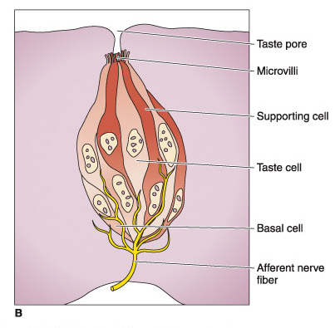
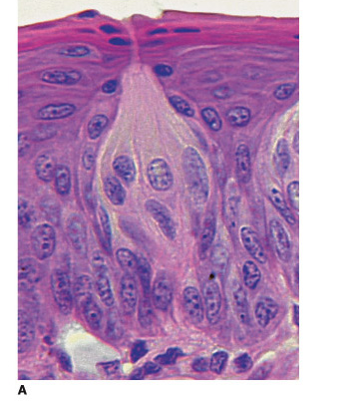
Taste buds

Slide 14
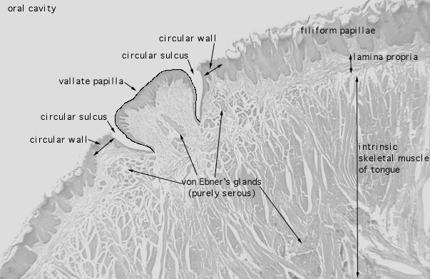
Circumvallate Papillae
Circumvallate papillae are 7–12 extremely large circular papillae whose flattened surfaces extend above the other papillae
They are distributed in the V region in the posterior portion of the tongue
Numerous serous (von Ebner's) glands drain their contents into the deep groove that encircles the periphery of each papilla
This moatlike arrangement provides a continuous flow of fluid over the great number of taste buds present along the sides of these papillae
The glands also secrete a lipase that probably prevents the formation of a hydrophobic layer over the taste buds that would hinder their function.
This flow of secretions is important in removing food particles from the vicinity of the taste buds so that they can receive and process new gustatory stimuli

Slide 15
Along with this local role, lingual lipase is active in the stomach and can digest up to 30% of dietary triglycerides
Other small mucous salivary glands dispersed throughout the lining of the oral cavity act in the same way as the serous glands associated with this type of papilla to prepare the taste buds in other parts of the oral cavity, such as the anterior portion of the tongue, to respond to taste stimuli.

Slide 16
Salivary Glands
Saliva is a complex fluid that has digestive, lubricating, and protective functions
In addition to the small salivary glands scattered throughout the oral cavity, there are three pairs of large salivary glands: the parotid, submandibular (submaxillary), and sublingual glands
In humans, the minor salivary glands secrete 10% of the total volume of saliva, but they account for approximately 70% of the mucus secreted.

Slide 17
A capsule of connective tissue, rich in collagen fibers, surrounds the large salivary glands.
The parenchyma of the glands consists of secretory end pieces and a branching duct system arranged in lobules, separated by septae of connective tissue originating from the capsule
The secretory end pieces present two types of secretory cellsâ€”serous and mucous
as well as the nonsecretory myoepithelial cells
This secretory portion is followed by a duct system whose components modify and conduct the saliva to the oral cavity.

Slide 18
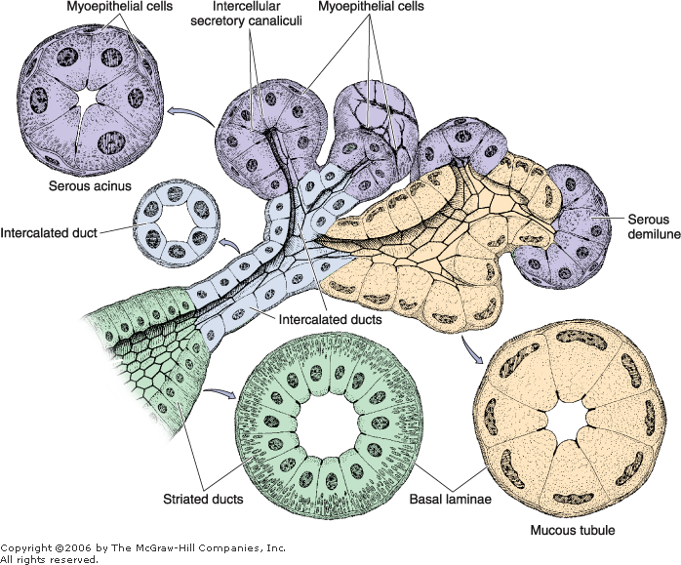
Serous cells are usually pyramidal in shape, with a broad base resting on the basal lamina and a narrow apical surface with short, irregular microvilli facing the lumen
They exhibit characteristics of polarized protein-secreting cells.
Adjacent secretory cells are joined together by junctional complexes and usually form a spherical mass of cells called acinus, with a small lumen in the center
This structure can be thought of as a grape attached to its stem; the stem corresponds to the duct system.

Slide 19
Mucous cells are usually cuboidal to columnar in shape; their nuclei are oval and pressed toward the bases of the cells.
They exhibit the characteristics of mucus-secreting cells containing glycoproteins important for the moistening and lubricating functions of the saliva
Most of these glycoproteins are called mucins and contain 70â€“80% carbohydrate moieties in their structure
Mucous cells are most often organized as tubules, consisting of cylindrical arrays of secretory cells surrounding a lumen.

Slide 20
Myoepithelial cells
are found between the basal lamina and the basal plasma membrane of the cells
forming secretory end pieces and intercalated ducts (to a lesser extent), which form the initial portion of the duct system
Myoepithelial cells surrounding each secretory portion, usually two to three cells per secretory unit, are well developed and branched (and are sometimes called basket cells
whereas those associated with intercalated ducts are spindle shaped and lie parallel to the length of the duct
These cells show several characteristics that resemble smooth muscle cells, including contractility. However, they also establish intercellular junctions among themselves and with secretory cells, such as desmosomes
Although the contraction of myoepithelial cells accelerates the secretion of saliva, their main function seems to be the prevention of end piece distention during secretion due to the increase in intraluminal pressure

Slide 21
In the duct system, secretory end pieces empty into the intercalated ducts, lined by cuboidal epithelial cells
These cells have the ability to divide and differentiate into secretory or ductal cells
Several of these short intercalated ducts join to form striated ducts
characterized by radial striations that extend from the bases of the cells to the level of the central nuclei.
Intercalated and striated ducts are also called intralobular ducts because of their location within the lobule.
When viewed in the electron microscope, the striations are seen to consist of infoldings of the basal plasma membrane with numerous elongated mitochondria that are aligned parallel to the infolded membranes; this structure is characteristic of ion-transporting cells

Slide 22
The striated ducts of each lobule converge and drain into ducts located in the connective tissue septae separating the lobules, where they become interlobular, or excretory, ducts
They are initially lined with pseudostratified or stratified cuboidal epithelium, but more distal parts of the excretory ducts are lined with stratified columnar epithelium containing a few mucus-secreting cells
The main duct of each major salivary gland ultimately empties into the oral cavity and is lined with nonkeratinized-stratified squamous epithelium.

Slide 23
Vessels and nerves enter the large salivary glands at the hilum and gradually branch into the lobules.
A rich vascular and nerve plexus surrounds the secretory and ductal components of each lobule
The capillaries surrounding the secretory end pieces are very important for the secretion of saliva, stimulated by the autonomic nervous system.
Parasympathetic stimulation, usually through the smell or taste of food, promotes vasodilation and a copious watery secretion content. Sympathetic stimulation produces small amounts of viscous saliva, rich in organic material

Slide 24
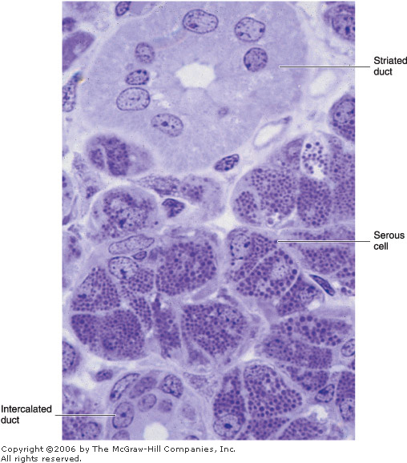
Parotid Gland
The parotid gland is a branched acinar gland; its secretory portion is composed exclusively of serous cells
containing secretory granules that are rich in proteins and have a high amylase activity
This activity is responsible for most of the hydrolysis of ingested carbohydrates.
The digestion begins in the mouth and continues for a short time in the stomach, before the gastric juice acidifies the food and thus decreases amylase activity considerably
Intercalated and striated ducts are easily observed within the lobules, due to their length.
As in other large salivary glands, the connective tissue contains many plasma cells and lymphocytes
The plasma cells secrete IgA, which forms a complex with a secretory component synthesized by the serous acinar, intercalated duct, and striated duct cells
The IgA-rich secretory complex released into the saliva is resistant to enzymatic digestion and constitutes an immunological defense mechanism against pathogens in the oral cavity.

Slide 25
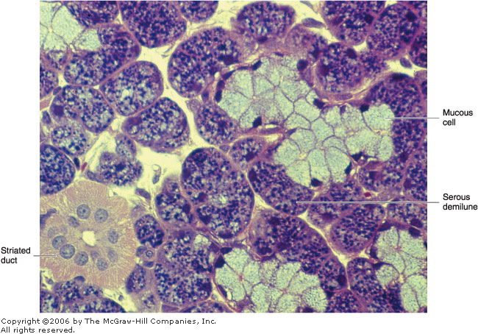
Submandibular (Submaxillary) Gland
The submandibular gland is a branched tubuloacinar gland
its secretory portion contains both mucous and serous cells
The serous cells are the main component of this gland and are easily distinguished from mucous cells by their rounded nuclei and basophilic cytoplasm
In humans, 90% of the end pieces of the submandibular gland are serous acinar, whereas 10% consist of mucous tubules with serous demilunes
Serous cells are responsible for the weak amylolytic activity present in this gland and its saliva
The cells that form the demilunes in the submandibular gland secrete the enzyme lysozyme, whose main activity is to hydrolyze the walls of certain bacteria
Some acinar and intercalated duct cells in large salivary glands also secrete lactoferrin, which binds iron, a nutrient necessary for bacterial growth
Striated ducts are easily observed in the human submandibular gland, but intercalated ducts are very short.

Slide 26
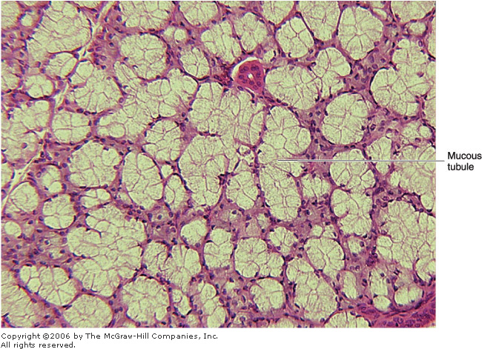
Sublingual Gland
The sublingual gland, like the submandibular gland, is a branched tubuloacinar gland formed of serous and mucous cells
Mucous cells predominate in this gland; serous cells are present almost exclusively on demilunes of mucous tubules
As in the submandibular gland, cells that form the demilunes in this gland secrete lysozyme.
Intralobular ducts are not as well developed as in other major salivary glands.

Slide 27
Minor Salivary Glands
These nonencapsulated glands are distributed throughout the oral mucosa and submucosa
Saliva is produced by small groups of secretory units and is conducted to the oral cavity by short ducts, with little modification of its content
Although variations exist, minor salivary glands are usually mucous
The small serous glands present in the posterior region of the tongue (von Ebner's glands) are the only exception
Lymphocyte agregates are commonly observed within minor salivary glands, associated with IgA secretion.

