Slide 1
Gi Embryology 3

Slide 2
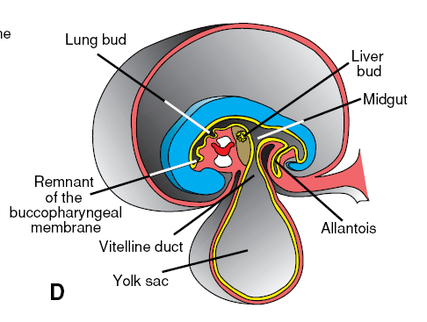
Midgut
the midgut is suspended from the dorsal abdominal wall by a short mesentery and communicates with the yolk sac by way of the vitelline duct or yolk stalk
Over its entire length the midgut is supplied by the superior mesenteric artery
Development of the midgut is characterized by rapid elongation of the gut and its mesentery, resulting in formation of the primary intestinal loop
At its apex, the loop remains in open connection with the yolk sac by way of the narrow vitelline duct

Slide 3
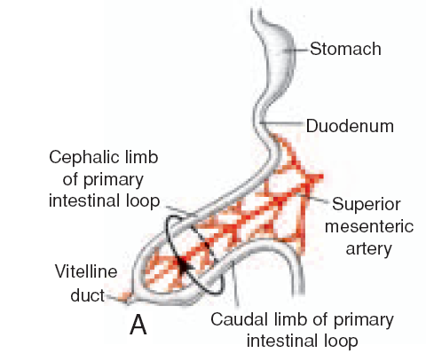
In the adult the midgut begins immediately distal to the entrance of the bile duct into the duodenum
terminates at the junction of the proximal two-thirds of the transverse colon with the distal third.
The cephalic limb of the loop develops into the distal part of the duodenum, the jejunum, and part of the ileum.
The caudal limb becomes the lower portion of the ileum, the cecum, the appendix, the ascending colon, and the proximal two-thirds of the transverse colon.

Slide 4
PHYSIOLOGICAL HERNIATION
Development of the primary intestinal loop is characterized by rapid elongation, particularly of the cephalic limb.
As a result of the rapid growth and expansion of the liver, the abdominal cavity temporarily becomes too small to contain all the intestinal loops, and they enter the extraembryonic cavity in the umbilical cord during the sixth week of development (physiological umbilical herniation)

Slide 5
ROTATION OF THE MIDGUT
Coincident with growth in length, the primary intestinal loop rotates around an axis formed by the superior mesenteric artery
When viewed from the front, this rotation is counterclockwise, and it amounts to approximately 270◦ when it is complete
Even during rotation, elongation of the small intestinal loop continues, and the jejunum and ileum form a number of coiled loops
The large intestine likewise lengthens considerably but does not participate in the coiling phenomenon.
Rotation occurs during herniation (about 90◦) as well as during return of the intestinal loops into the abdominal cavity (remaining 180◦)

Slide 6
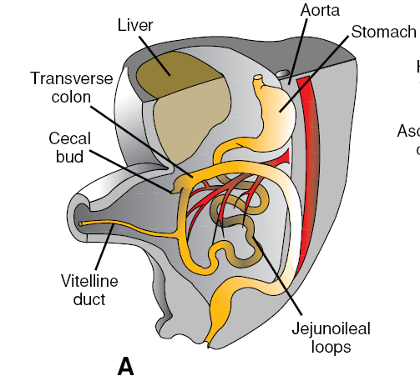
RETRACTION OF HERNIATED LOOPS
During the 10th week, herniated intestinal loops begin to return to the abdominal cavity.
is thought that regression of the mesonephric kidney, reduced growth of the liver, and expansion of the abdominal cavity play important roles.
The proximal portion of the jejunum, the first part to reenter the abdominal cavity, comes to lie on the left side
The later returning loops gradually settle more and more to the right.

Slide 7
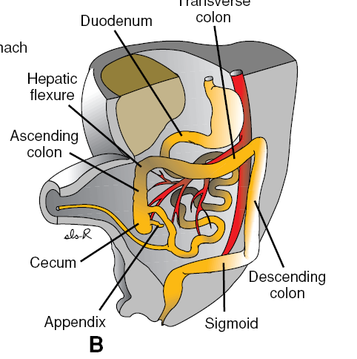
The cecal bud, which appears at about the sixth week as a small conical dilation of the caudal limb of the primary intestinal loop, is the last part of the gut to reenter the abdominal cavity.
Temporarily it lies in the right upper quadrant directly below the right lobe of the liver
From here it descends into the right iliac fossa, placing the ascending colon and hepatic flexure on the right side of the abdominal cavity

Slide 8
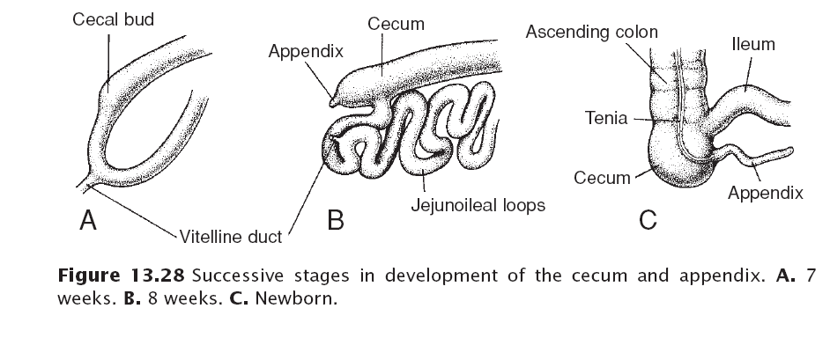
During this process the distal end of the cecal bud forms a narrow diverticulum, the appendix
Since the appendix develops during descent of the colon, its final position frequently is posterior to the cecum or colon.
These positions of the appendix are called retrocecal or retrocolic, respectively

Slide 9
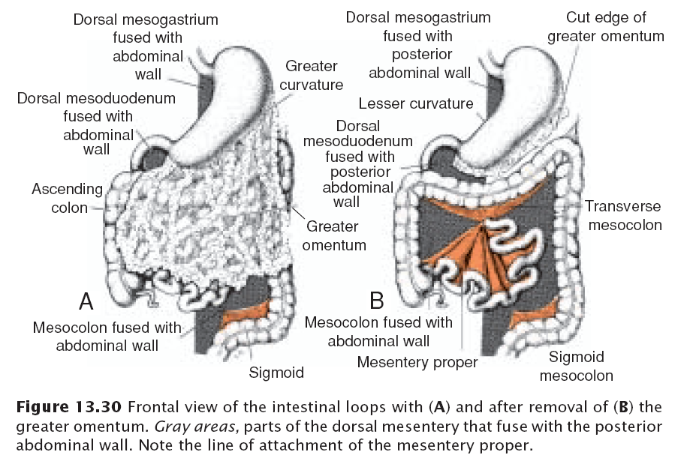
MESENTERIES OF THE INTESTINAL LOOPS
The mesentery of the primary intestinal loop, the mesentery proper, undergoes profound changes with rotation and coiling of the bowel.
When the caudal limb of the loop moves to the right side of the abdominal cavity, the dorsal mesentery twists around the origin of the superior mesenteric artery
Later, when the ascending and descending portions of the colon obtain their definitive positions, their mesenteries press against the peritoneum of the posterior abdominal wall

Slide 10
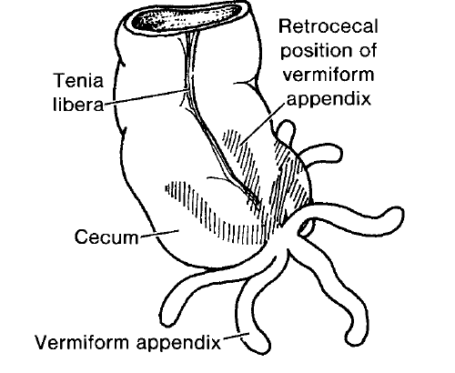
After fusion of these layers, the ascending and descending colons are permanently anchored in a retroperitoneal position.
The appendix, lower end of the cecum, and sigmoid colon, however, retain their free mesenteries
The fate of the transverse mesocolon is different. It fuses with the posterior wall of the greater omentum but maintains its mobility.
Its line of attachment finally extends from the hepatic flexure of the ascending colon to the splenic flexure of the descending colon

Slide 11
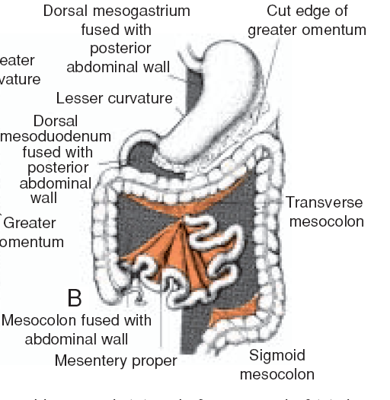
The mesentery of the jejunoileal loops is at first continuous with that of the ascending colon
When the mesentery of the ascending mesocolon fuses with the posterior abdominal wall, the mesentery of the jejunoileal loops obtains a new line of attachment that extends from the area where the duodenum becomes intraperitoneal to the ileocecal junction

Slide 12
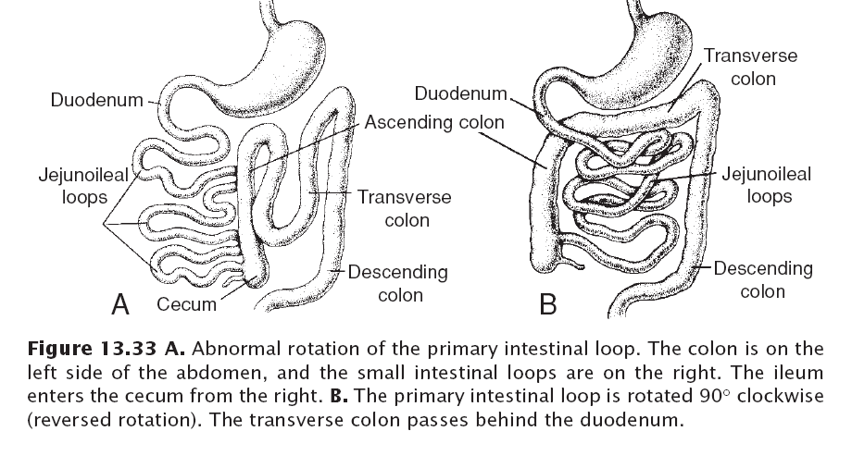
Gut Rotation Defects
Abnormal rotation of the intestinal loop may result in twisting of the intestine (volvulus) and a compromise of the blood supply.
Normally the primary intestinal loop rotates 270◦ counterclockwise. Occasionally, however, rotation amounts to 90◦ only.
When this occurs, the colon and cecum are the first portions of the gut to return from the umbilical cord, and they settle on the left side of the abdominal cavity
The later returning loops then move more and more to the right, resulting in left-sided colon.

Slide 13
Reversed rotation of the intestinal loop occurs when the primary loop rotates 90◦ clockwise
In this abnormality the transverse colon passes behind the duodenum and lies behind the superior mesenteric artery.
Duplications of intestinal loops and cysts may occur anywhere along the length of the gut tube
They are most frequently found in the region of the ileum, where they may vary from a long segment to a small diverticulum.
Symptoms usually occur early in life, and 33% are associated with other defects, such as intestinal atresias, imperforate anus, gastroschisis, and omphalocele

Slide 14
Gut Atresias and Stenoses
Atresias and stenoses may occur anywhere along the intestine
Most occur in the duodenum, fewest occur in the colon, and equal numbers occur in the jejunum and ileum (1/1500 births).
Atresias in the upper duodenum are probably due to a lack of recanalization

Slide 15
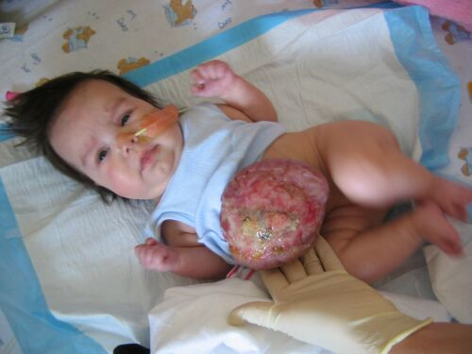
Body Wall Defects
Omphalocele involves herniation of abdominal viscera through an enlarged umbilical ring.
The viscera, are covered by amnion.
The origin of the defect is a failure of the bowel to return to the body cavity from its physiological herniation
Omphalocele occurs in 2.5/10,000 births and is associated with a high rate of mortality (25%) and severe malformations, such as cardiac anomalies (50%) and neural tube defects (40%).
Approximately half of live-born infants with omphalocele have chromosomal abnormalities.

Slide 16
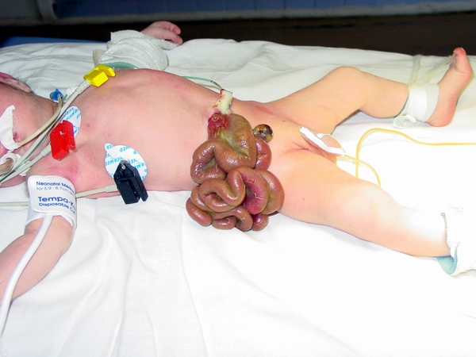
Gastroschisis is a herniation of abdominal contents through the body wall directly into the amniotic cavity.
It occurs lateral to the umbilicus usually on the right

Slide 17
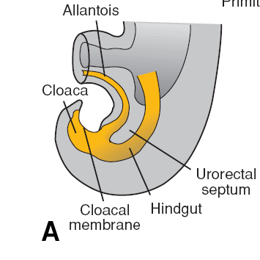
Hindgut
The hindgut gives rise to the distal third of the transverse colon, the descending colon, the sigmoid, the rectum, and the upper part of the anal canal.
The endoderm of the hindgut also forms the internal lining of the bladder and urethra
The terminal portion of the hindgut enters into the posterior region of the cloaca, the primitive anorectal canal; the allantois enters into the anterior portion, the primitive urogenital sinus

Slide 18
The cloaca itself is an endoderm-lined cavity covered at its ventral boundary by surface ectoderm.
This boundary between the endoderm and the ectoderm forms the cloacal membrane
A layer of mesoderm, the urorectal septum, separates the region between the allantois and hindgut.
This septum is derived from the merging of mesoderm covering the yolk sac and surrounding the allantois

Slide 19
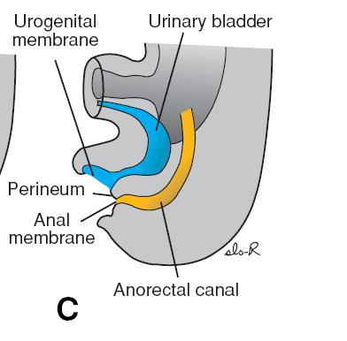
At the end of the seventh week, the cloacal membrane ruptures, creating the anal opening for the hindgut and a ventral opening for the urogenital sinus.
Between the two, the tip of the urorectal septum forms the perineal body
proliferation of ectoderm closes the caudalmost region of the anal canal.
During the ninth week, this region recanalizes
Thus, the caudal part of the anal canal originates in the ectoderm, and it is supplied by the inferior rectal arteries, branches of the internal pudendal arteries

Slide 20
The junction between the endodermal and ectodermal regions of the anal canal is delineated by the pectinate line, just below the anal columns
At this line, the epithelium changes from columnar to stratified squamous epithelium.

Slide 21
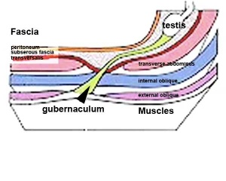
Testis
Toward the end of the second month, the urogenital mesentery attaches the testis and mesonephros to the posterior abdominal wall
Prior to descent of the testis, this band of mesenchyme terminates in the inguinal region between the differentiating internal and external abdominal oblique muscles.
Later, as the testis begins to descend toward the inguinal ring, an extra-abdominal portion of the gubernaculum forms and grows from the inguinal region toward the scrotal swellings.
When the testis passes through the inguinal canal, this extra-abdominal portion contacts the scrotal floor

Slide 22
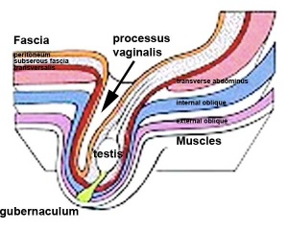
Normally, the testes reach the inguinal region by approximately 12weeks gestation, migrate through the inguinal canal by 28 weeks, and reach the scrotum by 33 weeks
The process is influenced by hormones, including androgens and MIS
Independently from descent of the testis, the peritoneum of the abdominal cavity forms an evagination on each side of the midline into the ventral abdominal wall.
This evagination, the processus vaginalis, follows the course of the gubernaculum testis into the scrotal swellings
Hence the processus vaginalis, accompanied by the muscular and fascial layers of the body wall, evaginates into the scrotal swelling, forming the inguinal canal

