Slide 1
Lecture 4: bioenergetics and metabolism (mitochondria and peroxisomes)
Dr. Mamoun Ahram
Faculty of Medicine
Second year, Second semester, 2014-2014
Principles of Genetics and Molecular Biology

Slide 2
What are the mitochondria?
Mitochondria are thought to have evolved from bacteria via enndosymbiosis.
They play a critical role in the generation of metabolic energy in eukaryotic cells
Generation of ATP from the breakdown of carbohydrates and fatty acids
Most mitochondrial proteins are translated on free cytosolic ribosomes and imported into the organelle.
They contain their own DNA, which encodes tRNAs, rRNAs, and some mitochondrial proteins. Mitochondrial proteins are encoded by their own genomes and nuclear genome.

Slide 3
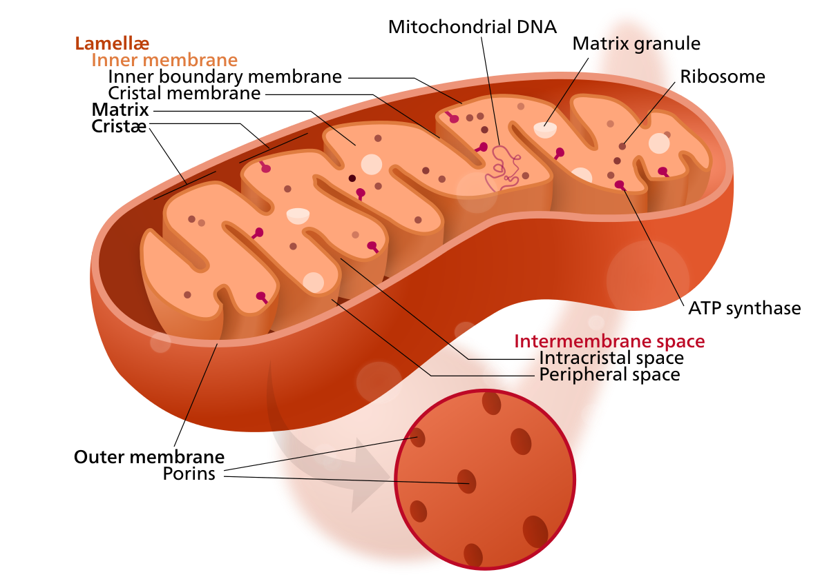

Slide 4
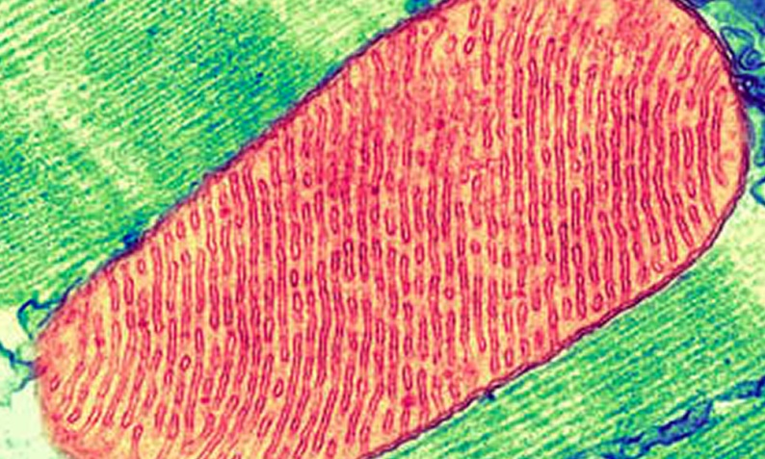
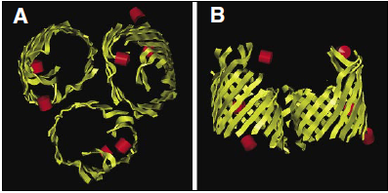
Structure
Outer membrane
permeable to small molecules (~1000 Da) because of porins
Inner membrane
contains a high percentage (>70%) of proteins
Forms folds (cristae) to increase surface area
Function; oxidative phosphorylation, ATP generation, transport of metabolites
impermeable to most ions and small molecules
Intermembrane space
Composition is similar to the cytosol
Matrix
contains the mitochondrial genetic system and the enzymes responsible for the Krebs cycle

Slide 5
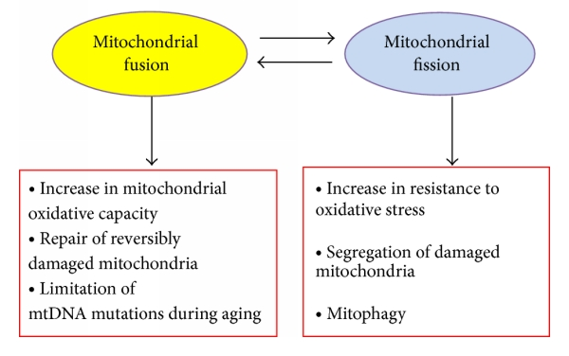
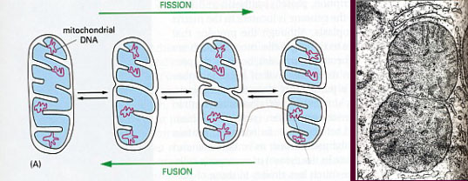
Properties and features
They are located in cells requiring high-energy use such as synapses
They are dynamic (fusion and division)
Exchange genetic material
Regulate authophagy
Cell survival

Slide 6
The Genetic System of Mitochondria
Mitochondrial DNA (~16 Kb) is circular and present in multiple copies per organelle.
It encodes 13 proteins involved in electron transport and oxidative phosphorylation, two rRNAs, and 22 tRNAs.

Slide 7
Mitochondrial proteins
He nuclear genomes encodes for most mitochondrial proteins including those required for DNA replication, transcription, translation, oxidative phosphorylation, and enzymes for mitochondrial metabolism.
The proteins encoded by these genes (more than 95% of mitochondrial proteins) are synthesized on free cytosolic ribosomes and imported into mitochondria as completed polypeptide chains.

Slide 8
Protein Import and Mitochondrial Assembly
Partially folded polypeptide
**
Positively charged
Amphipathic α-helix
Cleavage of presequence by matrix processing peptidase (MPP)

Slide 9
Targeting of inner membrane proteins
Many mitochondrial proteins are multi-pass transmembrane proteins that do not contain presequences, but have multiple internal import signals
They are recognized by mobile chaperones in the intermemebrane space.
These chaperones transfer the protein to a Tim complex.
Inner membrane proteins encoded by mitochondrial genome are inserted via Oxa translocase.

Slide 10
Targeting of outer membrane proteins
Tom complex inserts proteins with α-helical transmembrane domains.
SAM complex inserts β-barrel proteins such as porins.

Slide 11
Mitochondrial phospholipids
Phosphatidylcholine and phosphatidylethanolamine are synthesized in the ER and carried to mitochondria by phospholipid transfer proteins
Phosphatidylserine is synthesized from phosphatidylethanolamine.
The unusual phospholipid, cardiolipin, which contains four fatty acid chains is also synthesized in the mitochondria.
This molecule imprives the efficiency of oxidative phosphorylation by restricting proton flow across the membrane
Cardiolipin

Slide 12
Mitochondrial diseases

Slide 13
General information
A fertilized human egg carries 2000 copies of the human mitochondrial genome, all but one or two inherited from the mother.
A human in whom all of these mitochondrial genomes carried a deleterious mutation would generally not survive.
But some mothers carry a mixed population of both mutant and normal mitochondrial genomes.
Their daughters and sons inherit this mixture of normal and mutant mitochondrial DNAs and are healthy.

Slide 14
General information
In cases of mitochondrial defects, muscle and nervous tissues are most at risk, because of their need for particularly large amounts of ATP
Mitochondria diseases can be classified according to their cause: genetic or biochemical

Slide 15
The biochemical classification of mitochondrial diseases

Slide 16
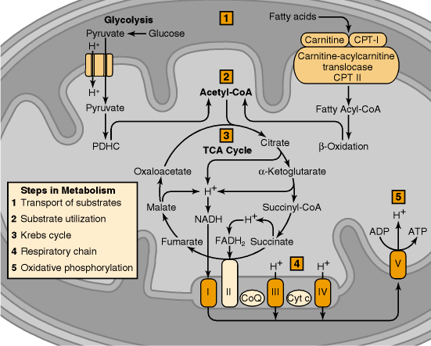

Slide 17
Defects of mitochondrial transport
interfere with the movement of molecules across the inner mitochondrial membrane, which is tightly regulated by specific translocation systems.

Slide 18
Substrate utilization
Pyruvate dehydrogenase (PDH) deficiency can cause alterations of pyruvate metabolism.
The PDH complex (PDHC) catalyzes the irreversible conversion of pyruvate to acetyl-CoA.
The most devastating phenotype of PDH deficiency presents in the newborn period.
The majority of patients are male with severe metabolic acidosis, elevated lactate in blood or CSF, and associated elevations of pyruvate and alanine.

Slide 19
Defects of the Krebs cycle
Fumarase deficiency is reported with patients having mitochondrial encephalomyopathy.
The enzyme defect has been found in muscle and liver.
Features: excretion of large amounts of fumaric acid and, to a lesser extent, succinic acid in the urine.

Slide 20
Abnormalities of the respiratory chain reaction
Defect in any of the 4 electron chain complexes have been reported

Slide 21
Defects of oxidation-phosphorylation coupling
The best known example of such a defect is Luft's disease, or nonthyroidal hypermetabolism.
Oxidative phosphorylation is at maximal rate even in the absence of ADP, an indication that respiratory control is lost.
Respiration proceeds at a high rate independently of phosphorylation, and energy is lost as heat, causing hypermetabolism and hyperthermia.

Slide 22
The genetic classification of mitochondrial diseases

Slide 23
Defects of mitochondrial DNA (mtDNA)
These disorders are associated with dysfunction of the respiratory chain because all 13 subunits encoded by mtDNA are subunits of respiratory chain complexes.
Diseases due to point mutations are transmitted by maternal inheritance.

Slide 24
MERRF and others
One main syndrome is myoclonic epilepsy and ragged red fiber disease (MERRF), which can be caused by a mutation in one of the mitochondrial transfer RNA genes required for synthesis of the mitochondrial proteins responsible for electron transport and production of ATP.
Other syndromes include
lactic acidosis and stroke-like episodes (MELAS)
Leber's hereditary optic neuropathy (LHON),
neurogenic atrophy, ataxia and retinitis pigmentosa (NARP)

Slide 25
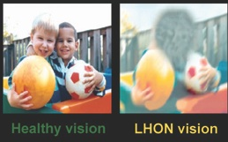
Leber's hereditary optic neuropathy (LHON)
Females (10%) are affected less frequently than males (50%), but males never transmit LHON to their offspring and not all individuals with mutations develop the disease.
Inheritance is mitochondrial (cytoplasmic) not nuclear.
The mutations reduce the efficiency of oxidative phosphorylation and ATP generation.
A rare inherited disease that results in blindness because of degeneration of the optic nerve.
Vision loss is only manifestation, occurs between 15-35

Slide 26
Mutations causing LHON
50% is a histidine-to-arginine mutation in a subunit of complex I of the electron transport chain (NADH dehydrogenase)
30% is due to two mutations in other subunits of complex I or a mutation in cyochrome b (a component of complex III)
A fifth mutation affectsing a complex I subunit can cause either LHON or muscular disorders.
Since the central nervous system (including the brain and optic nerve) is most highly dependent on oxidative metabolism, blindness is the main manifestation.
The low incidence of disease among carriers of LHON mutations is because each cell contains thousands of copies of mitochondrial DNA, which can be present in mixtures of mutant and normal mitochondria.

Slide 27
Defects of nuclear DNA
The vast majority of mitochondrial proteins are encoded by nuclear DNA.
All areas of mitochondrial metabolism can be affected.
The nuclear DNA controls many functions of the mitochondria DNA, including mitochondrial replication.
Mutations of nuclear genes controlling these functions could cause alterations in the mitochondria DNA.

Slide 28
Peroxisomes

Slide 29
Structural features of peroxisomes
Small, membrane-enclosed organelles
They contain enzymes involved in a variety of metabolic reactions, including several aspects of energy metabolism.
They replicate by division.
Most human cells contain 500 peroxisomes.

Slide 30
Peroxins
Peroxisomal proteins are called peroxins.
They are 85 genes that encode peroxins, most of which are metabolic enzymes.
Internal proteins are synthesized on free ribosomes and then imported into peroxisomes.
Other membrane proteins act as receptors for the import of internal proteins.

Slide 31
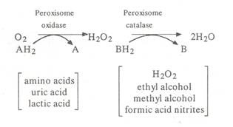
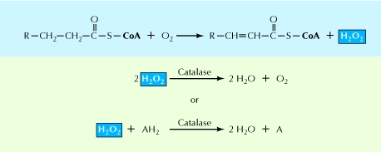
Function of peroxisomes
Peroxisomes carry out oxidation reactions leading to the production of hydrogen peroxide.
Because hydrogen peroxide is harmful to the cell, peroxisomes also contain the enzyme catalase.
Substrates like uric acid, amino acids, and fatty acids are broken down by oxidative reactions in peroxisomes.
fatty acids are oxidized in both peroxisomes and mitochondria.

Slide 32
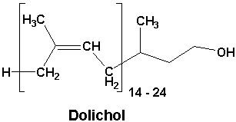
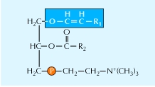
Synthesis in peroxisomes
Cholesterol
Dolichol
made from farnesyl
Bile acids (liver)
Plasmalogens
important in membranes of heart and brain

Slide 33
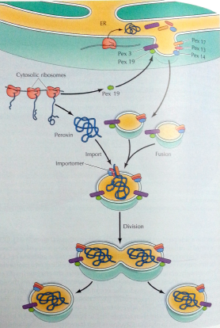
The protein pex3 recruits pex9 to initiate budding of peroxisome from ER.
The new peroxisome fuses with a new or an older one.
Membrane proteins act as receptors for the import of internal proteins.
Internal proteins are targeted mostly by peroxisome targeting signal 1 (PTS1) or PTS2.
These signals are recognized by cytosolic receptors and proteins are imported via a channel (importomer).

Slide 34
Peroxisome maturation and division
Different proteins are added at different times producing different peroxisomes

Slide 35
Peroxisomal diseases
Single peroxisomal enzyme deficiencies
Defective specific peroxisomal enzymes
Peroxisomal biogenesis disorders (PBDs).
Mutations of PEX genes leading to deficiencies of multiple peroxisomal enzymes
Example: Zellweger syndrome
Lethal
Due to mutations in at least 10 genes such as the receptor of PTS1
X-linked adrenoleukodystrophy (XALD).
Defective transport of very long chain fatty acid (VLCFA) across the peroxisomal membrane.

