Slide 1
Functional Gastrointestinal Disorders (FGIDs)
Eyad Swaity, MD
American Board, MRCP GI
Senior Gastroenterology & Hepatology Specialist
Division of Gastroenterology - Jordan University Hospital

Slide 2
General Definition
A functional disorder is:
A medical condition that impairs the normal function of a bodily process, but where every part of the body looks completely normal under examination, dissection or even under a microscope.

Slide 3
Definition of FGIDs
The term "functional" is generally applied to disorders where the body's normal activities are impaired in terms of the:
•Movement of intestine
•Sensitivity of nerves of the intestine
•The way in which the brain controls some of these functions.
While,
there are no structural abnormalities that can be seen by endoscopy, x-ray, or blood tests.

Slide 4
Prevalence
Functional GI & motility disorders,
Are the MOST COMMON GI DISORDERS in the general population.

Slide 5
About 1 in 4 people in the U.S. have one of these disorders.

Slide 6
Account for about 40% of GI problems seen by doctors.

Slide 7
Criteria
The Rome diagnostic criteria categorize the functional gastrointestinal disorders and define symptom based diagnostic criteria for each category.

Slide 8
Esophageal disorders
Globus

Slide 9
Esophageal disorders
Globus:
A sensation of a lump, something stuck, or a tightness in the throat.

Slide 10
Esophageal disorders
Functional chest pain

Slide 11
Esophageal disorders
Functional chest pain:
The feeling of chest pain, presumably of esophageal origin.
↓(Can be confused w/cardiac chest pain which must be R/Oed 1st)

Slide 12
Esophageal disorders
Functional heartburn

Slide 13
Esophageal disorders
Functional heartburn:
Persistent burning sensation in the absence of gastroesophageal reflux disease (GERD), a motility disorder, or a structural explanation.

Slide 14
Esophageal disorders
Functional dysphagia

Slide 15
Esophageal disorders
Functional dysphagia:
The sensation of difficulty swallowing.

Slide 16
Esophageal disorders
Reflux hypersensitivity

Slide 17
Workup

Slide 18
Alarm Symptoms
Age ≥ 50
Typical Symps ≥ 5yr
Dysphagia
Odynophagia
Persistent Vomiting
GI Bleed / ⊕FOB
Fe Def Anemia
↓Wt
LNs Or Palpable Mass,
FHx of UGI Ca
Poor ttt Response
Chest Pain

Slide 19
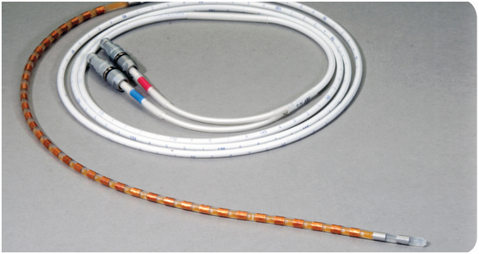

Slide 25
Esophageal Disorder
Alarm Symptoms
NO Alarm Symptoms
Chest
Pain
PPI trial for 4 to 8 weeks
-
EGD
±
Bx
-
R/O Angina
-
Dysphagia
No Dysphagia
-
Manometry
24 pH

Slide 26
Gastro-Duodenal disorders
Functional Dyspepsia

Slide 27
Functional Dyspepsia
AKA: Non Ulcer Dyspepsia (NUD)
Dyspepsia in General population (15% (Up to 25%))
Commonest Æ of Dyspepsia (60%)
Occurrence w/IBS (30%)

Slide 28
Alarm Symptoms
(+NSAIDS use in UK)
Dyspepsia w/Age (>55)
Dysphagia / Odynophagia
Persistent vomiting
Anorexia / unexplained ↓Wt
Hematemesis / Melena
unexplained anemia or Iron def
Palpable Epigastric Mass/LN
Jaundice
Hx of Gastric Sx / PUD
FHx of UGI Ca

Slide 29
Functional Dyspepsia
Definition: (Rome III)
(Onset: ≥ 6Ms + Duration: ≥ 3Ms): ≥ 1 of:
•Postprandial fullness •Early satiety
•Epigastric pain • Epigastric burning
+
No evidence of structural D/O (N. EGD)
± Gastric Scintigraphy
+
No evidence that dyspepsia exclusively relieved by defecation or is assoc w/the onset of change in stool frequency or form

Slide 30
Functional Dyspepsia
Dysmotility
Delayed gastric emptying
↓gastric compliance
Visceral sensitivity
N. gastric compliance, gastric distension → pain 2ry to <N. threshold for pain
Duodenum
(if w/up ⊖): Pts w/Psych D/Os more prone to suffer from functional dyspepsia
Psychological factors
Infection
Accelerated gastric emptying
duodenal hypersensitivity to lipids or acid
H. Pylori
Gastroenteritis
Pathophysiology

Slide 31
Sub-Types
>87% <10%
Center for Functional GI & Motility Disorders, University of North Carolina, Chapel Hill
Postprandial Distress
Syndrome
(PDS)
❑
Meal related symp: Fullness & Early satiety
❑
± response to
Prokinetics
Epigastric Pain
Syndrome
(EPS)
❑
Meal unrelated symp:
Epigastric Pain & Burning
❑
± response to
PPI

Slide 32
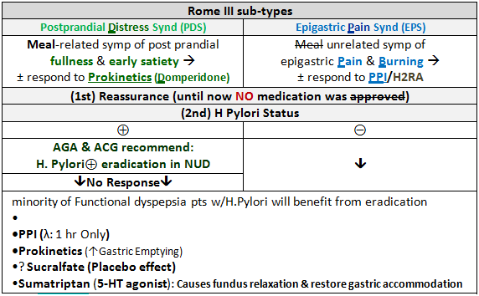
Management
Antidepressants

Slide 33
Other Gastro-Duodenal D/Os
Cyclic Vomiting Synd (CVS):
Rome III Criteria: •stereotypical (Onset/Duration) episodes of N&V last <1wk + ≥ 3 episodes/yr + •completely asymptomatic between episodes. ≈no other Dx ± Hx/FHx of migraine. ttt: Tri-Cyclic Antidepressants.
Rumination Synd: effortless controlled Vomiting, (w/o Nausea), non-Acidic, reswallowing/spitting. ttt: Behavioral: diaphragmatic breathing

Slide 34
Bowel disorders
Irritable Bowel Syndrome (IBS)

Slide 35
Alarm Symptoms
Age>50
↓Wt
Rectal Bleeding
Recent Change In Bowel Habits X6 Wks
(Change In Stool Caliber / Frequency / Consistency)
Nocturnal Symptoms
FHx Of GI Ca
FHx Of IBD
Significant Unexplained Hematological (Anemia) / Biochemical Abnormalities
P/E Findings (Abd Mass / Rectal Mass)

Slide 36
Irritable Bowel Syndrome (IBS)
Rome III Criteria:
Recurrent abd pain/discomfort for
≥3 ds/M x ≥3 Ms since 6Ms, associated w/: ≥2 of:
•Improvement with defecation
•Onset associated with a change in stool frequency
•Onset associated with a change in stool form or appearance
Rome II Criteria: + Mucus per rectum
Criteria must have been fulfilled for the past 3 Ms, with symptom onset ≥ 6 Ms before diagnosis

Slide 37
Irritable Bowel Syndrome (IBS)
Etiology: (?)
Food Intolerance:
↑↑Mast Cells + Food Ag → Food intolerance → IBS
Post infectious GE IBS:
•(P-P): post-infection ↑Permeability & persistent inflammation
•Risk factors for Post infectious GE IBS (10%):
↑Duration of infection (the strongest factor)
↑w/↑severity of infection
Cramping w/initial infection
F
Psych D/Os
↓ Age (IBS↓ w/↑Age)

Slide 38
Irritable Bowel Syndrome (IBS)
Constipation-predominant IBS (C-IBS) | Diarrhea-predominant IBS (D-IBS)
Slow colonic transit (only 25%). Majority w/N. colonic transit | •Rapid colonic transit (45%) •↓TI production of Fibroblast Growth Factor 19 (FGF-19) which ⊖ Bile Acid reuptake→ ↑Bile Acid reaching colon → Cholerheic diarrhea (25%) •possible association w/SIBO (10% imp w/Rifaximin (Yet, Rifaximin use should be limited to pts w/confirmed SIBO). •↑Fat in diet •↑FODMAPs in diet •↑mucosal permeability & ↑number of enteroendocrine cells containing serotonin

Slide 39
Irritable Bowel Syndrome (IBS)
A Diagnosis of exclusion:
•CBC N.
•CRP N. (<10)
•ESR N. (M<20/F<30)
•tTG ⊖
•±: TSH, Stool Routine

Slide 40
Irritable Bowel Syndrome (IBS)
FODMAPs
Fermentable
Oligo-
Di-
Mono-saccharides
And
Polyols

Slide 41
Irritable Bowel Syndrome (IBS)
Management:
1st step
(1)(Defining & eliminating food-related stimuli):
• Restriction of osmotic, rapidly fermentable, poorly absorbed carbs: FODMAPs → significantly ↓symptoms in IBS
•Gluten causes GI symptoms in IBS
(even w/out celiac disease)
(2) Behavioral ttt:
Deal w/specific patient concerns or fears regarding their symptoms → improve pt sense of global well being
(3) Deal w/psychosocial stressors

Slide 42
Irritable Bowel Syndrome (IBS)
Management:
2nd step (Symptoms directed)
Abdominal pain:
•Spasmolytics: Anticholinergics/Peppermint Oil→
•low-dose Tri-cyclic antidepressants
•SSRIs (Sertalin may cause diarrhea)

Slide 43
Irritable Bowel Syndrome (IBS)
Management:
2nd step (Symptoms directed)
Bloating:
Pro-Biotics (Bifidobacteria) ± Simethicon/Dimethicon

Slide 44
Irritable Bowel Syndrome (IBS)
Management:
2nd step (Symptoms directed)
Constipation :
1) ↑Fibers

2) Laxatives:
±
3)Stimulant Laxative

Slide 45
Irritable Bowel Syndrome (IBS)
Management:
2nd step (Symptoms directed)
Diarrhea:
1) Bulk forming Agents (Psyllium)/Rice (low FODMAP)
(Avoid ↑FODMAP: Beans, Apple, Cabbage, wheat)
2) Opioids: Loperamide Diphenoxylate

