Slide 1
The Forearm 2

Slide 2
Contents of the Lateral Fascial Compartment of the Forearm
The lateral fascial compartment may be regarded as part of the posterior fascial compartment
Muscles: Brachioradialis and extensor carpi radialis longus
Blood supply: Radial and brachial arteries
Nerve supply to the muscles: Radial nerve

Slide 3
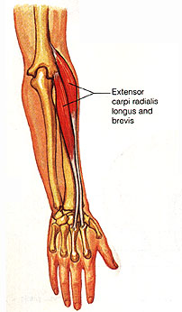
Muscles of the Lateral Fascial Compartment of the Forearm
1. Brachioradialis is ant to elbow joint, acts as an accessory flexor of this joint.
2. Extensor carpi radialis longus
A:Extends and abducts wrist
Origin
Both of them originates from the Lateral supracondylar ridge of humerus
Insertion
Brachioradialis Base of styloid process of radius
Extensor carpi radialis longus Posterior surface of base of second metacarpal bone
Nerve Supply:
Radial nerve before it divides into superficial and deep branches
The arterial supply is derived from branches of the radial and brachial arteries

Slide 4
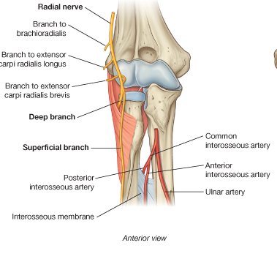
Radial Nerve
The radial nerve pierces the lateral intermuscular septum in the lower part of the arm and passes forward into the cubital fossa
It then passes downward in front of the lateral epicondyle of the humerus, lying between the brachialis on the medial side and the brachioradialis and extensor carpi radialis longus on the lateral side
At the level of the lateral epicondyle, it divides into superficial and deep branches

Slide 5
Branches
Muscular branches to the brachioradialis, to the extensor carpi radialis longus, and a small branch to the lateral part of the brachialis muscle
Articular branches to the elbow joint
Deep branch of the radial nerve. This winds around the neck of the radius, within the supinator muscle and enters the posterior compartment of the forearm
Superficial branch of the radial nerve

Slide 6
Superficial Branch of the Radial Nerve
The superficial branch of the radial nerve is the direct continuation of the nerve after its main stem has given off its deep branch in front of the lateral epicondyle of the humerus
It runs down under cover of the brachioradialis muscle on the lateral side of the radial artery
In the distal part of the forearm, it leaves the artery and passes backward under the tendon of the brachioradialis
It reaches the posterior surface of the wrist, where it divides into terminal branches that supply the skin on the lateral two thirds of the posterior surface of the hand
and the posterior surface over the proximal phalanges of the lateral three and a half fingers.
The area of skin supplied by the nerve on the dorsum of the hand is variable

Slide 7
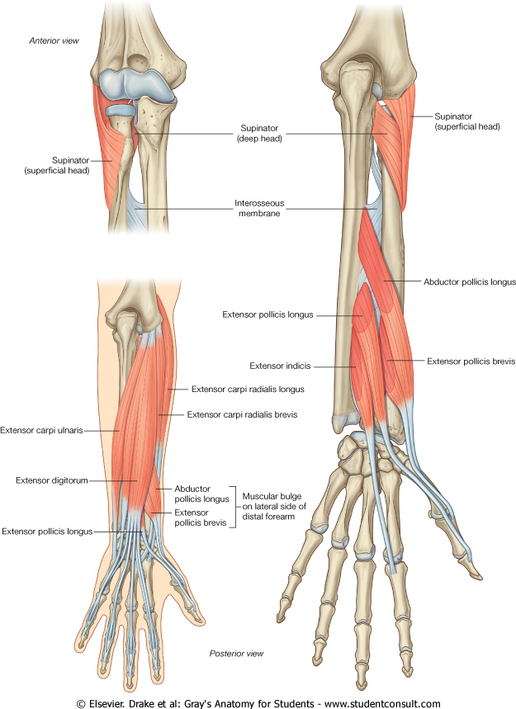
Contents of the Posterior Fascial Compartment of the Forearm
Muscles:
The superficial group includes the
extensor carpi radialis brevis,
extensor digitorum,
extensor digiti minimi,
extensor carpi ulnaris,
and anconeus.
These muscles possess a common tendon of origin, which is attached to the lateral epicondyle of the humerus
The deep group includes
the supinator,
abductor pollicis longus,
extensor pollicis brevis,
extensor pollicis longus,
and extensor indicis.
Blood supply: Posterior and anterior interosseous arteries
Nerve supply to the muscles: Deep branch of the radial nerve (posterior interosseous nerve).

Slide 8
EXTENSOR CARPI RADIALIS BREVIS
O:Lateral epicondyle of humerus.
Radial collaeral lig of elbow
I: Dorsal surfaces of bases of 2nd and 3rd metacarpals .
Lies deep to extensor carpi radialis longus.
A:Extends and abducts wrist.
NS: Posterior interosseous nerve.

Slide 9
EXTENSOR DIGITORUM
O: Lateral epicondyle of humerus
Forms four tendons, each passes into a finger
I: Base of dorsal surfaces of middle and distal phalanges.
A:Extends all joints of hand
NS: Posterior interosseous nerve.

Slide 10
EXTENSOR DIGITI MINIMI
An accessory extensor of little finger, medial to extensor digitorum .
O: Lateral epicondyle of humerus
I: Dorsal digital expansion of little finger along with the tendon of extensor digitorum.
A:Extends MCP &IP joints of little finger
NS: Posterior interosseous nerve

Slide 11
EXTENSOR CARPI ULNARIS
Lies medial to the extensor digiti minimi
O: Lateral epicondyle of the humerus
Posterior border of ulna by an aponeurosis
I: Medial side of the base of 5th metacarpal .
A: Extends and adducts the wrist
NS: Posterior interosseous nerve

Slide 12
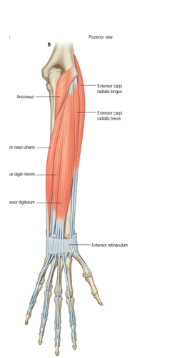
ANCONEUS
Small triangular muscle behind the cubital joint.
O:Post surface of lat epicondyle of humerus.
I: Lat aspect of Olecranon
Proximal 1/4th of post surface of ulna.
A: Weak extensor of elbow
NS: Radial Nerve

Slide 13
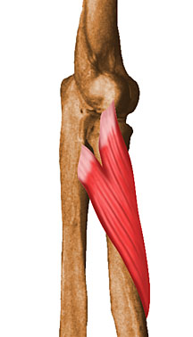
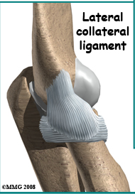
SUPINATOR
Two heads
O: Superficial head: lat epicondyle of humerus, radial collateral lig of elbow
annular lig,
Deep head : supinator crest of ulna,post part of triangular area in front of it
I: Lat surface of prox 1/3 of radius
A: Supinates the forearm and hand
NS: Posterior interroseous nerve.

Slide 14
EXTENSOR CARPI RADIALIS BREVIS
O:Lateral epicondyle of humerus.
Radial collaeral lig of elbow
I: Dorsal surfaces of bases of 2nd and 3rd metacarpals .
Lies deep to extensor carpi radialis longus.
A:Extends and abducts wrist.
NS: Posterior interosseous nerve.

Slide 15
EXTENSOR DIGITORUM
O: Lateral epicondyle of humerus
Forms four tendons, each passes into a finger
I: Base of dorsal surfaces of middle and distal phalanges.
A:Extends all joints of hand
NS: Posterior interosseous nerve.

Slide 16
EXTENSOR DIGITI MINIMI
An accessory extensor of little finger, medial to extensor digitorum .
O: Lateral epicondyle of humerus
I: Dorsal digital expansion of little finger along with the tendon of extensor digitorum.
A:Extends MCP &IP joints of little finger
NS: Posterior interosseous nerve

Slide 17
EXTENSOR CARPI ULNARIS
Lies medial to the extensor digiti minimi
O: Lateral epicondyle of the humerus
Posterior border of ulna by an aponeurosis
I: Medial side of the base of 5th metacarpal .
A: Extends and adducts the wrist
NS: Posterior interosseous nerve

Slide 18
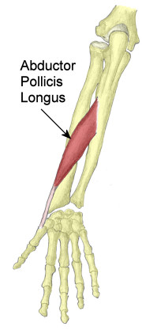
ABDUCTOR POLLICIS LONGUS
O: Prox post surfaces of the radius and ulna, interosseous memb.
I: Radial side of base of 1st metacarpal .
Trapezium
A: Abd and ext of thumb at carpometacarpal joint
NS: Posterior interroseous nerve

Slide 19
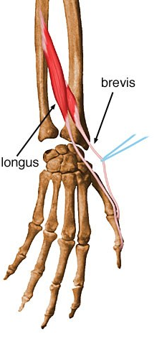
EXTENSOR POLLICIS BREVIS
O: Post surface of radius, interosseous memb.
I:Dorsal surface of base
of prox phalanx of thumb.
A:Extends prox phalanx and metacarpal of thumb.
NS: Posterior interroseous nerve.

Slide 20
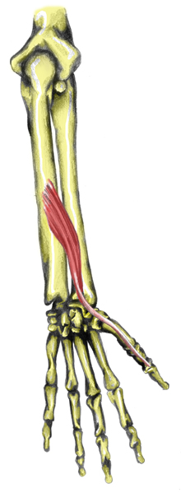
EXTENSOR POLLICIS LONGUS
O: Posterior surface of ulna
interosseous memb.
I:Dorsal surface of distal phalanx of the thumb
A:Extends all joints of the thumb
NS: Posterior interosseous nerve.

Slide 21
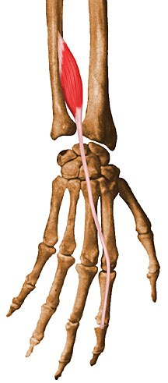
EXTENSOR INDICES
O: Posterior surface of ulna distal to extensor pollicis longus, interosseous memb .
I:Ulnar side of tendon of extensor digitorum for index finger.
A:Extension of Index finger.
NS: Posterior interosseous nerve

Slide 23
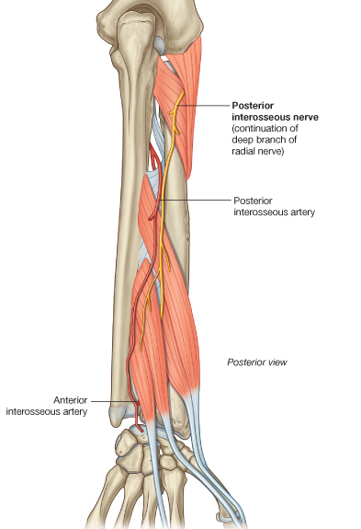
Arteries of the Posterior Fascial Compartment of the Forearm
The anterior and posterior interosseous arteries arise from the common interosseous artery, a branch of the ulnar artery
They pass downward on the anterior and posterior surfaces of the interosseous membrane, respectively, and supply the adjoining muscles and bones.
They end by taking part in the anastomosis around the wrist joint.

Slide 24
Deep Branch of the Radial Nerve
The deep branch arises from the radial nerve in front of the lateral epicondyle of the humerus in the cubital fossa
pierces the supinator and winds around the lateral aspect of the neck of the radius in the substance of the muscle to reach the posterior compartment of the forearm.
The nerve descends in the interval between the superficial and deep groups of muscles
It eventually reaches the posterior surface of the wrist joint.
Branches :
Muscular branches
Articular branches to the wrist and carpal joints

Slide 25
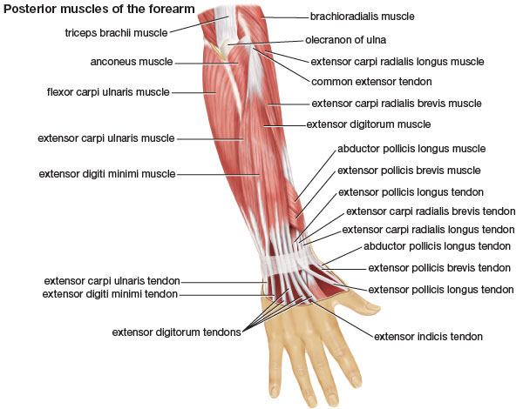
Extensor Retinaculum
The extensor retinaculum is a thickening of deep fascia that stretches across the back of the wrist and holds the long extensor tendons in position
converts the grooves on the posterior surface of the distal ends of the radius and ulna into six separate tunnels for the passage of the long extensor tendons
Each tunnel is lined with a synovial sheath, which extends above and below the retinaculum on the tendons
The tunnels are separated from one another by fibrous septa that pass from the deep surface of the retinaculum to the bones
The retinaculum is attached medially to the pisiform bone and the hook of the hamate and laterally to the distal end of the radius
The upper and lower borders of the retinaculum are continuous with the deep fascia of the forearm and hand, respectively.

Slide 26
Carpal Tunnel
The bones of the hand and the flexor retinaculum form the carpal tunnel
The median nerve lies in a restricted space between the tendons of the flexor digitorum superficialis and the flexor carpi radialis muscles

Slide 27
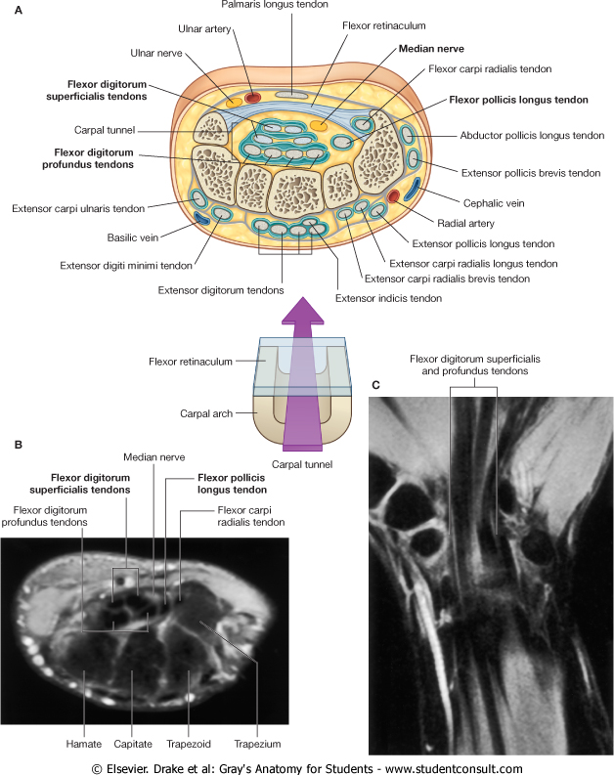
Structures on the Anterior Aspect of the Wrist
The following structures pass superficial to the flexor retinaculum from medial to lateral
Flexor carpi ulnaris tendon, ending on the pisiform bone
Ulnar nerve lies lateral to the pisiform bone.
Ulnar artery lies lateral to the ulnar nerve.
Palmar cutaneous branch of the ulnar nerve
Palmaris longus tendon (if present), passing to its insertion into the flexor retinaculum and the palmar aponeurosis
Palmar cutaneous branch of the median nerve

Slide 28
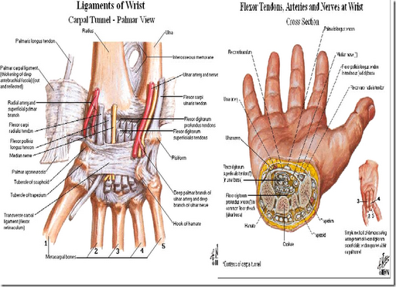
The following structures pass beneath the flexor retinaculum from medial to lateral
Flexor digitorum superficialis tendons and, posterior to these, the tendons of the flexor digitorum profundus; both groups of tendons share a common synovial sheath.
Median nerve
Flexor pollicis longus tendon surrounded by a synovial sheath
Flexor carpi radialis tendon going through a split in the flexor retinaculum. The tendon is surrounded by a synovial sheath.

Slide 29
Structures on the Posterior Aspect of the Wrist
The following structures pass superficial to the extensor retinaculum from medial to lateral
Dorsal (posterior) cutaneous branch of the ulnar nerve
Basilic vein
Cephalic vein
Superficial branch of the radial nerve

Slide 30
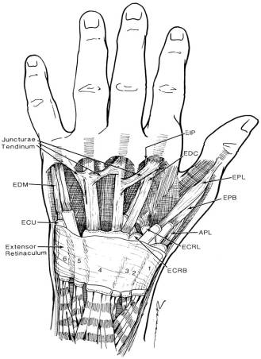
Beneath the extensor retinaculum, fibrous septa pass to the underlying radius and ulna and form six compartments that contain the tendons of the extensor muscles
Each compartment is provided with a synovial sheath, which extends above and below the retinaculum
The following structures pass beneath the extensor retinaculum from medial to lateral
1. Extensor carpi ulnaris tendon which grooves the posterior aspect of the head of the ulna (num 6 on the figure)
2. Extensor digiti minimi tendon situated posterior to the distal radioulnar joint.
3. Extensor digitorum and extensor indicis tendons share a common synovial sheath and are situated on the lateral part of the posterior surface of the radius.
4. Extensor pollicis longus tendon winds around the medial side of the dorsal tubercle of the radius.

Slide 31
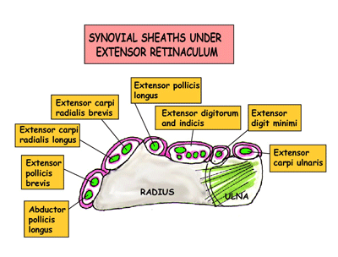
5. Extensor carpi radialis longus and brevis tendons share a common synovial sheath and are situated on the lateral part of the posterior surface of the radius.
6. Abductor pollicis longus and the extensor pollicis brevis tendons have separate synovial sheaths but share a common compartment.
The radial artery reaches the back of the hand by passing between the lateral collateral ligament of the wrist joint and the tendons of the abductor pollicis longus and extensor pollicis brevis

Slide 32
EXTENSOR RETINACULUM
Starting from lateral side.
COMPARTMENT STRUCTURES
I Abductor pollicis longus
Extensor pollicis brevis
II Extensor carpi radialis longus
Extensor carpi radialis brevis
III Extensor pollicis longus.
IV Extensor digitorium
Extensor indicis
Post interrosseous nerve
Ant interrosseous artery
V Extensor digiti minimi.
VI Extensor carpi ulnaris

