Slide 1
Fluid Management and Blood Transfusion
Dr. Ahmed Shahin M.D

Slide 2
Outline
Body Fluid Compartements
Body Fluid Composition, Estimated Blood Volume, Allowable Blood Loss
Osmolality and Tonicity
Daily Intake and Output
Types of Fluid
Blood Transfusion

Slide 3
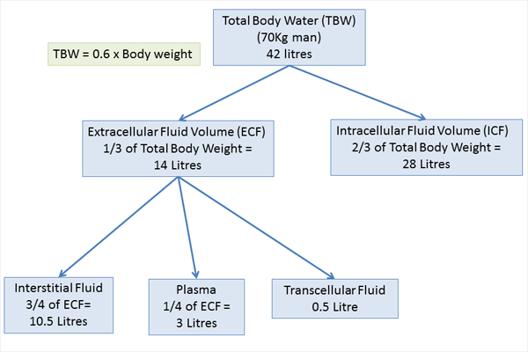
Body Fluid Compartments
TBW: 55-60% of the BW in men and 45-50% in young women

Slide 4
Body Fluid Composition in Age Groups
AGE TBW AS % OF
TOTAL BODY WEIGHT
Neonate 80
6 months 70
1 year 60
Young adult 60
Elderly 50

Slide 5
Composition of Body Fluid Compartments
Ion Plasma (mmol/L) ICF (mmol/L)
Na+ 143 9
K+ 5 135
Ca2+ 1.3 <0.8
Mg2+ 0.9 25
Cl- 103 9
HCO3- 24 9
HPO42- 0.4 74
Sulphate- 0.4 19
Proteinate- 1.14 64

Slide 6
ESSENTIAL PRINCIPLES

Slide 7
Solvents, solutes, and solutions
Mixture, Solution, solvent, solute.
Osmole, mosmole, mole

Slide 8
Osmolarity and Osmolality
These are ways of quantifying how much of a solute is dissolved in a solution.
• Osmola(R)ity No. of osmoles of solute particles per unit VOLUME of solution and has units osmoles/litre. In the body we use milliosmole
• Osmola(L)ity No. of osmoles of solute particles per unit WEIGHT of solvent and has units osmoles/kilogram.

Slide 9
Plasma Osmolality
Plasma osmolality = 2 (Na + K) + glucose + urea
= 2 (137 + 4.0) + 5.0 + 4
= 291 mosmol/kg H20
Glu: /18
Urea: /2.8

Slide 10
Tonicity
A way of describing the relative solute concentrations of two solutions which are separated by a selectively-permeable membrane (often called a semi-permeable membrane).

Slide 12
In clinical practice the tonicity of fluid administered intravenously is described relative to the tonicity of the internal environment of the red blood cell and with reference to the red blood cell membrane.

Slide 13
WHAT IS THE ‘NORMAL’ DAILY INTAKE AND OUTPUT OF FLUID AND ELECTROLYTES?

Slide 14
OUTPUT, INTAKE
Input: Oral, Enteral, Intravenous
Output: ‘Sensible’: that it is easily seen and measured e.g. urine output and loses from the gastrointestinal tract.
‘Insensible’: not seen and not easy to quantify e.g. sweat, and water vapor in exhaled gases.

Slide 15
 | OUTPUT
1500 ml | Urine
200 ml | Gastrointestinal(faeces)
400 ml | Skin(sweat)
400 ml | Respiratory
2500 | Total
 | INTAKE
1500 ml | Drinking
750 ml | Eating
250 ml | Metabolism
2500 | Total

Slide 16
The above volumes do not contain just water but also electrolytes….

Slide 17
75 Kg PERSON PER DAY | DAILY LOSS / REQUIREME NT | ELECTROLYTE
75 - 112.5 mmol | 1-1.5 mmol/kg | Sodium
75 – 112.5 mmol | 1-1.5 mmol/kg | Potassium
7.5 – 15 mmol | 0.1-0.2 mmol/kg | Magnesium
7.5 – 15 mmol | 0.1-0.2 mmol/kg | Calcium
5.25 – 16.5 mmol | 0.07-0.22 mmol/kg | Chloride
1500 – 3000 mmol | 20-40 mmol/kg | Phosphate

Slide 18
Maintenance and Deficit
Maintenance vs deficit
Rule of 4 /2/ 1
Ex. 70 kg patient
1st 10 kg: 10 kg * 4 ml = 40 ml / kg
2nd 10 kg: 10 kg * 2 ml = 20 ml / kg
3rd 10 kg: 50 kg * 1 ml = 50 ml / kg Total=110ml/kg
Ex. Fasting for 10 hr without any intake: 10*110= 1100ml

Slide 19
Estimated Blood Volume (EBV)
Men 75 ml / kg
Women 65 ml / kg
Infants 80 ml / kg
Neonates 85 ml / kg
Premature Neonates 96 ml / kg

Slide 20
Allowable Blood Loss (ABL)
EBV = weight (kg) * Average blood volume
Allowable Blood Loss = [EBV*(Hi-Hf)]/Hi
Where:
EBV=Estimated Blood Volume
Hi= initial hemoglobin (Hct)
Hf= final hemoglobin (Hct)
Normal Hct Values
Men 42-52%
Women 37-47%

Slide 21
Example
Q: Before surgery is to take place, what is the EBV of a female patient weighing 50 kg? Also, what is the ABL of this patient if her Hct is 45?
EBV = 50kg x 65 = 3250, The final lowest acceptable Hct (Hf) = 30%
(3250 x (45 – 30))/45 = 1083 Using this rough estimate, the patient in this example could loose 1083 mL of blood without needing a transfusion.
Replacing Blood Loss
“Ideally, blood loss should be replaced with crystalloid or colloid solutions to maintain intravascular volume (normovolemia) until the danger of anemia outweighs the risks of transfusion. For most patients, that point corresponds to a hemoglobin between 7 and 10 g/dL (or a hematocrit of 21-30%). Below a hemoglobin concentration of 7 g/dL, the resting cardiac output has to increase greatly to maintain normal oxygen delivery”

Slide 22
Intravenous Fluids

Slide 23
Types
Three main types
Crystalloids
Colloids
Blood products

Slide 25
Solutions that contain a combination of water and electrolytes.
Divided into "balanced" salt solutions (e.g. Ringer's lactate) and hypotonic solutions (e.g. D5W).

Slide 26
Classified into three groups based on their predominant use
Replacement Solutions
Maintenance Solutions
Special Solutions

Slide 27
Replacement Solutions
Used to replace ECF
All isotonic, usually replace losses that involves both water and electrolytes
Have a [Na+] similar to that of the ECF which effectively limits their fluid distribution to the ECF compartment.
Distributes between the ISF ¾ and the plasma ¼ in proportion to their volumes

Slide 28
1cc blood with 3-4 cc crystalloids

Slide 29
Ringer Lactate
Na+ = 131 mmol/L
Cl- = 111 mmol/L
Lactate = 29 mmol/L
K+ = 5 mmol/L
Ca++ = 2 mmol/L
PH = 6.5
Osmolality = 279 mosm/L
Potential problem = potassium may accumulate, lactate metabolism causes alkalosis

Slide 30
Maintenance Solutions
Isosmotic as administered but not necessarily isotonic
Usually used when the loss involves mainly pure water
Ex. D5W, Normal Saline

Slide 31
Normal saline (0.9% saline solution)
9 g of NaCl/L water
154 mmol/L sodium
154 mmol/L chloride
Osmolality = 308 mosm/L
PH = 5.0
Potential problem = hyperchloraemic metabolic acidosis, more likely with renal insufficiency

Slide 32
Special Solutions
Hypertonic (3%) saline.... hyponatremia
30 gm NaCl, 1027, 4.5 to 7.0
Half normal saline.... hypernatremia
77 meq/L
8.4% Bicarbonate solution... acidosis
Mannitol 20%....brain oedema, pulmonary oedema

Slide 33
Albumin Dextran Gelatins Starches

Slide 34
Colloids
Colloid: a large molecule that does not diffuse across semipermeable membranes (capillary)
Exerts an osmotic pressure in the blood, causing fluid to remain within the vascular system. The result is an increase in intravascular volume.

Slide 35
Two categories of colloid may be defined:
Natural (e.g. human albumin)
Artificial (e.g. gelatins, dextran and hydroxyethyl starches [HES]).

Slide 36
Albumin
Half-life (t½) = 1.6 hours in plasma
Stays within the intravascular space unless the capillary permeability is abnormal
5% solution - isooncotic; 10% and 25% solutions - hyperoncotic
Expands volume 5x its own volume in 30 minutes
Effect lasts about 24-48 hours
Side effects - volume overload, fever (pyrogens in albumin), defects of haemostasis

Slide 37
Dextran
High MW polysaccharide
Dextran 40 - MW 40,000 (greater effects on coagulation than D70)
Dextran 70 - MW 70,000
10% solution in NS or D5W
Side effects: anaphylaxis, coagulopathy, renal failure
Dose: limit to 20 ml/kg/day
Used as antiaggregant in patients undergoing vascular and microvascular surgical procedures

Slide 38
Hetastarch (HES= hydroxyethyl starch)
Synthetic hydroxy-substituted amylopectin, a highly branched glucose polymer
Variable MW
6% and 10% solution in normal saline solution
Plasma t½ is 5 days
90% eliminated in 40 days
Side effects: coagulopathy (coated platelets, increased fibrinolysis, decreased factor VIII level) but usually not a major clinical problem
Dose: limit the amount to 20 ml/kg/d.

Slide 39
PRIOPERATIVE BLOOD TRANSFUSION

Slide 40
Purpose of Infusion of Fluids and Blood Products
Maintain organ transfusion
Normal blood pressure and heart rate, normal mental status (in non-comatose patients), normal oxygen saturation, normal urine output, well perfused extremities

Slide 41
Major Blood Components
Cellular
Fluid

Slide 42
Blood Products
Whole blood
Packed Red Cells
Platelets
Fresh Frozen Plasma
Cryoprecipitate
Human Albumin

Slide 43
Blood Bank Practices

Slide 44
Preparation of Blood Components
Blood donors:
Approximately 17 million units of blood are donated in Europe each year.
Each donor is interviewed for medical history of known infectious diseases
Each unit is screened for antibodies to:
Syphilis
Hepatitis B and C
HIV 1 and 2
+/- CMV

Slide 45
Exclusion Criteria
Hct less than 37%(Hgb<12.5) for allogeneic or 32% for autologous donors.
Weight less than 50 kilograms
Temperature above 37.5°C
Blood pressure above 180 systolic or 100 diastolic
Pulse rate outside the limits of 50 to 100 beats per minute
Arrhythmia detected on pulse examination

Slide 46
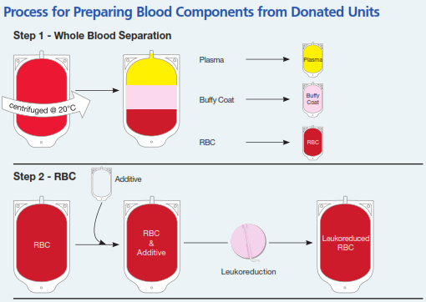
Centrifugation
Collect 500 mL whole blood
Divert the first 40 mL to reduce risk of bacterial contamination from donor skin
The 40 mL are used for
donor unit testing
Blood is centrifuged and
separated into 3 parts:
◆ Red Blood Cells
◆ Plasma
◆ Buffy coat

Slide 47
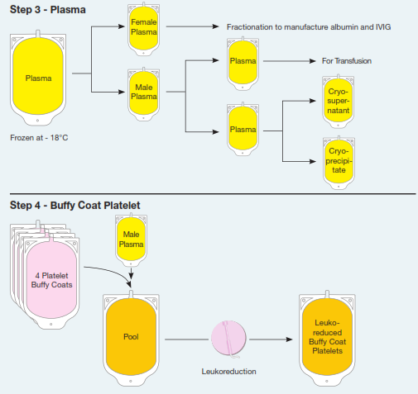
The Buffy coat units from four donors are further processed to separate the platelets
The red blood cell and platelet components are leukoreduced

Slide 48
Separated of blood components by 1 unit of Whole blood:
PRBCS(hematocrit 70%):
250 mL+saline preservative=350 mL.
1–6°C.
May be frozen in a hypertonic glycerol solution for up to 10 years(rare phenotypes)

Slide 49
A preservative–anticoagulant solution is added. The most commonly used solution is CPDA-1:
Citrate as an anticoagulant (by binding calcium)
Phosphate as a buffer
Dextrose as a RC energy source
Adenosine as a precursor for ATP synthesis.
35 days
AS-1 (Adsol) or AS-3 (Nutrice) extends the shelf-life to 6 weeks.
ADSOL (Adenine, glucose, mannitol and sodium chloride)
NUTRICE (Adenine, glucose, citrate, phosphate and NaCl)

Slide 50
Platelet:
50–70 mL.
20–24°C for 5 days.
Plasma:
The remaining plasma supernatant is further processed and frozen to yield fresh frozen plasma; rapid freezing helps prevent inactivation of labile coagulation factors (V and VIII). Slow thawing of fresh frozen plasma yields a gelatinous precipitate (cryoprecipitate) that contains high concentrations of Factor VIII and fibrinogen.
200 mL.
Once thawed it must be transfused within 24 h.

Slide 51
Blood Groups
At least 20 separate blood group antigen systems are known; fortunately, only the ABO and the Rh systems are important in the majority of blood transfusions.

Slide 52
The ABO System
Simply speaking, the chromosomal locus for this system produces two alleles: A and B. Each represents an enzyme that modifies a cell surface protein.
Type | Naturally Occurring Antibodies in Serum | Incidence
A | Anti-B | 45%
B | Anti-A | 8%
AB (Universal recipient) | — | 4%
O (Universal donor) | Anti-A, anti-B | 43%

Slide 53
The Rh System and others
The Rh system is encoded by two genes located on chromosome 1.
There are about 46 Rh-related antigens, but in most clinical settings, the five principal antigens (D, C, c, E, and e).
The most common and most immunogenic allele is the D antigen (80–85% of white).
Other systems include the Lewis, P, Ii, MNS, Kidd, Kell, Duffy, Lutheran, Xg, Sid, Cartright, YK, and Chido Rodgers antigens.
Fortunately, with some exceptions (Kell, Kidd, Duffy, and S), alloantibodies against these systems rarely cause serious hemolytic reactions.

Slide 54
Compatibility Testing

Slide 55
ABO-Rh Testing (Group and Save)
The patient's RCs are tested with serum known to have anti A and anti B antibodies to determine blood type.
Confirmation of blood type is then made by testing the patient's serum against RCs with a known antigen type.
The patient's RCs are also tested with anti-D antibodies to determine Rh.
Crossmatching
Mimics transfusion: donor cells are mixed with recipient serum.
(1) confirms ABO and Rh typing (<5 min)
(2) detects antibodies to the other blood group systems (45 min)
(3) detects antibodies in low titers or those that do not agglutinate easily(45 min)

Slide 56
Intra-operative Transfusion Practices

Slide 57
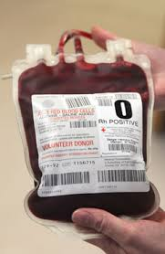
Packed Red Blood Cells
Allows optimal utilization of blood bank resources.
Ideal for patients requiring RCs but not volume
replacement (eg, anemia pt in compensated
CHF).
Hgb 7-8 g/dL (<6, most people require blood;
>10 most people do not)
Each unit raise Hgb by 1g/dl
170-µm filter to trap any clots or debris.
Warming to 37°C during infusion.
Hypothermia and low levels of 2,3-diphosphoglycerate (2,3-DPG) in stored blood can cause a marked leftward shift of the hemoglobin–oxygen dissociation curve

Slide 58
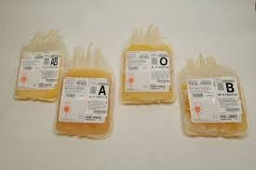
Fresh Frozen Plasma
FFP contains all plasma proteins, including all clotting factors.
Indications:
Isolated factor deficiencies.
Reversal of warfarin therapy.
Coagulopathy associated with liver disease.
CABG,bleeding+NL ACT.
Massive blood transfusions.
Antithrombin III def.
The initial therapeutic dose is usually 10–15 mL/kg
ABO-compatible units are mandatory.
Coagulation factors INR 1.4-1.6 (INR>1.6, most people require FFP transfusion for major surgery; INR<1.4, most people do not require)

Slide 59
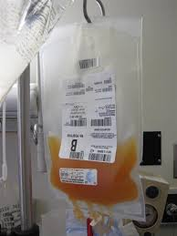
Platelets
Thrombocytopenia or dysfunctional platelets .
Surgery or invasive procedures: 70,000 x 10⁹/L.
Vaginal delivery and minor surgical procedures: 50,000 x 10⁹/L.
Each unit expected to increase the count by 10,000–20,000 x 10⁹/L.
ABO-compatible platelet transfusions are desirable but not necessary

Slide 60
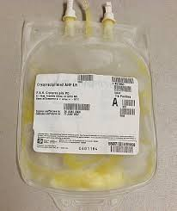
Cryoprecipitate
Each unit (15 ml) contains fibrinogen 150 mg, factor VIII 100 units, von Willebrand factor (vWF) (100 units)
DIC, hemophilia A, von Willebrand disease, quick reversal of thrombolytic therapy
Fibrinogen (most people require
cryoprecipitate for major surgery if
fibrinogen < 1 g/dL)

Slide 61
Complications of Blood Transfusion

Slide 62
Hemolytic reactions
Acute Vs. Delayed
Febrile Non hemolytic reactions
Transfusion Related Acute Lung Injury (TRALI)
Infectious complications

Slide 63
Hemolytic Reactions
Classified as either acute or delayed
Acute Hemolytic Reactions
1:38,000. fatal in 1 in 100,000 (severity depends on volume of incompatible blood)
The most common cause is misidentification … ABO mostly
Often severe.
In awake: chills, fever, nausea, and chest and flank pain.
In anesthetized: rise in temperature, unexplained tachycardia, hypotension, hemoglobinuria, and diffuse oozing in the surgical field. DIC, shock, and renal shutdown can develop rapidly

Slide 64
Management of hemolytic reactions
1. Once suspected, the transfusion should be stopped immediately.
2. The unit should be rechecked against the blood slip and the patient's identity bracelet.
3. Blood should be drawn to identify hemoglobin in plasma, to repeat compatibility testing, and to obtain coagulation studies and a platelet count.
4. A urinary catheter should be inserted, and the urine should be checked for hemoglobin.
5. Osmotic diuresis should be initiated with mannitol and intravenous fluids.
6. In the presence of rapid blood loss, platelets and FFP are indicated.

Slide 65
Delayed Hemolytic Reactions
1:12,000
Antibodies to non-D antigens of the Rh system or to foreign alleles in other systems such as the Kell, Duffy, or Kidd antigens.
1–1.6% chance even if ABO and Rh compatabale.
By the time significant amounts of these antibodies have formed (weeks to months), the transfused RCs have been cleared from the circulation. Moreover, the titer of these antibodies subsequently decreases and may become undetectable.

Slide 66
The hemolytic reaction is therefore typically delayed 2–21 days after transfusion, and mild, consisting of malaise, jaundice, and fever, failure of the patient's Hct to rise in spite of the transfusion and the absence of bleeding, and serum unconjugated bilirubin increases.
Diagnosis by direct Coombs test and re-examination of pre-transfusion specimens from both the patient and the donor.
The treatment is primarily supportive.

Slide 67
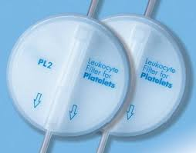
Febrile non-haemolytic transfusion reactions (FNHTR)
Acute (<24 hours)
Cytokine accumulation during storage of cellular components (especially in platelet units)
Recipient antibodies (raised as a result of previous transfusions or pregnancies) reacting to donor human leucocyte antigens (HLA)
Unexpected temperature rise (≥38ºC or ≥1ºC above baseline), Chills, rigors, increased respiratory rate, hypotension, anxiety and a headache
leucocyte depletion

Slide 68
TRALI
ARDS following blood transfusion
High morbidity … mechanical ventilation
Lung injury is generally transient with PO2 levels returning to pretransfusion levels within 48 -96 hours and CXR returning to normal within 96 hours.
Mortality rate, often approximated at 5 to 10%
Treatment as ARDS

Slide 69
Approaches to Fluid Management

Slide 70
The “Classic” Approach
Step 1: Calculate Ongoing Maintenance Requirements
4/2/1 rule: 4 cc/kg/hr for the first 10 kg, 2 cc/kg/hr for the second 10 kg, and 1 cc/kg/hr for every kg above 20.
Ex. 70kg → 10 * 4 ml = 40 ml
10 * 2 ml = 20 ml
50 * 1 ml = 50 ml
110ml / hour given each hour as oral or enteral intake is stopped
Ex. 15kg → 10 * 4 ml = 40 ml + 5 * 2 ml = 10 ml = 50 ml / hour

Slide 71
Step 2:Calculate Preoperative Fluid deficit
Maintenance * the time without intake what so ever
Ex. 70kg fasting for 10 hours pre-operatively
M = 110ml/hour * time 10 hour = 1100 ml
Step 3: Calculate Anticipated Surgical Fluid Losses
Minimal tissue trauma (ex. herniorrhaphy): 0-2 cc/kg/hr
Moderate tissue trauma (ex. cholecystectomy): 4-6 cc/kg/hr
Severe tissue trauma (ex. bowel resection): 8-10 cc/kg/hr
Ex. 70kg undergoing major laparotomy →
10 ml * 70 kg = 700 ml/hour as long as surgery is going on

Slide 72
Step 4: Adjust for Blood Losses
A common recommendation is to give 3-4 cc of crystalloid for every 1 cc of blood loss
Remember to add up suction volume, lap pads (100-150 cc each if fully soaked) and 4x4 small pads (10 cc each if fully soaked)
Ex. In the 1st hour of laparotomy there was 200ml of pure blood in the suction jar, 2 fully soaked lap pads, and 10 fully soaked small gauses
200 ml + 2 * 150 ml + 10 * 10 ml = 600 ml ( in that hour) to be replaced with either 600 * 4 of cryst. or -if indicated- 600 ml of blood

Slide 73
1st hour = Maintenance + ½ Deficit + Blood loss + Ongoing loss
2nd hour = Maintenance + ¼ Deficit + Blood loss + Ongoing loss
3rd hour = Maintenance + ¼ Deficit + Blood loss + Ongoing loss
Maintenance continued post-operatively as long as fasting
Blood loss replaced as long as there is bleeding
Ongoing loss as long as the surgery continues

Slide 74
THANK YOU

