Slide 1
Inferential statistics
Inference involves making a Generalization about a larger group of individuals on the basis of a subset or sample.

Slide 2
Null and alternative hypotheses
In hypotheses testing, a specific hypothesis ( Null and alternative Hypothesis ) are formulated and tested.
The null hypotheses H0 means : X1=X 2
Or X1-X 2=0
this means that there is no difference between x1 and x2
The alternative hypotheses H1 means
X1>X2 or X1< X2

Slide 3
Hypothesis Testing
The method of assessing the hypotheses testing is known as significance test.
The significance testing is a method for assessing whether a result is likely to be due to chance or due to a real effect.

Slide 4
General principles of significance tests
set up a null hypothesis and its alternative.
find the value of the test statistic.
refer the value of the test statistic to a known distribution which it would follow if the null hypothesis was true.

Slide 5
General principles of significance tests
4-conclude that the data are consistent or inconsistent with the null hypothesis.
If the data are not consistent with the null hypotheses, the difference is said to be statistically significant. If the data are consistent with the null hypotheses it is said that we accept it i.e. statistically insignificant.

Slide 6
General principles of significance tests P<0.05
In medicine, we usually consider that differences are significant if the probability is less than 0.05. This means that if the null hypothesis is true, we shall make a wrong decision less than 5 in a hundred times

Slide 7
The t-test
Inferences about Population Means

Slide 8
TYPES OF DATA
VARIABLES
QUANTITATIVE
QUALITATIVE
RATIO
Pulse rate
Height
INTERVAL
36º-38ºC
ORDINAL
Social class
NOMINAL
Gender
Ethnicity

Slide 9
Background
The t statistic allows researchers to use sample data to test hypotheses about an unknown population.
Developed by Gossett for the quality control of beer.
Comes in 3 varieties:
Single sample t test , independent samples t test , and dependent samples t test (paired t-test).

Slide 10
The T Distribution:
1- It has mean of zero.
2- It is symmetric about the
mean.
3- It ranges from -∞ to ∞.
0

Slide 11
Assumptions of t-Test
Dependent variables are interval or ratio.
The population from which samples are drawn is normally distributed.
Samples are randomly selected.
For very large samples, the t‐distribution approximates the standard normal ( z) distribution.
In practice, it is best to use t‐distributions any time the population standard deviation is not known.

Slide 12
Important guidelines
critical t‐values for common alpha levels (0.10, 0.05, 0.01, and so forth) are usually given in a single table.
Values in the t‐table are not actually listed by sample size but by degrees of freedom (df).
The number of degrees of freedom for a problem involving the t‐distribution for sample size n is simply n – 1 for a one‐sample mean problem.
The t‐distribution is particularly useful for tests with small samples ( n < 30).

Slide 13
One-Sample t-test
Requirements: Normally distributed population, σ is unknown
Test for population mean
Hypothesis test
Formula:
where x is the sample mean, Δ is a specified value to be tested, s is the sample standard deviation, and n is the size of the sample.

Slide 14
Note
Note that the formula for the one‐sample t‐test is the same as the z‐test, except that the t‐test substitutes the sample standard deviation s for the population standard deviation σ and takes critical values from the t‐distribution instead of the z‐distribution.

Slide 15
Example 1
A professor wants to know if her introductory statistics class has a good grasp of basic math. Six students are chosen at random from the class and given a math proficiency test. The professor wants the class to be able to score above 70 on the test. The six students get scores of 62, 92, 75, 68, 83, and 95. Can the professor have 90 percent confidence that the mean score for the class on the test would be above 70?
null hypothesis: H ₀: μ = 70
alternative hypothesis: H _{a} : μ > 70

Slide 16
One sample t-test
Values in the t‐table are not actually listed by sample size but by degrees of freedom(df). The number of degrees of freedom for a problem involving the t‐distribution for sample size n is simply n – 1 for a one‐sample mean problem.

Slide 17
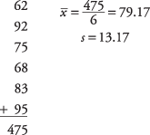
Example 1
First, compute the sample mean and standard deviation:

Slide 18
Example 1
Next, compute the t‐value:

Slide 19
Example 1
To test the hypothesis, the computed t‐value of 1.71 will be compared to the critical value in the t‐table.
Because the sample mean is in the numerator, the larger it is, the larger the resulting t‐value will be.
The higher sample mean will make it more likely that the professor will conclude that the math proficiency of the class is satisfactory and that the null hypothesis of less‐than‐satisfactory class math knowledge can be rejected.
The larger the computed t‐value, the greater the chance that the null hypothesis can be rejected. It follows, then, that if the computed t‐value is larger than the critical t‐value from the table, the null hypothesis can be rejected.
Notes:
But which do you expect to be larger and which do you expect to be smaller? One way to reason about this is to look at the formula and see what effect different means would have on the computation. If the sample mean had been 85 instead of 79.17, the resulting t‐value would have been larger.

Slide 20
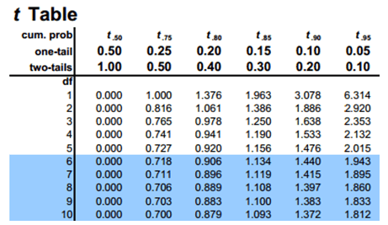
Student’s t-Test Table

Slide 21
Example 1
A 90 percent confidence level is equivalent to an alpha level of 0.10. Because extreme values in one rather than two directions will lead to rejection of the null hypothesis, this is a one‐tailed test, and you do not divide the alpha level by 2.
The number of degrees of freedom for the problem is 6 – 1 = 5. The value in the t‐table for t _{.10,5} is 1.476.
Because the computed t‐value of 1.71 is larger than the critical value in the table, the null hypothesis can be rejected, and the professor has evidence that the class mean on the math test would be at least 70.

Slide 22
Example 2
A Little League baseball coach wants to know if his team is representative of other teams in scoring runs. Nationally, the average number of runs scored by a Little League team in a game is 5.7. He chooses five games at random in which his team scored 5 , 9, 4, 11, and 8 runs. Is it likely that his team's scores could have come from the national distribution?

Slide 23
Example 2
Assume an alpha level of 0.05.
Because the team's scoring rate could be either higher than or lower than the national average, the problem calls for a two‐tailed test. First, state the null and alternative hypotheses:
null hypothesis: H ₀: μ = 5.7
alternative hypothesis: H _{a} : μ ≠ 5.7

Slide 24
Example 2
Next, the t‐value:

Slide 25
Example 2
Now, look up the critical value from the t‐table
You need to know two things in order to do this: the degrees of freedom and the desired alpha level.
The degrees of freedom is 5 – 1 = 4. The overall alpha level is 0.05, but because this is a two‐tailed test, the alpha level must be divided by two, which yields 0.025.
The tabled value for t _{.025,4}is 2.776.
The computed t of 1.32 is smaller, so you cannot reject the null hypothesis that the mean of this team is equal to the population mean.
The coach cannot conclude that his team is different from the national distribution on runs scored.

Slide 26
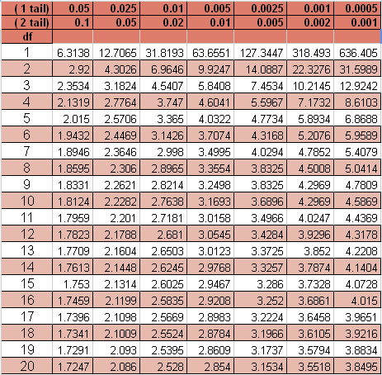
Student’s t-Test Table

Slide 27
The t Statistic
The t statistic is used when a researcher wants to determine whether or not a treatment causes a change in a population mean. In this case you must know the value of μ for the original, untreated population. A sample is obtained from the population and the treatment is administered to the sample. If the resulting sample mean is significantly different from the original population mean, you can conclude that the treatment has a significant effect.

Slide 28
The t Statistic
The particular advantage of the t statistic, is that it can be used to test hypotheses about a completely unknown population; that is, both μ and σ are unknown, and the only available information about the population comes from the sample.

Slide 29
The t Statistic
If the population mean is unknown . A sample is then obtained from the population and the t statistic is used to compare the actual sample mean with the hypothesized population mean. A significant difference indicates that the hypothesized value for μ should be rejected.

Slide 30
The t Statistic (cont.)
All that is required for a hypothesis test with t is a sample and a reasonable hypothesis about the population mean.

Slide 31
The Estimated Standard Error and the t Statistic
Whenever a sample is obtained from a population you expect to find some discrepancy or "error" between the sample mean and the population mean.
This general phenomenon is known as sampling error.
The goal for a hypothesis test is to evaluate the significance of the observed discrepancy between a sample mean and the population mean.

Slide 32
The Estimated Standard Error and the t Statistic (cont.)
The hypothesis test attempts to decide between the following two alternatives:
1. Is it reasonable that the discrepancy between M and μ is simply due to sampling error and not the result of a treatment effect?
2. Is the discrepancy between M and μ more than would be expected by sampling error alone? That is, is the sample mean significantly different from the population mean?

Slide 33
The t Distributions and Degrees of Freedom (cont.)
The value of degrees of freedom, df = n - 1, is used to determine how well the distribution of t approximates a normal distribution.
For large values of df, the t distribution will be nearly normal, but with small values for df, the t distribution will be flatter and more spread out than a normal distribution.

Slide 34
The t Distributions and Degrees of Freedom (cont.)
To evaluate the t statistic from a hypothesis test, you must select an α level, find the value of df for the t statistic, and consult the t distribution table.
If the obtained t statistic is larger than the critical value from the table, you can reject the null hypothesis.
In this case, you have demonstrated that the obtained difference between the data and the hypothesis (numerator of the ratio) is significantly larger than the difference that would be expected if there was no treatment effect (the standard error in the denominator).

Slide 35
Student’s t-Test Table

Slide 36
Two Independent Samples t test for Comparing Two Means
Requirements: Two normally distributed but independent populations, σ is unknown.
Degrees of freedom: is the smaller of n ₁– 1 and n ₂– 1.

Slide 37
Hypothesis testing
Formula:
where and are the means of the two samples, Δ is the hypothesized difference between the population means (0 if testing for equal means), s₁ and s ₂are the standard deviations of the two samples, and n ₁and n ₂are the sizes of the two samples.

Slide 38
Example 3
An experiment is conducted to determine whether intensive tutoring (covering a great deal of material in a fixed amount of time) is more effective than paced tutoring (covering less material in the same amount of time). Two randomly chosen groups are tutored separately and then administered proficiency tests. Use a significance level of α < 0.05.
Let μ ₁ represent the population mean for the intensive tutoring group and μ ₂represent the population mean for the paced tutoring group.

Slide 39
Hypothesis testing
null hypothesis: H ₀: μ ₁ = μ ₂
or H ₀: μ ₁ – μ ₂ = 0
alternative hypothesis: H _{a} : μ ₁ > μ ₂
or: H _{a} : μ ₁ – μ ₂ > 0

Slide 40
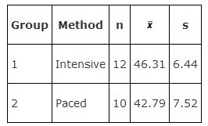
Let us organize the inputs we have

Slide 41
Calculating t value

Slide 42
Testing the hypothesis
The degrees of freedom parameter is the smaller of (12 – 1) and (10 – 1), or 9.
Because this is a one‐tailed test, the alpha level (0.05) is not divided by two.
The next step is to look up t _{.05,9}in the t‐table, which gives a critical value of 1.833. The computed t of 1.166 does not exceed the tabled value, so the null hypothesis cannot be rejected.
Our conclusion is: This test has not provided statistically significant evidence that intensive tutoring is superior to paced tutoring.

Slide 43
Paired Difference t-test
Requirements: A set of paired observations from a normal population
This t‐test compares one set of measurements with a second set from the same sample. It is often used to compare “before” and “after” scores in experiments to determine whether significant change has occurred.

Slide 44
Hypothesis testing
Formula:
where is the mean of the change scores, Δ is the hypothesized difference (0 if testing for equal means), s is the sample standard deviation of the differences, and n is the sample size. The number of degrees of freedom for the problem is n – 1.

Slide 45
Example 4
A farmer decides to try out a new fertilizer on a test plot containing 10 stalks of corn. Before applying the fertilizer, he measures the height of each stalk. Two weeks later, he measures the stalks again, being careful to match each stalk's new height to its previous one. The stalks would have grown an average of 6 inches during that time even without the fertilizer. Did the fertilizer help? Use a significance level of 0.05.

Slide 46
Hypothesis testing
null hypothesis: H ₀: μ = 6
alternative hypothesis: H _{a} : μ > 6

Slide 47
Steps of calculation of t
Subtract each stalk's “before” height from its “after” height to get the change score for each stalk; then compute the mean and standard deviation of the change scores and insert these into the formula.

Slide 48
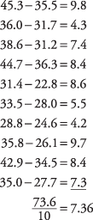
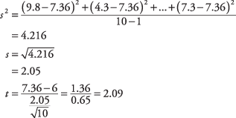

Slide 49
Hyopothesis testing
The problem has n – 1, or 10 – 1 = 9 degrees of freedom.
The test is one‐tailed because you are asking only whether the fertilizer increases growth, not reduces it. The critical value from the t‐table for t _{.05,9} is 1.833.
Because the computed t‐value of 2.098 is larger than 1.833, the null hypothesis can be rejected.
Conclusion: The test has provided evidence that the fertilizer caused the corn to grow more than if it had not been fertilized. The amount of actual increase was not large (1.36 inches over normal growth), but it was statistically significant.

Slide 50
Chi-Square (X2)
The statistical procedures that we have reviewed thus far are appropriate only for numerical variables.
The chi‐square (χ ²) test can be used to evaluate a relationship between two categorical variables. It is one example of a nonparametric test.
Nonparametric tests are used when assumptions about normal distribution in the population cannot be met. These tests are less powerful than parametric tests.

Slide 51
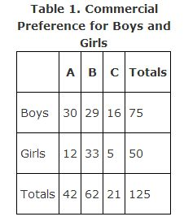
Example 5
Suppose that 125
children are shown
three television
commercials for
breakfast cereal
and are asked
to pick which they liked best. The results are shown in Table 1:

Slide 52
Calculation
You would like to know if the choice of favorite commercial was related to whether the child was a boy or a girl or if these two variables are independent.
The totals in the margins will allow you to determine the overall probability of (1) liking commercial A, B, or C, regardless of gender, and (2) being either a boy or a girl, regardless of favorite commercial.

Slide 53
Calculation
If the two variables are independent, then you should be able to use these probabilities to predict approximately how many children should be in each cell.
If the actual count is very different from the count that you would expect if the probabilities are independent, the two variables must be related.

Slide 54
The overall probability of a child in the sample being a boy is 75 ÷ 125 = 0.6.
The overall probability of liking Commercial A is 42 ÷ 125 = 0.336.
The multiplication rule states that the probability of both of two independent events occurring is the product of their two probabilities.
Therefore, the probability of a child both being a boy and liking Commercial A is 0.6 × 0.336 = 0.202.
The expected number of children in this cell, then, is 0.202 × 125 = 25.2.

Slide 55
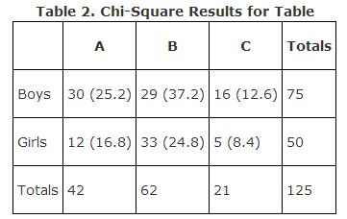
There is a faster way of computing the expected count for each cell:
Multiply the row total by the column total and divide by n. The expected count for the first cell is, therefore, (75 × 42) ÷ 125 = 25.2.
If you perform this operation for each cell, you get the expected counts (in parentheses) shown in Table 2.

Slide 56
The formula for χ ², compares each cell's actual count to its expected count:
The formula describes an operation that is performed on each cell and which yields a number. When all the numbers are summed, the result is χ ². Now, compute it for the six cells in the example:

Slide 57
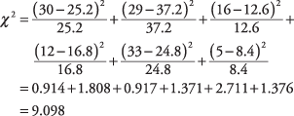

Slide 58
Example 5
The larger χ ², the more likely that the variables are related; note that the cells that contribute the most to the resulting statistic are those in which the expected count is very different from the actual count.
Chi‐square has a probability distribution, the critical values for which are listed in χ ² Statistics Table.
" As with the t‐distribution, χ ² has a degrees‐of‐freedom parameter, the formula for which is (number of rows – 1) × (number of columns – 1)
or in your example: (2 – l) × (3 – 1) = 1 × 2 = 2

Slide 59
Conclusion
Based on the table," a chi‐square of 9.097 with two degrees of freedom falls between the commonly used significance levels of 0.05 and 0.01.
If you had specified an alpha of 0.05 for the test, you could, therefore, reject the null hypothesis that gender and favorite commercial are independent.
At a = 0.01, however, you could not reject the null hypothesis.

Slide 60
Last
The χ ² test does not allow you to conclude anything more specific than that there is some relationship in your sample between gender and commercial liked (at α = 0.05). Examining the observed versus expected counts in each cell might give you a clue as to the nature of the relationship and which levels of the variables are involved. For example, Commercial B appears to have been liked more by girls than boys. But χ ²tests only the very general null hypothesis that the two variables are independent.
Sometimes a chi‐square test of homogeneity of populations is used. It is very similar to the test for independence. In fact the mechanics of these tests are identical. The real difference is in the design of the study and the sampling method.

Slide 61
Student’s t-Test Table

