Slide 1
Pathology of the Female genital tract -2 Uterine Pathology

Slide 2
ENDOMETRITIS
Inflammation of the endometrium (Endometritis ) is seen as part of:
1- pelvic inflammatory disease (PID
2-retained products of conception subsequent to miscarriage or delivery
3- foreign body such as an intrauterine device (IUCD).
Endometritis is classified as acute or chronic based on whether there is a predominant neutrophilic or lymphoplasmacytic response

Slide 3
ENDOMETRITIS
Clinically: fever, abdominal pain, menstrual abnormalities, infertility and ectopic pregnancy due to damage to the fallopian tubes.
Occasional causes: tuberculosis (granulomatous endometritis), frequently with tuberculous salpingitis and peritonitis. It is common in countries where tuberculosis is endemic.

Slide 4
ADENOMYOSIS
Nests of endometrial stroma, glands, or both, are found embedded in the myometrium between the muscle bundles.
The uterine wall is thickened and the uterus is enlarged.
Because these glands derive from the stratum basalis of the endometrium, they do not undergo cyclical bleeding.
marked adenomyosis may produce menorrhagia, dysmenorrhea, and pelvic pain before the onset of menstruation.

Slide 5
ENDOMETRIOSIS
characterized by endometrial glands and stroma in a location outside the uterus.
10% of women in reproductive years; half of women with infertility.
dysmenorrhea, and pelvic pain, and may present as a pelvic mass filled with degenerating blood (chocolate cyst).

Slide 6
multifocal and may involve multiple tissues in the pelvis (ovaries, pouch of Douglas, uterine ligaments, tubes, and rectovaginal septum).
Sometimes more remote sites include the peritoneal cavity and the umbilicus and uncommonly lymph nodes, lungs, and even heart, skeletal muscle, or bone

Slide 7
“Chocolate“ cyst in an ovary

Slide 8
ENDOMETRIOSIS- Pathogenesis
Three possibilities have been invoked to explain the origin of endometriosis lesions:
The regurgitation theory, currently the most accepted, proposes menstrual backflow through the fallopian tubes with subsequent implantation..
The metaplastic theory proposes endometrial differentiation of coelomic epithelium, which is the origin of the endometrium itself.
The vascular or lymphatic dissemination theory has been invoked to explain extrapelvic or intranodal implants.

Slide 9
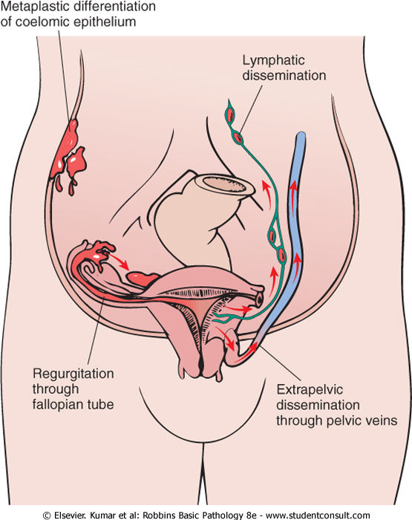
Conceivably, all pathways are valid in individual instances.

Slide 10
ENDOMETRIOSIS
in contrast to adenomyosis, endometriosis almost always contains functionalis endometrium, which undergoes cyclic bleeding.
Because blood collects in these foci, they usually appear grossly as red-blue to yellow-brown nodules or implants. They vary in size from microscopic to a few cm in diameter.

Slide 11
Consequences: widespread fibrosis, adherence of pelvic structures, sealing of the tubal fimbriated ends, and distortion of the oviducts and ovaries.
The histologic diagnosis at all sites depends on finding two of the following three features within the lesions: endometrial glands, endometrial stroma, or hemosiderin pigment.

Slide 12
DUB- Dysfunctional Uterine Bleeding
The various causes of dysfunctional bleeding include among many causes:
1- Failure of ovulation. The most common cause of DUB. Causes:
at both ends of reproductive life
dysfunction of the hypothalamic-pituitary axis, adrenal, or thyroid
ovarian tumor producing an excess of estrogen
Malnutrition, obesity, debilitating disease; severe physical or emotional stress.

Slide 13
2- Endomyometrial disorders: including chronic endometritis, endometrial polyps, submucosal leiomyomas, endometrial hyperplasia and cancers.

Slide 14
Dysfunctional Uterine Bleeding
Age Group | Cause(s)
Prepuberty | Precocious puberty (hypothalamic, pituitary, or ovarian origin)
Adolescence | Anovulatory cycle
Reproductive age | Complications of pregnancy (abortion, trophoblastic disease, ectopic pregnancy) Organic lesions (leiomyoma, adenomyosis, polyps, endometrial hyperplasia, carcinoma)
 | Anovulatory cycle Ovulatory dysfunctional bleeding (e.g., inadequate luteal phase)
Perimenopause | Anovulatory cycle Irregular shedding Organic lesions (carcinoma, hyperplasia, polyps)
Postmenopause | Organic lesions (carcinoma, hyperplasia, polyps)
 | Endometrial atrophy

Slide 15
Endometrial Hyperplasia
A prolonged or marked excess of estrogen relative to progestin →exaggerated endometrial proliferation (hyperplasia
The severity of hyperplasia is classified based on architectural crowding and cytologic atypia, ranging from:
1- Simple hyperplasia
2- Complex hyperplasia
3- Atypical hyperplasia.

Slide 16
Endometrial Hyperplasia
It may eventually give rise to carcinoma.
Simple hyperplasia carries a negligible risk, while atypical hyperplasia has a 20% risk of developing endometrial carcinoma

Slide 17
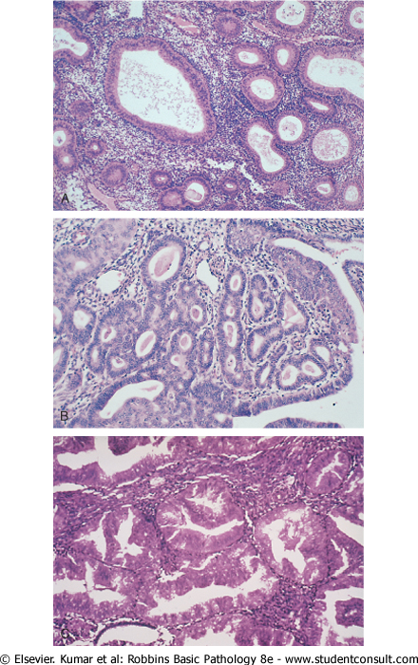
Simple hyperplasia
Complex Hyperplasia
Atypical Hyperplasia

Slide 18
TUMORS OF THE ENDOMETRIUM
Endometrial Polyps
These are sessile or pedunculated lesions that are 0.5 to 3 cm in diameter.
Histologically they are composed of endometrial cystically dilated glands, with small muscular arteries and fibrotic stroma.
Benign tumors with no risk of endometrial cancer.

Slide 19
Endometrial Carcinoma
Endometrial carcinoma is the most frequent cancer in the female genital tract.
most frequently in 50s and 60s.
two clinical settings in which endometrial carcinomas arise:
in perimenopausal women with estrogen excess
in older women with endometrial atrophy.
These scenarios are correlated with differences in histology: endometrioid and serous carcinoma of the endometrium, respectively.

Slide 20
Endometrioid carcinoma:
termed endometrioid because of similarity to normal endometrium.
risk factors: Obesity; Diabetes; Hypertension (mostly an association and not a true risk factor); Infertility; Prolonged estrogen replacement therapy; Estrogen-secreting ovarian tumors.
Many of these risk factors are the same as those for endometrial hyperplasia
The precancerous lesion is atypical endometrial hyperplasia
Mutations in DNA mismatch repair genes and PTEN

Slide 21
Serous carcinoma
It typically arises in a background of atrophy, (no relation with endometrial hyperplasia).
nearly all cases have mutations in the p53 tumor suppressor gene.
Mutations in DNA mismatch repair genes and PTEN are rare in serous carcinoma;

Slide 22
Endometrioid
carcinoma
p53
Serous
carcinoma

Slide 23
Prognosis
Endometrioid carcinoma: 5-year survival rate for stage I 90%; this rate drops to 30% to 50% in stage II and to less than 20% in stages III and IV.
serous carcinomas: strongly dependent on the spread of tumor, as determined by operative staging with peritoneal cytology. Generally worse prognosis than endometrioid ca.

Slide 24
Tumors of the myometrium
Lieomyomas
Benign tumors arise from the smooth muscle cells in the myometrium, (a.k.a. fibroids).
the most common benign tumor in females (30% - 50% of women in reproductive life).
Estrogen-dependent, they shrink post-menopausally.
Macroscopically: circumscribed, firm gray-white masses with whorled cut surface.

Slide 25
Lieomyomas
Location in myometrium: (intramural), (submucosal), or directly beneath the serosa (subserosal). Usually very well demarcated.
may develop foci of hemorrhage and cystic softening, and after menopause they may become calcified.
Clinically: may be entirely asymptomatic; menorrhagia; a dragging sensation.
leiomyomas almost never transform into sarcomas, and the presence of multiple lesions does not increase the risk of harboring a malignancy.

Slide 26
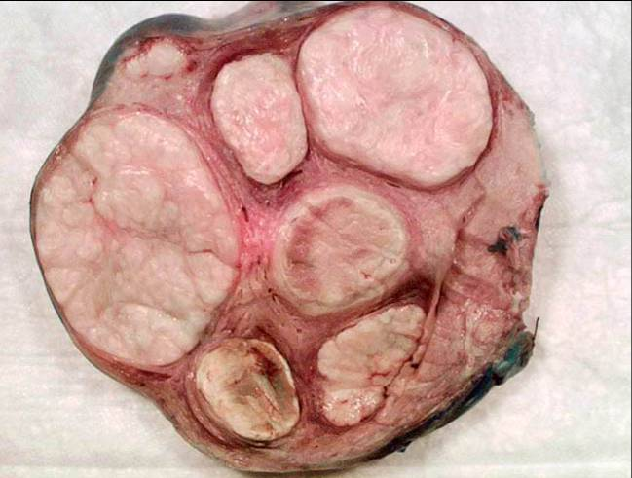
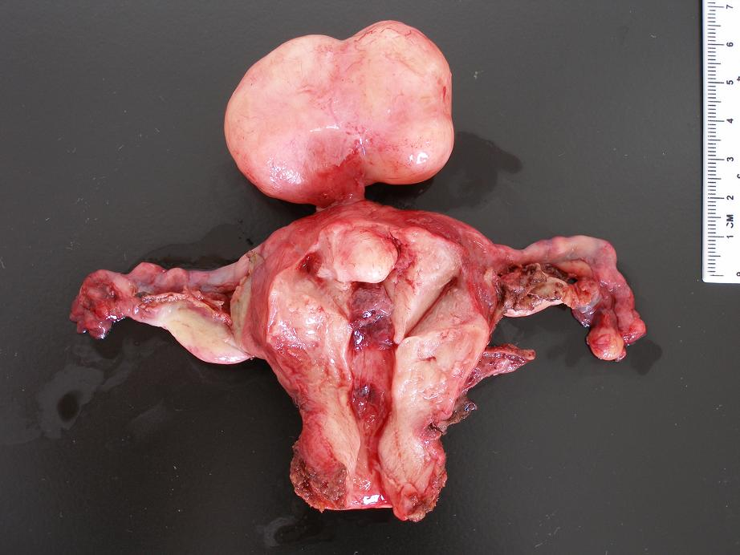
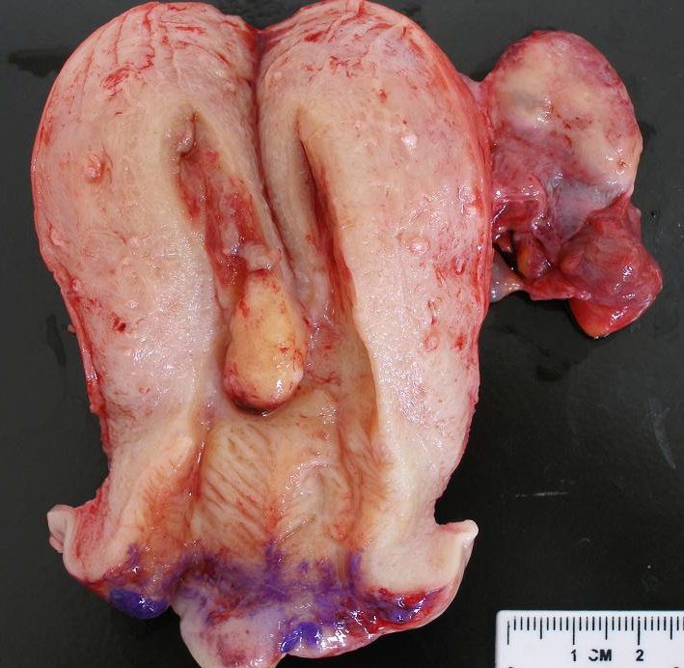
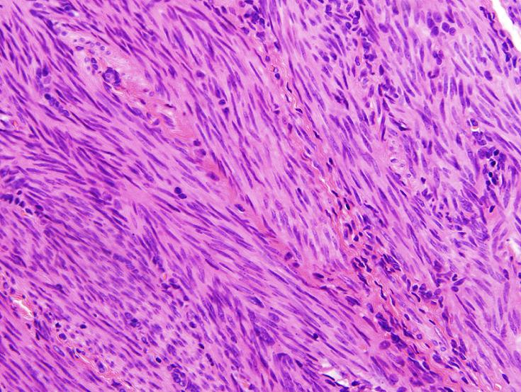

Slide 27
Lieomyosarcoma
Malignant counterpart. Typically arise de novo, not from preexisting leiomyomas.
They are almost always solitary tumors, in contrast to the frequently multiple leiomyomas.
They are frequently soft, hemorrhagic, and necrotic. Have infiltrative borders.

Slide 28
Lieomyosarcoma
The diagnostic features of leiomyosarcoma: coagulative necrosis, cytologic atypia, and mitotic activity.
Recurrence after removal is common, and many metastasize, typically to the lungs, yielding a 5-year survival rate of 40%.
The more anaplastic tumors have a poorer outlook than the better differentiated lesions

Slide 29
