Slide 1
Fertilization

Slide 2
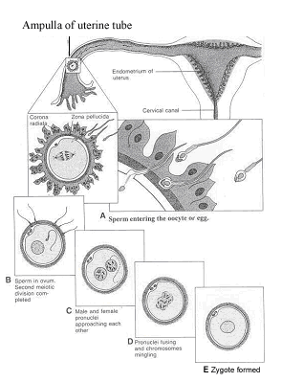
Fertilization, the process by which male and female gametes fuse, occurs in the ampullary region of the uterine tube.
This is the widest part of the tube and is close to the ovary
Spermatozoa may remain viable in the female reproductive tract for several days.
Only 1% of sperm deposited in the vagina enter the cervix, where they may survive for many hours
Movement of sperm from the cervix to the oviduct is accomplished primarily by their own propulsion, although they may be assisted by movements of fluids created by uterine cilia.
The trip from cervix to oviduct requires a minimum of 2 to 7 hours, and after reaching the isthmus, sperm become less motile and cease their migration

Slide 3
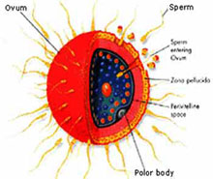
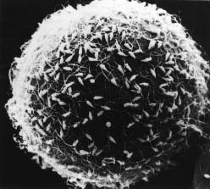
At ovulation, sperm again become motile, perhaps because of chemoattractants produced by cumulus cells surrounding the egg, and swim to the ampulla where fertilization usually occurs
Spermatozoa are not able to fertilize the oocyte immediately upon arrival in the female genital tract but must undergo
(a) capacitation and
(b) the acrosome reaction to acquire this capability.

Slide 4
Capacitation is a period of conditioning in the female reproductive tract that in the human lasts approximately 7 hours
Much of this conditioning, which occurs in the uterine tube, entails epithelial interactions between the sperm and mucosal surface of the tube
During this time a glycoprotein coat and seminal plasma proteins are removed from the plasma membrane that overlies the acrosomal region of the spermatozoa.
Only capacitated sperm can pass through the corona cells and undergo the acrosome reaction.
The acrosome reaction, which occurs after binding to the zona pellucida, is induced by zona proteins
This reaction culminates in the release of enzymes needed to penetrate the zona pellucida, including acrosin and trypsin-like substances

Slide 5
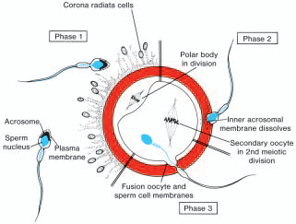
The phases of fertilization include
phase 1, penetration of the corona radiata
phase 2, penetration of the zona pellucida;
and phase 3, fusion of the oocyte and sperm cell membranes.

Slide 6
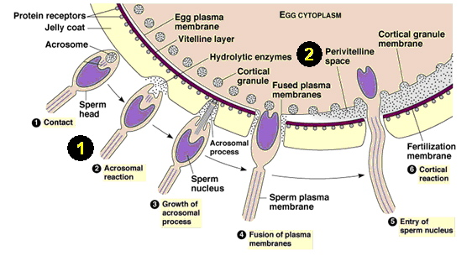
PHASE 1: PENETRATION OF THE CORONA RADIATA
Of the 200 to 300 million spermatozoa deposited in the female genital tract, only 300 to 500 reach the site of fertilization.
Only one of these fertilizes the egg
It is thought that the others aid the fertilizing sperm in penetrating the barriers protecting the female gamete.
Capacitated sperm pass freely through corona cells

Slide 7
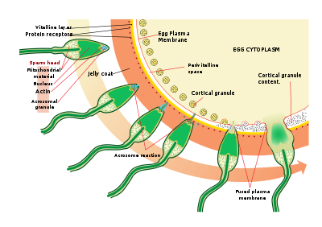
PHASE 2: PENETRATION OF THE ZONA PELLUCIDA
The zona is a glycoprotein shell surrounding the egg that facilitates and maintains sperm binding and induces the acrosome reaction
Both binding and the acrosome reaction are mediated by the ligand ZP3, a zona protein.
Release of acrosomal enzymes (acrosin) allows sperm to penetrate the zona, thereby coming in contact with the plasma membrane of the oocyte
Permeability of the zona pellucida changes when the head of the sperm comes in contact with the oocyte surface
This contact results in release of lysosomal enzymes from cortical granules lining the plasma membrane of the oocyte.
In turn, these enzymes alter properties of the zona pellucida (zona reaction) to prevent sperm penetration and inactivate species-specific receptor sites for spermatozoa on the zona surface
Other spermatozoa have been found embedded in the zona pellucida, but only one seems to be able to penetrate the oocyte

Slide 8
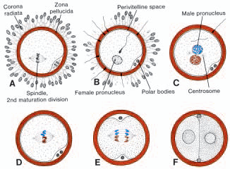
PHASE 3: FUSION OF THE OOCYTE AND SPERM CELL MEMBRANES
The initial adhesion of sperm to the oocyte is mediated in part by the interaction of integrins on the oocyte and their ligands, disintegrins, on sperm.
After adhesion, the plasma membranes of the sperm and egg fuse
Because the plasma membrane covering the acrosomal head cap disappears during the acrosome reaction, actual fusion is accomplished between the oocyte membrane and the membrane that covers the posterior region of the sperm head
In the human, both the head and tail of the spermatozoon enter the cytoplasm of the oocyte, but the plasma membrane is left behind on the oocyte surface.

Slide 9
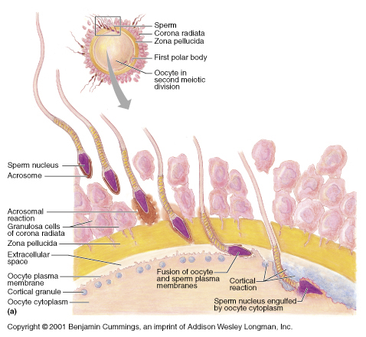
As soon as the spermatozoon has entered the oocyte, the egg responds in three ways:
1. Cortical and zona reactions. As a result of the release of cortical oocyte granules, which contain lysosomal enzymes
(a) the oocyte membrane becomes impenetrable to other spermatozoa
(b) the zona pellucida alters its structure and composition to prevent sperm binding and penetration.
These reactions prevent polyspermy (penetration of more than one spermatozoon into the oocyte).

Slide 10
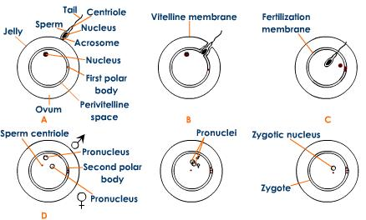
2. Resumption of the second meiotic division.
The oocyte finishes its second meiotic division immediately after entry of the spermatozoon.
One of the daughter cells, which receives hardly any cytoplasm, is known as the second polar body; the other daughter cell is the definitive oocyte.
Its chromosomes (22+X) arrange themselves in a vesicular nucleus known as the female pronucleus

Slide 11
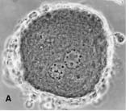
3. Metabolic activation of the egg.
The activating factor is probably carried by the spermatozoon
Postfusion activation may be considered to encompass the initial cellular and molecular events associated with early embryogenesis.
The spermatozoon, meanwhile, moves forward until it lies close to the female pronucleus.
Its nucleus becomes swollen and forms the male pronucleus
the tail detaches and degenerates.
Morphologically, the male and female pronuclei are indistinguishable, and eventually, they come into close contact and lose their nuclear envelopes

Slide 12
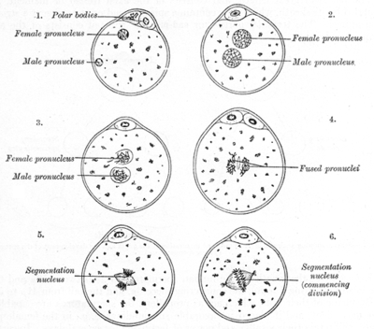
During growth of male and female pronuclei (both haploid), each pronucleus must replicate its DNA.
If it does not, each cell of the two-cell zygote has only half of the normal amount of DNA.
Immediately after DNA synthesis, chromosomes organize on the spindle in preparation for a normal mitotic division.
The 23 maternal and 23 paternal (double) chromosomes split longitudinally at the centromere, and sister chromatids move to opposite poles, providing each cell of the zygote with the normal diploid number of chromosomes and DNA
As sister chromatids move to opposite poles, a deep furrow appears on the surface of the cell, gradually dividing the cytoplasm into two parts

Slide 13
Results of fertilization
The main results of fertilization are as follows:
Restoration of the diploid number of chromosomes, half from the father and half from the mother.
Hence, the zygote contains a new combination of chromosomes different from both parents.
Determination of the sex of the new individual.
An X-carrying sperm produces a female (XX) embryo, and a Y-carrying sperm produces a male (XY) embryo.
Hence, the chromosomal sex of the embryo is determined at fertilization.
Initiation of cleavage.
Without fertilization, the oocyte usually degenerates 24 hours after ovulation.

Slide 14
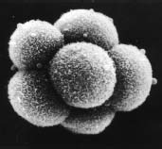
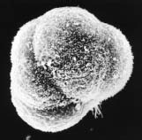
Cleavage
Once the zygote has reached the two-cell stage, it undergoes a series of mitotic divisions, increasing the numbers of cells.
These cells, which become smaller with each cleavage division, are known as blastomeres
Until the eight-cell stage, they form a loosely arranged clump
However, after the third cleavage, blastomeres maximize their contact with each other, forming a compact ball of cells held together by tight junctions
This process, compaction, segregates inner cells, which communicate extensively by gap junctions, fromouter cells.

Slide 15
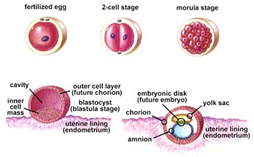
Approximately 3 days after fertilization, cells of the compacted embryo divide again to form a 16-cell morula (mulberry).
Inner cells of the morula constitute the inner cell mass, and surrounding cells compose the outer cell mass.
The inner cell mass gives rise to tissues of the embryo proper, and the outer cell mass forms the trophoblast, which later contributes to the placenta.

Slide 16
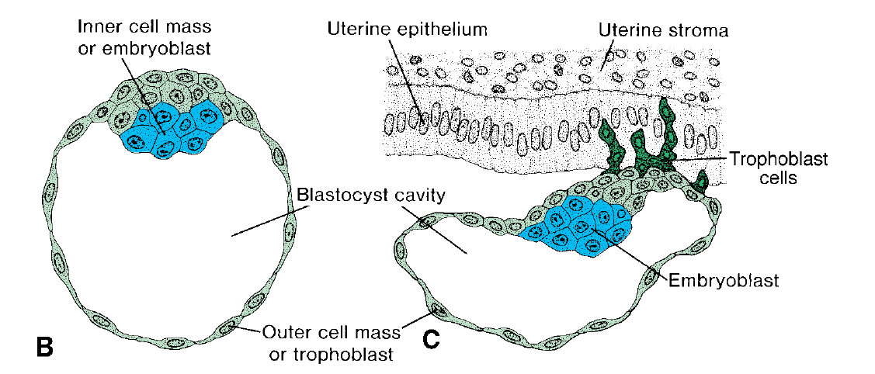
Blastocyst Formation
About the time the morula enters the uterine cavity, fluid begins to penetrate through the zona pellucida into the intercellular spaces of the inner cell mass.
Gradually the intercellular spaces become confluent, and finally a single cavity, the blastocele, forms
At this time, the embryo is a blastocyst
Cells of the inner cell mass, now called the embryoblast, are at one pole, and those of the outer cell mass, or trophoblast, flatten and form the epithelial wall of the blastocyst
The zona pellucida has disappeared, allowing implantation to begin.

Slide 17
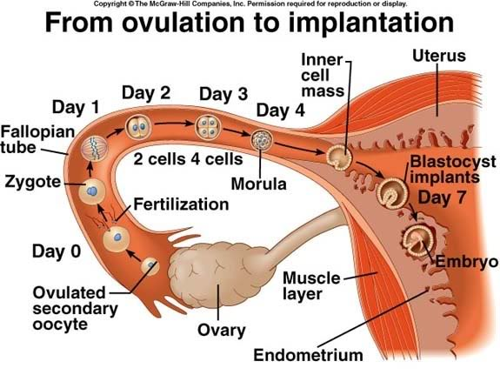
In the human, trophoblastic cells over the embryoblast pole begin to penetrate between the epithelial cells of the uterine mucosa about the sixth day
Attachment and invasion of the trophoblast involve integrins, expressed by the trophoblast, and the extracellular matrix molecules laminin and fibronectin.
Integrin receptors for laminin promote attachment, while those for fibronectin stimulate migration.
These molecules also interact along signal transduction pathways to regulate trophoblast differentiation so that implantation is the result of mutual trophoblastic and endometrial action.
Hence, by the end of the first week of development, the human zygote has passed through the morula and blastocyst stages and has begun implantation in the uterine mucosa.

