Slide 1
Anaesthesia for Emergency Surgery
Dr. Ahmed Shahin M.D

Slide 2
Outline
Definitions
Types
Preparation
Intra-operative management
Post-operative management
Examples:
ATLS
Caeserian Section

Slide 3
Definitions
Elective … ahead of time … planned
Ex. Inguinal hernia, Cataract …… Breast implants

Slide 4
EMERGENCY
Ex. Intestinal Obstruction

Slide 5
Urgency
Ex. Kidney stone

Slide 6
Types
Traumatic
Non-traumatic:
Obstetrical
Neurological
Vascular
Burns
Genito-Urinary
Gastrointestinal … etc…

Slide 7
Preoperative preparation

Slide 8
Anesthesia for emergency situations is unplanned, hence the time available to evaluate the patient preoperatively and prepare for surgery is short.
At bare minimum, one needs to have answers to the following questions:
• Why patient needs emergency surgery?
• How much time is available for resuscitation?
• Are there are signs indicating presence of hemorrhage?
• What are the results of quick airway assessment for difficult intubation?
• Whether patient will need ventilatory support postoperatively, ICU care, etc.?

Slide 9
Full history and examination if possible
S – Symptoms
A – Allergies
M – Medications
P – Past medical history
L – Last oral intake
E – Events prior to incident

Slide 10
Lab investigations if possible … usually done as resuscitation is carried on
Prepare to manage any uncontrolled co-morbidities
Ex. D.M, HTN, ASTHMA

Slide 11
Consent for anaesthesia mentioning high risk of awareness and another one for blood transfusion
Major trauma surgery … 11-43% !!!!

Slide 12
O.R
Warm as is practical
Intravenous fluid warmers and rapid infusion devices
Good Suction device … full stomach … aspiration
Difficult intubation equipment … C-collar … (e.g., fiber optic bronchoscopes, video laryngoscopes)

Slide 13
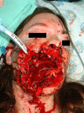
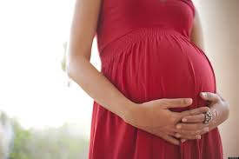
Risk of aspiration
Inadequate fasting time
Head & neck trauma
Unable to protect airway [head or spinal injury ,vocal cord injury]
Pregnancy
Intestinal obstruction
Pain
Intra abdominal mass
Obesity

Slide 14
Complications of difficult airway
Aspiration
Hypoxemia
Trauma to upper airway
Potential spinal cord injury in cervical injury

Slide 15
Upon arrival
2 large caliber peripheral intravenous lines if not already established … 16G or 14G … if difficult… central line
Routine monitors … Invasive monitoring per case

Slide 16
Anesthetic Induction & Maintenance
General anaesthesia
Neuro-axial anaesthesia Ex for LSCS
Combined anaesthesia
Peripheral nerve block

Slide 17
Anesthetic Induction & Maintenance
Hemodynamic unstable conscious patient …. Nightmare
Etomidate … Ketamine … Scopolamine
Always much less doses, and slowly

Slide 18
Rapid sequence induction (RSI)
Minimizes the risk of aspiration
The availability of suction must be confirmed before induction.
Preoxygenation with 100% oxygen for 3-5 minutes or 4 vital breaths.
Predetermined rapid IV induction agent.
Followed by rapid acting muscle relaxant without waiting to assess the effect of induction agent.
Combined with cricoid pressure to reduce the risk of aspiration.
Patient is not artificially ventilated.

Slide 19
Why Cricoid Cartilage?

Slide 20
Damage Control Surgery
Stop hemorrhage and limit gastrointestinal contamination of the abdominal compartment
Definitive repair of complex injuries is not part of DCS

Slide 21
Analgesia
Effective analgesia ASAP
Titrated to the desire of the Patient
Respiratory depression
No NSAIDS for hyopovolemic patients
Regional Anaesthesia (Hemodynamic instability, Coagulopathy)

Slide 22
Heat Loss should be prevented in all ages
Invasive monitoring should be applied when required
Local or Regional Anaesthesia should be used when feasible

Slide 23
Summary
Inadequate History and Investigations
Inadequate Preparation
a- Not Fasting – Requires Rapid Sequence Induction of Anaesthesia
b- Untreated Pre-Existing Diseases – Requires Resuscitation and Careful Choice of Anaesthetic Drugs and Techniques
c- Unavailability of Appropriate Investigations – Requires Depending on Clinical Impression and Minimal Investigations
d- Unavailability of Appropriate Cross-Matched blood – Requires use of Type-Specific blood or Group O-Neg blood transfusion in life saving procedures until proper Cross-Matched blood is available

Slide 24
Post-operative Management

Slide 25
Decision for extubation depends on patient’s haemodynamic status
In stable patient, before extubation Direct laryngoscopy is performed and secretion or debris are removed. If nasogastric tube is in situ, it is aspirated.

Slide 26
Atropine and neostigmine are given and patient will breathe in 100% oxygen.
Because of the risk of aspiration, extubation is performed only when there is recovery of airway reflexes.

Slide 27
Some patients may require continuation of ventilatory assistance postoperatively.
They will be sent to ICU for further resuscitation and ventilation.

Slide 28
Indications for Postoperative ICU Admission
Severe chest injury
Evidence of aspiration pneumonia
Unstable hemodynamic status
Severe head injury for cerebral protection
Massive blood loss with massive blood transfusion with DIC
Polytrauma

Slide 29
ATLS

Slide 30
TRAUMA
Trauma is a leading cause of morbidity and mortality in all age groups

Slide 31
ATLS
PRIMARY SURVEY
SECONDARY SURVEY
RESUSCITATION
DEFINITIVE TRAUMA INTERVENTIONS

Slide 32
PRIMARY SURVEY
A….. It is rather an Ac
B…..
C…..
D…..
E…..

Slide 33
Ac
(1) BLS … hypoxia … hypercapnia
(2) Presumed cervical spinal cord injury until proven otherwise … neck pain … any significant head injury … neurological signs or symptoms … intoxication … loss of consciousness … cervical collar (“C-collar”) … MILS.
During intubation do not remove c-collar or stop MILS
(3) Potential failed tracheal intubation … alternative airway devices are now approved for resuscitation

Slide 34
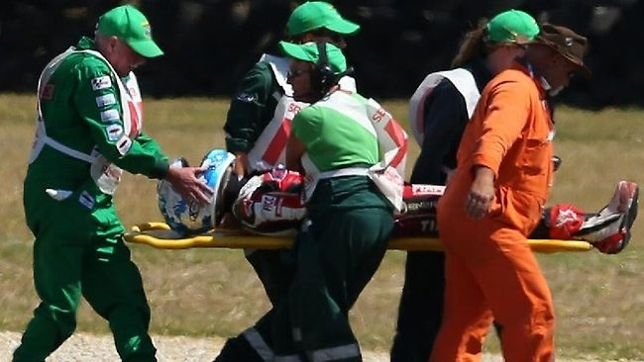
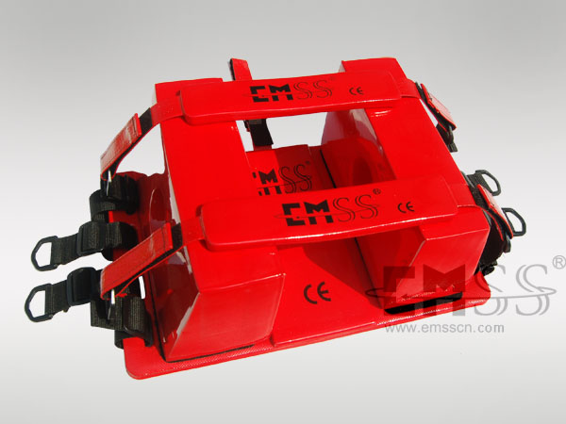
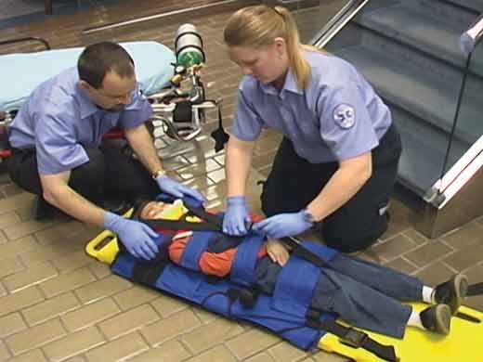

Slide 35
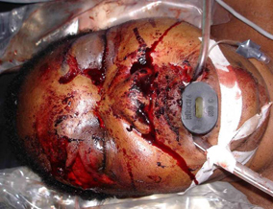

Slide 36
B
Adequate gas exchange … chest rise … auscultation … vapor … capnography
Life Threatening pulmonary injury … ex. Tension pneumo-thorax

Slide 37
C
Pulse and Blood pressure
Capillary refill
Urine output

Slide 38
D
L.O.C … pupillary size and reaction … lateralizing signs … signs of spinal cord injury
Glucose level
Alcohol intoxication … illicit or prescribed medications … hypoperfusion … hypercapnia

Slide 39
E
Full exposure … But …

Slide 40
SECONDARY SURVEY
Head to Toe Examination
Scalp .. Face .. Ears .. Neck
Chest
Abdomen .. Pelvis
Extremities

Slide 41
Goals for Resuscitation of The Trauma Patient
GOAL | PARAMETER
Systolic 80 mmHg, mean 50-60mmHg | Blood pressure
< 120 bpm | Heart rate
SaO2 > 95% | Oxygenation
0.5ml/kg/h | Urine output
Following commands | Mental status
<1.6mmol/l | Lactate level
> -5 | Base deficit
>8.0g/dl | Haemoglobin

Slide 42
Trauma-Induced Coagulopathy
Common following major trauma
Trauma-induced coagulopathy is an independent risk factor for death
Acute traumatic coagulopathy is only related to severe metabolic acidosis (base deficit ≥6 mEq/L)

Slide 44
Complications of Coagulopathy
Uncontrolled bleeding
Hemorrhagic shock
Death

Slide 45
Haemostatic Resuscitation
Damage control resuscitation
Blood products in equal portions early in resuscitation has become an accepted approach
1 : 1 : 1
O-negative → type-specific → cross matched

Slide 46
DEFINITIVE TRAUMA INTERVENTIONS

Slide 47
Caesarean Section

Slide 48
Special Precautions
Supine Hypotensive Syndrome
Pregnancy Induced (Associated) Hypertension
Fetal Hypoxia
Acidic Resting Stomach Juice
Regurgitation

Slide 49
C/S rate 14-15% at US
Anesthesia: 3-12% maternal death
Majority during G/A: failed intubation, ventilation, oxygenation and pulmonary aspiration of gastric content

Slide 50
Risk factors:
Obesity
Hypertensive disorder of pregnancy
Emergently performed procedure

Slide 51
Thank You for listening

